Slide 1
FINAL PRACTICAL EXAM
MEAAD AL-MUSINED

Slide 2
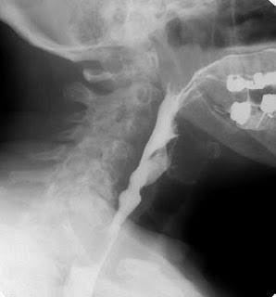
Slide: 1
Write the name of the Procedure ...

Slide 3
Slide: 2
Name the Position of the Patient

Slide 4
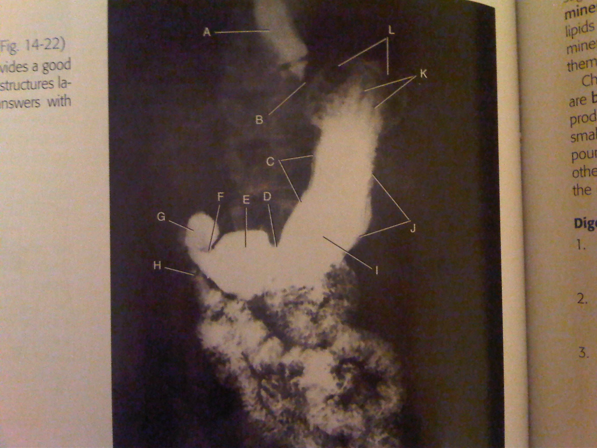
Slide: 3
Label:
B…
C…
G..

Slide 5
Slide: 4
Name the Position of the Patient

Slide 6
Slide: 5
Label:
A ..
C..
D..

Slide 7
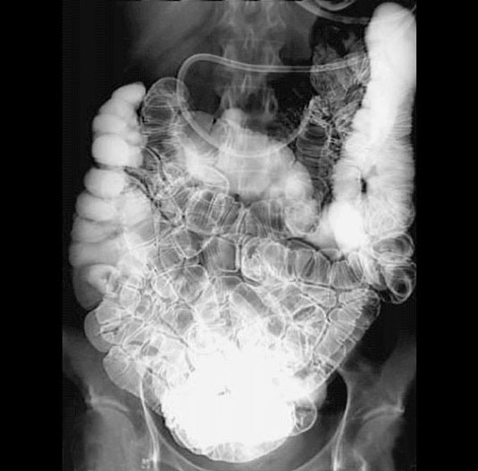
Slide: 6
Write the name of the Procedure ...

Slide 8
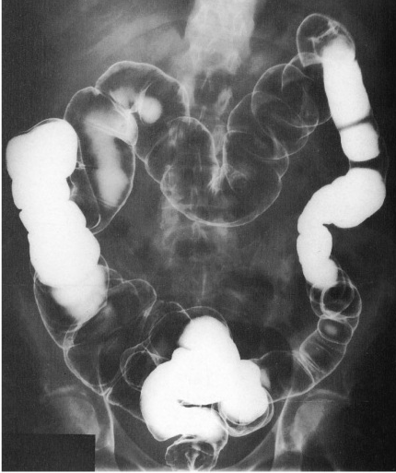
Slide: 7
Write the name of the Procedure ...
Name the Position of the Patient

Slide 9
Slide: 8
Name the Position of the Patient

Slide 10
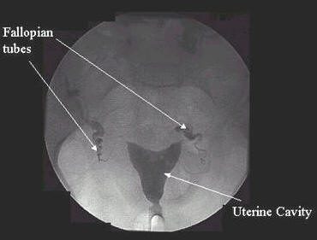
Slide: 9
Write the name of the Procedure ...
Label:
A…
B…
C…
A
B
C

Slide 11
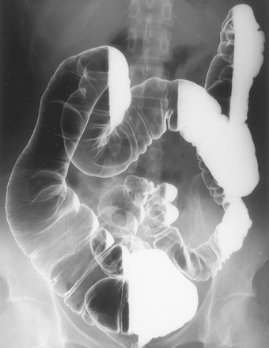
Slide: 10
Name the Position of the Patient

Slide 12
Slide: 11
LABEL
A:
C:
A
B
C

Slide 13
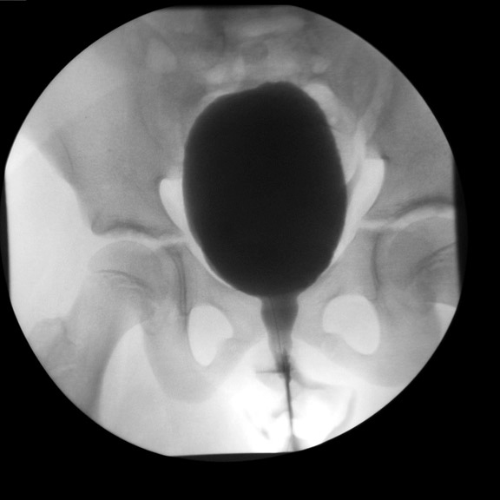
Slide: 12
Write the name of the Procedure ...

Slide 14
BEST WISHES

