Slide 1
MOLECULAR INFORMATION
(Molecular Taxonomy)

Slide 2
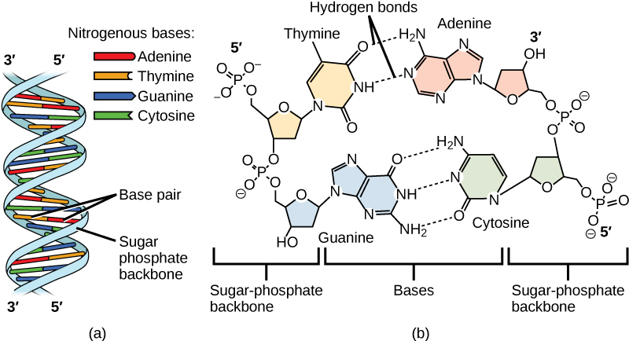
Source of Taxonomic Evidences: Molecular Data / DNA / Molecular Taxonomy
DNA: Deoxyribo Nucleic Acid / DNA is a molecule composed of two chains that coil around each other to form a double helix carrying the genetic instructions used in the growth, development, functioning, and reproduction of all known living organisms.

Slide 3
Molecular Taxonomy or Molecular systematics or Molecular phylogenetics deals the utilization of nucleic acid data. As DNA sequence of a gene is constant in a species, hence advantage over morphological data for taxonomic studies.
Taxonomist use molecular data from three different locations within a plant cell: chloroplast, mitochondrion and the nucleus.
Molecular systematics involves following steps:
Collection of fresh leaf sample
DNA extraction
Amplification using PCR –Polymerase chain Reaction
DNA / Gene Sequencing
Analysis of Sequence data using computer software / bioinformatics tools

Slide 4
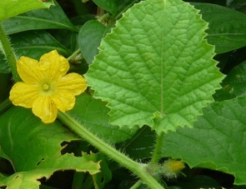
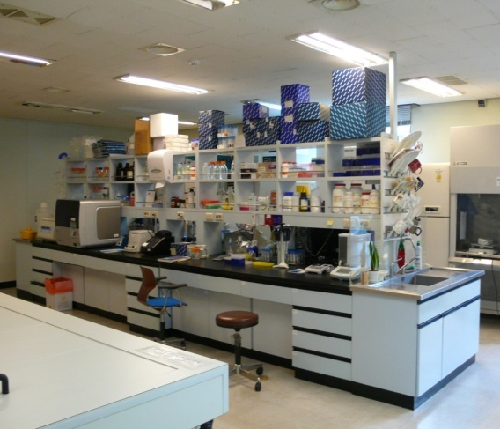

DNA can be extracted from the plant tissue or cell using tools and techniques of molecular biology.
DNA extraction is tedious and long process need skill hands and experience of molecular biology.
DNA extraction need compete setup of molecular biology laboratory also.
A view of molecular biology laboratory

Slide 5
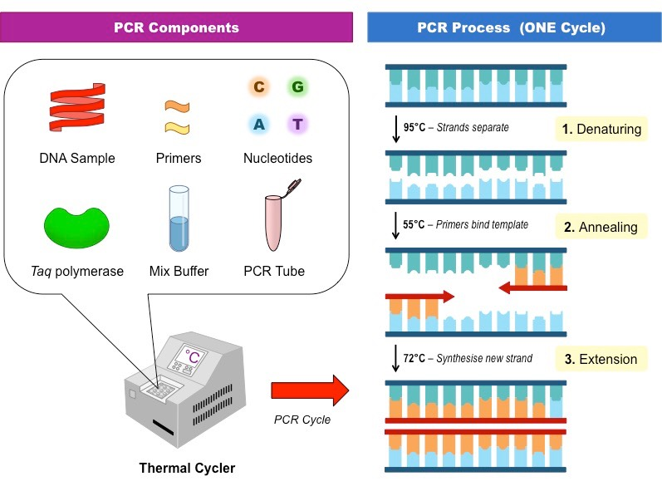
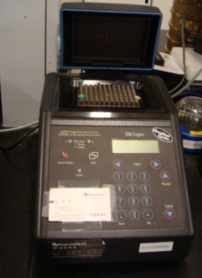
Experimental Techniques of Amplification using PCR –Polymerase Chain Reaction
Polymerase chain reaction (PCR) is a method widely used in molecular biology to make many copies of a specific DNA segment. Using PCR, a single copy (or more) of a DNA sequence is exponentially amplified to generate thousands to millions of more copies of that particular DNA segment.
Primer (a short DNA segment) is used in the PCR for the amplification.

Slide 6
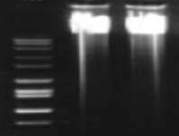
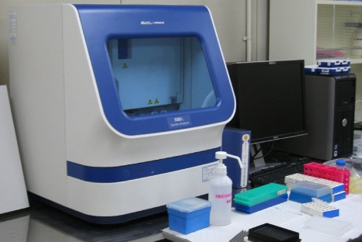
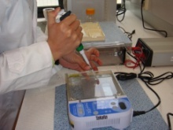
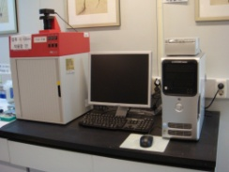
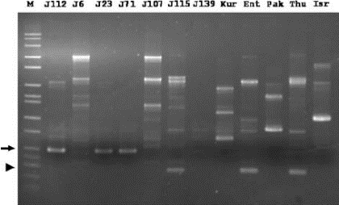
PCR product is viewed under gel electrophoresis to view the DNA bands.
Pattern of DNA bands are analyzed and interpreted in taxonomic perspectives; however this is the older method.
The PCR product is subject to know the pattern of DNA sequence of the some gene, and analyzed and interpreted in taxonomic perspectives; this is the modern and advanced method.
DNA sequencing
DNA sequence based
Band based
RAPD bands

Slide 7
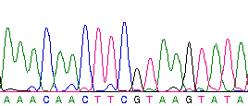

Experimental Techniques of Gel Electrophoresis
DNA sequencing is the process of determining the order of nucleotides in DNA. It includes any method or technology that is used to determine the order of the four bases: adenine, guanine, cytosine, and thymine.
The PCR product is subject for DNA sequencing to know the pattern of DNA sequence of the some gene, and analyzed and interpreted in taxonomic perspectives; this is the modern and advanced method.
DNA sequencing is tedious and long process need skill hands and experience of molecular biology.
DNA sequencing need compete setup of molecular biology laboratory also.

Slide 8
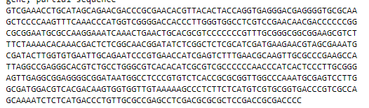
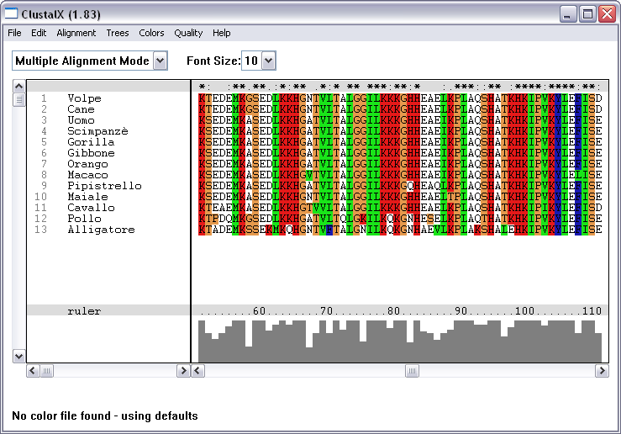
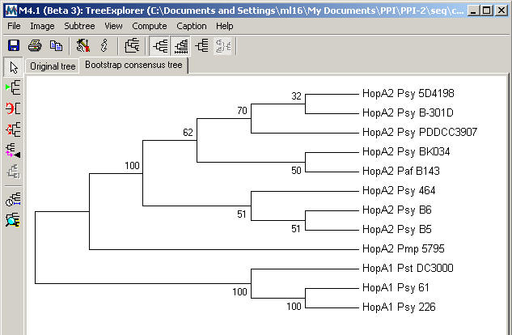
Analysis of DNA sequence data
DNA sequencing data is analyzed using computer software
There is software ClustalX, MEGA used for the analysis of the DNA sequences
DNA sequence dataset preparation:
The generated DNA sequences analyzed together with previously published DNA sequence available in GenBank.
The related sequences are retrieved from the GenBank, and analyzed together with the generated sequences to be analyzed
DNA sequence alignment using ClustalX
DNA sequence alignment using MEGA software to generate tree.
The tree shows relationships among the species, which are the similar / close / far etc.

Slide 9
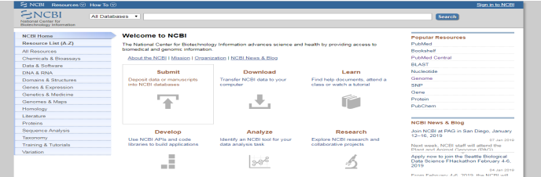
Analysis of DNA Sequence Data (NCBI GenBank)
https://www.ncbi.nlm.nih.gov/
GenBank (-the NIH, National Institute of Health genetic sequence database, an annotated collection of all publicly available DNA sequences) has a very important role in molecular taxonomy and DNA barcoding.

Slide 10
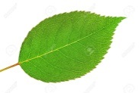

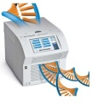
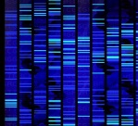
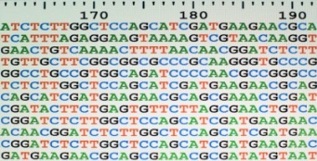

DNA barcoding
DNA barcoding is a system for fast and accurate species identification that makes ecological system more accessible by using short DNA sequence
The short DNA sequence is generated from standard region of genome known as marker. This marker is different for various species like matK for plants and Internal Transcribed Spacer (ITS) for fungus.
DNA barcoding has many applications in various fields like preserving natural resources, protecting endangered species, controlling agriculture pests, identifying disease vectors, monitoring water quality, authentication of natural health products and identification of medicinal plants.
DNA barcoding can speed up identification of species.
Raw drug authentication / Medicinal plant identification or authentication
In DNA barcoding, complete data set can be obtained from a single specimen irrespective to morphological or life stage characters.
The core idea of DNA barcoding is based on the fact that the highly conserved stretches of DNA, either coding or non coding regions, vary at very minor degree during within the species.
The ideal DNA barcode region is reliably amplified and sequenced across large assemblages of taxa and provides a high level of species discrimination
Matching of the barcode sequence with the database of the GenBank
Identified as Genus Rosa, many times helps in the identification even up to the species level
Analysis of DNA sequence using computer software, and generation of DNA barcode from the DBNA sequence
Unidentified leaf
DNA extraction
PCR
DNA sequencing

Slide 11
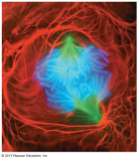
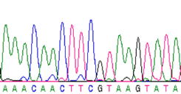
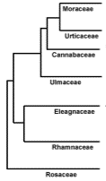
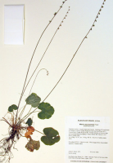
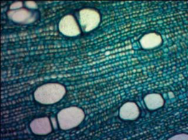
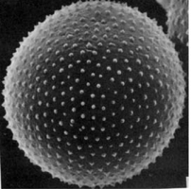
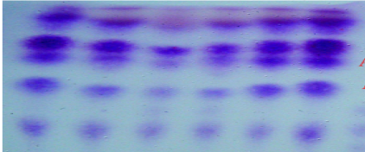
Thus in this way, the morphology to molecular data are utilized as taxonomic evidence to resolve the taxonomic problem
Morphology
Anatomy
Chemistry
11
Pollen
Chromosomes
DNA / Molecular taxonomy

