Slide 1
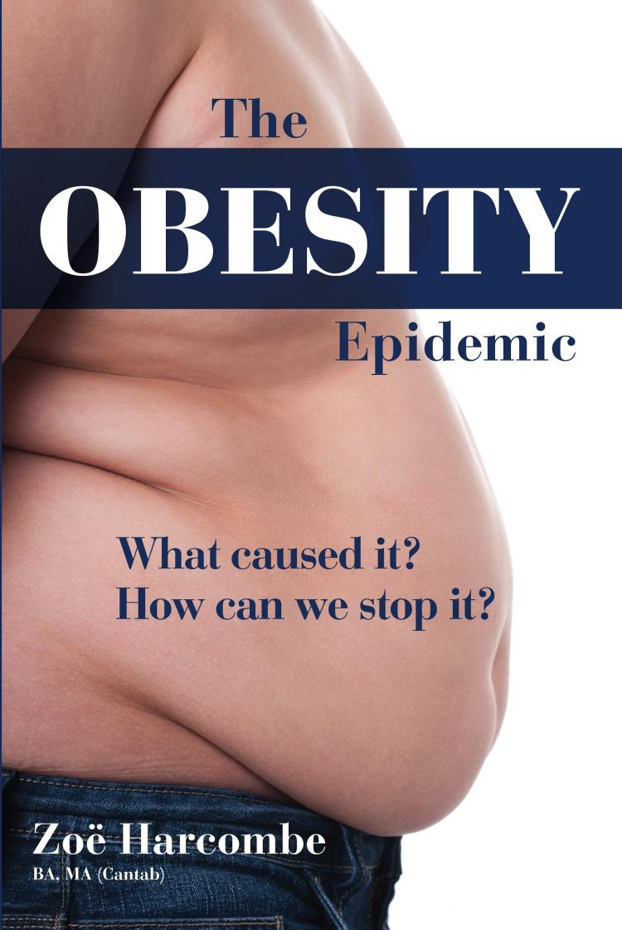
Pathophsiology of Metabolism

Slide 2
Obesity
What Is Obesity?
Obesity means having too much body fat .

Slide 3
What Causes Obesity?
a) Environmental factors and life style
Taking in more calories than you burn can lead to obesity because the body stores unused calories as fat
Increase the energy input :
Eating more food than your body can use.
eating habit
Decrease the output energy and physical activity: Not getting enough exercise.

Slide 4
What Causes Obesity?
b) Medical problems or treatments cause weight gain, including:
Endocrine disorders :hypothyroidisms, and type 2 diabetes.
Medicines such as :birth control pills, steroids, and antidepressants.
Psychological factors: Stress, anxiety, feeling sad, or not sleeping well
Genetic factors and family history.

Slide 5
Obesity diagnosis
Body mass index (BMI).BMI= kg/m²
obese when it is greater than 30 kg/m²
Waist circumference: ( waist measurement in inches) Extra weight around the middle or stomach area increases the risk for type 2 diabetes.
Broca’s index=body height(cm)-100
considered obese when his or her weight is 20% or more above normal weight.
Skin fold measurements : taken to check your body fat percentage.
Blood tests :thyroid hormones level, and glucose blood level .

Slide 6
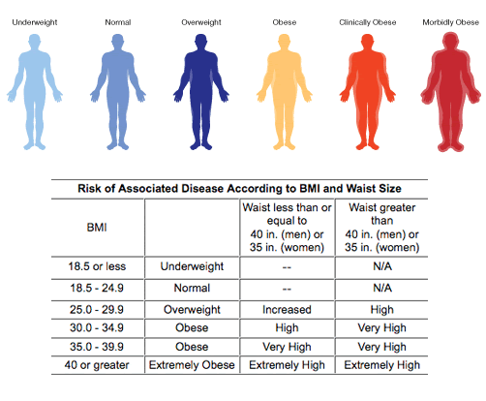

Slide 7
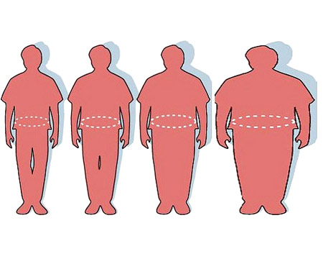
waist circumference measurement
From left to right, the "healthy" man has a 33 inch (84 cm) waist,
the "overweight" man a 45 inch (114 cm) waist,
and the "obese" man a 60 inch waist

Slide 8
Skin fold measurements

Slide 9
What are the Treatments of obesity ?
An active lifestyle and regular exercise, along with healthy eating diet , is the best way to lose weight .
Weight loss drugs
Surgery: The two most common weight-loss surgeries are:
laposcopic gastricbanding and gastric bypass surgery.

Slide 11
Complication of obesity:
osteoarthritis
Gallstones and liver problems(fatty leaver)
Heart failure ,hypertension and stroke.
High blood sugar ,and diabetes type 2.
High blood cholesterol and triglycerides

Slide 12
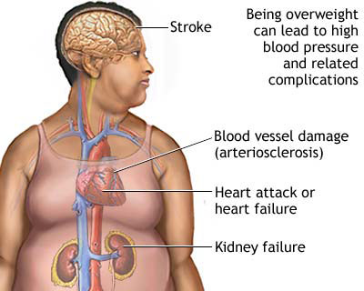
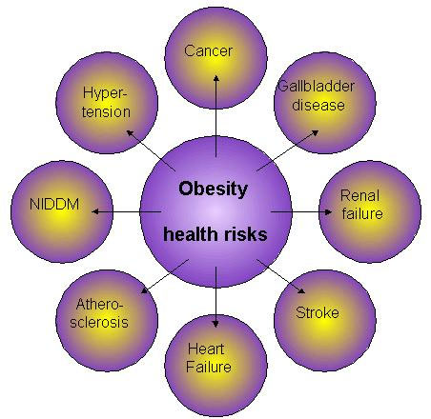
Obesity complications

Slide 13
Case study presentation
Mark is a 38-year old production engineer. He comes to diet center clinic for a problem unrelated to obesity.
However, examination reveals the following:
Weight 95kg
Height 1.76m
BP 160 /85 mm Hg
Nothing else significant.
No significant past medical history.
No medication take

Slide 14
Case study
What is Mark's BMI?
Mark is 95kg and 1.76m.
his BMI is 95/(1.76x1.76) = 30.7kg/m2
Is Mark obese according to this result?
yes he has class I obesity
BMI | Classification
< 18.5 | underweight
18.5–24.9 | normal weight
25.0–29.9 | overweight
30.0–34.9 | class I obesity
35.0–39.9 | class II obesity
≥ 40.0 | class III obesity

Slide 15
Case study
What additional information and test would you require?
Mark's waist circumference should be measured.
Random blood glucose level (RBS)or fasting blood glucose (FBS) ,lipid levels.
Smoking status, family history, physical activity and exercise .

Slide 16
Case study
Mark fasting blood glucose test is 7.5 mmol/l.
He is a non smoker
but his father had a heart attack at age 55 years.
His blood pressure and lipid levels that are within the normal range

Slide 17
Case study
Is Mark at high risk to develop diabetes and cardiac disease ?
Mark has impaired glucose tolerance
Whilst he does not have diabetes, he is at increased risk of developing it.
With his family history of cardiovascular disease, it is important that his obesity is managed proactively.

Slide 18
Case study
What advice would you offer Mark based on this result?
he should losing his Weight by fallowing healthy eating diet ,along with regular exercise is the best way to lose weight .

Slide 19
Thank you

