Slide 1
Scanning spectrophotometry and spectrophotometric determination of concentration
BCH 333 [practical]

Slide 2
Objectives:
1. What is absorption spectrum and determination of λmax.
2. standard curve and determination of concentration of an unknown solution.

Slide 3
How a spectrophotometer works

Slide 4
The spectrophotometer: it can be used to measure the amount of light absorbed by a solution.
-Using the spectrophotometer, we can quantitatively measure absorbance, and this information can be used to determine the concentration of the absorbing molecule.
-A more concentrated solution will absorb more light and transmists less .[why?]
So, the more concentrated solution → high absorbance value.
And Less concentrated solution → less absorbance value.

Slide 5
Absorption spectrum:
The curve that display the action or behavior of absorption of molecule[solute] at different weave lengths. Every molecule has its own Absorption spectrum, So it’s act as fingerprint for each molecule.
λmax: it is the weave length at which the molecule has the maximum absorbance at this weave length.[best absorbance]
[the wavelength of maximum absorption (λmax)]

Slide 6
Absorption spectrum curve and determination of λmax.

Slide 7
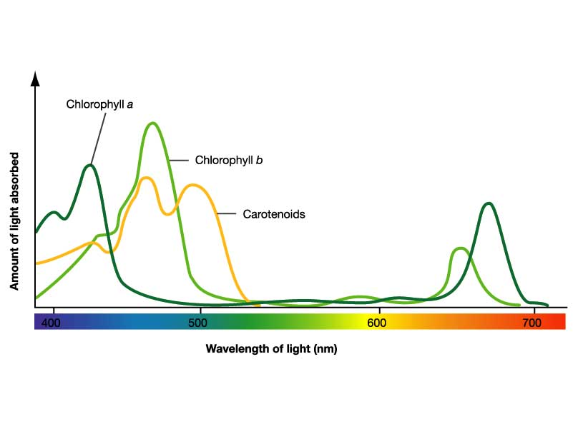

Slide 8
What is the benefit of studying the Absorption spectrum :
λmax.
used to identify substances.
It also can be used to know if there is any contamination with another molecule.

Slide 9
How does a spectrophotometer work?
http://www.youtube.com/watch?v=pxC6F7bK8CU

Slide 10
Principle:
The absorption of light by a solution is described by the Beer-Lambert law:
The law implies that there is linear relationship between absorbance and concentration of an absorbing species].
A = εlc
A= is the absorbance.
ε = extinction(absorption) coefficient.
l = length of the light path through the solution.
c = concentration of the absorbing substance.
So, what does standard curve mean?

Slide 11
A standard curve:
- It is a graph that shows the relationship between different known concentrations of a substance and the absorbance at a specific wave length .
-Standard curve are most commonly used to determine the concentration of a substance, using serial dilution of solutions of known concentrations.
For example, a standard curve for protein concentration is often created using known concentrations of bovine serum albumin [BSA].
So, what is standard solutions???
standard solution is a solution containing a precisely known concentration of an element or a substance.

Slide 12
If the unknown solution has absorbance =0.45, the conc. From the curve will be ......
Absorbance of the
” unknown solution”
Concentration of the
” unknown solution”

Slide 13
To determine the concentration of an unknown solution:
From standard curve:
-Measure the absorbance of the “unknown solution” in order to determine the concentration.
- …
Beer-Lambert law:
Using available information of any standard solution to determine the “ε”,
then using these information to get the unknown concentration. Using:A = εlc
Note: “ε” will changed if when the weave length changed.

Slide 14
Standard curve animation:
http://www.wellesley.edu/Biology/Concepts/Html/standardcurve.html
Spectrophotometry Introduction:
http://www.youtube.com/watch?v=qbCZbP6_j48
Spectrophotometry Example
http://www.youtube.com/watch?v=VqAa_cmZ7OY&feature=relmfu

