Slide 1
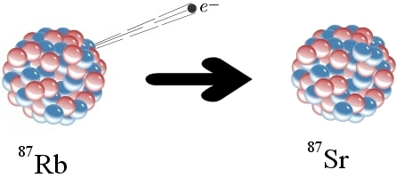
The Rb – Sr Method of Dating
Geo 564 Geochronology Course
Course Director’ Dr. Bassam A. A. Abuamarah

Slide 2
The Rb-Sr method of Dating - Introduction
We will learn how the Radioactive decay Of Rb is confined in the geological materials (i.e rocks, minerals.. Etc), that can be used to date the geological processes, via the following topics:
We will have a brief notes on the geochemistry of Rb and Sr .
Nature of occurring the Rb and Sr Isotopes
Radioactive decay of Rb and the growth of ⁸⁷Sr.
Graphical presentation of isotope data – is called Isochron diagram
Application on the use of the method to date magnetism and metamorphism and sedimentation

Slide 3
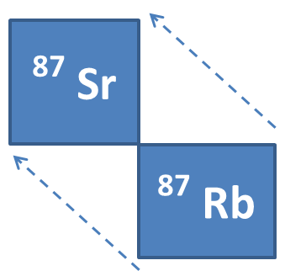
Rb and Sr in the Periodic Table
Atomic Mass
1st column
2nd column
⁸⁷ Rb
¹ H
³ Li | ⁴ Be
¹¹ Na | ¹² Mg
¹⁹ K | ²⁰ Ca
³⁷ Rb | ³⁸ Sr
⁵⁵ Cs | ⁵⁶ Ba
⁸⁷ Fr | ⁸⁸ Ra
38
Proton (P⁺)
Atomic Number
Increasing in Ionic Radius (sizebigger
37
Neutron (N)
Neutral atoms of the alkali metals are characterized by 1 electron in outer shell, therefore, they are monovalent ions.
أكبر
K¹⁺
K
1.33 Å
Rb¹⁺
Rb
Ca²⁺
Ca
These elements commonly form divalent ions.
Ca radii Å 1.32
1.48 Å
Sr
Sr²⁺
smallest Å
bigger ionic radii Å 1.32

Slide 4
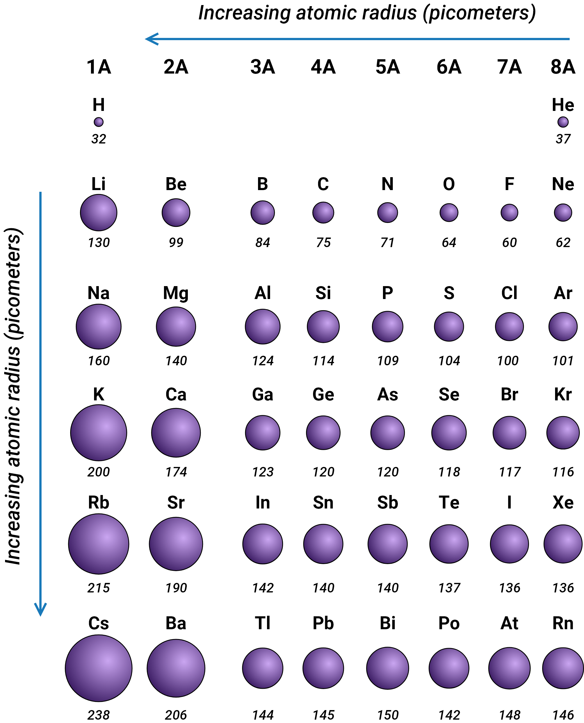
Thus,
The Periodic table arranges the chemical element upon their Atomic Number, and electron configuration, and then elements are presented according to the increase in atomic number horizontally.
The Atomic Radius is the distance from the atomic nucleus to the outermost Electron Orbital in the Atom.
In general, the atomic radius decreases as we move from left to right in a period, and it increases when we go down a group.

Slide 5
This is because, in periods, the valence electrons are in the same outermost shell.
The atomic number increases within the same period while moving from left to right, which in turn increases the effective nuclear charge.

Slide 6
Cont’d: Rb and Sr in the Periodic Table
Thus, Rubidium (Rb) belong to alkali metals (column 1 above) which also include Sodium (Na) and Potassium (K).
and
Strontium (Sr) belong to the earth alkali metals Column 2 , which include Magnesium (Mg) and Calcium (Ca)
Thus, the ionic radii of the alkali elements increase towards higher atomic number.
The ionic radii of Rb (1.48 Å) is sufficiently similar to that of K (1.33 Å) to allow Rb to substitute for K in all K-bearing minerals.

Slide 7
Cont’d: Rb and Sr in the Periodic Table
Thus, minerals suitable or used for the Rb-Sr method dating rocks which involve the following minerals:
Micas
K-feldspar
Clay minerals
and
Evaporate minerals such as sylvite and Carnallite
The ionic radius of Sr is slightly larger than of that Calcium (Ca), which can replace it in many common minerals, such as plagioclase, apatite and calcite

Slide 8
whereas the (⁸⁵ Rb) is stable
Cont’d: Rb and Sr in the Periodic Table
39
Y ⁸⁵ | Y ⁸⁶ | Y ⁸⁷ | Y ⁸⁸ | Y ⁸⁹ | Y ⁹⁰
Sr ⁸⁴ | Sr ⁸⁵ | Sr ⁸⁶ | Sr ⁸⁷ | Sr ⁸⁸ | Sr ⁸⁹
Rb ⁸³ | Rb ⁸⁴ | Rb ⁸⁵ | Rb ⁸⁶ | Rb ⁸⁷ | Rb ⁸⁸
K ⁸² | K ⁸³ | K ⁸⁴ | K ⁸⁵ | K ⁸⁶ | K ⁸⁷
38
# of protons
37
36
46
47
48
49
50
51
# of Neutrons
Rb has 2 natural occurring isotopes (⁸⁷Rb) and (⁸⁵Rb)
(⁸⁷ Rb) is radioactive, whereas the (⁸⁵ Rb) is stable
Sr has four natural occurring isotopes, which all are STABLE Sr ⁸⁴, Sr ⁸⁶,Sr ⁸⁷,Sr ⁸⁸

Slide 9
Cont’d: Rb and Sr in the Periodic Table
⁸⁷Sr
Atomic Mass
38
⁸⁷Rb
Atomic Number
37
⁸⁷ Rb
Thus, from the above
The ⁸⁷Rb nucleus consists of :
37 protons ,and
50 neutron.
Thus, ⁸⁷Rb is unstable and it radioactive decays to ⁸⁷Sr., by emitting β particles:

Slide 10
The β decay Mechanism
⁸⁷Sr
β
⁸⁷Rb
∇
⁸⁷ Sr
i.e. one neutron of the nucleus transform to PROTON by emitting a (β) particles , and releasing antineutron (∇).
The results the⁸⁷Sr nucleus consist of 38 PROTONS and 49 NEUTRONS, which corresponds to ⁸⁷Sr.
The decay of ⁸⁷Rb to stable ⁸⁷ Sr is described as follows the formula:
⁸⁷Rb = ⁸⁷ Sr + β + ∇ + Q
Where β = represents the Beta Particles or neutrons,
∇ is the antineutron, and Q = is the decay energy released during the decay reactions
Notes:
antineutron
is an elementary particle having no charge and having a mass and spin equal to that of the neutron but with magnetic moment opposite to that of the neutron; the antiparticle of the neutron.
, or it is used as neutron bombs.
antiparticle
a particle all of whose properties, as mass, spin, or charge, have the same magnitude as but, where appropriate, the opposite sign of a specific elementary particle; neutral pions, photons, and gravitons are considered to be their own antiparticles: The positron is the antiparticle of the electron. .

Slide 11
Radioactive Decay of ⁸⁷Rb and the growth of ⁸⁷ Sr
⁸⁷Rb
# of Atoms
⁸⁷SR
Time
⁸⁷Rb
⁸⁷Rb has a half-life (T_{½}) = 4.88 X 10¹⁰ years,
which corresponds to the
decay constant λ = 1.42 X 10⁻¹¹ y⁻¹
And Half-life = (T_{½}= 0.693/ λ),
For instance; the above right box filled with 32 atoms of ⁸⁷Rb .
Thus, what will happen to ⁸⁷Rb atoms as years passed by?

Slide 12
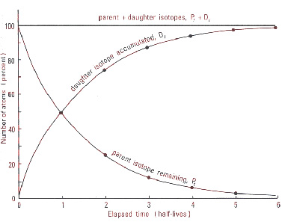
Radioactive Decay of ⁸⁷Rb and the growth of ⁸⁷ Sr
⁸⁷ Rb
9.76
4.88
24.40
19.52
14.64
# of Atoms
⁸⁷Rb & ⁸⁷Sr
⁸⁷ Sr
Time Ga
After 4.88 billion years half-life of the ⁸⁷ Rb atoms of that initially was found in the box have decayed via radioactive processes to ⁸⁷ Sr
This range in time corresponds to one half (½) of the initial ⁸⁷ Rb found in the box
And then

Slide 13
⁸⁷Rb/⁸⁷Sr Decay Scheme
⁸⁷Sr by emitting B
Half-life = 48.8 Billion years
^{In nature:}
⁸⁷Rb=27.83 %
⁸⁵Rb= 72.17
Decayed to
⁸⁸ Sr = 82.53%
⁸⁷ Sr= 7.04%
⁸⁶Sr=9.87&
⁸⁴Sr==0.56%

Slide 14
Cont’d: Radioactive Decay of ⁸⁷Rb and the growth of ⁸⁷ Sr
Thus, for every 4.88 billion years the number of ⁸⁷Rb will be halved, and the number of ⁸⁷ Sr increases (growth) accordingly.
As a result, after a period of 5 half-lives, only 1 atom of ⁸⁷Rb will remains in the box.
So, the number of ⁸⁷ Sr atoms found in the box is 31 atoms

Slide 15
Cont’d: Radioactive Decay of ⁸⁷Rb and the growth of ⁸⁷ Sr
Thus, ⁸⁷ Sr and ⁸⁷Rb represent the number of the respective isotope atoms in the box TODAY.,
⁸⁷Sr_{i} represents the initial content of the ⁸⁷Sr in the box( Zero in the example above)
So the equation can be arranged as follows:
t = (1/λ) ln [ (⁸⁷Sr –⁸⁷Sr_{i}) / ⁸⁷ Rb) + 1]
We fill the numbers that are known:
t = (1/1.42 X 10⁻¹¹ y⁻¹) ln [ (31 – ^{0.0}_{i} / 1) + 1]
The age is t= 24.4 years

Slide 16
Cont’d: Radioactive Decay of ⁸⁷Rb and the growth of ⁸⁷Sr
So
How do we calculate the age ?
The tool we are going to use for Rb-Sr method of dating is applying the following equation
⁸⁷Sr = ⁸⁷Sr_{i} + ⁸⁷Rb ( e^{λt} – 1)
Where :
⁸⁷Sr_{i} represents the initial content of the ⁸⁷Sr in the box( Zero in the example above)
⁸⁷ Sr and ⁸⁷Rb represent the number of the respective isotope atoms in the box TODAY

Slide 17
The Fundamental Equation
⁸⁷Sr = ⁸⁷Sr_{i} + ⁸⁷Rb ( e^{λt} – 1)
therefore
if we know how many⁸⁷Sr atoms were incorporated
in the mineral at its formation or initiation time (⁸⁷Sr_{i}),
then
we have to analyses the percentage (Ratio) (%) of the ⁸⁷Rb and ⁸⁷Sr content in the mineral (Concentration).
So as to calculate the age of the mineral (i.e. the rock) the equation above will be applied:

Slide 18
Cont’d: The Fundamental Equation
Practically, the concentration of the isotopes as input is required to apply the above equation.
Mass-spectrometry, is the instrument that performs an isotopes analyses by giving isotopes ratios as an output,
So, in order to have the ratio; we have to DIVIDE THE BOTH SIDE OF THE EQUATION (1) BY ⁸⁶Sr as a stable isotope, So, the equ. Becomes:
⁸⁷Sr/⁸⁶Sr = ⁽⁸⁷Sr/⁸⁶Sr)_{i} + ⁸⁷Rb/⁸⁶Sr( e^{λt} – 1) Equation 1

Slide 19
Cont’d: The Fundamental Equation
and
⁸⁶Sr is not produced by decay, it is a naturally occurring isotope of other elements.
Thus, the ⁸⁶Sr content in the mineral does not change with time.
The equation 1 is considered as source for age calculation by using Rb – Sr method
I believe before we apply this equation, we have to have an idea about using ISOCHRON DIAGRAM, and have some of its basic mathematics , in order to be used for

Slide 20
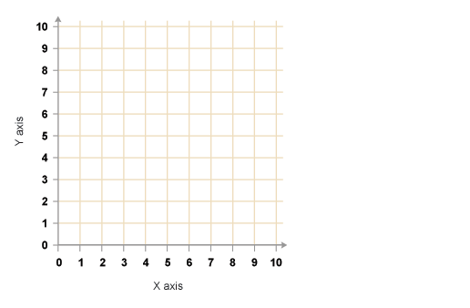
Mathematics used-The Isochrom Diagram
^{Equation 2: 87}Sr/⁸⁶Sr = ⁽⁸⁷Sr/⁸⁶Sr)_{i} + ⁸⁷ Rb/⁸⁶Sr ( e^{λt} – 1)
When you crystallize a rock, you will always have some Sr Presented
Measured
Isochron is a line plotted in X-Y diagram,
Measured
Y = A + X K
The equation used for this line is Y = 1 + 0.5 X
Y axis
slope
This line intersect with Y–axis at y = 1= A, the slope of the line is 0.5 = k
Y = 1 + 0.5 X
Thus, the general expression for a line in X-Y diagram is
Y =A + XK (linear equation)
X axis
(A) point corresponds to the point of intersection between line and Y-axis, while K corresponds to the slope of the line.

Slide 21
The Isochrom Diagram
Y = A + X K
⁸⁷ Sr/⁸⁶Sr = (⁸⁷Sr/⁸⁶Sr)_{i} + ⁸⁷ Rb/⁸⁶Sr ( e^{λt} – 1)
⁸⁷ Sr/⁸⁶Sr
⁸⁷ Rb/⁸⁶Sr
Now, let us compare the Equ. 2 With the general equation for a line of a X-Y diagram.
On the basis of equation 2, we can plot a diagram with ⁸⁷Rb/⁸⁶Sr
along the horizontal axis (x-axis), and ⁸⁷Sr/⁸⁶Sr along the vertical axis (Y-axis)

Slide 22
The Isochrom Diagram
In this diagram, equation 1 represent a line :
⁸⁷Sr/⁸⁶Sr = (⁸⁷ Sr/ ⁸⁶Sr)_{i} + ( ⁸⁷Rb/⁸⁶Sr) ( e^{λt} – 1)
Isochron diagram shows value of (⁸⁷Rb/⁸⁶Sr) plotted along on the horizontal axis (X-axis), while the values of ⁸⁷Sr/⁸⁶Sr plotted along the vertical axis (Y-axis).
( e^{λt} – 1)
(⁸⁷ Sr/⁸⁶Sr)_{i}
⁸⁷ Sr/⁸⁶Sr
And
⁸⁷ Rb/⁸⁶Sr

Slide 23
Cont’d: The Isochron Diagram
The values of (⁸⁷Sr/⁸⁶Sr_{i}) as initial content corresponds to the points of intersection between the line and the vertical axis (Y-axis),
while ( e^{λt – 1}) value corresponds to the slope of the line.

Slide 24
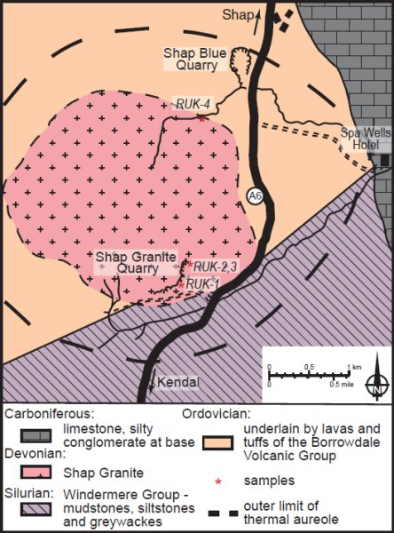
Dating of igneous Rocks
Now we will take a look at the results of Rb-Sr isotopes.
of the a geological map of the granitic area showed
⁸⁷Sr/⁸⁶Sr = (⁸⁷Sr/⁸⁶Sr)_{i} + (⁸⁷ Rb/⁸⁶Sr) (e^{λt} – 1)
( e^{λt} – 1) = slope= 0.02523
0.77
In the diagram 7 samples of the granite were prepared for the analyses by a Mass-Spectrometry:
0.76
⁸⁷ Sr/⁸⁶Sr
0.75
0.74
0.73
0.72
(⁸⁷ Sr/⁸⁶Sr)_{I} = 0.70404
0.71
070
⁸⁷ Rb/⁸⁶Sr

Slide 25
Cont’d: Dating of igneous Rocks
Samples 1 & 2 were biotite poor granite,
3 to 5 were characterized by intermediate biotite content,
while samples 6 & 7 were rich in biotite mineral.
When the analyses had been carried out, the data were plotted in the diagram, as shown above.
Note:
that the Rb content of the samples correlates with the biotite contents of the rocks, why?

Slide 26
Cont’d: Dating of igneous Rocks
A line can be drawn through the data points.
The line intersects with the vertical axis (Y-axis) at the value of ⁸⁷ Sr/⁸⁶Sr = 0.70404.
( e^{λt} – 1) = slope= 0.02523
0.77
⁸⁷ Sr/⁸⁶Sr
0.76
0.75
7
This is corresponding to the ⁸⁷Sr/⁸⁶Sr ratio of granite (and all minerals it is composed of) immediately after formation.
0.74
0.73
2
0.72
1
(⁸⁷ Sr/⁸⁶Sr)_{I} = 0.70404
0.71
070
⁸⁷ Rb/⁸⁶Sr
The slope of the line gives us the equation ( e^{λt} – 1) = 0.02523 in this equation there is only an unknown, namely (t) (Time), which can be found by solving the equation.

Slide 27
Cont’d: Dating of igneous Rocks
The line in this diagram is called a ISOCHRON, which mean “ similar age”
In the ISOCHRON Diagram, rocks and minerals of the similar age plot along a single-an Isochron

Slide 28
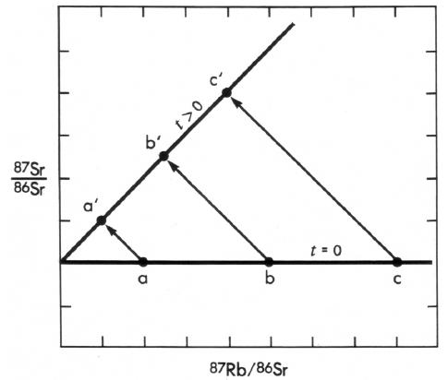
Cont’d: Dating of Igneous Rocks
When the granite crystallized all minerals in the rocks get the same value of ⁸⁷Sr/⁸⁶Sr ratio = (0.70404),
Because they all formed from the same isotopically homogenized magma.
The slope of the isochron was Zero which corresponds to the age = Zero
7
2
6
0.74
5
0.73
4
3
2
1
0.71
1
0.70
0.69
1.0
2.0
3.0
4.0
Sample with higher Rb
Sample with lower Rb
The bottom line;
High Rb/Sr contains more ⁸⁷Sr
Low Rb/Sr contains less ⁸⁷Sr

Slide 29
Cont’d: Dating of Igneous Rocks
(Line 2 )In the diagram above:
Since the time of the crystallization, atoms of ⁸⁷Rb have continuously undergone radioactive decay to ⁸⁷Sr.
In rocks with initial low content of ⁸⁷Rb, They relatively have a small amount of ⁸⁷SR formed.
T = 1706 ± 15 Ma
0.79
0.78
0.77
0.74
⁸⁷Sr/⁸⁶Sr
0.76
0.75
0.74
0.73
0.72
0.71
0.5
1.5
2.5
3.5
4.0
1.0
2.0
3.0
⁸⁷Sr/⁸⁶Sri
⁸⁷Rb/⁸⁶Sr
⁸⁷Sr/⁸⁶Sr = (⁸⁷Sr/⁸⁶Sr)_{i} + ⁸⁷Rb/⁸⁶Sr(e^{λt} – 1) Equation 1

Slide 30
Cont’d: Dating of Igneous Rocks
In the rocks which initially contained more ⁸⁷Rb, it proportionally showed a higher amount of ⁸⁷Sr formed.
Note:
Seven samples were plotted on a line at any stage, during the evolution of the rocks. This line is hinged to the vertical Y-axis, at the value of (⁸⁷Sr/⁸⁶Sr).
The slope of the line increases as time goes by present slope indicate that the Granite is 1.706 Ma old

Slide 31
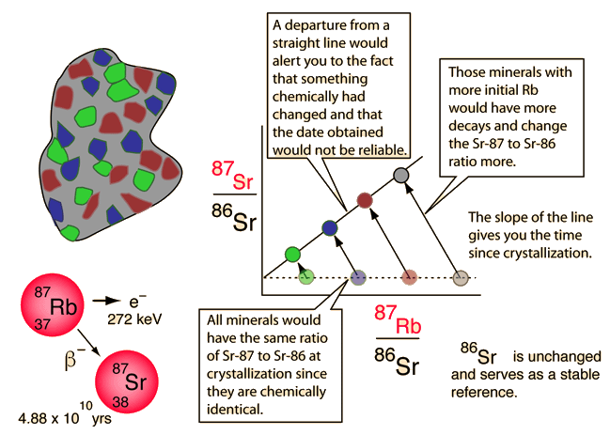
Rubidium-Strontium Isochrons

Slide 32
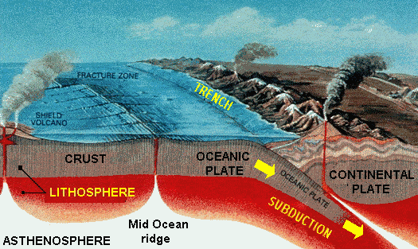
Cont’d: Dating of Igneous Rocks
⁸⁷Sr/⁸⁶Sr ratios for igneous Rocks:
MORB = 0.7025
Continents = 0.7119
Oceanic Island = 0.704
Meteorites = 0.699
⁸⁷Rb/⁸⁶Sr ratios for Various Rocks are:
Ultra basic = 0.2
Basaltic = 0.06
Granite = 0.25 -1.7
Shale = 0.46
Sandstone = 3
Rb/Sr =0.8
Rb/Sr =1.2
Rocks ⁸⁷Sr/⁸⁶Sr = 0.702
Rb/Sr =0.6
Mantle ⁸⁷Sr/⁸⁶Sr = 0.702

Slide 33
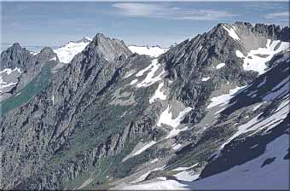
Dating of Metamorphic Rocks
R 2
0.77
0.76
2
0.75
⁸⁷Sr/⁸⁶Sr
0.74
0.73
3
R 1
M 1
M 2
M 3
R 3
0.72
1) line 1: Now
0.71
1
we will focus on how the Rb-Sr method can be used to date metamorphic rocks, The mountain on the lift Is composed of metamorphic igneous rocks (R), while M1, M2, and M3 the red circle represent three minerals contained in R2
0.70
1.0
2.0
3.0
M 1
R 2
M 3
R 1
R 3
M 2
⁸⁷Rb/⁸⁷Sr

Slide 34
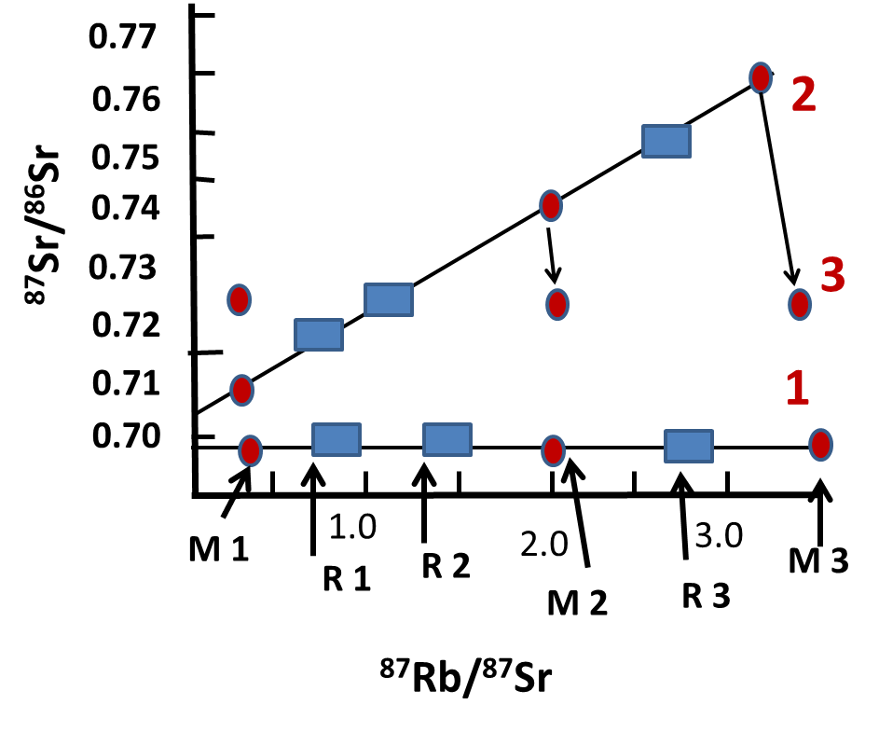
Cont’d: Dating of Metamorphic Rocks
The diagram to the right shows the isotopic composition of the rock volumes and the minerals formed shortly after crystallization
Both the rocks volume and minerals show the same ⁸⁷Sr/⁸⁶Sr ratio,
since they all formed in the same ISOTOPICALLY homogenous melt.

Slide 35
Cont’d: Dating of Metamorphic Rocks
The ⁸⁷Rb/⁸⁶Sr ratios, however, are different because various minerals fractionate Rb and Sr differently.
2) Line 2 formed
due to, after, 1000 Ma, the line will be hinged as shown in the above diagram.
i.e. during the period of 1000 Ma, the slope of the Isochron increases in response to the RADIOACTIVE DECAY of ⁸⁷Rb and the growth of ⁸⁷Sr.

Slide 36
Cont’d: Dating of Metamorphic Rocks
R 2
3) Line 3 :
Then the rock was heated (in the diagram) under metamorphic events of short duration,
R 1
M 1
M 2
M 3
R 3
The increased temperature (T º) led to a mobilization of Sr on a small scale (between the minerals of a piece of the rock), which resulted in an ISOTOPIC HOMOGENIZATION of minerals in the sample of R2
T= 1000 Ma

Slide 37
Cont’d: Dating of Metamorphic Rocks
However, the mobility of Sr was not large enough to homogenize larger volume of the rock.
After cooling, the Sr was immobilized, and ⁸⁷Sr/⁸⁶Sr ratios continued to evolve in the minerals and rocks volumes.
0.78
t₁= 1500 Ma
0.77
0.76
R 3
0.75
M1
M2
M3
0.74
⁸⁷Sr/⁸⁶Sr
0.73
t_{m}= 500 Ma
The age 1500 Ma, after the crystallization of the rocks specimen define an ISOCHRON that gives the of the crystallization of the rocks (t).
R 2
0.72
0.71
R 1
0.70
1
2
3
4
⁸⁷Rb/⁸⁶Sr

Slide 38
The ISOCHRON defined by the sample R2 and the 3 minerals from R2,
However it gives the age of the metamorphic event, which occurred 500 Ma ago as (t_{m})
0.78
t₁= 1500 Ma
0.77
0.76
R 3
0.75
M1
M2
M3
0.74
⁸⁷Sr/⁸⁶Sr
0.73
t_{m}= 500 Ma
R 2
0.72
0.71
R 1
0.70
1
2
3
4
⁸⁷Rbr/⁸⁶Sr

Slide 39
Dating Of Sedimentary Processing using Sr isotope of Marine Carbonate
Many Organisms living in the Ocean water have shells or Hard parts that are made of CaCO₃. As we know the Sr²⁺ is a divalent element and the Ca ²⁺ has similar charges and Ionic Radii,
Consequently, the Sr²⁺ is readily substituted for the Ca²⁺ cation in the carbonate structure.
Rb, however, is not incorporated in Carbonates
The ⁸⁷Sr/⁸⁶Sr ratio in the carbonaceous shell of a living organism is similar to the ⁸⁷Sr/⁸⁶Sr ratio of the water living in.

Slide 40
Cont’d: Dating Of Sedimentary Processing using Sr isotope of Marine Carbonate
Consequently, when the organism died and is incorporated into the bottom’s sediments of the sea, the ⁸⁷Sr/⁸⁶Sr signature belongs to the environment it was living in and is preserved in the sediments that formed.
i.e. since the shell does not contains Rb.
So, the ⁸⁷Sr/⁸⁶Sr signature is not altered with time
Conclusion:
The marine Carbonate can be used only to monitor the variation in ⁷⁸Sr/⁸⁶Sr of the Ocean water throughout the time

Slide 41
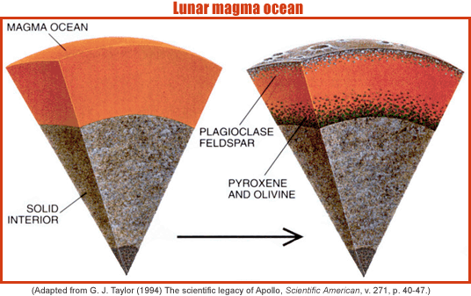
Sr isotopes of the mantle and the crust
Now, let us have a quick look at the ⁸⁷Sr/⁸⁶Sr ratios of the Earth’s crust and Mantle.
Mantle
Crust
0.710
Since the formation of the earth 4.6 Ga ago;
The mantle has been homogenous with respect to the ⁸⁷Rb/⁸⁶Sr and ⁸⁷Sr/⁸⁶Sr ratios.
0.708
0.706
⁸⁷Sr/⁸⁶Sr
0.704
0.702
0.689
4
3
2
1
⁸⁷Rbr/⁸⁶Sr
Present

Slide 42
Cont’d : Sr isotopes of the mantle and the crust
Shortly, after the formation of the earth, the ⁸⁷Sr/⁸⁶Sr ratios of the Mantle was about 0.699.
0.710
The reason is that of the RADIOACTIVE DECAY of ⁸⁷Rb to ⁸⁷Sr, and due to ⁸⁷Sr/⁸⁶Sr ratios of the mantle.
The mantle has evolved to present an ⁸⁷Sr/⁸⁶Sr value of about 0.704,
0.708
0.706
⁸⁷Sr/⁸⁶Sr
0.704
0.702
Mantle
0.699
4
3
2
1
⁸⁷Rbr/⁸⁶Sr
Present

Slide 43
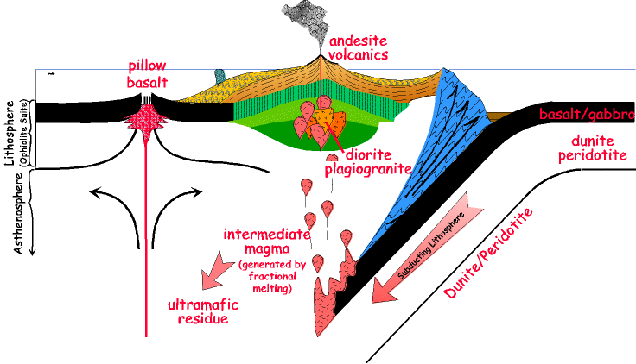
Cont’d : Sr isotopes of the mantle and the crust
and
Formation of new crust
Partial melting
During the partial melting of the mantle.
Materials extracted from the mantle and added to the Earth’s crust;
Immediately after the formation of the new crust, its Sr isotopic composition is similar to the composition of the mantle it was extracted from

Slide 44
Cont’d : Sr isotopes of the mantle and the crust
During the partial melting of the mantle, Rb is partitioned, and segregated into a melt relative Sr.
Formation of new crust
Partial melting
0.710
This happened immediately after its formation; the newly formed crust shows a high Rb/Sr ratio than the mantle it was extracted from.
0.708
Crustal Rocks
0.706
⁸⁷Sr/⁸⁶Sr
0.704
Depleted Mantle
0.702
Mantle
0.689
4
3
2
1
⁸⁷Rbr/⁸⁶Sr
Present

Slide 45
Cont’d : Sr isotopes of the mantle and the crust
Similarly, the part of the mantle that has undergone partial melting ( it is depleted; i.e. quantity not able to fulfil) shows a lower Rb/Sr ratio than the un-depleted mantle,
Formation of new crust
Partial melting
0.710
0.708
Crustal Rocks
Because and due
0.706
⁸⁷Sr/⁸⁶Sr
0.704
Depleted Mantle
to the differences in their Rb/Sr ratio, the ⁸⁷Sr/⁸⁶Sr ratios of the crust’
0.702
Mantle
Present
0.689
4
3
2
1
⁸⁷Rbr/⁸⁶Sr

Slide 46
Cont’d : Sr isotopes of the mantle and the crust
The depleted (no longer sufficient) and un-depleted mantle evolved differently.
So, crustal rocks show , in general, considerably higher ⁸⁷Sr/⁸⁶Sr ratios than mantle rocks
The Mantle is; as pointed out on a previous slide homogenous concerning its Sr isotope composition.

Slide 47
Cont’d : Sr isotopes of the mantle and the crust
Different components of the earth’s crust , and ; however; show large vartion in the ratios of ⁸⁷Sr/⁸⁶Sr
A
B
C
0.710
Crustal Rocks
0.708
0.706
⁸⁷Sr/⁸⁶Sr
The reason for this is that the various components of the crust have been extracted from the mantle at a different time as shown in the diagram
C
0.704
B
A
0.702
0.689
4
3
2
1
B
⁸⁷Rbr/⁸⁶Sr
A
C
Present
mantle
Partial melting

Slide 48
Sr Isotope source of the Oceans
The Sr of Marine water is derived from 3 principles sources:
Sea level
Sr from continent crust
Water on the crust ⁸⁷Sr/⁸⁶Sr signature that enters the sea via rivers, and runoff water.
Sr from marine Carbonate
Sr from mantle
Water from mantle ⁸⁷Sr/⁸⁶Sr signature that enters the sea through the hydrothermal system along the Mid-oceanic ridge (MORB), and
Recirculation of Sr from Pre-existing Carbonate rich rocks

Slide 49
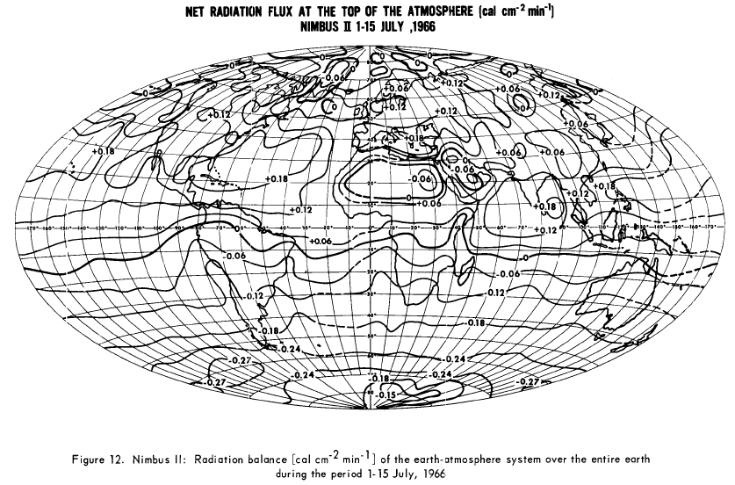
Sr Isotope of the Oceans
Although the ocean of the world continuously receives Sr of high variable isotopic compositions from the source mentioned above.
The isotopic composition of the Oceans are everywhere the same of:
⁸⁷Sr/⁸⁶Sr = 0.70924
The strong current of the Ocean’s waters is very important for the isotopic homogenization of Sr on a Global Scale.
Equally important is, however, the high Sr solubility in marine waters

Slide 50
Sr Isotope source of the Oceans
Sr that is introduced to the SEA from external sources exist in for sufficiently long time in the sea to homogenize isotopically on a global scale.
Less soluble elements such as (Nd) participate long before the global isotopic homogenization is attained
Modern ocean water ⁸⁷Sr/⁸⁶Sr = 0.70924
0.7095
0.7090
⁸⁷Sr/⁸⁶Sr = 0.7082=25Ma
0.7085
⁸⁷Sr/⁸⁶Sr = 0.7076=75 &200 Ma
⁸⁷Sr/⁸⁶Sr
0.7080
0.7075
0.7070
0.7065
25
50
75
100
150
200
^{Age Ma}

Slide 51
Sr Isotope source of the Oceans
Sr Isotope source of the Oceans
The diagram shows the ⁸⁷Sr/⁸⁶Sr variation ratios of the ocean water back to about 210 Ma.
That the ocean receive high amount of Sr with Mantle signature (⁸⁷Sr/⁸⁶Sr = 0.704) in that period
Indicating
The low ⁸⁷Sr/⁸⁶Sr ratio at about 155 – 165 Ma

Slide 52
Sr Isotope source of the Oceans
This contrast is due to modern oceanic water ⁸⁷Sr/⁸⁶Sr) = 0.709
Which indicating
High input of Sr with CRUSTAL signature (High ⁸⁷Sr/⁸⁶Sr)
Thus, the ocean water ⁸⁷Sr/⁸⁶Sr ratio diagram can be used to date marine carbonate although the method does not always give unique results.
A ⁸⁷Sr/⁸⁶Sr ratio of 0.7082 corresponds to an age of about 25 Ma.
And an ⁸⁷Sr/⁸⁶Sr of 0.7076 corresponds to an age 75 and 200 Ma.

Slide 53
Summary
Rb substitute for K (Potassium) in minerals. Thus, K-bearing minerals such as Muscovite, Biotite, amphibole, and K-feldspar are suitable for Rb-Sr method dating.
Rb/Sr dating method is based on the radioactive decay of ⁸⁷Rb/⁸⁶Sr, thus the decay of ⁸⁷Rb to stable ⁸⁶Sr occurs by the β-decay mechanism, and is described by the Equation:
⁸⁷Rb = ⁸⁷ Sr + β + ∇ + Q
The decay of ⁸⁷Rb and production of ⁸⁷ Sr with time is normalized by dividing the equation by ⁸⁶Sr then can be expressed as follows:

Slide 54
Summary
⁸⁷Sr/⁸⁶Sr = ⁽⁸⁷Sr/⁸⁶Sr)_{i} + ⁸⁷Rb/⁸⁶Sr( e^{λt} – 1) Equation 1
Where t = time in only unknown
When ⁸⁷Rb/⁸⁶Sr and ⁸⁷Sr/⁸⁶Sr ratios of a geological system (Minerals, Rocks samples) is known, then the time elapsed since the system closed to Rb and Sr can be calculated from the equation (1) above.
The Isochron diagram of ⁸⁷Rb/⁸⁶Sr is drawn on a horizontal axis and ⁸⁷Sr/⁸⁶Sr is drawn in the graph as a vertical axis is the graphical presentation of the equation (1).

Slide 55
Summary
The calculated age may represent the time elapsed since crystallization of the rocks, or the time elapsed since the rock underwent metamorphose.
The ⁸⁷Sr/⁸⁶Sr of marine carbonates can be used to date the time of sediments depositional.

Slide 56
Rb Occurrence
Rubidium is the twenty-third most abundant element in the Earth's crust, roughly as abundant as zinc and rather more common than copper.
It occurs naturally in the minerals leucite, pollucite, carnallite, and zinnwaldite, which contain up to 1% of its oxide. Lepidolite contains between 0.3% and 3.5% rubidium, and is the commercial source of the element.
Some potassium minerals and potassium chlorides also contain the element in commercially significant amounts.
Seawater contains an average of 125 µg/L of rubidium compared to the much higher value for potassium of 408 mg/L and the much lower value of 0.3 µg/L for caesium.

Slide 57
Cont’d: Rb Occurrence
Because of its large ionic radius, rubidium is one of the "incompatible elements.”
During magma crystallization, rubidium is concentrated together with its heavier analogue caesium in the liquid phase and crystallizes last. Therefore the largest deposits of rubidium and caesium are zone pegmatite ore bodies formed by this enrichment process.
Because rubidium substitutes for potassium in the crystallization of magma, the enrichment is far less effective than in the case of caesium.
Zone pegmatite ore bodies containing mineable quantities of caesium as pollucite or the lithium minerals lepidolite are also a source for rubidium as a by-product.

Slide 58
Occurrence of Sr
Strontium commonly occurs in nature, being the 15th most abundant element on Earth (its heavier congener barium being the 14th), estimated to average approximately 360 parts per million in the Earth's crust and is found chiefly as the sulfate mineral celestine (SrSO₄) and the carbonate strontianite (SrCO₃).
Of the two, celestine occurs much more frequently in deposits of sufficient size for mining. Because strontium is used most often in the carbonate form

Slide 59
strontianite would be the more useful of the two common minerals, but few deposits have been discovered that are suitable for development.[
Celestine occurs much more frequently in deposits of sufficient size for mining. Because strontium is used most often in the carbonate form, strontianite would be the more useful of the two common minerals, but few deposits have been discovered that are suitable for development.

Slide 60
Because of the way it reacts with air and water, strontium only exists in nature when combined to form minerals.
Naturally occurring strontium is stable, but its synthetic isotope Sr-90 is only produced by nuclear fallout.
In groundwater, strontium behaves chemically much like calcium.
At intermediate to acidic pH Sr²⁺ is the dominant strontium species.
In the presence of calcium ions, strontium commonly forms coprecipitates with calcium minerals such as calcite and anhydrite at an increased pH. At intermediate to acidic pH, dissolved strontium is bound to soil particles by cation exchange.

Slide 61
The mean strontium content of ocean water is 8 mg/L.
At a concentration between 82 and 90 μmol/L of strontium, the concentration is considerably lower than the calcium concentration, which is normally between 9.6 and 11.6 mmol/L.
It is nevertheless much higher than that of barium, 13 μg/L

