Slide 1
Urine Analysis

Slide 2
Topics
This presentation covers the following topics:
  What is Urinalysis?
  Macroscopic examination of urine
  Chemical examination of urine
  Microscopic examination of urine
  Who performs urinalysis testing?

Slide 3
What is Urinalysis?
Urinalysis – or the analysis of urine – is one of the oldest laboratory procedures in the practice of medicine.
It is a good test for assessing the overall health of a patient.

Slide 4
What is Urinalysis?
It provides information about:
  The state of the kidney and urinary tract.
  Metabolic or systemic (non-kidney) disorders.
Urinalysis can reveal diseases that have gone unnoticed because they do not produce striking signs or symptoms.
  Examples include diabetes mellitus, various forms of kidney failure, and chronic urinary tract infections.

Slide 5
Urinalysis
Renal function tests, such as the urinalysis, are used to screen for the cause and the extent of renal dysfunction.
Urinalysis consists of the following measurements:
  Macroscopic exam
  Chemical exam
  Microscopic exam of the sediment

Slide 6
Constituents of Urine
  Normally urine is about 95% water and 5% dissolved waste products.
  Urine composition can be used diagnostically.

Slide 7
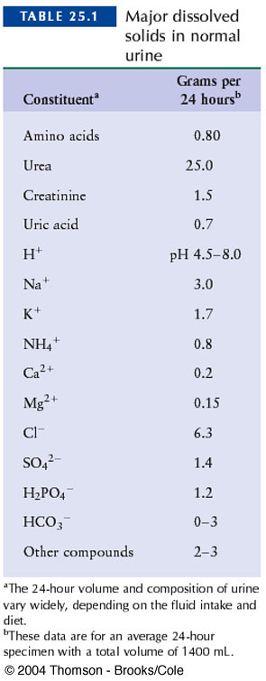
Constituents of Normal Urine

Slide 8
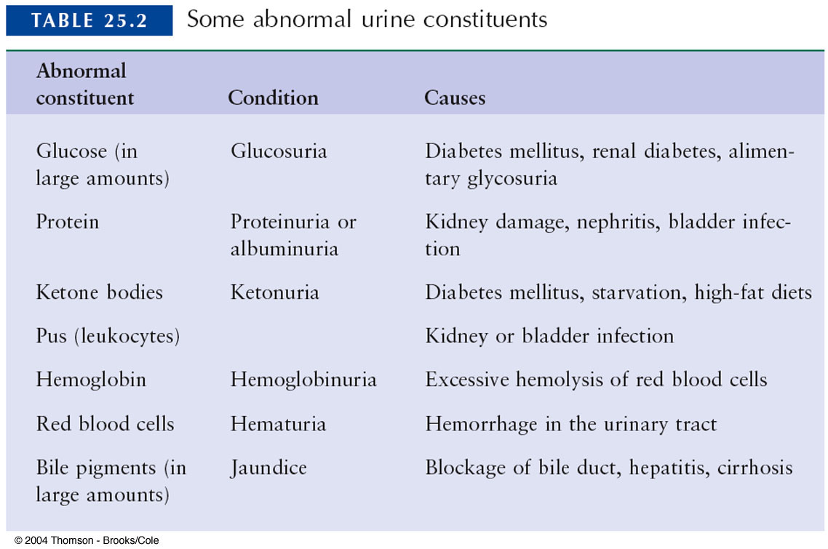
Abnormal Urine Constituents

Slide 9
Urine composition
Urine, a very complex fluid, is composed of 95% water and 5% solids .It is the end product of the metabolism carried out by billions of cells and results in an average urinary out put of 1-1.5 L per day.
Almost all substances found in urine are also find in the blood although in different concentration.
Urine may also contain formed elements such as cells, casts, crystals, mucus and bacteria.

Slide 10
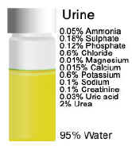

Slide 11
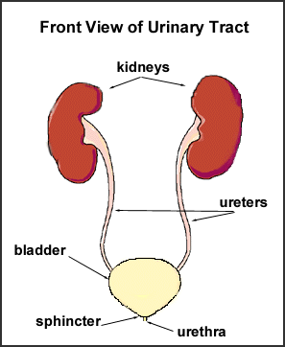
Anatomy of urinary system

Slide 12
Specimen collection
-The specimen must be collected in a clean dry, disposable container.
- The container must be properly labeled with the patient name, date, and time of collection. The labels should be applied to the container and not to the lid.
- The specimen must be delivered to the laboratory on time and tested within 1hr, OR it should be Refrigerated

Slide 13
CHANGES OCCUR IN NON PRESERVED SPECIMEN
Transformation of urea to ammonia which increase pH.
urease
Urea ─────── 2NH₃ + CO₂
(Bacteria)
Decrease glucose due to glycolysis and bacterial utilization.
Decrease ketones because of volatilization.
Decrease bilirubin from exposure to light.
Increase bacterial number.
Increase turbidity caused by bacteria & amorphous.
Disintegration of RBCs casts.
Increase nitrite due to bacterial reduction of nitrate.
Changes in color due to oxidation or reduction of metabolic.

Slide 14
TYPES OF SPECIMEN
Random specimen (at any time).
First morning specimen
24 hr’s collection
Post. Prandial sample
Clean catch sample (midstream urine)
Catheterized urine
Supra - pubic

Slide 15
Urine analysis
Macroscopic
Chemical
microscopic

Slide 16
MACROSCOPIC EXAMINATION OF THE URINE
Color
Clarity
Odor
Volume
Specific gravity
pH

Slide 17
color:
* Normal urine color has a wide range of variation ranging from pale yellow, straw, yellow, dark yellow, amber due to urobillin ,trace of urobilinogen appears in urine
The color is affected by: -
  Concentration of urine.
  pH.
  Metabolic activity.
  Diet intake (Beet).
  Drugs may change urine color (Rifampicine)

Slide 18
Color abnormalities :
Colorless or pale yellow:
  High fluid intake
  Reduction in perspiration.
  Using of diuretic.
  Diabetes Mellitus.
  Diabetes Insipidus.
  Alcohol ingestion
Dark yellow:
  Low fluid intake.
  Excessive sweating
  Dehydration (burns, fever).
  Carrots or vitamin (A) orange urine
  Pyridium(local analgesic effects on the urinary tract. It is typically used in conjunction with an antibiotic when treating a urinary tract infection)cause a distinct color change in the urine, typically to a dark orange to reddish color .
  Nitrofurantoin(antibiotic used against E. coli in urinary tract infection ).

Slide 19
Yellow – green
  Biliverdin (greenish) just in abnormal cases when there is liver cirrhosis
  Which give a yellow foam & (- ve) test for bilirubin
Blue – Green:
  Pseudomonas Infection
Brownish yellow:
  Hepatitis and obstructive jaundice, with excessive bilirubin in urine
  Bilirubin on shaking yellow foam will appear.
  Urobilin on shaking the foam has no color.

Slide 20
Pink – Red:
Due to the presence of fresh blood (hematuria) or Hb (hemoglobinuria)
Fresh blood will give smoky color while Hb gives clear reddish urine, which may be due to: -
  Urinary tract infection, Calculi, Trauma
  Menstrual contamination.
  Cancer kidney or cancer bladder
Dark brown:
Malignant Melanoma:
  .Melanogen (Colorless) ──light─ Melanin (Brown).
  Nephritic syndrome (cola color of urine)
  Black Urine: -
  Alkaptonurea (ochronosis), a disease of tyrosine metabolism.

Slide 21
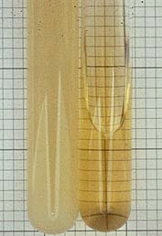
Clarity (Transparency).
Normal urine clear or transparent, any turbidity will indicate.
  WBCs (pus).
  RBCs
  Epithelial cells
  Bacteria
  Casts
  Crystals
  Lymph
  Semen.

Slide 22
ODOR
Fresh normal urine has a faint aromatic odor due to the presence of some volatile acids.
In some pathological conditions, certain metabolites may be produced to give a specific odor such as:
  Fruity odor is due to acetone.(Diabetic urine)
  Ammoniac odor urine standing long time
  Offensive odor Bacterial action of pus (UTI).
  Mousy odor Phenylalanine (phenylketonurea “PKU” ).

Slide 23
VOLUME
Adult urine volume = 600 – 2500 ml /24hr. 0.5-1ml /kg/hr, Average 1.5 litres
Children urine volume =200–400ml /24hr (4ml/kg/ hr).
Which depends on:
  Water intake
  External temperature.
  Mental and physical state.
  Intake of fluid and diuretics (Drugs, alcohol ,tea).

Slide 24
abnormalities
Oligouria: marked decrease in urine flow < 400 ml.
Polyuria: Marked increase in urine flow > 2500 ml.
Anuria: <100ml/day
Nocturia: excessive urination during night.
Causes of polyuria:
  Increased fluid in take (polydipsia ──>polyuria).
  Increased salt intake ad protein diet, which need more water to excrete.
  Diuretics intake (certain drugs, drinks , caffeine)
  Intravenous saline or glucose.

Slide 25
  Diabetes Mellitus.
  Diabetes Insipidus.
  End stages of chronic renal failure
  Hypoaldasteronism.
Hypercalcaemia
Hyperthyroidism
Pregnancy
Removal of urinary obstruction
Psychogenic polydepsia

Slide 26
Causes of Oliguria:
  Water deprivation
  Dehydration
  Prolonged vomiting.
  Diarrhea
  Excessive sweating
  Renal Ischemia
  Heart failure
  Hypotension
  Acute renal failure
  Obstruction by :Calculi,Tumor,Prostatic
  hypertrophy.
Causes of anuria:
  Sever Renal Defect and loss of urine formation mechanism.
  Due to the presence of stone or tumor.
  Post transfusion hemolytic reaction.

Slide 27
In acute post transfusion hemolytic reaction when there is incompatibility between donor's and receiver's blood, hemolysis of RBCs will occur , resulting in fever ,chills and rigors , most important will be acute renal failure caused by excess hemoglobin causing blockage of the renal tubules.

Slide 28
PH
One of the important functions of the kidneys is pH regulation, the glomerular filtrate of blood plasma is usually acidified by renal tubules and collecting ducts from a pH of 7.4 to about 6 in the final urine to keep blood pH about 7.4.
Hence, urine pH must vary to compensate for diet and products of metabolism, this function takes place in the distal convoluted tubule with the secretion of both H⁺ and reabsorbtion of bicarbonate.
Normal urine pH is (4.6 – 8.0) as average (6.0)
Even in abnormal conditions, urine pH mustn’t reach 9, if so or more this will indicate that urine is stand for along time & must be rejected

Slide 29
Renal physiology has several powerful mechanisms to control pH by the excretion of excess acid or base. In responses to acidosis, tubular cells reabsorb more bicarbonate from the tubular fluid, collecting duct cells secrete more hydrogen and generate more bicarbonate. In responses to alkalosis, the kidney may excrete more bicarbonate and decrease hydrogen ion secretion from the tubular epithelial cells.

Slide 30
Clinical significance of pH
Determine the existence of metabolic acid base disorder
Precipitation of crystals to from stone requires specific pH for each type. Hence, pH control may inhibit the formation of these stones by control diet.
Crystals found in alkaline urine : Ca carbonate, Ca phosphate, Mg Phosphate
Crystals found in acidic urine:Ca oxalate,uric acid.
Acidic urine in : acidosis , DKA, starvation dehydration, diarrhea
Alkaline urine in : alkalosis, congenital hypertrophic pyloric stenosis, renal tubular acidosis, UTI .

Slide 31
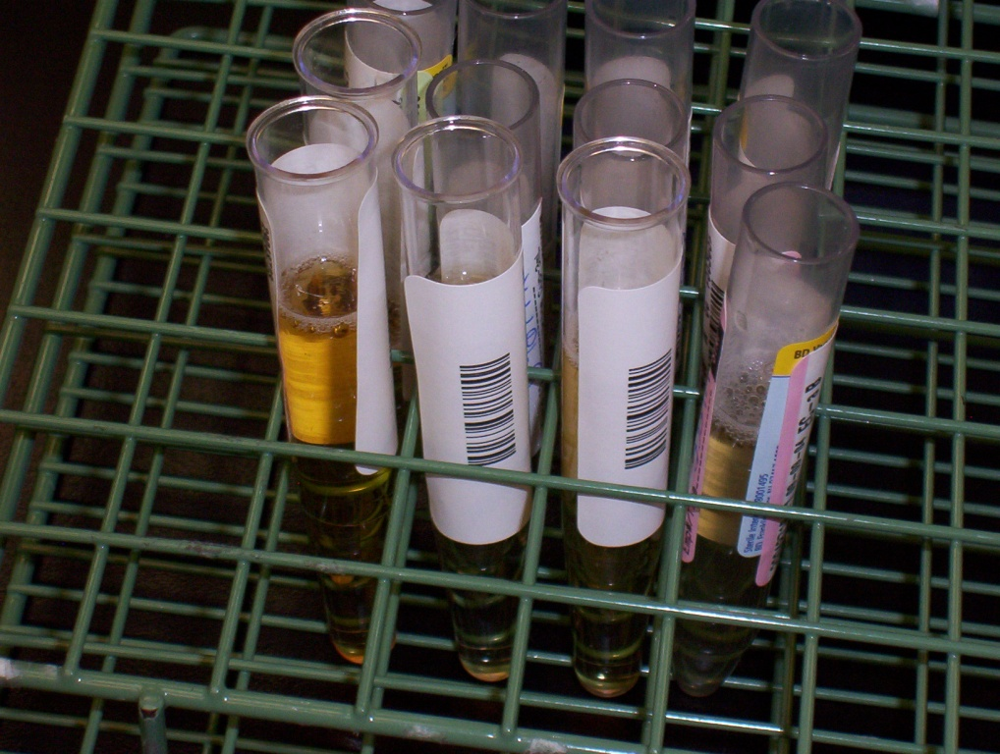
Macroscopic Exam
Examination of the physical properties including….
  Color
  Clarity (or transparency)

Slide 32
Macroscopic Exam
Color - normal
  yellow (straw to amber)
Color - abnormal (due to disease, drugs or diet)
  pale to colorless
  amber (dark yellow)
  orange
  pink or red
  green
  brown or black

Slide 33
Macroscopic Exam
Clarity (or transparency) - normal
  clear
Clarity - abnormal (due to insoluble elements such as cells, crystals, etc.)
  hazy
  cloudy
  turbid

Slide 34
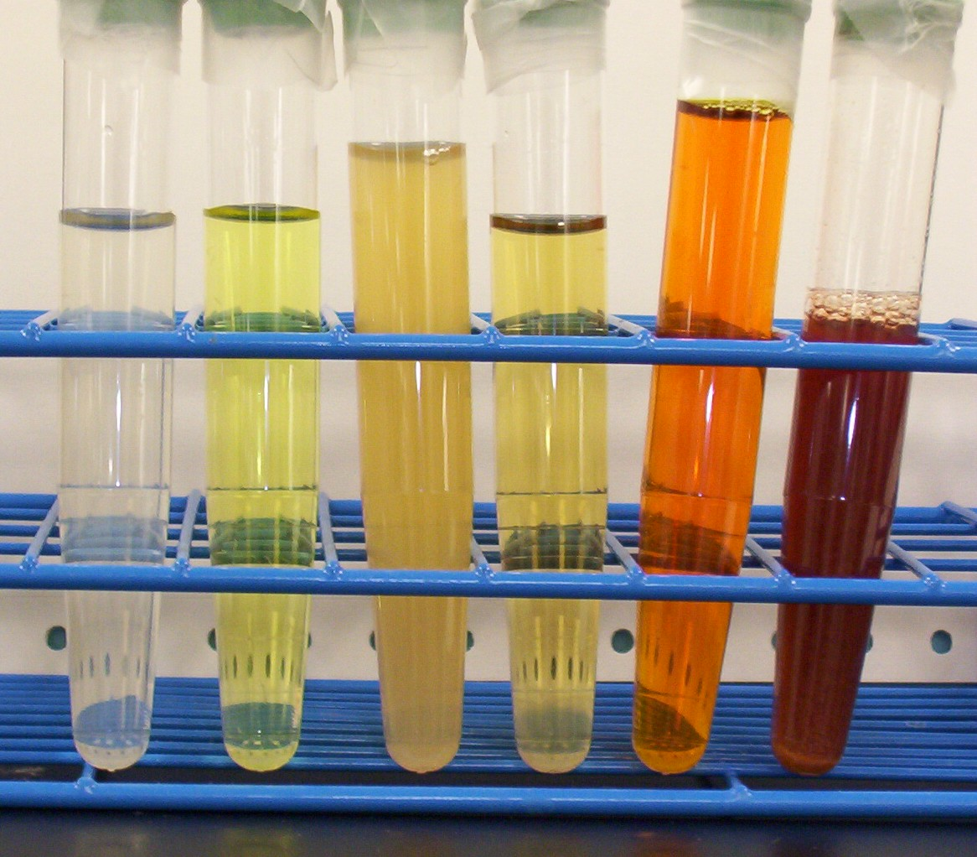
Macroscopic Exam
Left to right: Straw, clear; yellow, clear; yellow, hazy; yellow, clear; red-orange, clear; brown, hazy.

Slide 35
Chemical Exam
The presence of normal and abnormal chemical elements in the urine are detected using dry reagent strips.
These plastic strips contain absorbent pads with various chemical reagents for determining a specific substance.

Slide 36
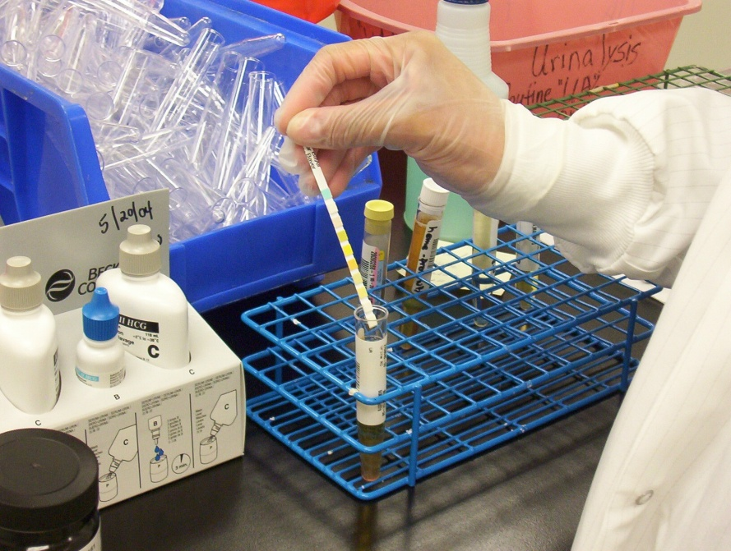
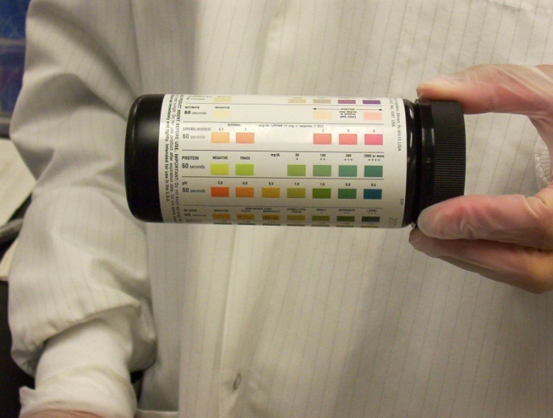
Chemical Exam
When the test strip is dipped in urine the reagents are activated and a chemical reaction occurs.
The chemical reaction results in a specific color change.

Slide 37
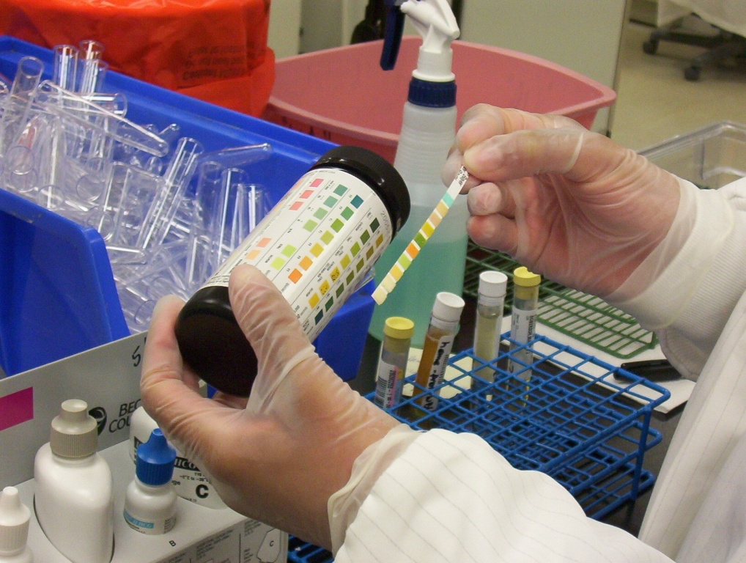
Chemical Exam
After a specific amount of time has elapse, this color change is compared against a reference color chart provided by the manufacturer of the strips.

Slide 38
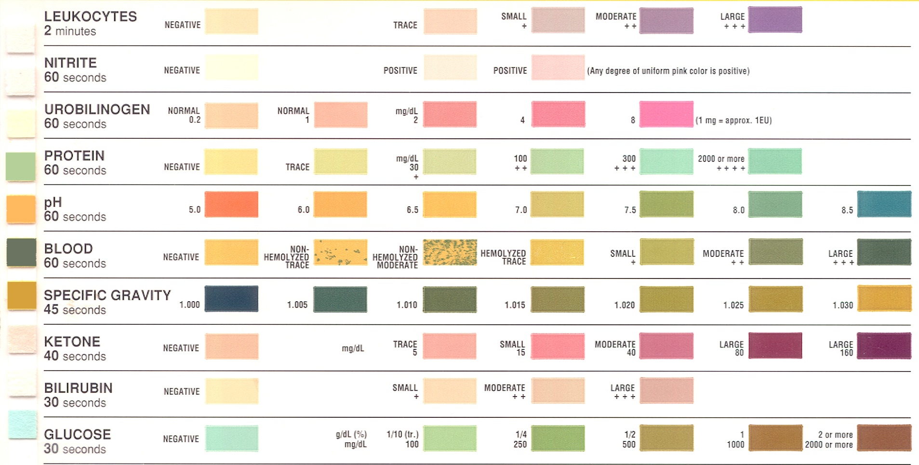
Chemical Reaction Chart

Slide 39
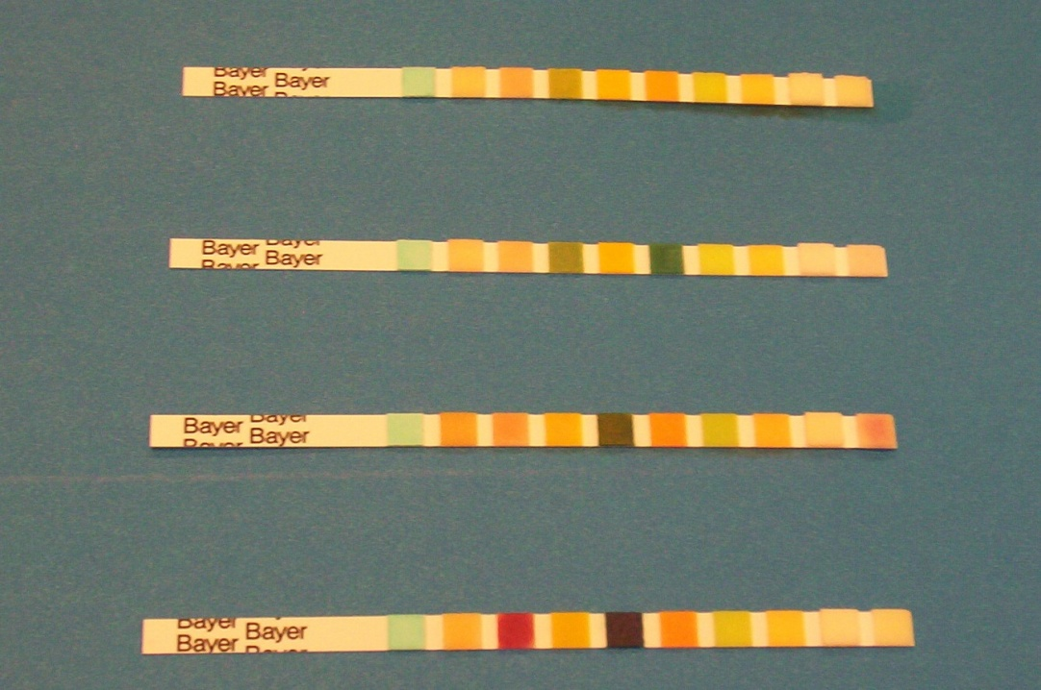
Chemical Exam
The intensity of the color formed is generally proportional to the amount of substance present.

Slide 40
Typical Substances Tested & Significance
pH - partial assessment of acid base status; alkaline pH indicates old sample or urinary tract infection
Specific Gravity - state of kidney and hydration status of patient
Protein - primarily detects protein called albumin; important indicator in the detection of renal disease
Glucose - primarily detects glucose (sugar); important indicator of diabetes mellitus

Slide 41
Typical Substances Tested & Significance
Blood - red blood cells, hemoglobin, or myoglobin (muscle hemoglobin); sensitive early indicator of renal disease
Ketone - normal product of fat metabolism; increased amounts seen in diabetes or starvation (extreme dieting)
Bilirubin - detects bilirubin (a product of red cell breakdown); indicator of liver function
Urobilinogen - another by-product of red cell breakdown; increased amounts seen in fever, dehydration, hemolytic anemia and liver disease

Slide 42
Typical Substances Tested & Significance
Nitrite - certain bacteria convert normal urine nitrate to nitrite; indicator of urinary tract infection
Leukocyte Esterase - detects esterase enzyme present in certain white blood cells (e.g, neutrophils, monocytes); indicator of urinary tract infection

Slide 43

Example Chemical Analysis Results

Slide 44
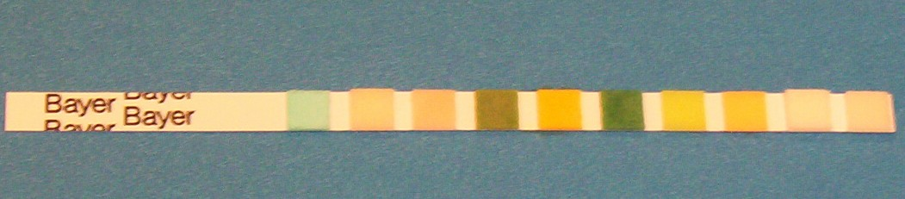
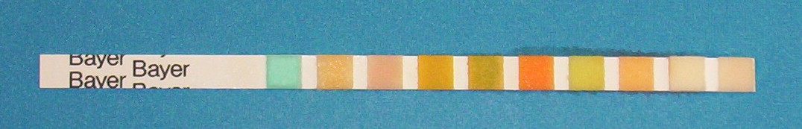
Elevated pH (alkaline)
(Normal for comparison)

Slide 45

Positive Glucose
(Normal for comparison)

Slide 46
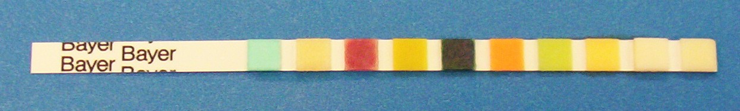
Positive Blood & Ketones
(Normal for comparison)

Slide 47
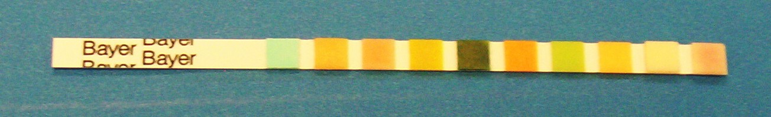
Positive Blood and Leukocyte Esterase
(Normal for comparison)

Slide 48
Microscopic Exam
Most commonly used procedure for the detection of renal and/or urinary tract disease.
This exam consists of reviewing the solid material suspended in the urine - both chemical and cellular.

Slide 49
Microscopic Exam
Requires a well-trained laboratory
professional who is:
  skilled in the use of various microscopic techniques such as bright field and phase microscopy
  able to distinguish normal or contaminating items from abnormal, pathologic elements
  knowledgeable of the clinical significance of each finding and its relationship to the chemical and physical analysis

Slide 50
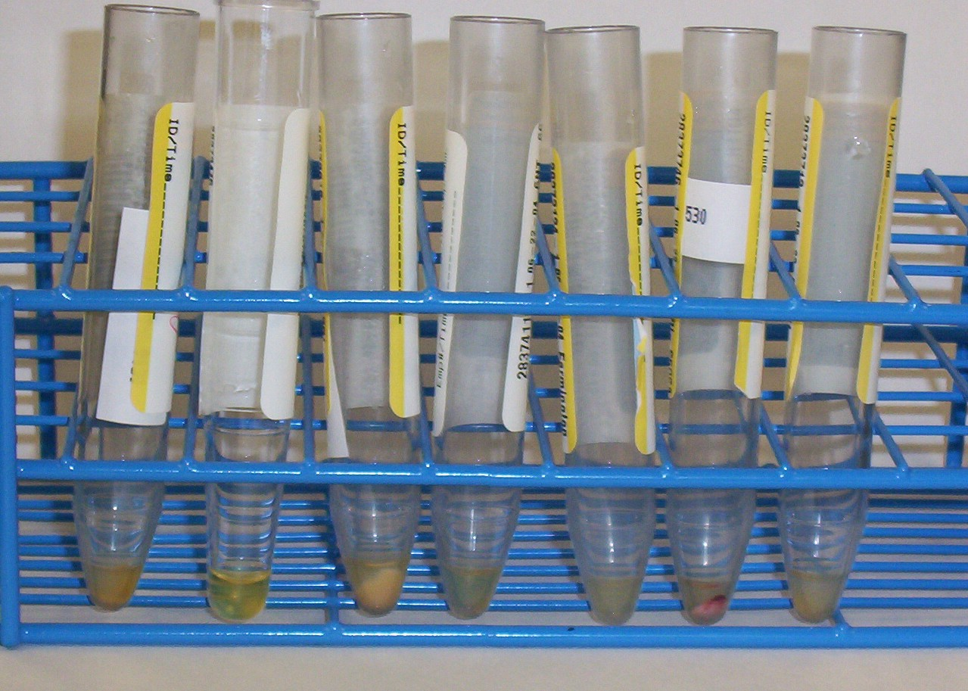
Microscopic Exam
The urine specimen is centrifuged and the liquid portion is poured off.
The concentrated cellular sediment

Slide 51
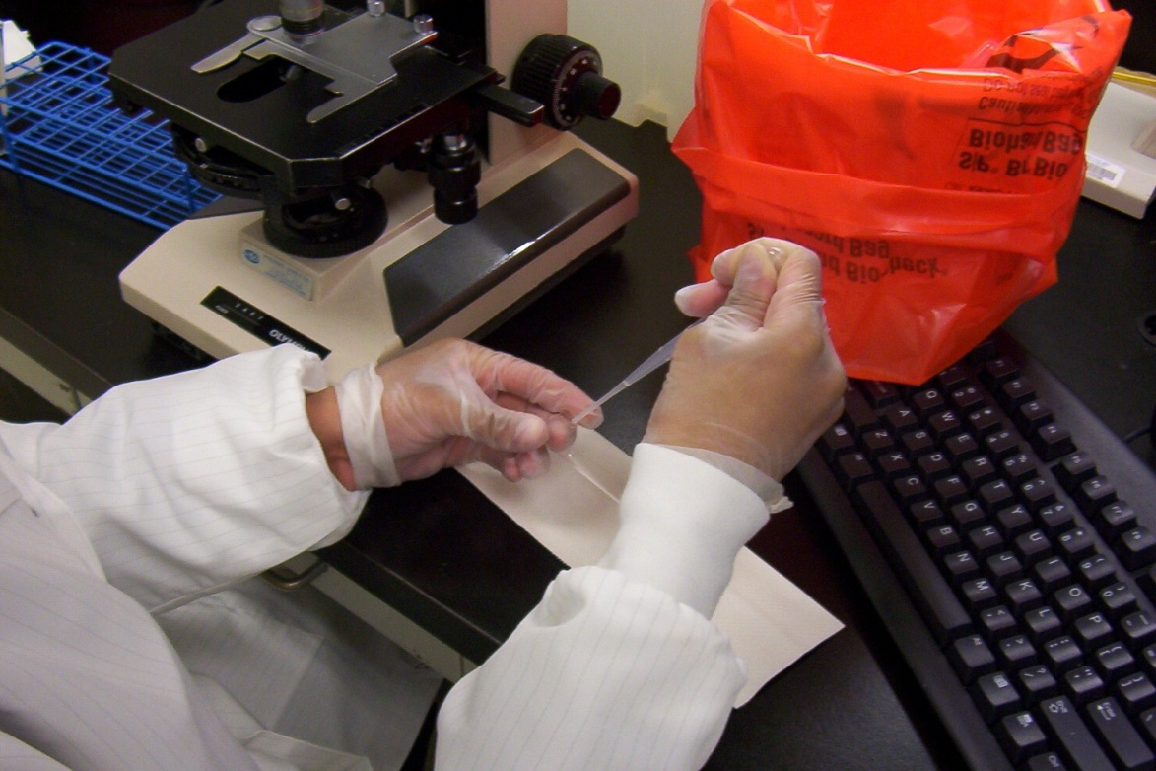
Microscopic Exam
is then placed on a microscope slide, covered with a cover slip and viewed under a microscope.

Slide 52
Microscopic Exam
A variety of normal and abnormal cellular elements may be seen in urine sediment such as:
  Red blood cells
  White blood cells
  Mucus
  Various epithelial cells
  Various crystals
  Bacteria

Slide 53
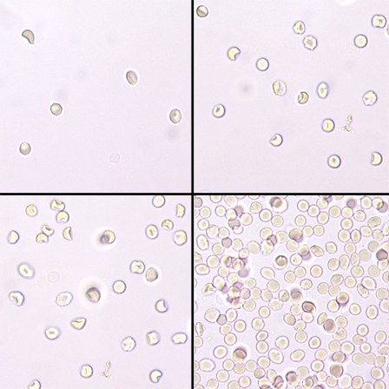
Microscopic Exam
Red blood cells
  presence of a few is normal
  higher numbers are indicator of renal disease
  result of bleeding at any point in urinary system
40x objective

Slide 54
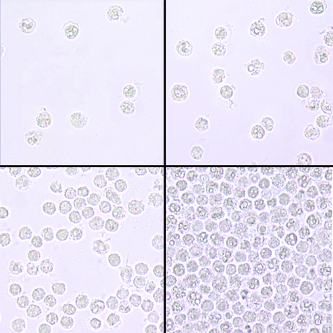
Microscopic Exam
White blood cells
  a few are normal
  high numbers indicate inflammation or infection somewhere along the urinary or genital tract
40x objective

Slide 55
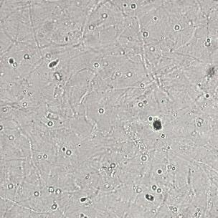
Microscopic Exam
Mucus
  look like long, ribbon-like threads
  common finding in urine sediment
  secreted by glands in the lower urinary tract
40x objective

Slide 56
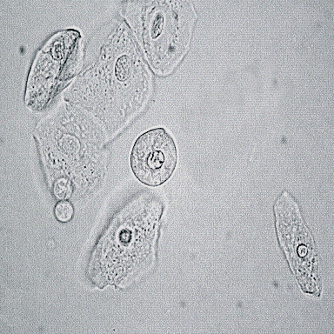
Microscopic Exam
Epithelial cells
  cells are large and flat
  normal cells that line the urinary and genital tract or renal tubules
40x objective

Slide 57
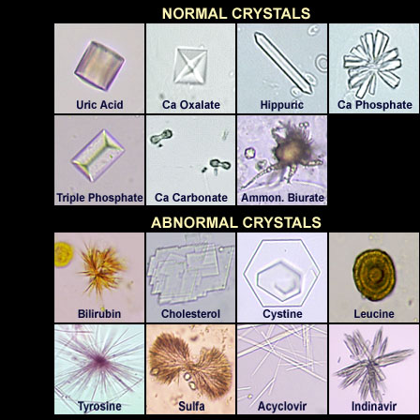
Microscopic Exam
A variety of normal and abnormal crystals may be present in the urine sediment.

Slide 58
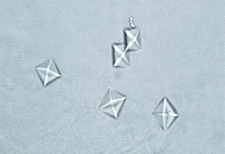
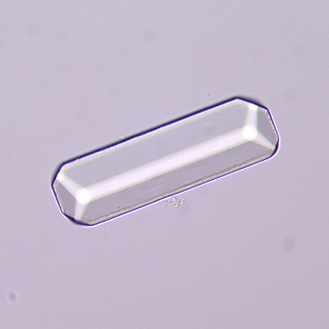
Microscopic Exam
Crystals of calcium oxalate
  colorless octahedron
  found in acid urine
Crystals of triple phosphate
  colorless, “coffin-lid” prism
  common finding; not clinically significant

Slide 59
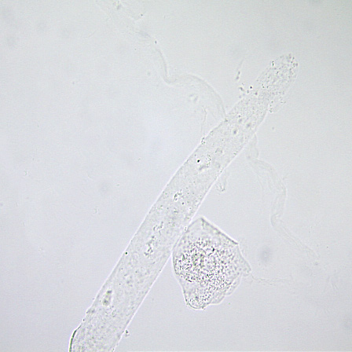
Microscopic Exam
Hyaline Casts
  colorless and fatter than mucus
  a few are normal
  may be increased after strenuous exercise
  form when protein solidifies in the nephron

Slide 60
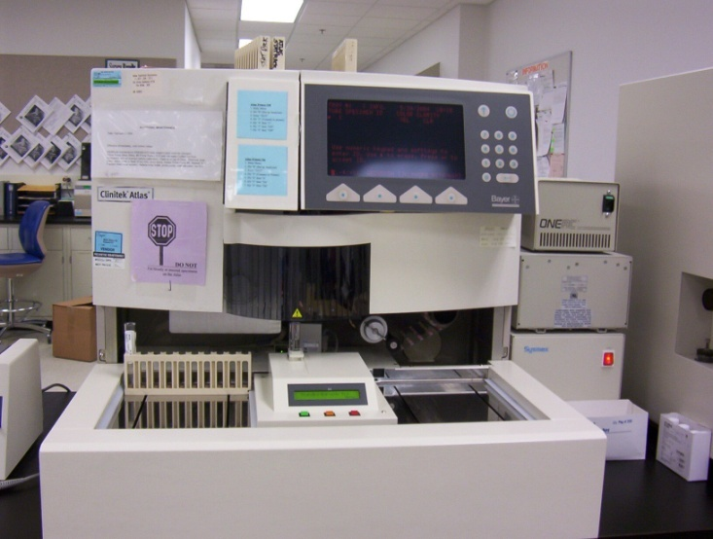
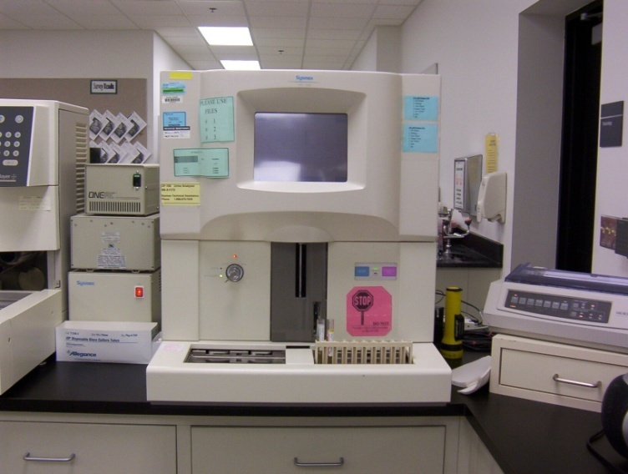
An additional note
The chemical and microscopic analysis of urine can be performed manually or with automated analyzers.
In many laboratories, abnormal automated findings are confirmed by manual techniques.

Slide 61
Who performs urinalysis testing?
In most clinical laboratories, urinalysis is performed by medical laboratory professionals called:
  Medical Laboratory Technicians or Clinical Laboratory Technicians (MLT/CLT)
  Medical Technologists or Clinical Laboratory Scientists (MT/CLS)

Slide 62
Summary
Urinalysis in an important clinical diagnostic test.
Urinalysis can reveal diseases that have gone unnoticed because they do not produce striking signs or symptoms.
Urinalysis provides information about the kidney, urinary tract, and systemic (non-kidney) disorders.
The results of the macroscopic, chemical and microscopic analysis must be interpreted together to arrive at a proper diagnosis.

Slide 63
Summary
Although urinalysis is easily performed with reagent test strips, the results are dependent on:
  correct technique
  an understanding of the limitations and interference's
Thus, technologists and technicians performing these tests must be properly trained, especially in correctly recognizing microscopic elements.

