Slide 1
Adipocytes as an Endocrine Tissue
First lecture
First semester 2018

Slide 2
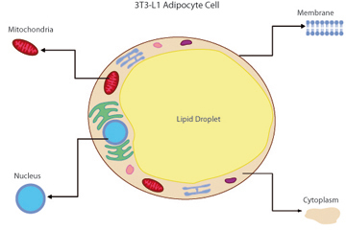
Adipose Tissue
Adipose tissue is a complex, essential, and highly active metabolic and endocrine organ. Besides adipocytes (lipocytes, fat cells), adipose tissue contains connective tissue matrix, nerve tissue, stromovascular fraction, of which approximately 10% are CD14, CD31 macrophages. Together these components function as an integrated unit.

Slide 3
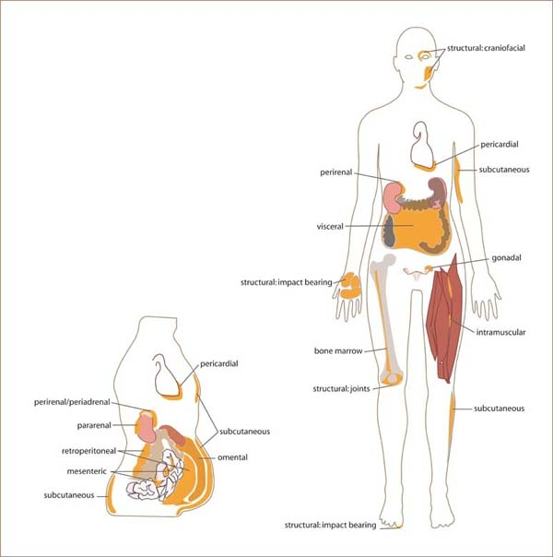
Distribution of Adipose Tissues
Adipose Tissue is divided into two compartments:
Central (the subcutaneous upper abdominal and visceral fat masses).
peripheral (hip and gluteal–femoral fat).

Slide 4
Distribution of Adipose Tissues
Women and men display dimorphic body fat composition, with men more apt to have central or abdominal obesity, and women more prone to adipose tissue in gluteal and femoral regions.
Greater central adiposity is also seen in men with lower testosterone levels and sex hormone binding globulin (SHBG).
There is data supporting an association of high testosterone and central obesity, along with low SHBG and increased body (particularly abdominal) fat in premenopausal women.

Slide 5
Distribution of Adipose Tissues
While alternate evidence suggests low testosterone to be associated with central obesity. Differences in age, pre- vs. postmenopausal status and the existence of other abnormalities such as PCOS have been proposed as explanations for these discrepancies.
The distribution and function of white adipocytes evolves with age, with maximum fat mass typically achieved in middle aged adults, while ethnicity and sex also influence white adipose tissue's quantity and distribution.

Slide 6
Distribution of Adipose Tissues
Excess central fat contributes to dyslipidaemia, hypertension and insulin resistance, whereas excess femoral fat has protective metabolic effects and is associated with a reduced cardiovascular risk.

Slide 7
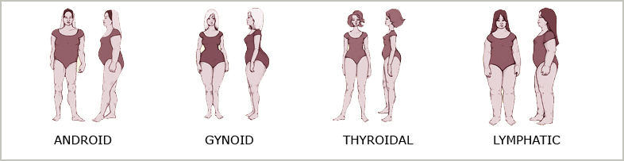
Approximately 40% of women (and most men) belong to android body type which is characterized by broad shoulders, strong muscular arms and legs, a narrow pelvis and narrow hips. If these people gain a lot of weight they tend to become apple shaped.

Slide 8
Approximately 40% of women belong to gynoid body type which is characterized by small to medium shoulders a narrow tapering waistline and wide hips. Weight gain tends to occur on the buttocks and thighs which further accentuate the pear shape of the gynoid type.

Slide 9
Approximately 10% of the women and 5% of the men belong to thyroidal body type which is characterized by a fine (small) bone structure relatively long limbs compared to the trunk and a long narrow neck. We call them thyroid types because they have such a rapid and efficient metabolism and not because they are more likely to suffer with thyroid diseases.

Slide 10
Approximately 10% of women and 5% of men belong to lymphatic type which is characterized by weight gain all over the body. The limbs have a thick puffy appearance and the bone structure is not very visible they have an inefficient lymphatic system which leads to water retention and makes these people appear more fatter than they are. Cellulite is common in these people.

Slide 11
Adipokines
White adipocytes produce numerous endocrine, paracrine and neuroendocrine signals via the production of adipokines.
The adipokines, or adipocytokines are cytokines (cell signaling proteins) secreted by mainly by adipocytes. Although adipose tissue secretes a variety of factors, only leptin and adiponectin (and possibly resistin, adipsin, and visfatin) are primarily produced by adipocytes and can therefore be properly classified as adipokines.

Slide 12
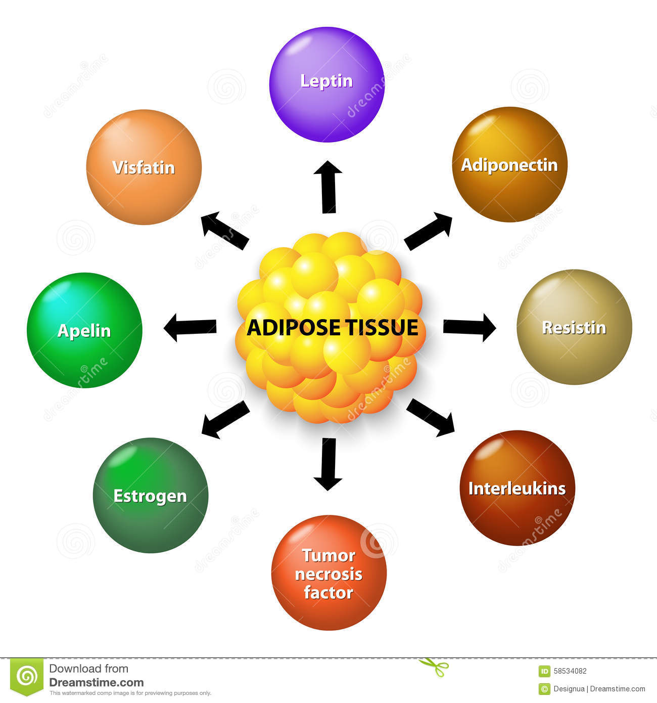
Adipocytes express and secrete several endocrine hormones.

Slide 13
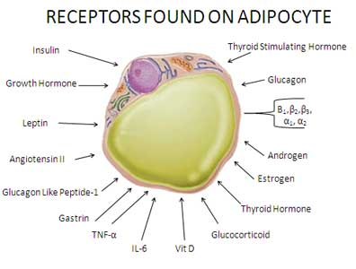

Slide 14
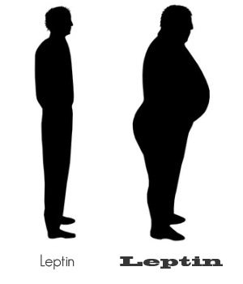
Leptin
Leptin is expressed and secreted by adipocytes in white adipose tissue, placenta and gastric epithelium
Leptin is a 16-kd protein encoded by the ob gene.
Adipocytes are the most important source of leptin, and circulating leptin levels directly correlate with adipose tissue mass.
In general, obese people have an unusually high circulating concentration of leptin. These people are said to be resistant to the effects of leptin.

Slide 15
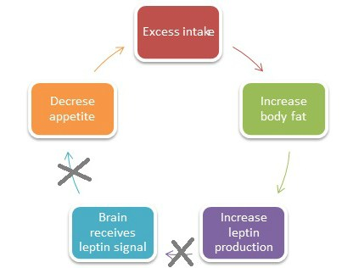
Leptin Resistance
Mutation of the gene for leptin receptors
in the brain.
Post receptor abnormalities in
leptin signal transduction.
Impaired leptin transport across
blood- brain barrier.

Slide 16
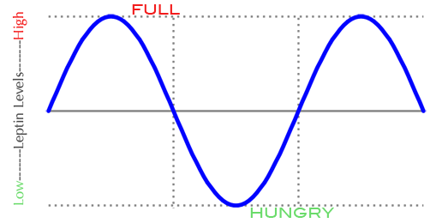
Leptin
Control of appetite decrease in food intake and increase in energy expenditure are the primary roles of leptin. In fact, mice with a mutation in the leptin (ob/ob mice) or leptin receptor (db/db mice) gene, as well as human subjects with mutations in the same genes, are massively obese.

Slide 17
Role of Leptin in Lipid Metabolism
Increase in fatty acid oxidation and reducing the fat tissue in muscles and liver (Inhibit intracellular lipid concentration)
Increase insulin sensitivity .

Slide 18
Leptin
Leptin protects T lymphocytes from apoptosis and regulates T-cell proliferation and activation.
Leptin also influences cytokine production from T lymphocytes, generally switching the phenotype toward a TH1 response. Of note, cytokine production from T lymphocytes is suppressed in leptin- deficient children and restored by leptin administration.

Slide 19
Role of Leptin on Puberty
Kisspeptin is known to increase the neural activity and mediate neuroendocrine events during puberty.
  One of the function of kisspeptinergic neurons in humans is establish a target for leptin hormone
Leptin surge promotes the kisspeptinergic neuron to secrete kisspeptin that would bind to GPR54 receptors in the GnRH neurons.
↑↑ stimulating of hypothalmic GnRH  secrete a high amount of GnRH that enhance the releasing of FSH and LH from anterior pituitary.

Slide 20
Adiponectin
Its metabolic effects include increased insulin sensitivity, decreased gluconeogenesis and reduced inflammations.
Adiponectin levels are found to be lower in obese individuals, insulin resistant, and type 2 diabetes-afflicted patients. It is found at greater levels in women than men.
Studies with PCOS generally suggest that adiponectin levels are lower in these patients.
TNF-a, which is increased in the WAT of obese subjects, might downregulate adiponectin production

Slide 21
Resistin
Resistin received its name from the original observation that it induced insulin resistance in mice.
Levels of resistin have been reported to be either increased, unchanged, or decreased in murine and human obesity and type II diabetes, somewhat dampening the initial enthusiasm of resistin as a possible link between adiposity and insulin resistance.

Slide 23
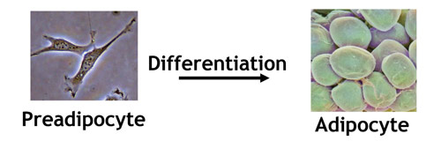
Differentiation of Adipocyte
Adipocytes are derived from mesenchymal stem cells.
Figure 1: Proliferating preadipocytes are differentiated into non-dividing adipocytes capable of accumulating lipid.

Slide 24
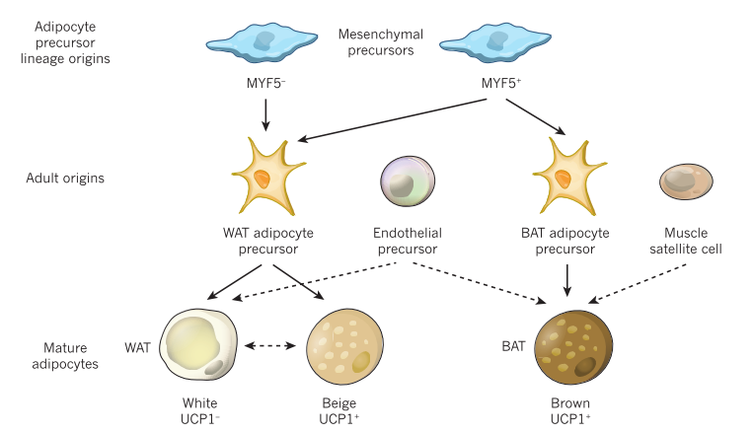
Differentiation of Adipocyte

Slide 25
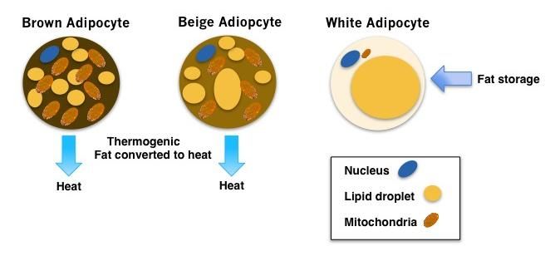
The Different Shades of Adipose Tissues
The contribution of three different ‘shades’ of adipose tissue: white (WAT), brown (BAT) and beige should be considered in the regulation of energy balance.

Slide 26
The Different Shades of Adipose Tissues
Brown adipocytes may appear after thermogenic stimuli at anatomical sites corresponding to white adipose tissue (WAT). This process is called the "browning" of WAT.
The brown adipocytes appearing in WAT derive from precursor cells different from those in classical BAT and are closer to the white adipocyte cell lineage.
The brown adipocytes appearing in WAT are often called "inducible, beige, or brite." The appearance of these inducible brown adipocytes in WAT may also involve transdifferentiation processes of white-to-brown adipose cells.

Slide 27
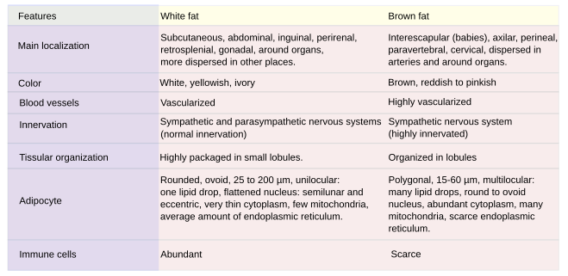
Main Differences Between White Fat and Brown Fat

Slide 28
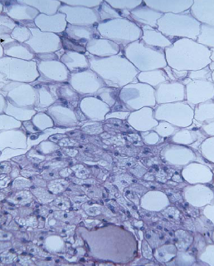
Unilocular
Multilocular
(Brown Fat)

Slide 29
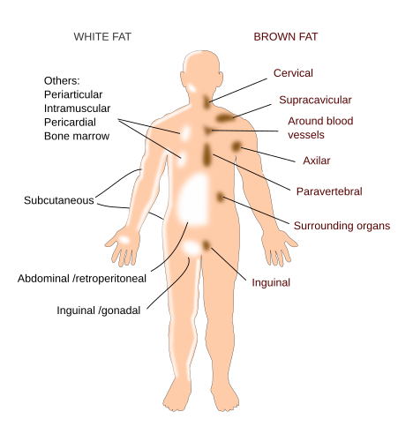
Distribution of White and Brown Fat in the Human Body

Slide 30
Distribution of Brown Fat in the Human Body
Figure 1. Location of hBAT.
in Adults,
(A) thyroid/tracheal,
(B), mediastinal,
(C) paracervical/ supraclavicular, (D) parathoracical,
(E) Supra and perirenal.
In the infant, also a kite-shaped thin layer of BAT has been described (in light brown).

Slide 31
Brown Fat in the Human Body
The primary function of BAT is to maintain core body temperature in response to cold stress by generating heat, a process known as thermogenesis.
BAT is unique in the sense that brown adipocytes can uncouple respiration from ATP synthesis. This is mediated by uncoupling protein 1 (ucp1), which is uniquely expressed by the mitochondrion-rich brown adipocyte.

Slide 32
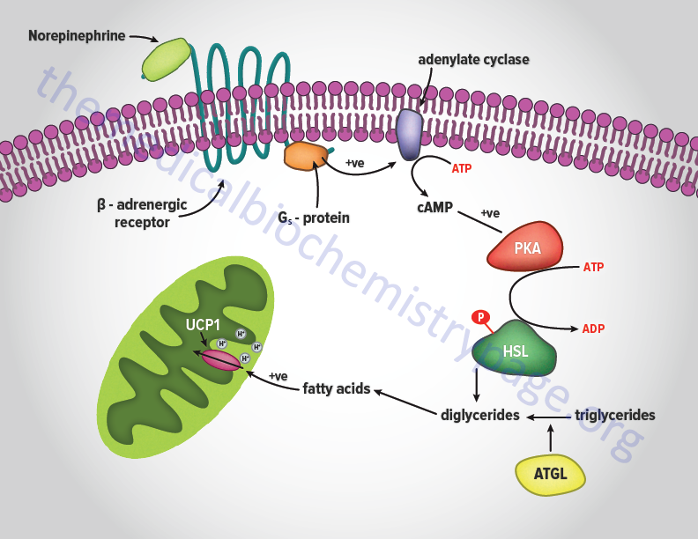
Regulation of lipolysis and thermogenesis in adipocytes by the sympathetic nervous system
Hormonal Generation of Heat in Brown Fat

Slide 33
Regulation of lipolysis and thermogenesis in adipocytes by the sympathetic nervous system
Noradrenaline (NA) released by sympathetic nerve endings binds to β-adrenoreceptors (β-ARs), which couple to Gα G-proteins that activate adenylate cyclase (AC), increasing the cellular concentration of cAMP.
This activates protein kinase A (PKA), which phosphorylates lipid droplet proteins including hormone-sensitive lipase (HSL), allowing activation of adipose triglyceride lipase (ATGL).
The net result is the hydrolysis of triglycerides stored in the lipid droplet to free fatty acids (FFAs), which are released.
This leads to increased expression of UCP1 and other thermogenic genes through the p38 MAPK cascade. FFAs released by lipolysis activate existing UCP1 in the mitochondria, and their oxidation produces heat.

Slide 34
Obesity and Adipose Tissue
Worldwide more than 1.9 billion adults are influenced by obesity, which represents a fast growing public health problem that contributes to higher mortality through an increase in hypertension, stroke, coronary heart disease, type 2 diabetes and some types of cancer.
Excess body fat is associated with dysfunctional metabolism, systemic inflammation characterized by elevated circulating concentrations of proinflammatory markers, and increased risks of type 2 diabetes (T2D) and cardiovascular problems.

Slide 35
Inflammation in Adipose Tissue
White adipose tissue is now well recognized as a highly active metabolic tissue and an important endocrine organ that plays a major role in balancing the homeostasis of our body.
Unfortunately, this balance is lost in obese individuals in whom the excessive expansion of adipose tissue gives rise to a chronic state of “low-grade” inflammation.

Slide 36
Inflammation in Adipose Tissue
The AT becomes dysfunctional in obesity, with a tendency towards overproduction of proinflammatory adipokines, and reduced production of anti-inflammatory and insulin-sensitizing adipokines such as adiponectin.
Moreover, enhanced fibrotic processes can worsen inflammation towards chronic irreversibility.
Hypoxia is another possible cause of AT inflammation in obesity, and has been proposed as an AT response that may be contributing to chronic inflammation.

Slide 37
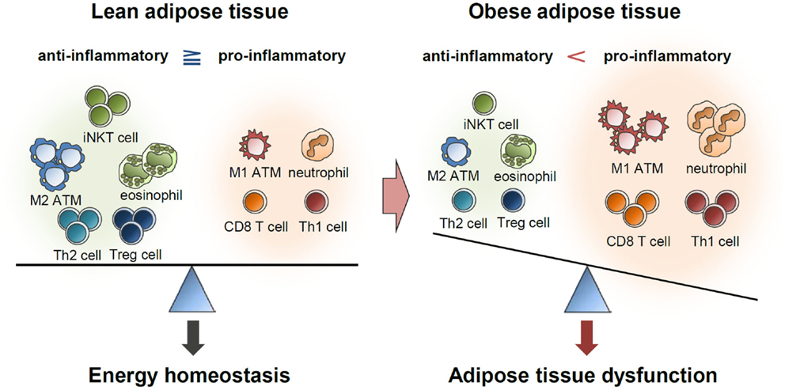

Slide 38
Pro- versus anti-inflammatory cytokines
Inflammation is characterized by an interplay between pro- and anti-inflammatory cytokines.
Cytokines are commonly classified in one or the other category: interleukin-1 (IL-1), tumor necrosis factor (TNF), gamma-interferon (IFN-gamma), IL-12, IL-18 and granulocyte-macrophage colony stimulating factor are well characterized as pro-inflammatory cytokines.
However, IL4, IL-10, IL-13, IFN-alpha and transforming growth factor-beta are recognized as anti-inflammatory cytokines.

Slide 39
Inflammation in Adipose Tissue
Pathological expansion of AT is characterized by changes in its blood flow, and the presence of enlarged and dysfunctional adipocytes that begin an inflammatory campaign of altered adipokine and cytokine secretions.
Adipocyte senescence, necrosis and death are associated with increased immune cell and macrophage infiltration of AT in obesity. This can boost inflammation and reinforce fat cell dysfunction and death.

Slide 40
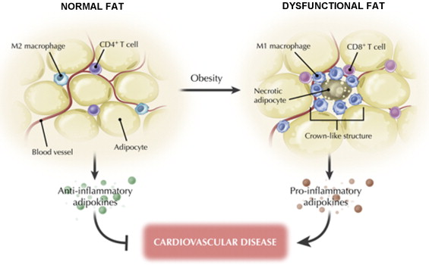
Adipose Tissue in Both Normal Physiology and Pathologic States

Slide 41
Inflammation in Adipose Tissue
When AT ceases to store lipids and energy efficiently, the lipid flux is directed towards non-adipose organs. This ectopic accumulation of lipids in cells other than adipocytes promotes a number of lipotoxic insults in those cells, thereby leading to insulin resistance, dyslipidaemia, apoptosis and inflammation.

Slide 42
Pro-inflammatory Cytokines and Adipose Tissue
mRNA expression studies show that adipocytes can synthesise both tumour necrosis factor α (TNF-α) and several interleukins (IL), notably IL-1β and IL-6.
There is general agreement that circulating TNF-α and IL-6 concentrations are mildly elevated in obesity while weight loss reduces plasma TNF-α and IL-6 concentrations.

Slide 43
Pro-inflammatory Cytokines and Adipose Tissue
TNF-α and IL-6 inhibit lipoprotein lipase, and TNF-α additionally stimulates hormone-sensitive lipase expression to increase lipolysis and induces uncoupling protein expression.
TNF-α also down regulates insulin-stimulated glucose uptake via effects on glucose transporter 4 (TNF-α can reduce expression of mRNA for glucose transporter 4), insulin receptor autophosphorylation and insulin receptor substrate-1.
All these effects will tend to reduce lipid accumulation within adipose tissue.

Slide 44
Pro-inflammatory Cytokines and Adipose Tissue
As the cells get bigger they produce more TNF-α, which in turn initiates changes to limit adipocyte size or to induce apoptosis.
TNF-α has been shown to regulate adipose tissue by (1) blocking differentiation of new adipocytes; (2) promoting de-differentiation of existing adipocytes or preadipocytes; (3) inducing apoptosis of adipocytes or preadipocytes.
TNF-α acts as a regulator of adipose tissue mass through its anti-adipogenic effects to reduce adiposity.

Slide 45
Pro-inflammatory Cytokines and Adipose Tissue
Insulin stimulates adipose tissue to produce more TNF-α, circulating TNF-α concentration tends to correlate with circulating insulinaemia.
Endotoxin from macrophages and monocytes induces TNF-α mRNA expression.
TNF-α is able to induce not only its own synthesis, but is also a powerful regulator of other cytokines, e.g. stimulating the production of IL-6.

Slide 46
Pro-inflammatory Cytokines and Adipose Tissue
systemically has significant effects on a variety of tissues, suppressingTNF-α, IL-6 injected appetite, increasing lipolysis and suppressing lipoprotein lipase. Additionally, it is a powerful regulator of the hypothalamus–pituitary–adrenal axis.
Injections of IL-6 can increase circulating concentrations of fatty acids, C-reactive protein and fibrinogen. IL-1 and IL-6 have anorectic effects on the brain and to induce gastric stasis.

Slide 47
Pro-inflammatory Cytokines and Adipose Tissue
IL-6 may have actions on the liver to stimulate the secretion of acute-phase proteins. IL-6 can also affect steroid hormone conversion, changing the balance of sex hormones, which is well known to regulate adipose tissue distribution.
Adipose tissue secretes into the general circulation several factors that might appear to be predominantly involved with immune functions. One example of this action is the secretion of complement components, some of which make adipsin, a component of adipocyte-stimulating protein.

Slide 48
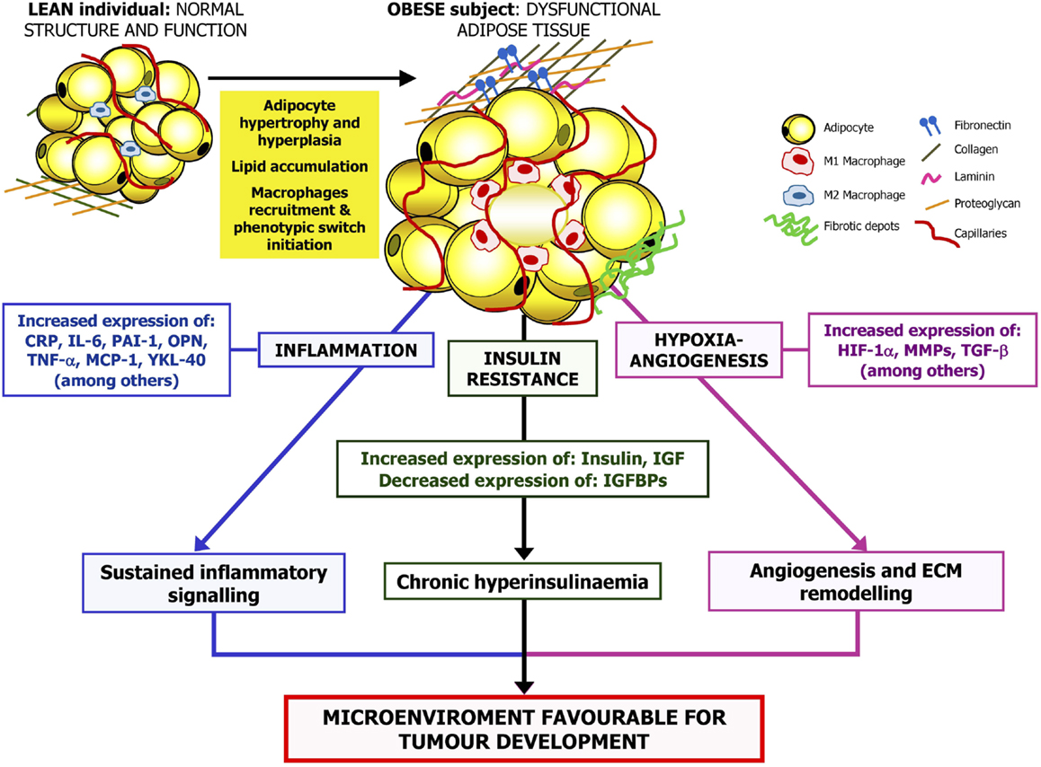

Slide 49
Adipose Tissue Expandability and PCOS
Insulin resistance is a key factor in the pathogenesis of PCOS phenotypes, as hyperinsulinemia increases ovarian androgen production and decreases hepatic sex hormone-binding globulin (SHBG) release, thereby leading to augmented levels of freely circulating androgens.
A higher level of serum IL-6 was found in PCOS patients.

Slide 50
Adipose Tissue Expandability and PCOS
Subcutaneous adipose tissue expresses significant levels of several sex steroid enzymes; the expression of testosterone synthesis enzymes was increased but that of dihydrotestosterone (DHT) and estrogen was decreased in PCOS patients; the expression of enzymes inactivating DHT and progesterone was increased.
Increased expression of leptin may be related to lower DHT synthesis and higher DHT inactivation in PCOS patients.

Slide 51
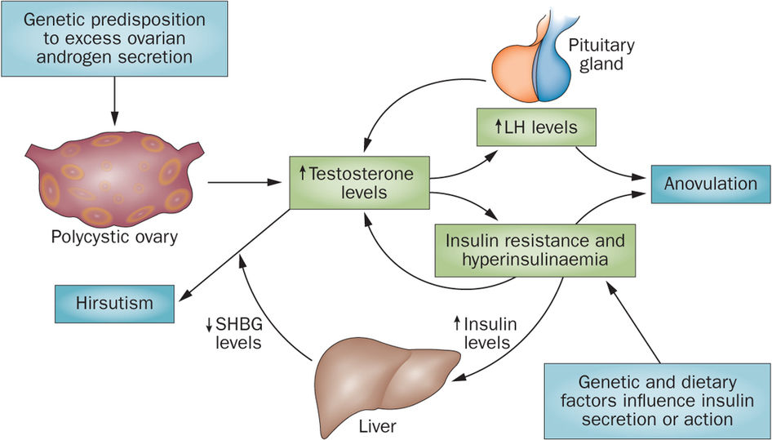
PCOS Pathology

Slide 52
The “adipose tissue expandability” Hypothesis
It proposed by Virtue and Vidal-Puig, when subcutaneous adipocytes start to be over- filled, a lipotoxic state emerges. Lipotoxicity is characterized by elevated free fatty acids, hypertriglyceridemia, an unfavorable adipocytokine profile [including low circulating levels of high molecular weight (HMW) adiponectin and high levels of interleukin-6 and tumor necrosis factor (TNF)-a] and by lipid deposition in non-subcutaneous AT and in non-adipose organs such as liver, muscle or pancreas. Lipotoxicity has adverse effects on metabolism, most notably on insulin action.

Slide 53
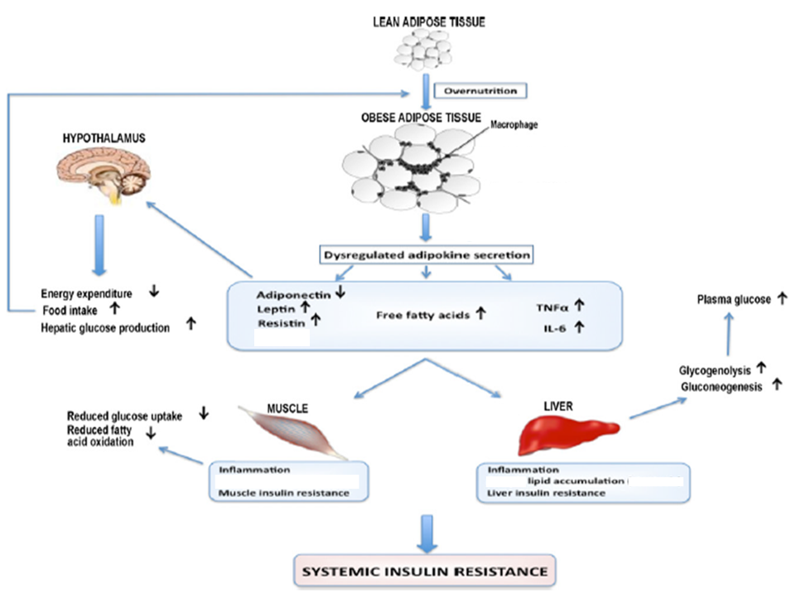

Slide 54
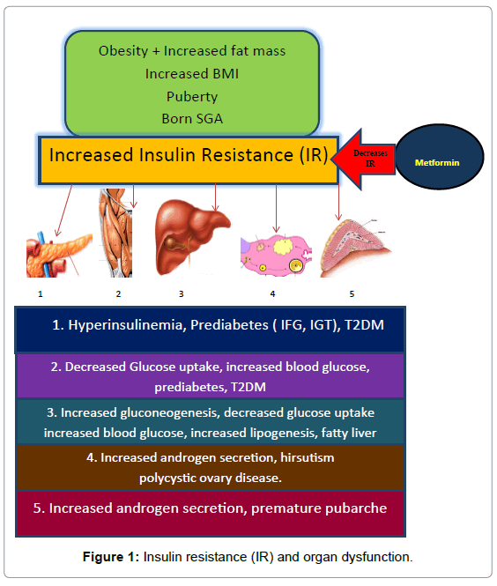

Slide 55
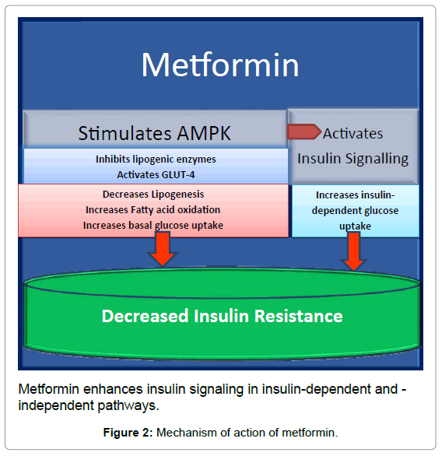

Slide 56


