Slide 1
The Actuarial Profession in the Insurance and Reinsurance Industry
Ahmad Alquraishi,
Saudi Re, CRO & Chief Actuary
ASA
King Saud University
8 February 2017-11 Jumada Al Awal 1438H

Slide 2
Agenda:
Saudi Re Profile
Saudi Insurance Market
Definition of An Actuary
Areas of Expertise
Who Employs Actuaries?
Examples of the role of Actuaries
Training and Qualifications
Attaining Associateship & Fellowship levels

Slide 3

Saudi Re Profile
1st
1st licensed reinsurance company in Saudi Arabia
+250
Clients
2008
Established in 2008 as a publicly listed company
70
Employees
1 billion
Paid up capital of SAR 1 billion(USD 267 M), the highest in MENA region
2
Head Office, Riyadh
Branch, KL Malaysia
BBB+
gcAA+
Rated BBB+ (Global) and gcAA+ (Regional) by Standard and Poor’s
+40
Serving clients in +40 countries in MENA, Asia and Africa

Slide 4
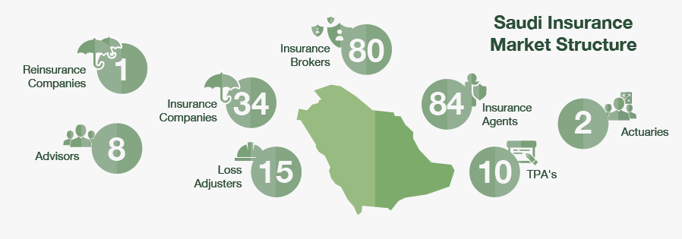
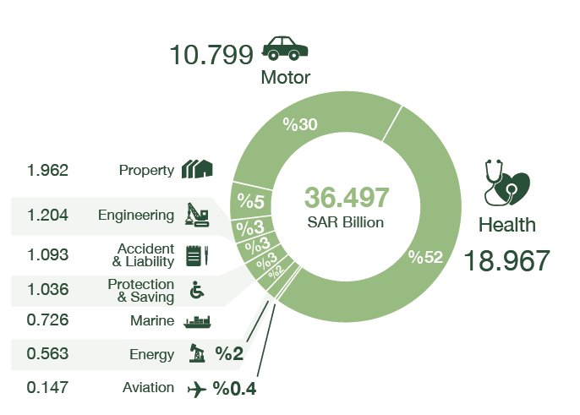
Saudi Insurance Market
Gross Written Premium (GWP)
SAR Billion
Lines of Business GWP, 2015 SAR Billion
Source: SAMA Market Reports

Slide 5
Definition of an Actuary
An Actuary is a business professional who deals with the financial impact of risk and uncertainty.
Actuaries provide expert assessments of financial security systems, with a focus on their complexity, their mathematics, and their mechanisms.
Actuaries evaluates the likelihood of future events.
Source: Be An Actuary.org

Slide 6
Areas of Expertise
Actuaries traditionally are specialized in life, health, property, and casualty insurance. But their skills and talents are transferable to any industry that requires risk modeling and management, including:
- Financial services, such as banking and investment management.
- Government institutions, Public Health and developing regulations and legislation.
- Risk management
- Accounting firms
Source: Be An Actuary.org

Slide 7
Who Employs Actuaries?
The following slides show the breakdown of the membership, in the US, of the Casualty Actuarial Society and the Society of Actuaries.

Slide 8
Who Employs Actuaries?
A. Casualty Actuarial Society
Source: Casualty Actuarial Society, December 2012

Slide 9
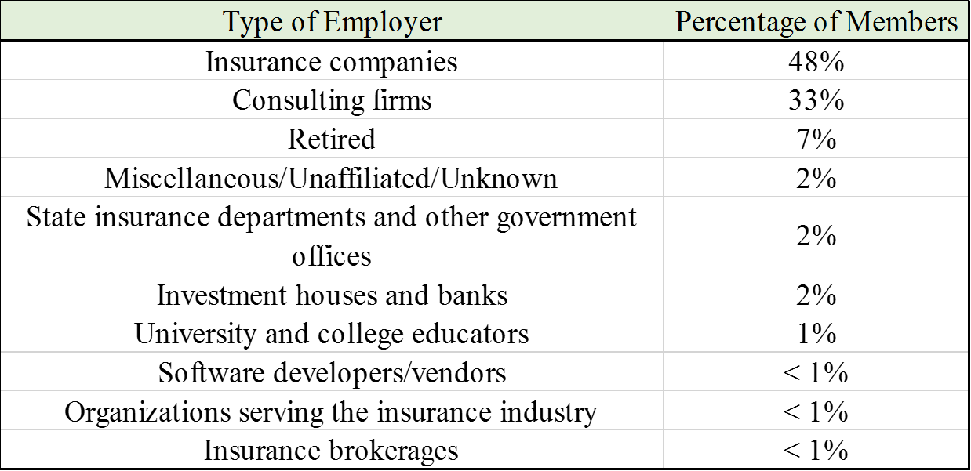
Who Employs Actuaries?
B. Society of Actuaries
Source: Society of Actuaries, April 2013

Slide 10
Examples of the role of Actuaries
Actuaries determine how much an insurance company should charge for motor insurance, medical expenses insurance or liability insurance.
Actuaries assist in developing life insurance products.
Actuaries assist governments in design, funding and regulatory aspects of pension plans (e.g. General Organization For Social Insurance & Public Pension Agency)
Actuaries assist governments in supervision of insurance industry (Saudi Arabian Monetary Authority).

Slide 11
Training and Qualifications
Actuaries need a strong background in mathematics, statistics, and general business.
To become a Qualified Actuary a series of exams should be passed. All Actuarial exams are written in English.
Professional societies sponsor programs leading to full professional status in their specialty. For example:
- In US, the Society of Actuaries (SOA) and the Casualty Actuarial Society (CAS).
-Institute and Faculty of Actuaries (U.K.)

Slide 12
Attaining Associateship & Fellowship levels
The process for gaining certification in these societies are similar.
To reach the first level of certification, the Associateship, a candidate must complete several exams, attend one course on professionalism and may complete a coursework or work’s experience. This process generally takes from 4 to 8 years.
The next level, the Fellowship, requires passing more additional exams in advanced topics. Most actuaries reach the fellowship level 2 to 3 years after attaining Associate status.

