Slide 1
Annuities – Part 2
Continuous Annuities + Varying annuities

Slide 2
Continuous Annuities
Is an annuities where payments are paid continuously .
Can payments be made continuously ?

Slide 3
Continuous Annuities
Is a theoretical tool , used as an approximation for annuities payable with great frequency (e.g daily ).

Slide 4

Continuous Annuities VS. Discrete Annuities
$a_{\overline{n}|}=P\frac{1−v^{n}}{i}$ ${ \overline{a}}_{\overline{n}|}=P\frac{1−e^{−δn}}{δ}=P\frac{1−v^{n}}{δ}$
$s_{\overline{n}|}=P\frac{(1+i)^{n}−1}{i}$ ${ \overline{s}}_{\overline{n}|}=P\frac{e^{δn}−1}{δ}$ REMEMBER:
$a_{\overline{∞ }|}=\frac{P}{i}$ ${ \overline{a}}_{\overline{∞ }|}=\frac{P}{δ}$ $δ=ln⁡(1+i)$

Slide 5

Example 1
The Annual Effective Interest Rate is 5% .Find the present value of an annuity of $25 per year payable continuously for 15 years.
$Try It For Yourself$

Slide 6
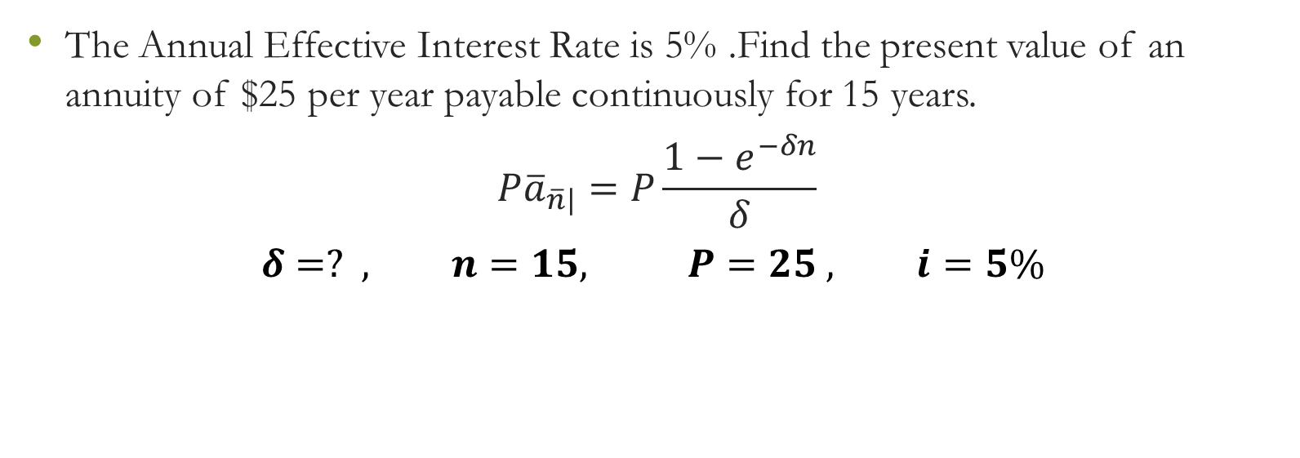
Example 1
The Annual Effective Interest Rate is 5% .Find the present value of an annuity of $25 per year payable continuously for 15 years.
$$P{\overline{a}}_{\overline{n}|}=P\frac{1−e^{−δn}}{δ}$$
$$δ=? , n=15, P=25 , i=5\%$$

Slide 7
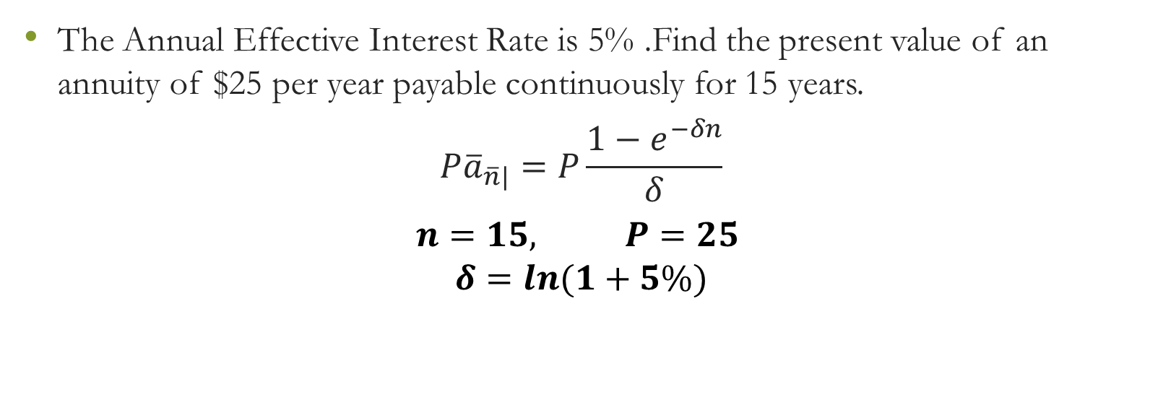
Example 1
The Annual Effective Interest Rate is 5% .Find the present value of an annuity of $25 per year payable continuously for 15 years.
$$P{\overline{a}}_{\overline{n}|}=P\frac{1−e^{−δn}}{δ}$$
$$n=15, P=25$$
$$δ=ln(1+5\%)$$

Slide 8
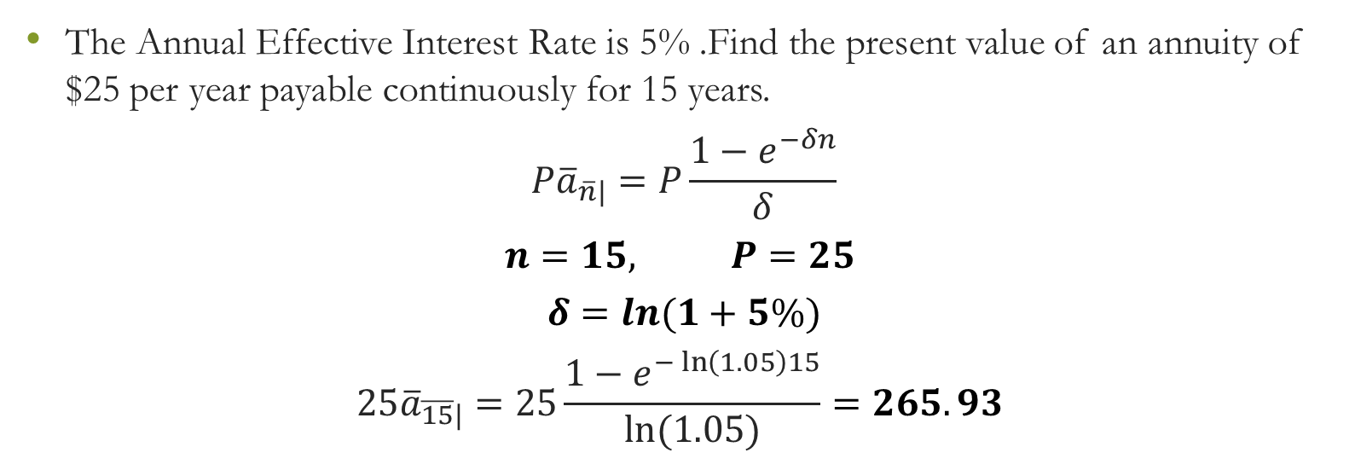
Example 1
The Annual Effective Interest Rate is 5% .Find the present value of an annuity of $25 per year payable continuously for 15 years.
$$P{\overline{a}}_{\overline{n}|}=P\frac{1−e^{−δn}}{δ}$$
$$n=15, P=25$$
$$δ=ln(1+5\%)$$
$$25{\overline{a}}_{\overline{15}|}=25\frac{1−e^{−\ln\left(1.05\right)15}}{ln⁡(1.05)}=265.93$$

Slide 9

Example 2
A ten year annuity pays $50 per year payable continuously. Given$δ=0.04$
Find the accumulated value at the end of ten years.
$$Try It For Yourself$$

Slide 10
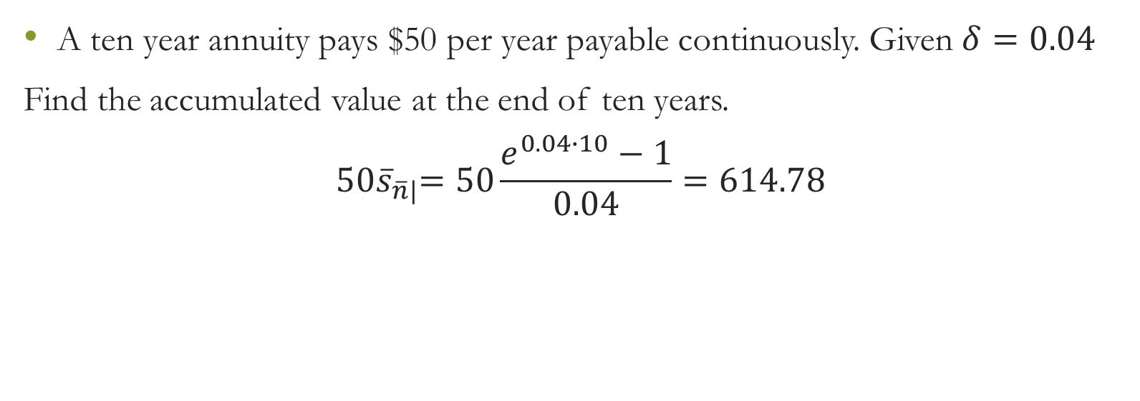
Example 2
A ten year annuity pays $50 per year payable continuously. Given$δ=0.04$
Find the accumulated value at the end of ten years.
$${ 50\overline{s}}_{\overline{n}|}=50\frac{e^{0.04∙10}−1}{0.04}=614.78$$

Slide 11

Relationship
Continuous Annuities and Discrete Annuities
$${\overline{a}}_{\overline{n}|}=\frac{i}{δ}{ a}_{\overline{n}|}$$
$${\overline{a}}_{\overline{n}|}=\frac{i}{δ}∙\frac{1−v^{n}}{i}$$

Slide 12
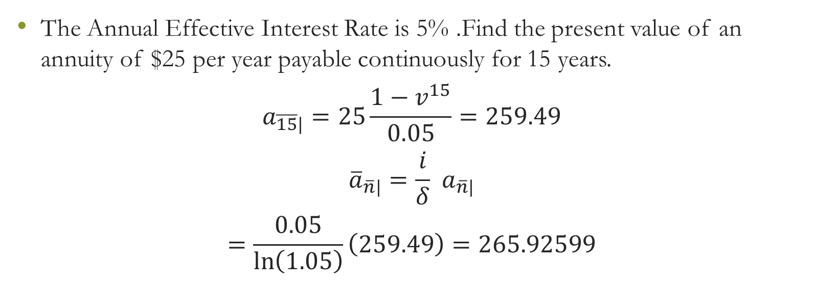
Example
The Annual Effective Interest Rate is 5% .Find the present value of an annuity of $25 per year payable continuously for 15 years.
$$a_{\overline{15}|}=25\frac{1−v^{15}}{0.05}=259.49$$
$${\overline{a}}_{\overline{n}|}=\frac{i}{δ}{ a}_{\overline{n}|}$$
$$=\frac{0.05}{\ln\left(1.05\right)}\left(259.49\right)=265.92599$$

Slide 13
Varying Annuities
Increasing Arithmetically
Decreasing Arithmetically
Increasing Geometrically
Decreasing Geometrically

Slide 14
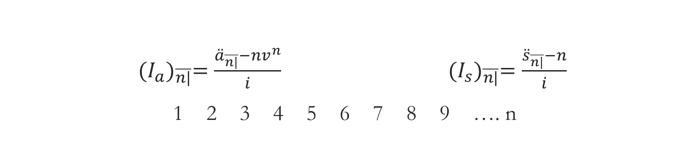
Increasing Arithmetically
${ (I_{a})}_{\overline{n|}}=\frac{{\ddot{a}}_{\overline{n|}}−nv^{n}}{i}$ ${(I_{s})}_{\overline{n|}}=\frac{{\ddot{s}}_{\overline{n|}}−n}{i}$
1 2 3 4 5 6 7 8 9 …. n
0 1 2 3 4 5 6 7 8 9 … n
$${ (I_{a})}_{\overline{∞|}}=\frac{1+i}{i^{2}}{ (I_{a})}_{\overline{∞|}}=\frac{1}{d^{2}}$$

Slide 15

Example
The Annual Effective Interest Rate is 5% .Find the present value of an of the payments 10 , 20, …,90 at times 1,2,…,9 respectively .
$$Try It For Yourself$$

Slide 16

Example 1
The Annual Effective Interest Rate is 5% .Find the present value of an of the payments 10 , 20, …,90 at times 1,2,…,9 respectively .
$$I_{\overline{n|}}=10\frac{{\ddot{a}}_{\overline{9|}}−9v^{9}}{0.05}=332.35$$

Slide 17
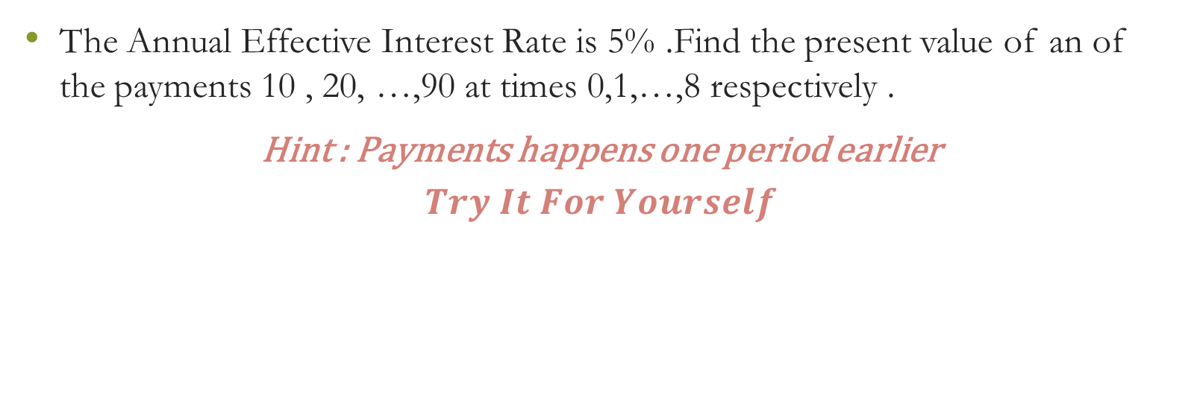
Example 2
The Annual Effective Interest Rate is 5% .Find the present value of an of the payments 10 , 20, …,90 at times 0,1,…,8 respectively .
Hint : Payments happens one period earlier
$$Try It For Yourself$$

Slide 18
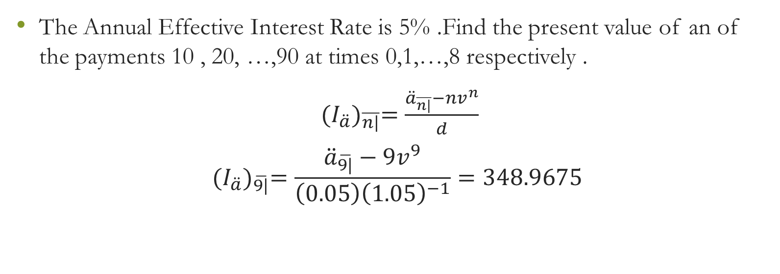
Example 2
The Annual Effective Interest Rate is 5% .Find the present value of an of the payments 10 , 20, …,90 at times 0,1,…,8 respectively .
${ (I_{\ddot{a}})}_{\overline{n|}}=\frac{{\ddot{a}}_{\overline{n|}}−nv^{n}}{d}$
$${ (I_{\ddot{a}})}_{\overline{9|}}=\frac{{\ddot{a}}_{\overline{9|}}−9v^{9}}{\left(0.05\right){\left(1.05\right)}^{−1}}=348.9675$$

Slide 19

Example 3
The Annual Effective Interest Rate is 5% .Find the present value of a perpetuity of the payments 10 , 20, …at times 1,2,…respectively .
$$Try It For Yourself$$

Slide 20
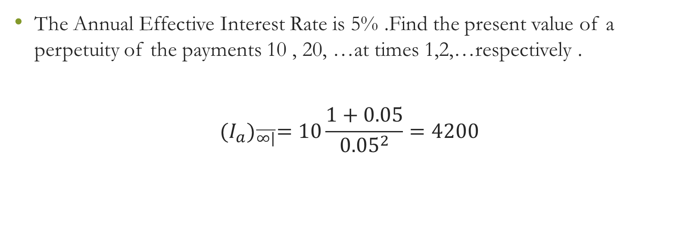
Example 3
The Annual Effective Interest Rate is 5% .Find the present value of a perpetuity of the payments 10 , 20, …at times 1,2,…respectively .
$${ (I_{a})}_{\overline{∞|}}=10\frac{1+0.05}{{0.05}^{2}}=4200$$

Slide 21
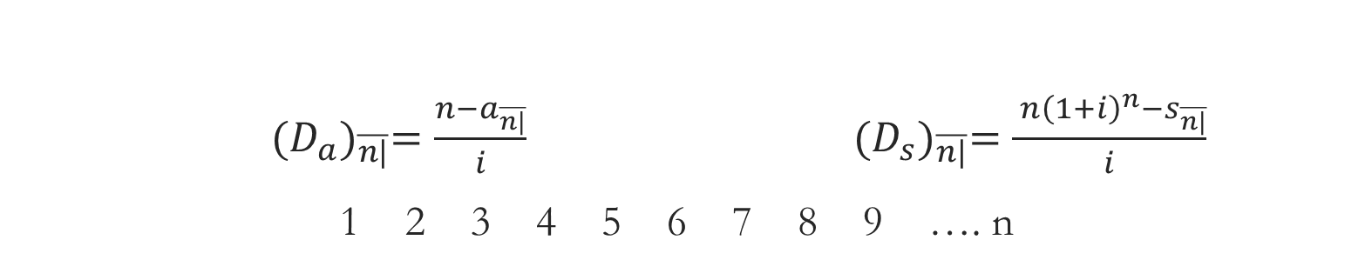
Decreasing Arithmetically
${ (D_{a})}_{\overline{n|}}=\frac{n−a_{\overline{n|}}}{i}$ ${(D_{s})}_{\overline{n|}}=\frac{ n{\left(1+i\right)}^{n}−s_{\overline{n|}}}{i}$
1 2 3 4 5 6 7 8 9 …. n
0 1 2 3 4 5 6 7 8 9 … n
$${ (I_{a})}_{\overline{∞|}}=\frac{1+i}{i^{2}}{ (I_{a})}_{\overline{∞|}}=\frac{1}{d^{2}}$$

Slide 22
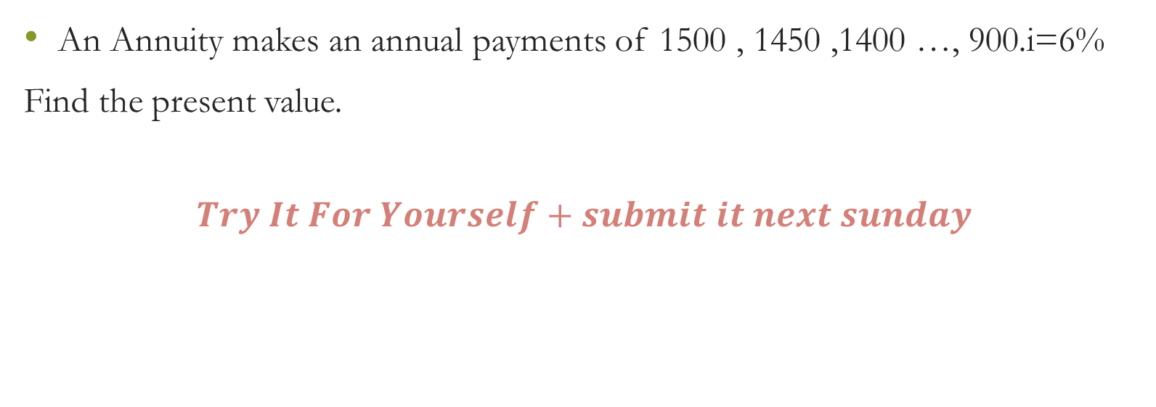
Example - HW
An Annuity makes an annual payments of 1500 , 1450 ,1400 …, 900.i=6%
Find the present value.
$$Try It For Yourself+submit it next sunday$$

Slide 23
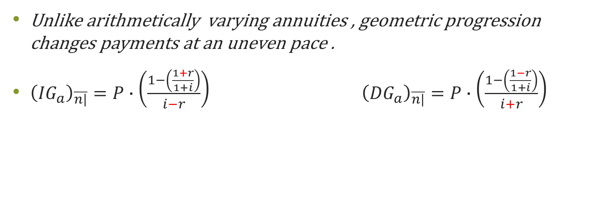
Increasing Geometrically
Decreasing Geometrically
Unlike arithmetically varying annuities , geometric progression changes payments at an uneven pace .
${\left({IG}_{a}\right)}_{\overline{n|}}=P∙\left(\frac{1−\left(\frac{1+r}{1+i}\right)}{i−r}\right) {\left({DG}_{a}\right)}_{\overline{n|}}=P∙\left(\frac{1−\left(\frac{1−r}{1+i}\right)}{i+r}\right)$
First payment
First payment

Slide 24
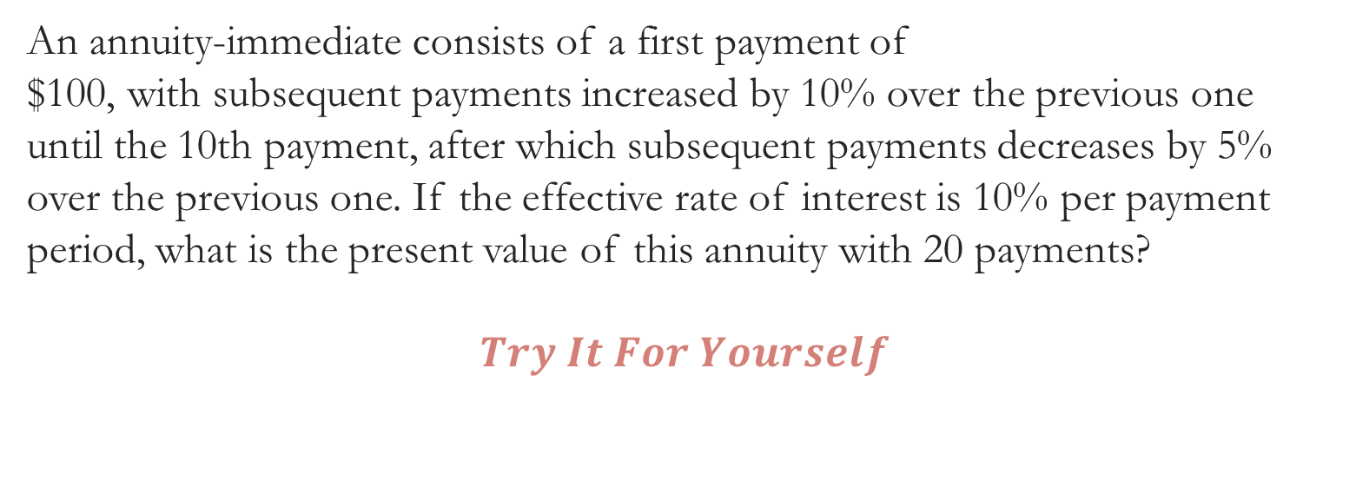
Example
An annuity-immediate consists of a first payment of
$100, with subsequent payments increased by 10% over the previous one
until the 10th payment, after which subsequent payments decreases by 5%
over the previous one. If the effective rate of interest is 10% per payment
period, what is the present value of this annuity with 20 payments?
$$Try It For Yourself$$

Slide 25
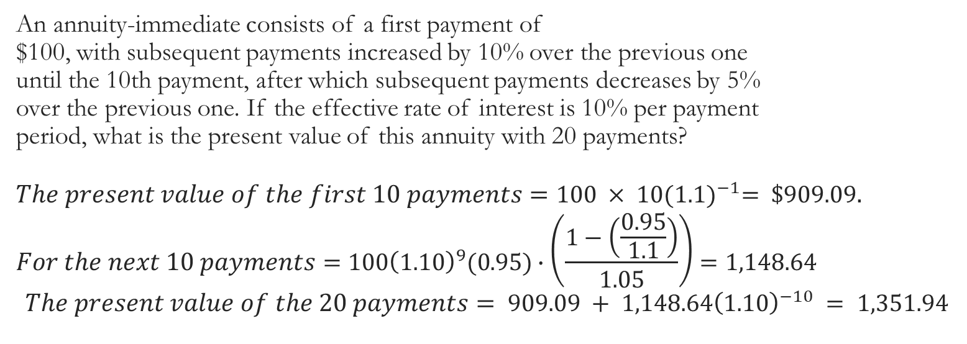
Example
An annuity-immediate consists of a first payment of
$100, with subsequent payments increased by 10% over the previous one
until the 10th payment, after which subsequent payments decreases by 5%
over the previous one. If the effective rate of interest is 10% per payment
period, what is the present value of this annuity with 20 payments?
$$The present value of the first 10 payments=100 × 10{(1.1)}^{−1}= \$909.09.$$
$$For the next 10 payments=100{\left(1.10\right)}^{9}(0.95)∙\left(\frac{1−\left(\frac{0.95}{1.1}\right)}{1.05}\right)=1,148.64$$
$$The present value of the 20 payments= 909.09 + 1,148.64{\left(1.10\right)}^{−10} = 1,351.94$$

