Slide 1
Basic Local Alignment Search Tool (BLAST)

Slide 2
BLAST
In bioinformatics, Basic Local Alignment Search Tool, or BLAST: is an algorithm for comparing primary biological sequence information, such as the amino-acid sequences of different proteins or the nucleotides of DNA sequences.
The BLAST program was designed by Stephen Altschul, Warren Gish, Webb Miller, Eugene Myers, and David J. Lipman at the NIH and was published in the Journal of Molecular Biology in 1990.
Notes:
Algorithm in computers means step by step set of operations

Slide 3
BLAST
A BLAST search enables a researcher to compare a query sequence with a library or database of sequences, and identify library sequences that resemble the query sequence above a certain threshold.
Different types of BLASTs are available according to the query sequences. For example, following the discovery of a previously unknown gene in the mouse, a scientist will typically perform a BLAST search of the human genome to see if humans carry a similar gene; BLAST will identify sequences in the human genome that resemble the mouse gene based on similarity of sequence.

Slide 4
TYPES OF BLAST ALGORITHM
Program Input Query search Database
1
blastn DNA DNA
1
blastp protein protein
6
blastx DNA protein
6
tblastn protein DNA
36
tblastx DNA DNA

Slide 5
Types of blast
Nature | Program | Query | Database
Nucleotide BLAST | blastn | Nucleotide (DNA, RNA) | Nucleotide (DNA, RNA)
Protein BLAST | blastp | Protein | Protein
Mixed BLAST | blastx | Translated nucleotide | Protein
 | tblastn | Protein | Translated nucleotide
 | tblastx | Translated nucleotide | Translated nucleotide

Slide 6
What is BLAST used for?
(1) Searching the databases.
You have a new isolated sequence but you do not know what it is?!
You want to know its name and/or function.
By searching databases for homology with others, thus you can get an idea about the name and function of your new gene or protein.
(2) Performing pairwise alignment.
(3) Designing PCR primers
(4) Checking your PCR primers for specificity

Slide 7
Imagine the problem
Databases now holds 100 millions of sequences.
If one optimal pairwise alignment took 1 second, then we need 3 years to search.
Basic Local Alignment Search Tool (BLAST) compare a query sequence to the entire database in a matter of seconds

Slide 8
How BLAST works
Query
split
seeding into database
Local alignment (Smith-Waterman algorithm)
No
Yes, Good Local Alignment (good scoring match)
Extend Local alignment in both directions
Excluded
Pass a threshold
Yes (High-Scoring Pair (HSP))
No
Order by e-value
Excluded

Slide 9
BLAST heuristic algorithm
Seeding the databases:
Searching the database with only this word.
Local alignment
Find good alignment (hit)
Extend in both directions
Find total scoring match.
Passing a threshold (High-Scoring Pair (HSP)).
Order by e-value.

Slide 10
Seeding & Splitting
Query sequence
BIOCHEMISTRYDEPARTMENTCOLLEGEOFSCIENCEKINGSAUDUNI
Split the query sequence into smaller short sequences called “words” or k-tuples
In this example, k=3. Meaning splitting every three letters

Slide 11
K-tuples
Query sequence
BIOCHEMISTRYDEPARTMENTCOLLEGEOFSCIENCEKINGSAUDUNI
1st tuple | BIO
2nd tuple | IOC
3rd tuple | OCH
4th tuple | CHE
5th tuple | HEM
………… | ……...
28th tuple | LEG
end^{th} tuple | ……..

Slide 12
BLAST heuristic algorithm (cont’ed)

Sequence A in database
THISISANEWLINETHATISNOTINTHELEGOFTHISPAPER
LEG

Sequence B in database
THATISNOTWHATYOUIMAGICOLLEGHJADMNJKSAAASLK
ARTMEN---TC-LLEG—-AD-NIC--A

Sequence C in database
ANOTHERNEWIDEAHEREARTMENTCOLLEGEOFSCIENCEK
ARTMENTCOLLEGEOFSCIENCEK
Threshold = 17
High-Scoring Pair (HSP)
Threshold = 10 for alignment in seq B
Threshold = 23 for alignment in seq C
So, seq C is selected (good hit)

Slide 13
Important notes
Any local alignment that passes the threshold is called high-scoring pair (HSP).
Decreasing the word size (K-tuple) to a low value, allows the identification of sequences that matches less well.
Thus, allowing the identification of similar genes when the sequences of the query sequences is showing weak similarity to the hit results.

Slide 14
What is expected (e)-value?
This setting specifies the statistical significance threshold for reporting matches against database sequences.
It is the number of hits one can "expect" to see by chance when searching a database of a particular size.
E value of 1 means one might expect to see 1 match with a similar score simply by chance.
The lower the E-value, or the closer it is to zero, the more "significant" the match is.

Slide 15
Which Value for Your E-Values ?
Low E-value ⬄ good hit
1 = bad e-Value
10^{e-3} = borderline E-value
10^{e-4} = good E-value
10^{e-10} = very good E-value
E-values lower than 10^{e-4} indicate possible homology
E-values higher than 10^{e-4} require extra evidence to support homology

Slide 16
In conclusion
The quality of the alignment is given by the Score (S).
The significance of the alignment is given by the expected E-value.
The smaller the e-value (the larger its negative exponents), the more significant is the score.

Slide 17
How to go to BLAST

Slide 18
OR

Slide 19
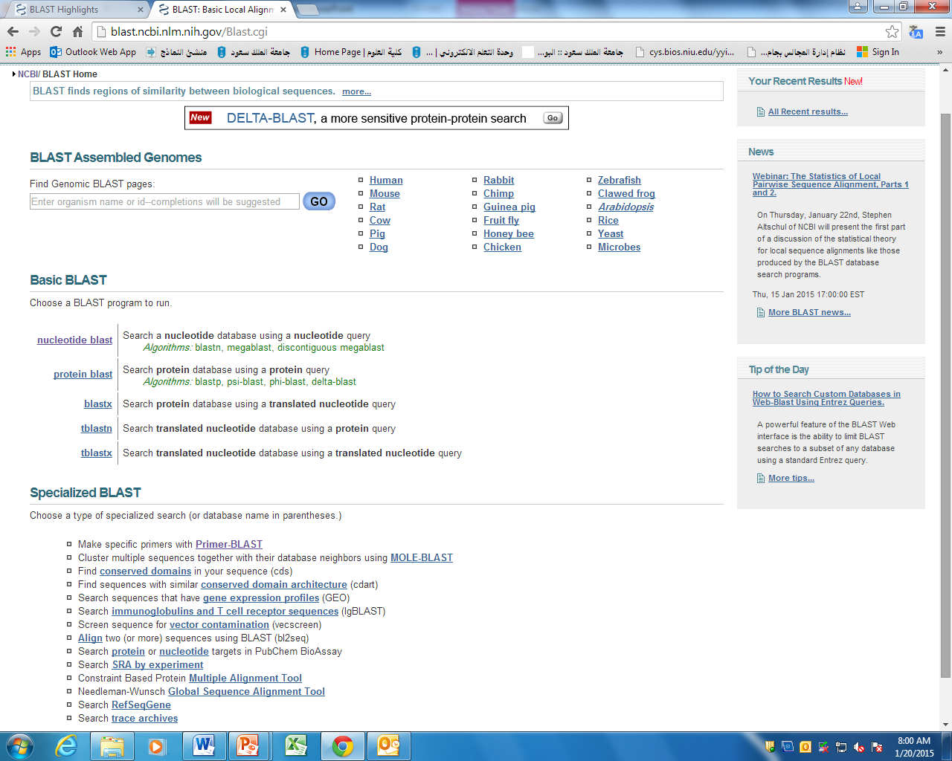
BLAST

Slide 20
Sections within BLAST

Slide 21
Nucleotide blast
Tick if you want to align only two seq
We will use only blastn
Paste your sequence as fasta only. Or paste AC
Or upload your file if it is too big
Select which organism you want to search its database
Default non-redundant nucleotide seq
Tick here to exclude the database that you entered
Enter the name of the database that you want to only search or exclude it
Select other options to find any week similarity
Click here to submit your job
Click here to access other options

Slide 22
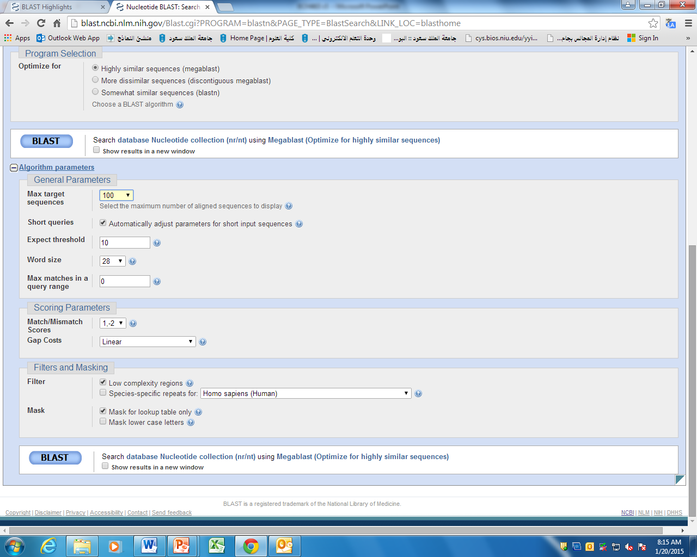
Algorithm parameters

Slide 23
Algorithm parameters

Slide 24
Algorithm parameters

Slide 25
Algorithm parameters

Slide 26
Algorithm parameters

Slide 27
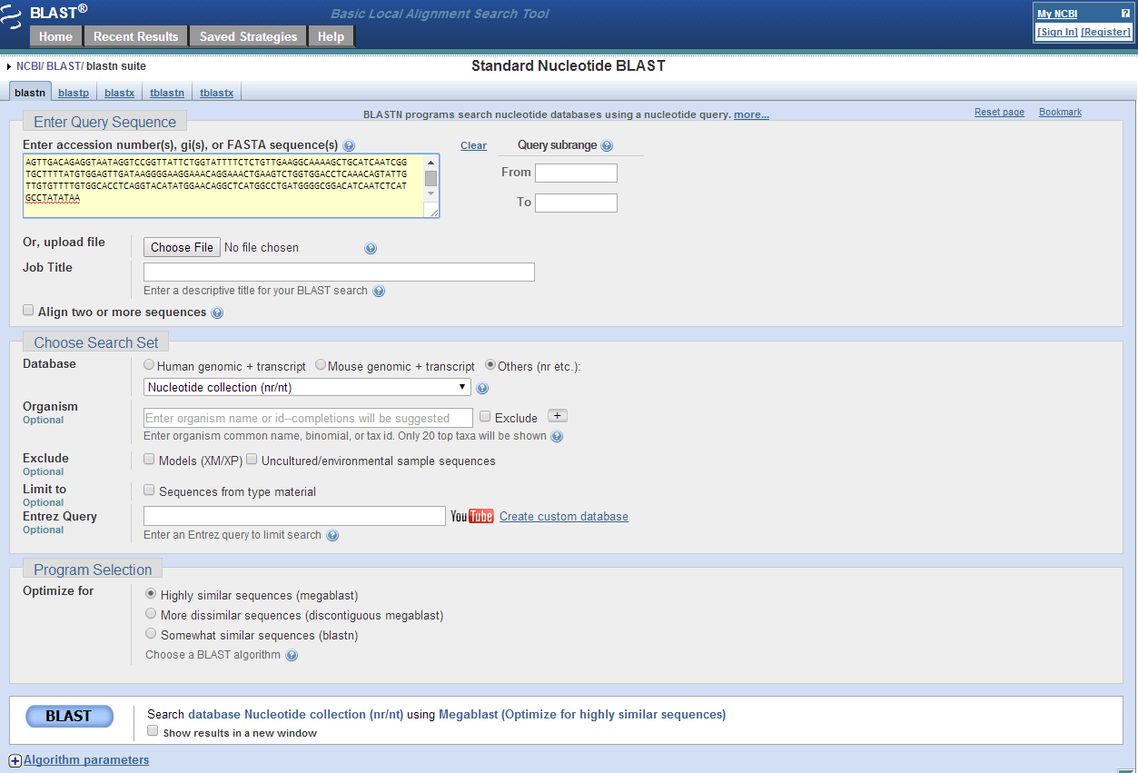
Blast search
Input sequences (in FASTA or Genbank format) and weight

Slide 28
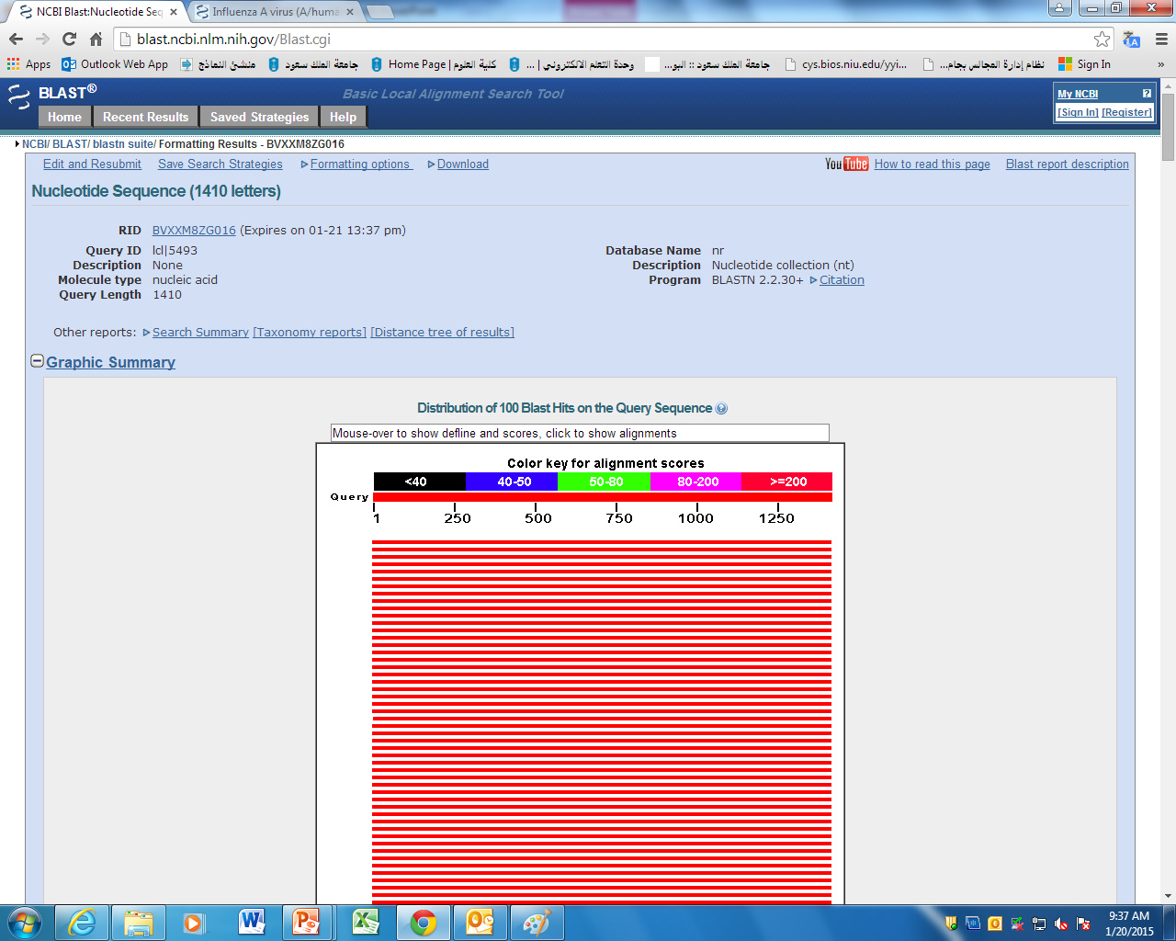
BLAST result
Note the color is coded with similarity

Slide 29
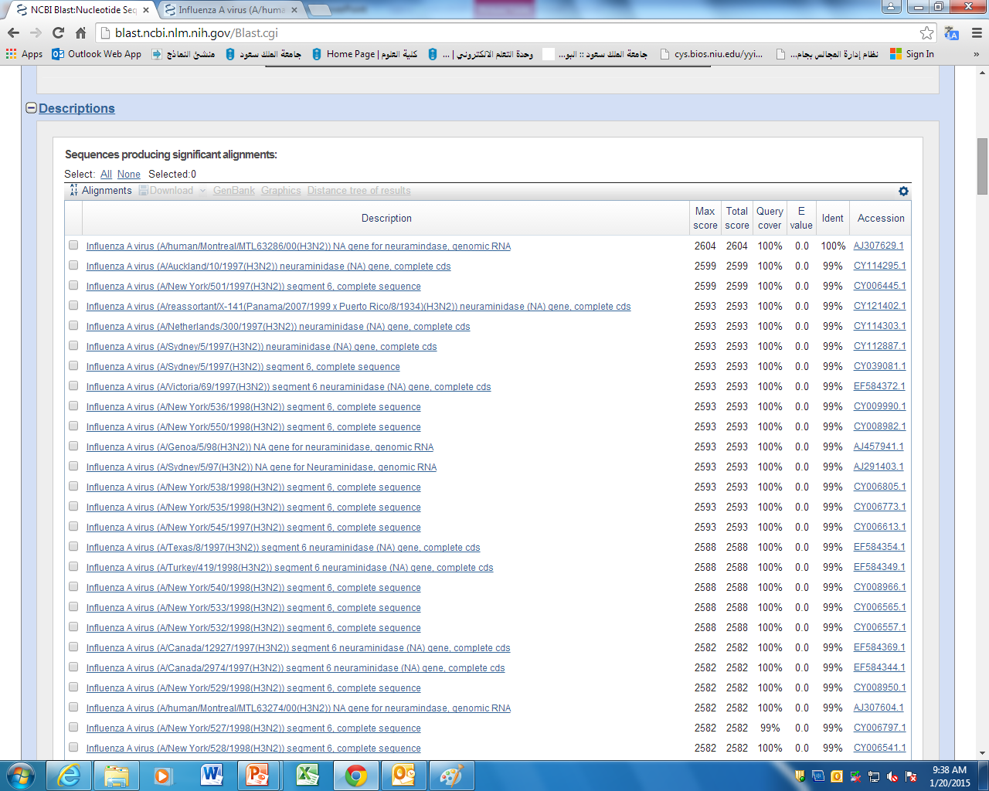
2nd part of result

Slide 30
Reading the results

Slide 31
Reading the results (2)
This is score given but sometimes the alignment is with different segments of the same sequence

Slide 32
Max & Total Scores & HSP
Single hit (HSP). So, one max and total score identical
One HSP
Multiple hits (HSPs). Each has its own max score. But one total score
One HSP
One HSP
One HSP
The High-scoring Segment Pair (HSP): is the fundamental unit of BLAST algorithm output. An HSP consists of two sequence fragments of arbitrary but equal length whose alignment is locally maximal and for which the alignment score meets or exceeds a threshold or cutoff score.

Slide 33
Reading the results (2)
Percentage the coverage of the query to the result
Click here to got o the GenBank page of that gene/RNA/protein.

Slide 34
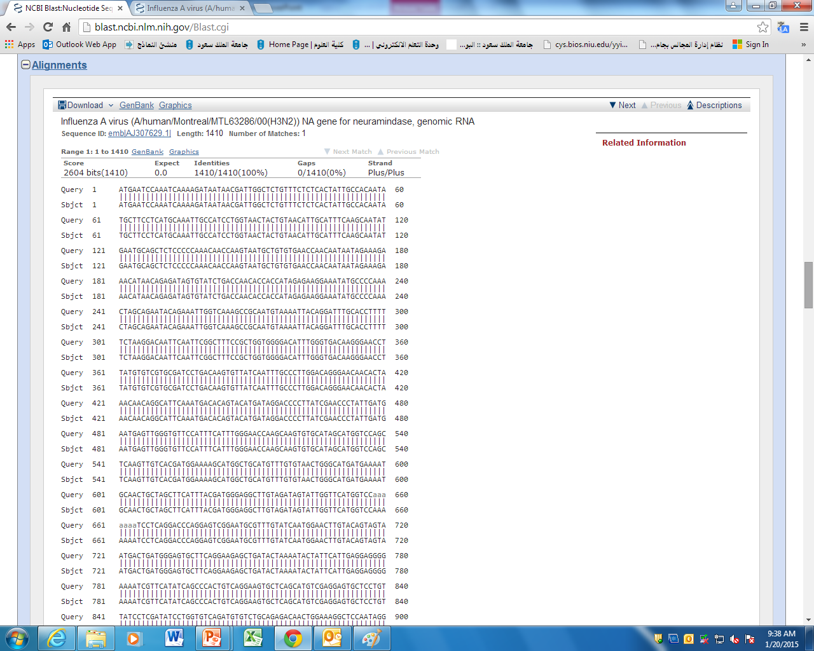
3rd part of result

Slide 35
Understanding the results (3)
Click here to get the GenBank page of that gene/RNA/protein.

Slide 36
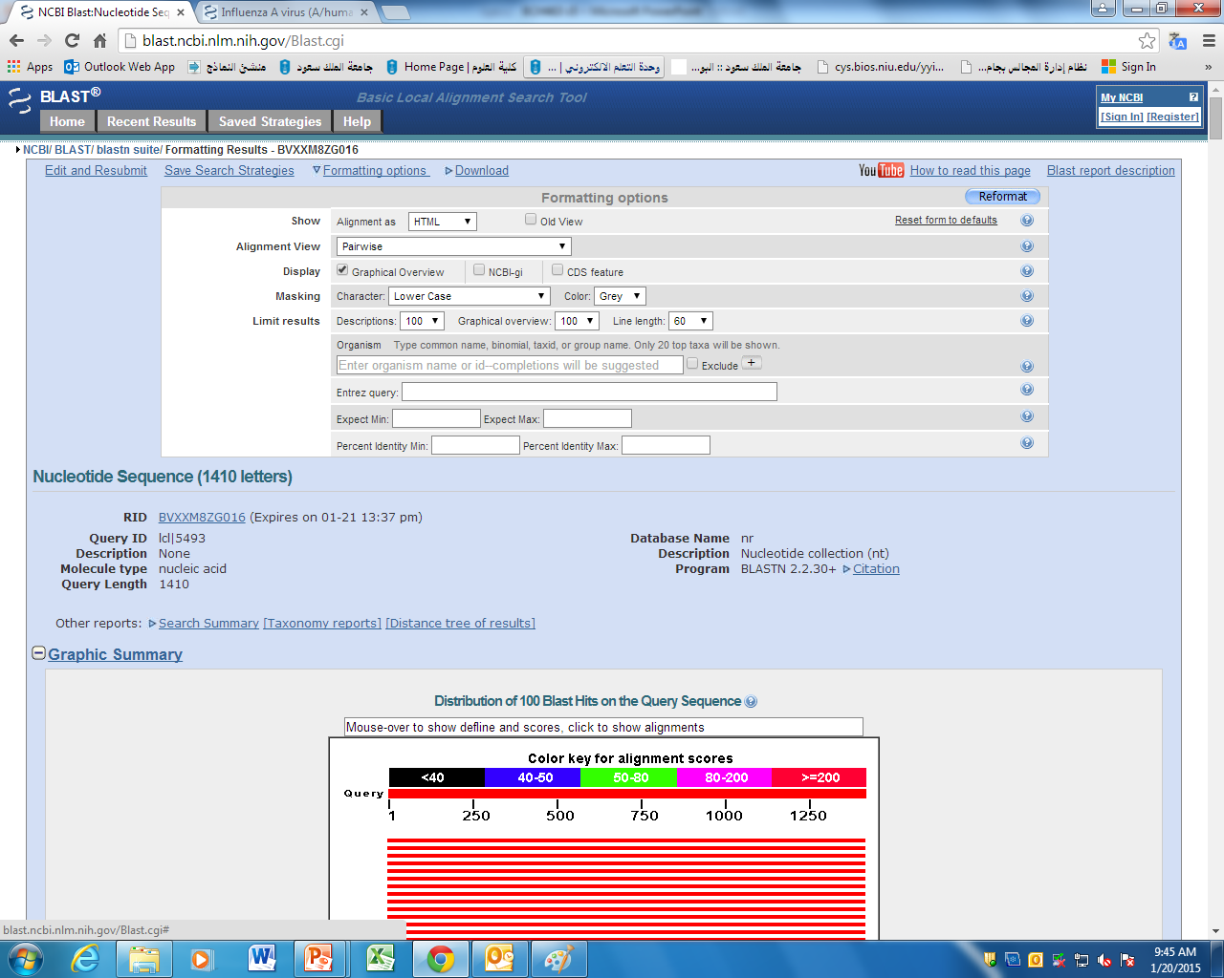
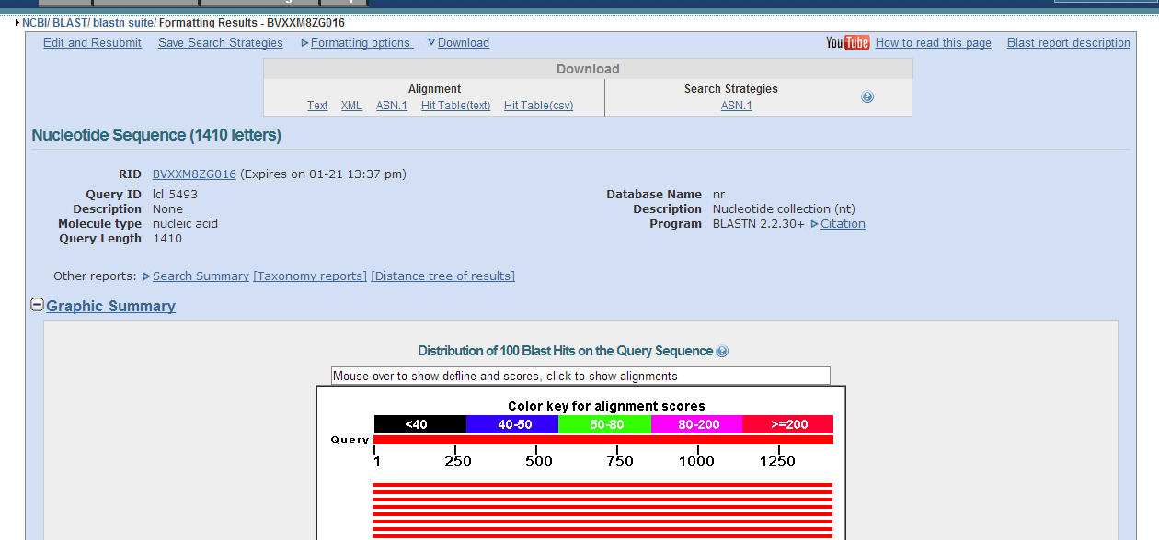
Manage & Download results
Formatting options to change what you see
Download xml file and open with excel as read only file

Slide 37
Aligning two sequences
Tick if you want to align only two seq
Click here to submit your job

Slide 38
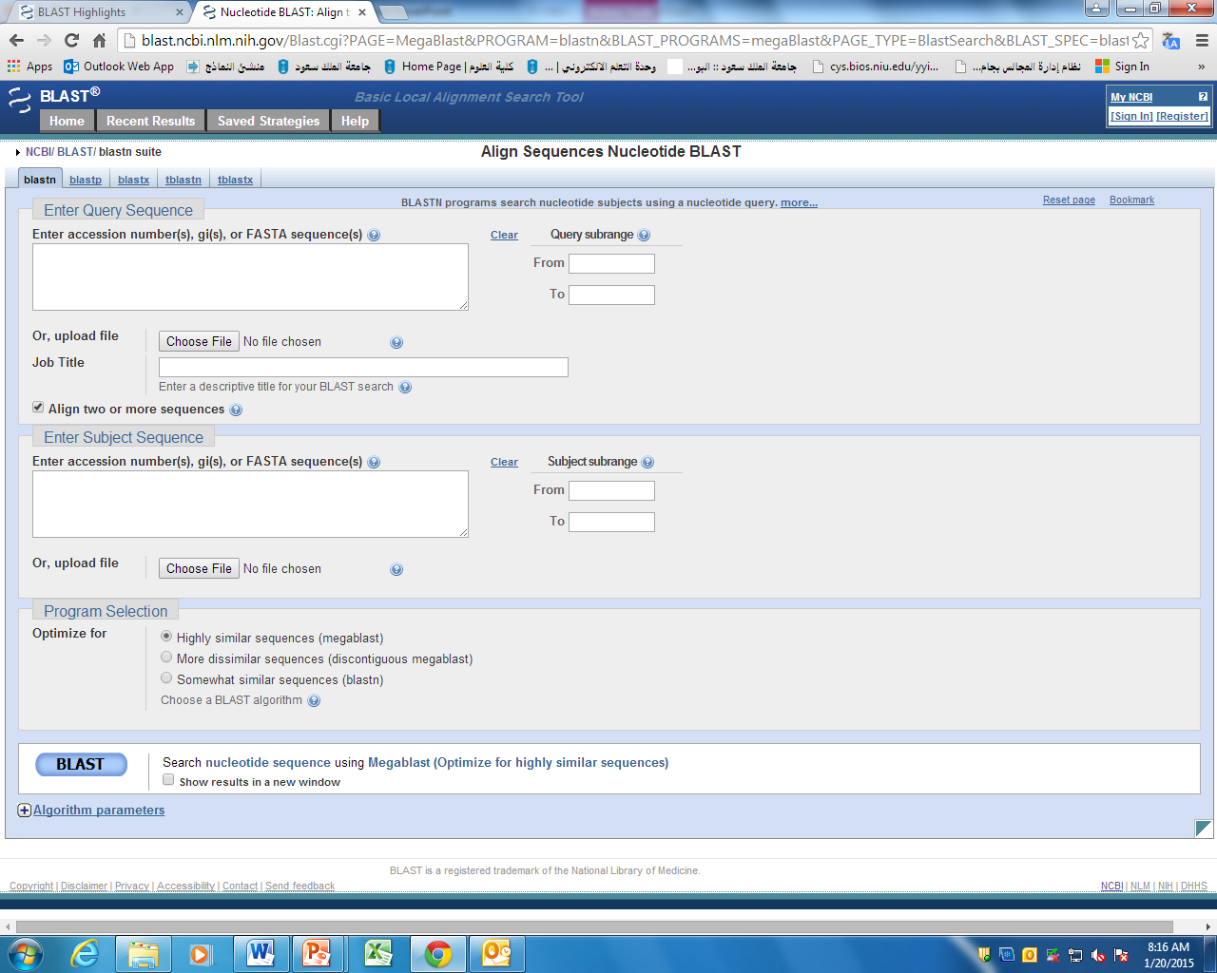
Aligning two sequences

