Slide 1


Slide 2
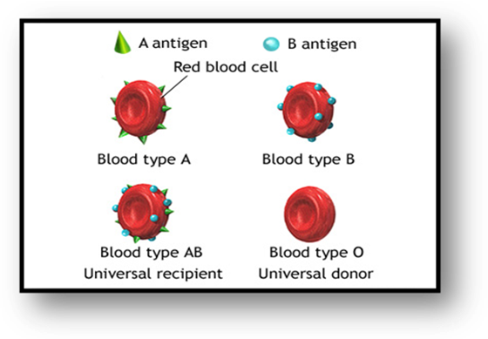
Prepared by:
Nouf khalid AL-Sultan
Blood group

Slide 3
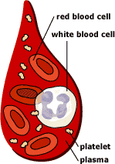
What is blood made up of ?
The red blood cells (RBCs).
The white blood cells .
The platelets .
The plasma .
The average adult has about FIVE liters of blood inside of their body, which makes up 7-8% of their body weight.

Slide 4
What makes up our blood?
RED BLOOD CELLS (Erythrocytes) –They are produced in the bone marrow and contain a protein called hemoglobin that carries oxygen to our cells.
WHITE BLOOD CELLS (Leukocytes) – They are part of the immune system and destroy infectious agents called pathogens.
PLASMA – This is the yellowish liquid portion of blood that contains, nutrients and vitamins, hormones, clotting factors, and proteins such as antibodies to fight infection.
PLATELETS (Thrombocytes) – The clotting factors that are carried in the plasma; they clot together in a process called coagulation to seal a wound and prevent a loss of blood.

Slide 5

What are the different blood groups?
In humans , about 15 major blood group systems have been recognized.
The differences in human blood are due to the presence or absence of certain protein molecules called antigens and antibodies.
The antigens are located on the surface of the red blood cells and the antibodies are in the blood plasma.
Individuals have different types and combinations of these molecules. The blood group you belong to depends on what you have inherited from your parents.

Slide 6
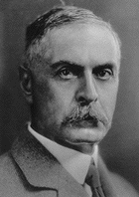
The ABO System
Discovered in 1901 by Dr. Karl Landsteiner.
4 Main Phenotypes (A, B, AB, O)
ABO gene located on long arm of chromosome 9 .
Noble Laureate Karl Landsteiner was involved in the discovery of both the AB0 and Rh blood groups.

Slide 7

Genetics of Blood Types
Your blood type is established before you are Born, by specific Genes inherited from your parents.
You inherit one gene from your Mother and one from your Father.
These genes determine your blood type.

Slide 8
AUTOSOMAL CHROMOSOME
The alleles for Blood group are in the same place on the chromosome 9. However the genes have a different code giving the different blood group
A,B,O
A
B
Khaled
Yara
one alleles from Khaled and one from Yara.

Slide 9
Inheritance of ABO Groups
Allele from
the mother
Allele from
the father
Genotype of
offspring
Blood types of
offspring
A
A
AA
A
A
B
AB
AB
A
O
AO
A
B
A
AB
AB
B
B
BB
B
B
O
BO
B
O
O
OO
O

Slide 10


AB0 blood grouping system
According to the AB0 blood group system there are four different kinds of blood groups: A, B, AB or O
Blood group A
If you belong to the blood group A, you have A antigens on the surface of your red blood cells and B antibodies in your blood plasma.
Blood group B
If you belong to the blood group B, you have B antigens on the surface of your red blood cells and A antibodies in your blood plasma.

Slide 11


Blood group AB
If you belong to the blood group AB, you have both A and B antigens on the surface of your red blood cells and no A or B antibodies at all in your blood plasma.
Blood group O
If you belong to the blood group 0 , you have neither A or B antigens on the surface of your red blood cells but you have both A and B antibodies in your blood plasma.

Slide 12
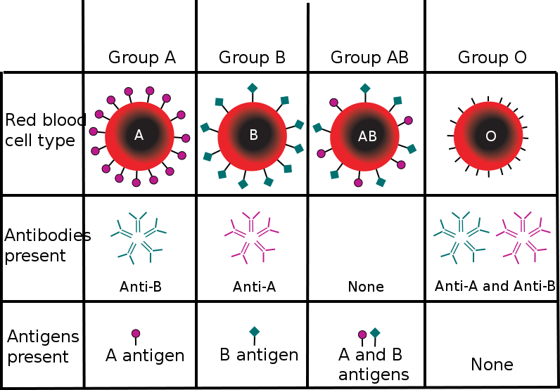

Slide 13
Do you know which blood group you belong to?

Slide 14
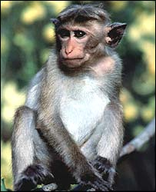
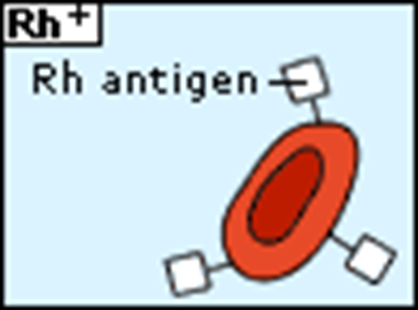
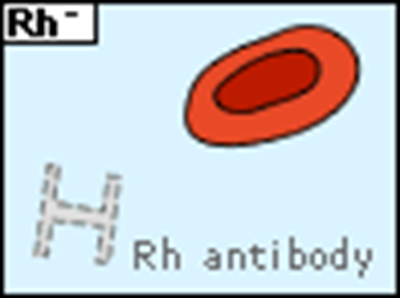
Rh Factors
Scientists sometimes study Rhesus monkeys to learn more about the human anatomy because there are certain similarities between the two species. While studying Rhesus monkeys, a certain blood protein was discovered. This protein is also present in the blood of some people.
Other people, however, do not have the protein.
The presence of the protein, or lack of it, is referred to as the Rh (for Rhesus) factor.
This is also an antigen and those who have it are called Rh positive (Rh+). Those who haven't are called Rh negative (Rh-).
A person with Rh- blood does not have Rh antibodies naturally in the blood plasma.

Slide 15
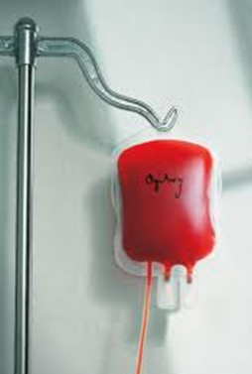
Blood Transfusions
A blood transfusion is a procedure in which blood is given to a patient through an intravenous (IV) line in one of the blood vessels. Blood transfusions are done to replace blood lost during surgery or a serious injury. A transfusion also may be done if a person’s body can't make blood properly because of an illness.
Universal Donor
Who can give you blood?
People with TYPE O blood are called Universal Donors, because they can give blood to any blood type.
People with TYPE AB blood are called Universal Recipients, because they can receive any blood type.
Rh + → Can receive + or -
Rh - → Can only receive -
O
A
B
AB
Universal Recipient

Slide 16
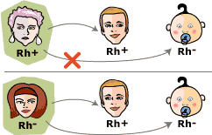
A person with Rh- blood can develop Rh antibodies in the blood plasma if he or she receives blood from a person with Rh+ blood, whose Rh antigens can trigger the production of Rh antibodies.
A person with Rh+ blood can receive blood from a person with Rh- blood without any problems.

Slide 17
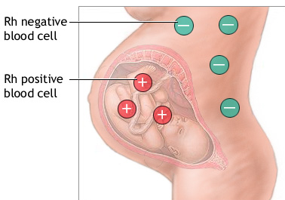
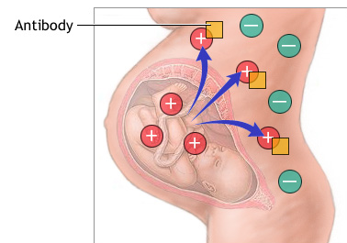
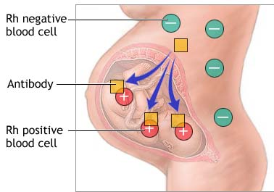
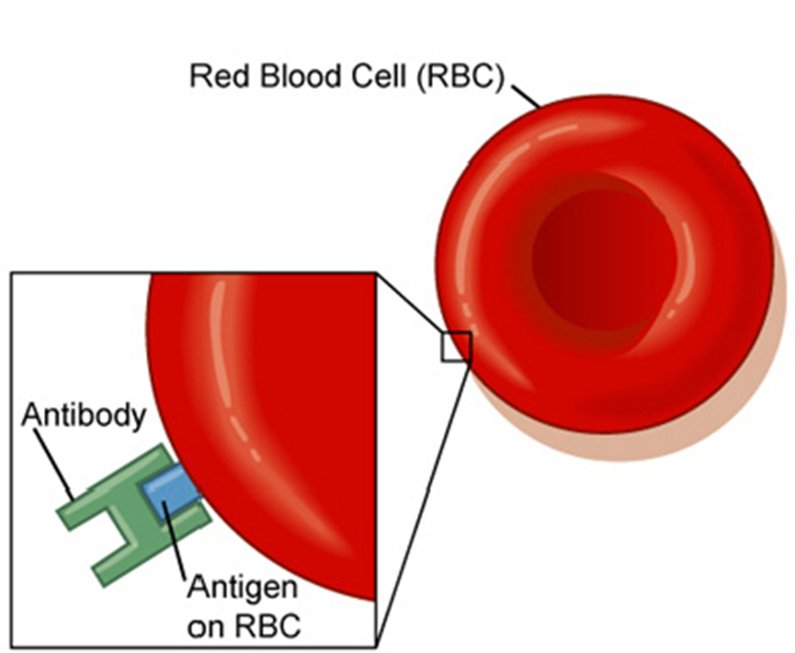

Slide 18
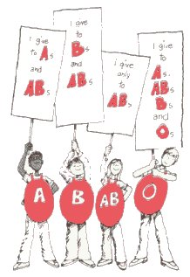

Slide 19
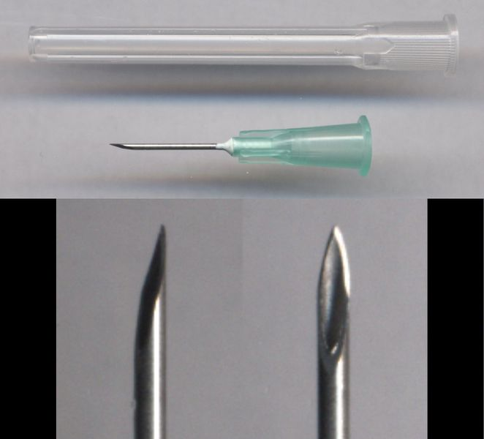
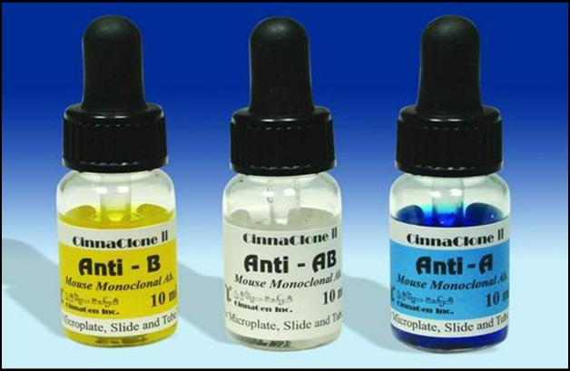
Determine the Blood type Group method:
Materials:-

Slide 20
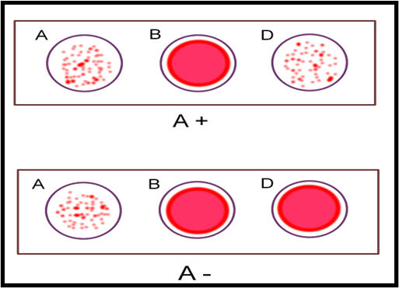
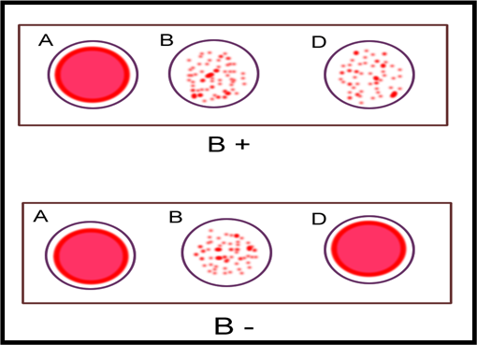
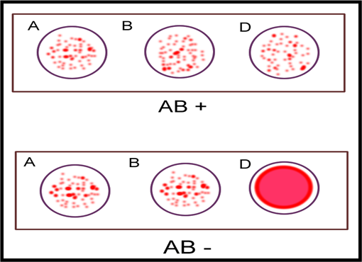
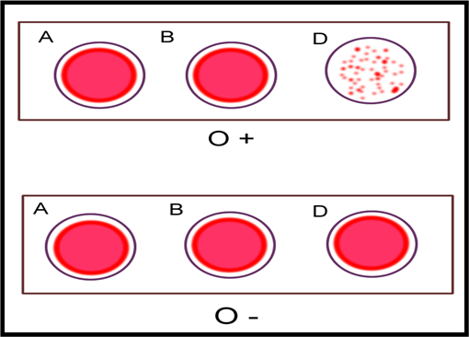
The human blood groups

Slide 21
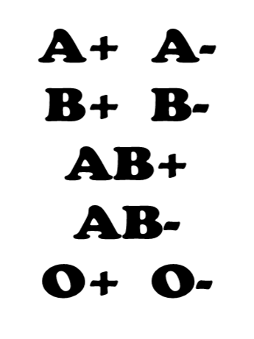



Slide 22




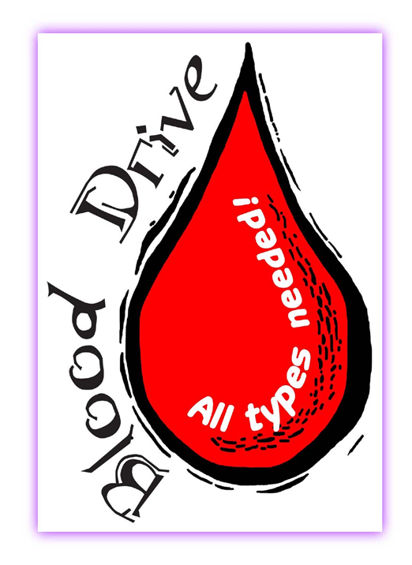

Slide 23



Slide 24



