Slide 1
Chapter 9
Selecting the Sample

Slide 2
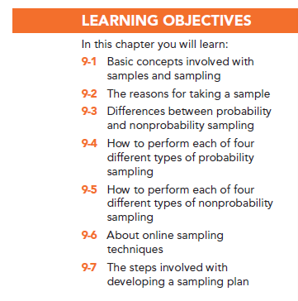

Slide 3
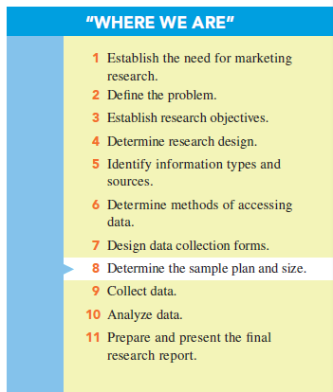

Slide 4
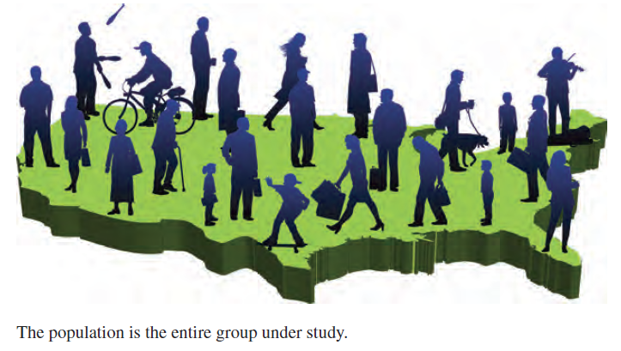
Basic Concepts in Sampling

Slide 5
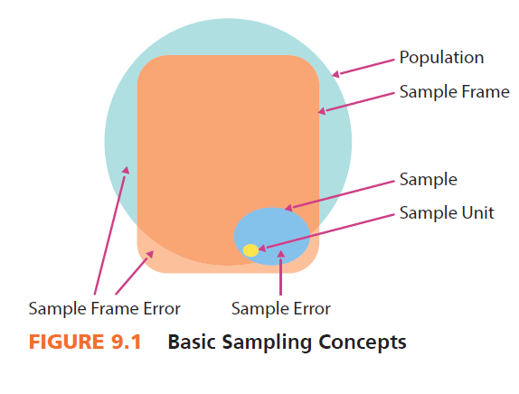

Slide 6
Basic Concepts in Sampling
A census is an accounting of the complete population.
The U.S. census is taken every 10 years by the U.S. Census Bureau (www.census.gov).

Slide 7
Basic Concepts in Sampling
Sample: a subset of the population that should represent the entire group
Sample unit: the basic level of investigation

Slide 8
Basic Concepts in Sampling
A sample frame: a master source of sample units in the population
Sampling frame error: the degree to which the sample frame fails to account for all of the population

Slide 9
Basic Concepts in Sampling
Sampling error: any error in a survey that occurs because a sample is used

Slide 10
Reasons for Taking a Sample
Practical considerations such as cost and population size
Inability to analyze huge amounts of data generated by a census

Slide 11
Basic Sampling Methods
Probability samples: ones in which members of the population have a known chance (probability) of being selected into the sample
Non-probability samples: instances in which the chances (probability) of selecting members from the population into the sample are unknown

Slide 12
Probability Sampling Methods
Simple random sampling
Systematic sampling
Cluster sampling
Stratified sampling

Slide 13
Probability Sampling:
Simple random sampling: the probability of being selected into the sample is “known” and equal for all members of the population

Slide 14
Simple Random Sampling
The random device method involves using a procedure or apparatus that assures that every member of the population has the same chance of being included in the sample.

Slide 15
Probability Sampling
Systematic sampling: way to select a random sample from a directory or list that is much more efficient than simple random sampling

Slide 16
Probability Sampling
Cluster sampling: method in which the population is divided into subgroups, called “clusters,” each of which could represent the entire population

Slide 17
Probability Sampling
Area sampling is a form of cluster sampling – the geographic area is divided into clusters.

Slide 18
Area (Cluster) Sampling
One-step area sample: the researcher may believe the various geographic areas (clusters) to be sufficiently identical to allow concentrating his or her attention on just one area and then generalizing the results to the full population
Two-step area sample: the researcher selects a random sample of areas, and then, he or she decides on a probability method to sample individuals within the chosen areas

Slide 19
Probability Sampling
Stratified Sampling: separates the population into different subgroups and then samples all of these subgroups

Slide 20
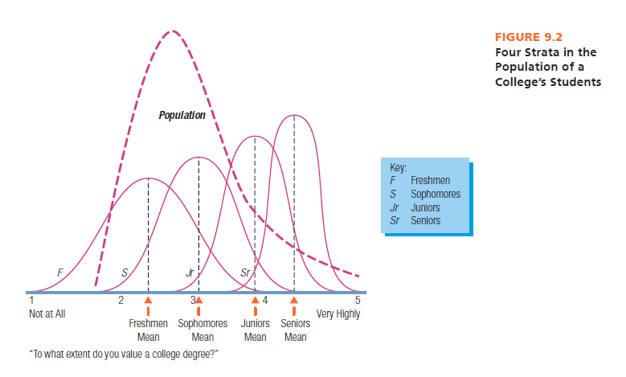

Slide 21
Nonprobability Sampling
With nonprobability sampling methods selection is not based on fairness, equity, or equal chance.
Convenience sampling
Purposive sampling
Chain referral sampling
Quota sampling

Slide 22
Nonprobability Sampling
Convenience samples: samples drawn at the convenience of the interviewer
Purposive samples: requires a judgment or an “educated guess” as to who should represent the population

Slide 23
Nonprobability Sampling
Chain referral samples: require respondents to provide the names of prospective respondents
Quota samples: specified percentages of the total sample for various types of individuals to be interviewed

Slide 25
Online Sampling Techniques
Online panels: large numbers of individuals who have agreed to participate in online surveys
River samples: created via the use of banners, pop-ups, or other online devices that invite website visitors to take part in the survey
E-mail list samples: purchased or otherwise procured from someone or some company that has compiled email addresses of opt-in members of the population of interest

Slide 26
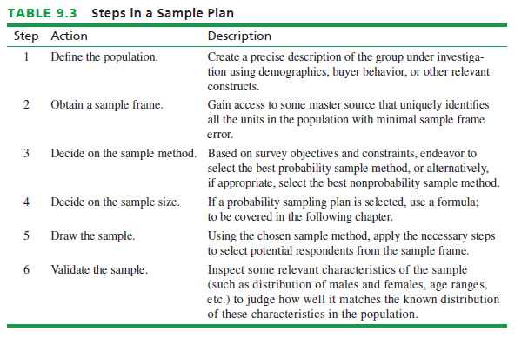

Slide 27
All rights reserved. No part of this publication may be reproduced, stored in a retrieval system, or transmitted, in any form or by any means, electronic, mechanical, photocopying, recording, or otherwise, without the prior written permission of the publisher. Printed in the United States of America.

