Slide 1
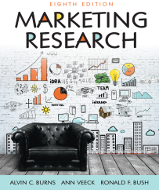
Chapter 10
Determining the Size of a Sample

Slide 2
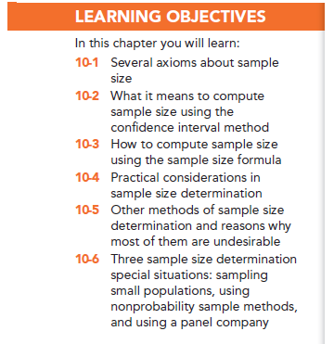

Slide 3
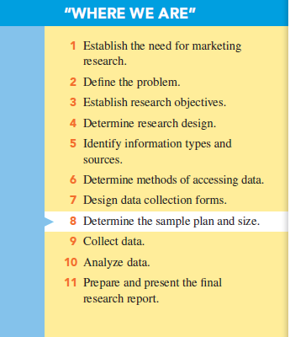

Slide 4
Important Points about Sampling
Sampling method (not sample size) is related to representativeness
Only a probability sample (random sample) is truly representative of a population
Sample size determines accuracy of findings

Slide 6
Sample Accuracy
Sample accuracy: refers to how close a random sample’s statistic is to the true population’s value it represents

Slide 7
Two Types of Error
Nonsampling error: pertains to all sources of error other than sample selection method and sample size
Sampling error: involves sample selection and sample size

Slide 8
Sample Size and Accuracy
Which is of these is more accurate?
A large probability sample, or
A small probability sample?
The larger a probability sample is, the more accurate it is (less sample error).

Slide 10
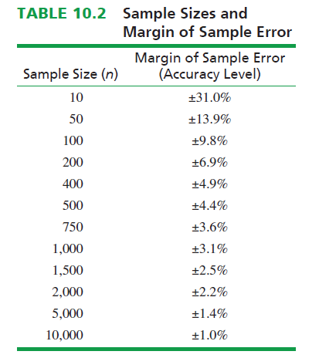

Slide 11
Sample Error

Slide 12
Variability
Variability refers to how similar or dissimilar responses are to a given question.

Slide 13
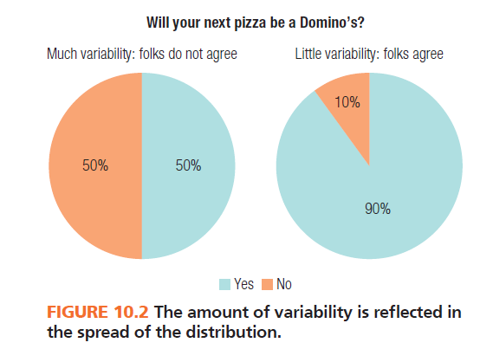

Slide 14
Example of Maximum Margin of Sample Error

Slide 15
Confidence Interval Approach
The confidence interval is a range whose endpoints define a certain percentage of the responses to a question.
This approach is based upon the normal distribution.
We can use the normal distribution because of the central limit theorem.

Slide 16
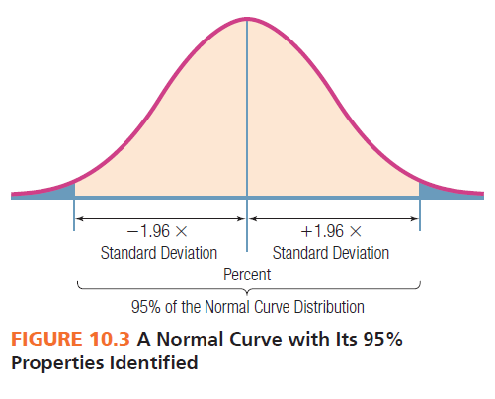

Slide 17
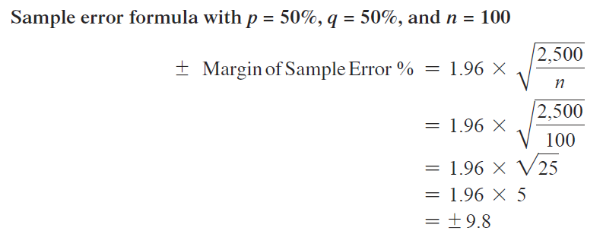
Example - Page 239

Slide 18
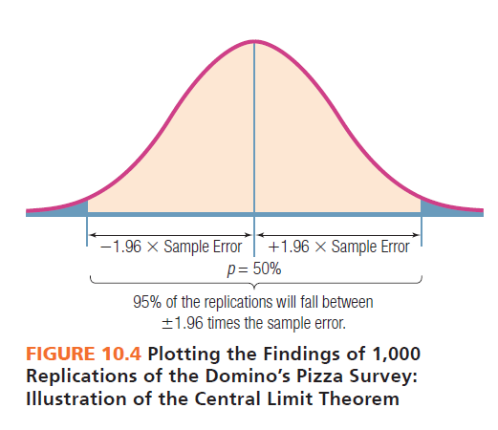

Slide 19
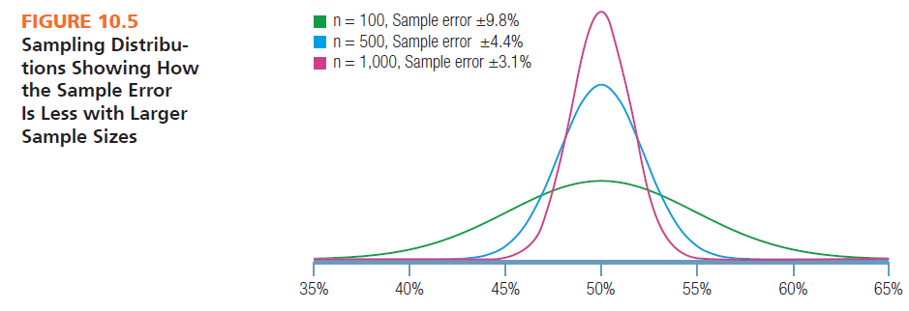

Slide 20
Sample Size Formula
Need to know
Variability: p x q
Acceptable margin of sample error: e
Level of confidence: z

Slide 22
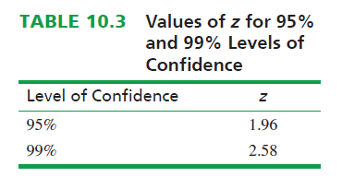

Slide 23
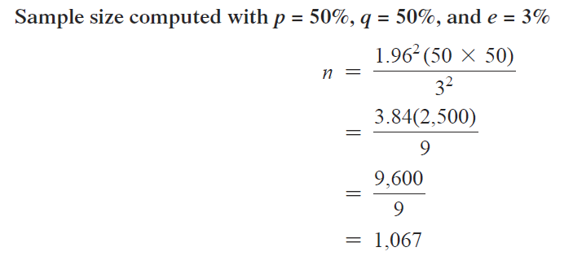
Example 1 - Page 243

Slide 24
Example 2 – Page 243

Slide 25
Estimating Variability
How to estimate variability
Use data from a previous study on the target population.
Conduct a pilot study of the target population.
Assume maximum variability (p and q =50%)
Estimate standard deviation by dividing range by 6

Slide 26
Practical Considerations
How to determine the amount of acceptable sample error?
Researchers should work with managers to make this decision. What are the implications? How much error is the manager willing to tolerate?

Slide 27
Practical Considerations
How to decide on the level of confidence to use?
Marketing researchers typically use 95% or 99%.

Slide 28
Practical Considerations
How to balance sample size with cost of data collection?
Researchers should work with managers to take cost into consideration in this decision.

Slide 29
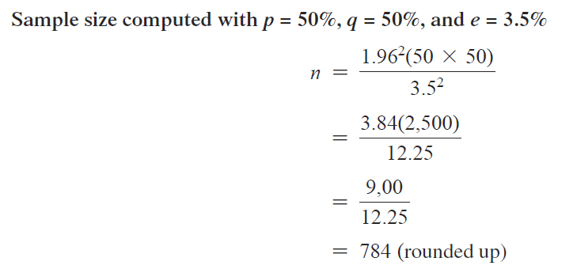
Example – Page 246

Slide 30
Other Methods of Sample Size Determination
Arbitrary “percentage rule of thumb”
Conventional sample size
Statistical analysis approach requirements
Cost basis (“all you can afford”)

Slide 31
Special Sample Size Determination Situations
Sample size:
-- when sampling from small populations
Correction factor is used to modify sample size
-- when using non-probability sampling
Must weigh value of information against cost of gathering information
-- when sampling from panels
Panels are unique and may not be truly representative

Slide 32
Sampling from Small Populations
With small populations, use the finite population multiplier to determine small size.

Slide 33
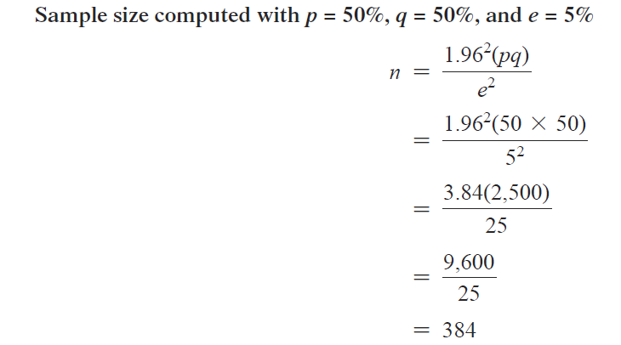
Example – Page 251

Slide 34
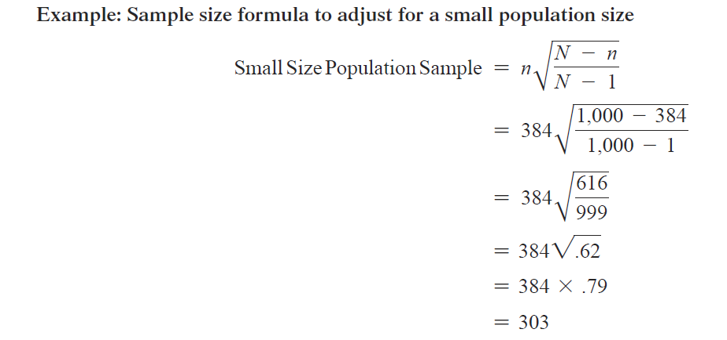
Example – Page 251

Slide 35
All rights reserved. No part of this publication may be reproduced, stored in a retrieval system, or transmitted, in any form or by any means, electronic, mechanical, photocopying, recording, or otherwise, without the prior written permission of the publisher. Printed in the United States of America.

