Slide 1
Bushra T. AlQuadeib بـــشرى توفيق القضيب
Office: Room 19 , Floor 2, Building 8
Email: bquadeib@ksu.edu.sa
Grade:
  Midterm: 15+15
  Final: 20+20
  Lab: 30
PHT 311 : Pharmaceutics (2).

Slide 2




Rules

Slide 3
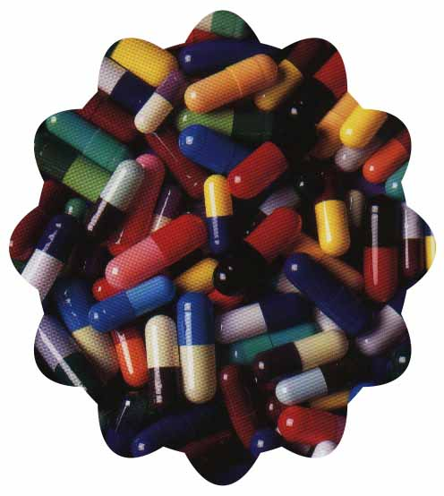
CAPSULES

Slide 4
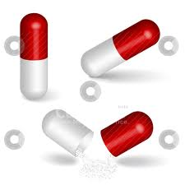
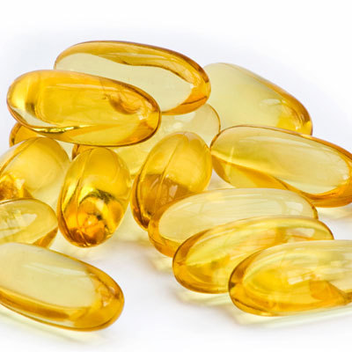
Gelatin Capsule Shells
Hard
Soft
Depending on their composition

Slide 5
There are two basic types of gelatin
TYPE A
It is manufactured mainly from pork skin.
TYPE B
It is manufactured mainly from animal bones

Slide 6

HARD GELATIN CAPSULE
DEFINITION:-
These are solid dosage form of medicaments, in which drug is enclosed within the shells made up of gelatin.
These capsules are made up of gelatin blends, small amount of certified dyes, opaquants, plasticizers and preservatives.

Slide 7
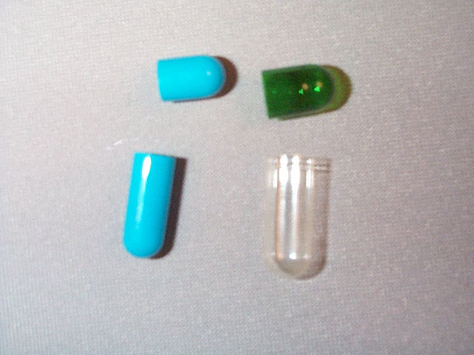
PARTS OF CAPSULE
CAP
BODY

Slide 8
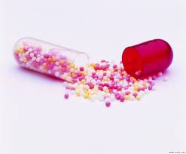
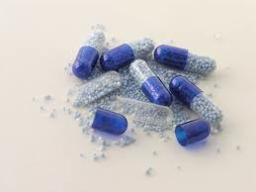

Slide 9
SOFT GELATIN CAPSULE
Definition:-
Soft Gelatin capsules are one piece, hermetically sealed, soft gelatin shells containing a liquid, a suspension, or a semisolid.
Soft gelatin is mainly composed of gelatin, plasticizers, preservative, colouring and opacifying agents, flavoring agents and sugars.

Slide 10
APPLICATION OF SOFT GELATIN CAPSULE:
The pharmaceutical applications of soft gelatin capsules are:
as an oral dosage form
as a suppository dosage form
as a specialty package in tube form, for human and veterinary use, single dose application for topical, ophthalmic, and rectal ointments.

Slide 11
NATURE OF CAPSULE SHELL
Gelatin
Water
Opacifying agents
Plasticizer
Preservatives

Slide 12
Plasticizer and Gelatin ratio
In soft gelatin capsule the amount of plasticizers used is more
In soft gelatin capsule the plasticizer and gelatin ratio is
0.8 : 1
In hard gelatin capsule the plasticizer and gelatin ratio is
0.4 : 1

Slide 13
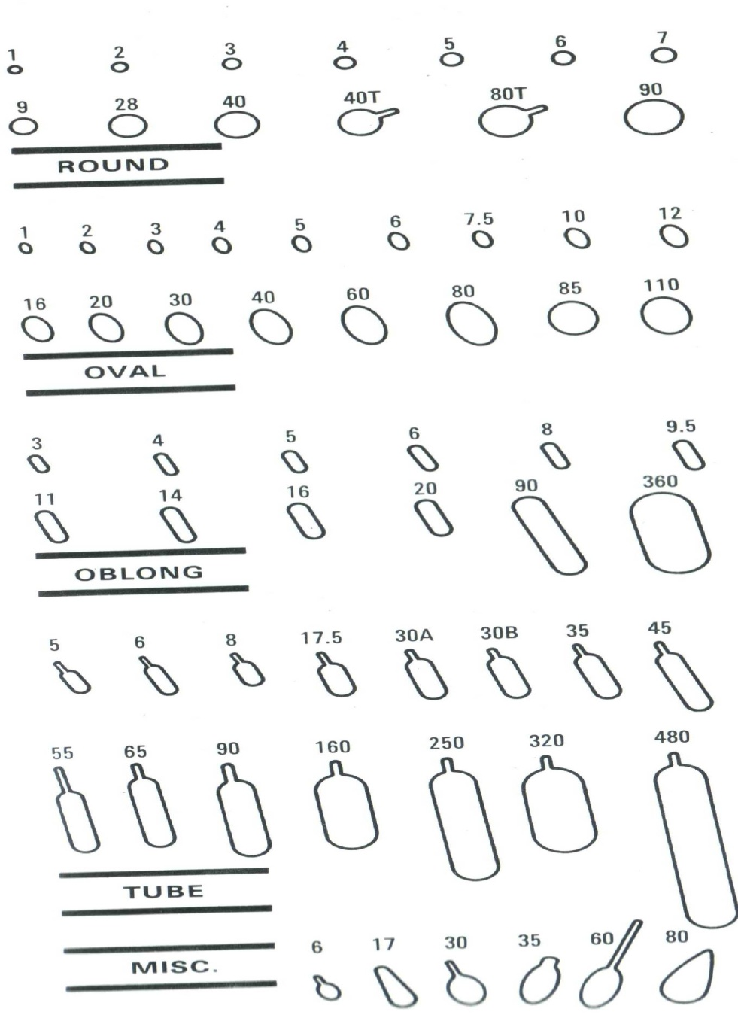
SHAPE OF CAPSULE
The shape of soft gelatin capsule are round, oval, oblong, tube.

Slide 14
Soft gelatin capsule

Slide 15
Advantages of capsules for oral administration
Easy to swallow due to their smooth and slippery nature.
Easy to handle and carry.
Can mask the unpleasant taste and odour of drug using tasteless shell.
More stable and have longer half life than liquid dosage forms
Better bioavailability than tablets and faster onset of action than tablets.
The shells are physiologically inert and easily and quickly digested in the gastrointestinal tract.
The shells can be opacified (with titanium dioxide) or coloured, to give protection from light.

Slide 16
Disadvantages of capsules
The drugs which are hygroscopic absorb water from the capsule shell making it brittle and hence are not suitable for filling into capsules.
Aqueous or hydro alcoholic liquids cannot be enclosed in capsules because they dissolve gelatin.
Capsules should not be used for packaging of highly water-soluble material such as ammonium chloride, KBr, KCl etc. because sudden release of such compounds can cause irritation in the stomach.

Slide 17
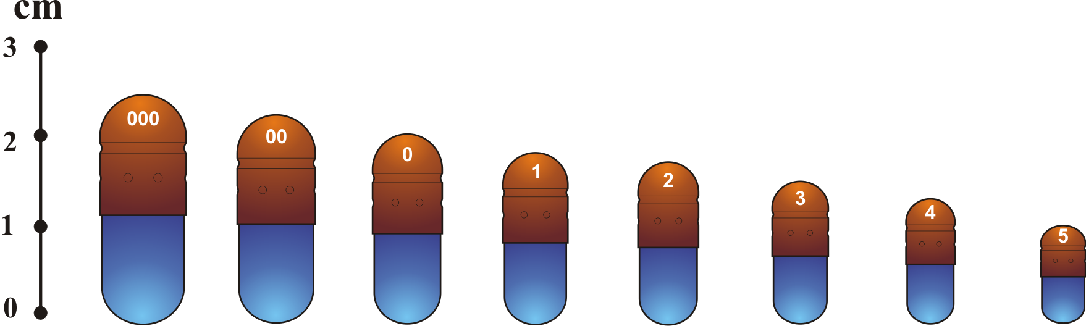
CAPSULE SIZES
For human use, empty capsules ranging in size from 000 (the largest) to 5 (the smallest) are commercially available

Slide 18
SIZE OF CAPSULES
Size | Volume in ml | Content of the drug (mg)
000 | 1.37 | 950
00 | 0.95 | 650
0 | 0.68 | 450
1 | 0.50 | 300
2 | 0.37 | 250
3 | 0.30 | 200
4 | 0.21 | 150
5 | 0.15 | 100

Slide 19
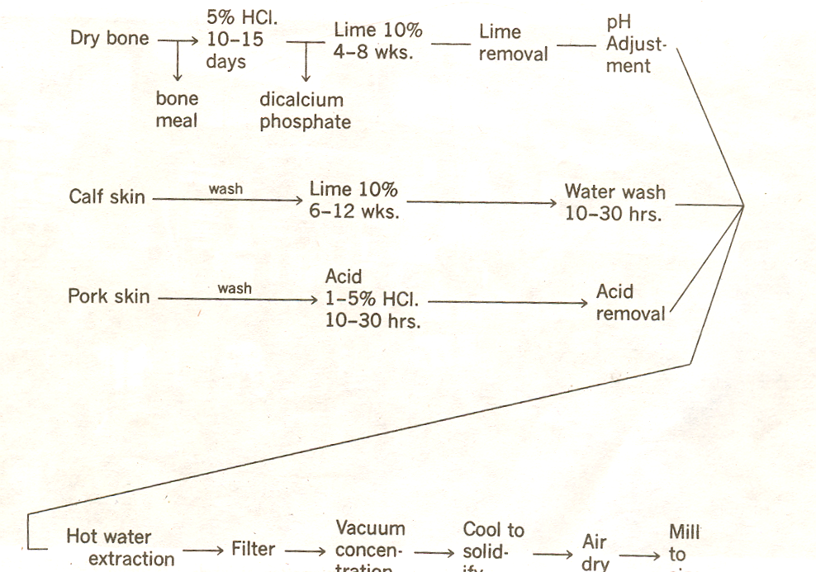
Preparation Of Gelatin

Slide 20
Gelatin charecteristics
Type A gelatin produced by acid hydrolysis, is manufactured mainly from pork skin
Type B gelatin produced by alkaline hydrolysis, is manufactured mainly from animal bones
The two types are differentiated by isoelectric points (4.8-5.0 for type B and 7.0-9.0 for type A) and their viscosity building properties and film-forming characteristics.
Bone gelatin contributes firmness, where as pork skin gelatin contributes plasticity clarity

Slide 21
The gelatin solubility :
Insoluble in cold water, soften through the absorption of up to ten times its weight of water; soluble in hot water and in warm gastric fluid.
Gelatin, being a protein, is digested by proteolytic enzymes in stomack

Slide 22
Other shell materials
HPMC: Hydroxy propyl methyl cellulose
HPMC capsules can be made by dipping technology
HPMC capsules generally have lower Equilibrium Moisture Content (EMC) than gelatin capsules and may show better physical stability on exposure to extremely low humidities

Slide 23
Preparation of filled hard gelatin capsules
The general steps of preparation:
1) developing and preparing the formulation and selecting the size of capsule.
2) filling the capsule shells.
3) capsule sealing.
4) cleansing and polishing the filled capsules.

Slide 24
Developing the formulation and selection of capsule size
The pharmaceutical processing in the preparation of filled hard gelatin capsules
1) Blending: → uniform powder mix, uniform drug distribution
2) Comminution/Milling: 50~100 microns, suitable for a drug of low dose (10mg or greater)
3) Micronization: 10~20 microns, suitable for drugs of lower dose

Slide 25
EXCIPIENTS USED IN THE FORMULATION
The pharmaceutical excipient in the preparation of filled hard gelatin capsules
Diluent/Filler: to produce the proper capsule fill volume; to provide cohesion to the powders,
e.g. lactose, microcrystalline cellulose and starch
Disintegrants/Disintegration agents: to assist the break-up and distribution of the capsule contents
e.g. pre gelatinized starch

Slide 26
Lubricant or Glidant: to enhance the flow properties of the powder mix
e.g. fumed silicon dioxide
Wetting agents: to facilitate wetting of the dry powder
e.g. Surfactant

Slide 27
Manufacturing of hard gelatin capsule shells`
The shell consists of two parts, the capsule body and the capsule cap.
The process of capsule shell production with the peg/pin method:
dipping→ drying → stripping→ trimming→ joining
The thickness of the gelatin walls must be strictly controlled.
The caps are slightly larger in diameter than the bodies.

Slide 28
Parts Of The Capsule

Slide 29
Dipping
Pairs of stainless steel pins lubricated, are dipped into the dipping solution to form caps and bodies simultaneously
The pins are at ambient temperature, 22 C where as the dipping solution is at 50 C in heated jacketed heating pan.
The dipping time to cast the film is about 12 secs

Slide 30
Rotation
After dipping, the pins are withdrawn from dipping solution. They are elevated and rotated until they are facing upward.
This helps distribution of the gelatin over the pins uniformly and to avoid the formation of bead at the capsule ends
After rotation they are given a blast of cool air to set the film

Slide 31
Drying
The racks of gelatin coated pins then pass into a series of four drying ovens
Drying is mainly done by dehumidification by passing large volumes of dry air over the pins
Temperature elevation of few degrees are permissible to prevent film melting
Drying also must be too rapid to prevent case hardening
Under drying leave film sticky for subsequent operations
Over drying must be avoided as this could cause the films to split on the pins due to shrinkage or at least make them brittle for later trimming step

Slide 32
Stripping
A series of bronze jaws strip the cap and body portions of the capsules from the pins
Trimming
  The stripped caps and bodies are delivered to collects in which they are firmly held
  As the collects rotate the knives are brought against the shells to trim them to the required length

Slide 33
Joining
The cap and body portions are aligned concentrically in channels, and the two portions are slowly pushed together
The entire cycle takes about 45 minutes, about 2/3 of which is required for the drying step alone

Slide 34
Sorting
The moisture content of capsules as they are ejected from machine will be in the range of 15-18% w/w
During sorting, the capsules passing on a lighted moving conveyor are observed visually by inspector
Any defective capsules spotted are thus manually removed

Slide 35
Sorting
The defects may cause serious problems
  Stoppage of a filling machine due to imperfect cuts, dented capsules, or capsule with holes
  some defects may cause usage problems, EX. Capsules with splits, long bodies etc.
  cosmetic faults like small bubbles, specks in film, marks on cut edge detract from appearance

Slide 36
Painting
In general, capsules are printed prior to filling as they are easy to handle
Generally printing is done on offset rotary presses having through capabilities as high as ¾ million capsules per hour
Available equipment can print axially along the length or radially around the circumference of capsules

Slide 37
Capsule sizes
How to select capsule size?
1) The amount of fill material to be encapsulated
2) The density and compressibility of the fill
3) The final determination largely may be the result of trial.
The sizes of empty capsules
For human use: 000(the largest) to size 5 (the smallest)
For veterinary use: No.s 10, 11and 12 having capacities of 30, 15 and 7.5 g, respectively

Slide 38
Sealing and self locking closures
Hard gelatin capsules are made self locking by forming indentations or grooves on the inside of the cap and body portions
When they are fully engaged, a positive interlock is created between the cap and body portions
Indentation formed further down on the cap provide a prelock, thus preventing accidental separation

Slide 39
Sealing and self locking closures
Hard gelatin capsules may made hermetically sealed by the technique of banding wherein a film of gelatin, often distinctly colored, is laid down around the seam of the cap and body
In the thermal method of spot welding, two hot metal jaws are brought into contact with the area where the cap overlaps the filled body

Slide 40
Sealing and self locking closures
Capsugel has proposed low temperature thermal method of hermetically sealing the hard gelatin capsules
This process involved immersion of the capsules for a fraction of second in hydro alcoholic solvent, followed by rapid removal excess solvent, leaving traces in the overlapping area of cap and body
Finally the capsules are dried with warm air

Slide 41
Sealing and self locking closures
A more recent approach is spraying of mist of hydro-alcoholic solution on to the inner cap surface immediately prior to the closure in filling machine
This is used to seal starch capsules together
These techniques makes the capsules tamper resistant

Slide 42
Storage, packaging, and stability
Finished capsules normally contain an EMC of 13-16%.
< 12% MC, the capsule shells become brittle
>18% make them too soft

Slide 43
Filling hard capsule shells
The “punch” method
Placing the powder on paper
Forming the powder mix into a cake
Punching the empty capsule body into the powder cake

Slide 44
Filling hard capsule shells
The Pouring method
Suitable for filling a small number of capsules in the pharmacy
Suitable for granular material

Slide 45
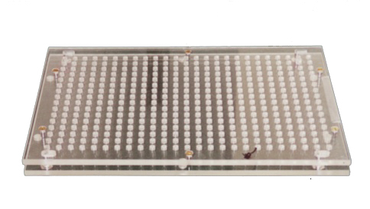
Filling hard capsule shells
Hand-operated capsule filling machines
Consist of a couple of plates

Slide 46
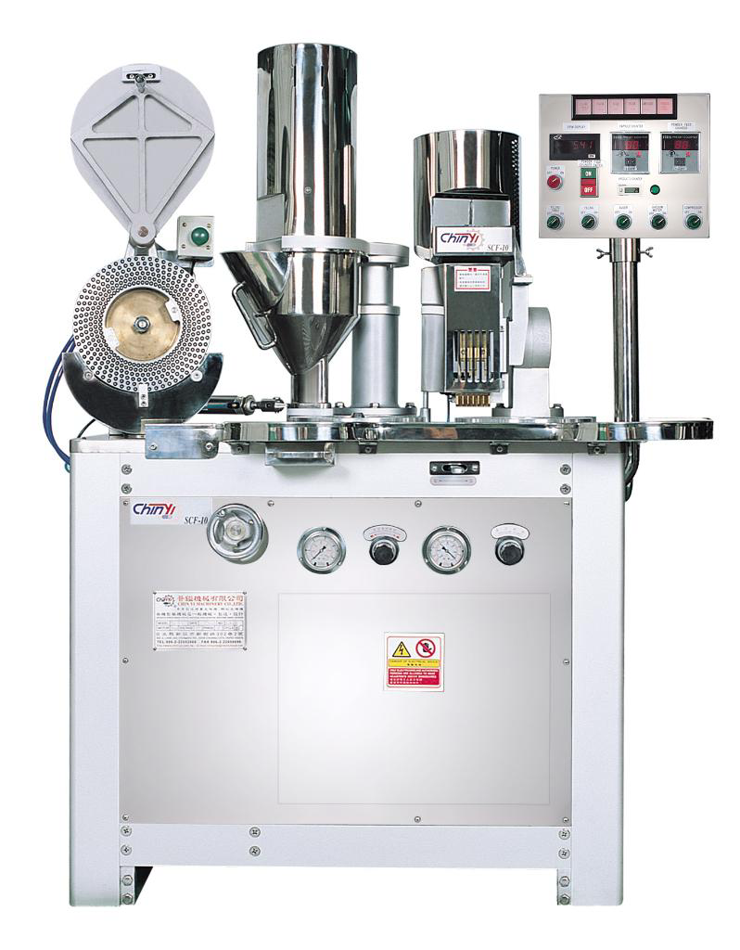
Filling hard capsule shells
Machines for industrial use:

Slide 47
Filling hard capsule shells
The process of working:
Rectification
Separating the caps from empty capsules
Filling the bodies
Scraping the excess powder
Replacing the caps
Sealing the capsules
Cleaning the outside of the filled capsules
160,000 capsules per 8hour shift

Slide 48
Rectification
The empty capsules are oriented so that all point the same direction i.e. body end downwards
In general, capsule pass one at a time through a channel just wide enough to provide grip at cap end
The capsules will always be aligned body end downwards, regardless of which end entered the channel first with the help of specially designated blades

Slide 49
Separation of caps from body
The rectified capsules are delivered body end first into the upper portion of split bushings or split filling rings
A vacuum applied from below pulls the body down into the lower portion of the split bushing
The diameter of the bush is too large to allow them to follow body
The split bushings are separated to expose the bodies for filling

Slide 50
Filling
Auger fill principle: Because the auger mounted in the hopper rotates at a constant rate, the rate of delivery of the powder to the capsules tend to be constant
  Flat blade auger
  Screw auger

Slide 51
Filling
Vibratory fill principle: in the powder, a perforated resin plate is positioned and connected to a vibrator
The powder blend tends to be fluidized by the vibration of plate and assists the powder to flow into the bodies through the holes in resin plate

Slide 52
Filling
Piston tamp principle:
In this pistons or tamping pins lightly compress the individual doses of the powders into plugs( also called as slugs) and eject the plugs into empty capsule bodies
  DOSATOR PRINCIPLE
  DOSING DISC PRINCIOLE

Slide 53
Filling
Piston tamp principle:
  DOSING DISC PRINCIPLE: a solid ‘stop’ brass plate is sliding down the dosing disc to close off the hole. Five sets of pistons compress the powder into cavities to form plugs
  DOSATOR PRINCIPLE: it consists of cylindrical dosing tube fitted with movable piston. The position of the piston is preset to a particular height to define a volume. Powder enters the open end of dosator and is slightly compressed against the piston into a plug

Slide 54
Cleaning and polishing capsules
Small amount of powder may adhere to the outside of capsules after filling.
1) Pan Polishing.
2) Cloth Polishing.
3) Brushing.

