Slide 1
Carcinogenesis
Dr. Nayira A. Abdel Baky
Associate Professor
Pharmacology and Toxicology

Slide 2
Carcinogenesis
Carcinogenesis is a multistep process at both the phenotypic and the genetic levels that end with the disease neoplasia.
Neoplasia is defined as a heritably altered, relatively autonomous growth of tissues.
Neoplasms may be either benign or malignant, the critical distinction between these is related to the characteristic of successful metastatic growth of malignant but not benign neoplasm.
It starts with a genetic damage [mutation]:
  Acquired =Environmental
    Chemical
    Radiation
    Viral
  Inherited
Notes:
Single cell which has the genetic damage undergoes neoplastic proliferation forming the tumor mass.

Slide 3
The Nomenclature of Neoplasia
It depends primarily on whether the neoplasm is benign or malignant and the derived cell (e.g. in case of malignant :epithelial or mesenchymal tissue).
For Benign neoplasms, the tissue of origin is followed by the suffix –oma (fibroma, lipoma, adenoma).
For malignant neoplasms derived from tissues of mesenchymal origin, the term sarcoma is added (fibrosarcoma, osteosarcoma, liposarcoma).
For malignant neoplasms derived from tissues of epithelial origin are termed carcinomas (hepatocellular carcinoma, gastric adenocarcinoma).
Notes:
Mesenchyme is a type of tissue characterized by loosely associated cells that lack polarity and are surrounded by a large extracellular matrix. Mesenchymal cells are able to develop into the tissues of the lymphatic and circulatory systems, as well as connective tissues throughout the body, such as bone and cartilage

Slide 4
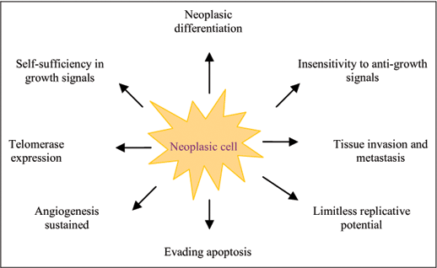
Malignant Cell Characteristics

Slide 5
Main changes in the cell that lead to
formation of the malignant phenotype
  Self-sufficiency in growth signals
  Insensitivity to growth-inhibitory signals
  Genomic instability
  Evasion of apoptosis
  Limitless replicative potential
  Sustained angiogenesis
  Ability to invade and metastsize

Slide 6
Remember The Cell Cycle
Normal cell division is required for the generation of new cells during development and for the replacement of old cells as they die.
In normal cells, tumour suppressor genes act as braking signals during G1 to stop or slow the cell cycle before it reaches the S phase.
DNA repair genes are active throughout the cell cycle, particularly during G2 after DNA replication and before the chromosomes prepare for mitosis.

Slide 7
A - Self-sufficiency in Growth signals
  Oncogene: Gene that promote autonomous cell growth in cancer cells
  They are derived by mutations in protooncogenes
  They are characterized by the ability to promote cell growth in the absence of normal growth-promoting signals
  Oncoproteins : are the products of these genes

Slide 8
HOW CANCER CELLS ACQUIRE SELF SUFFICIENCY IN GROWTH SIGNALS?
1- Growth factors:
  Cancer cells are capable to synthesize the same growth factors to which they are responsive
    E.g. Sarcomas ---- > TGF-α
2-Growth factors receptors:
  Receptors --- mutation ----continous signals to cells and uncontroled growth
  Receptors --- overexpression ---cells become very sensitive ----hyperresponsive to normal levels of growth factors
  Epidermal Growth Factor ( EGF ) Receptor family
    HER2
      Amplified in breast cancers and other tumors
      High levels of HER2 in breast cancer indicate poor prognosis
      Anti- HER2 antibodies are used in treatment

Slide 9
HOW CANCER CELLS ACQUIRE SELF SUFFICIENCY IN GROWTH SIGNALS?
3- Signal-transducing proteins :
They are proteins that receive signals from activated growth factors receptors and transmitte them to the nucleus. Examples :
  E.g. RAS gene
  30% of all human tumors contain mutated RAS gene . E.g : colon . Pancreas cancers
  Mutations of the RAS gene is the most common oncogene abnormality in human tumors
  Mutations in RAS --- cells continue to proliferate.

Slide 10
HOW CANCER CELLS ACQUIRE SELF SUFFICIENCY IN GROWTH SIGNALS?
4-Nuclear transcription factors :
  Mutations may affect genes that regulate transcription of DNA → growth autonomy
  E.g. MYC gene
    MYC protooncogene produce MYC protein when cell receives growth signals
    MYC protein binds to DNA leading to activation of growth-related genes
    Normally … MYC transcription decrease when cell cycle begins …but ..in tumors there is sustained expression of MYC → continuous proliferation
    E.g. Burkitt Lymphoma

Slide 11
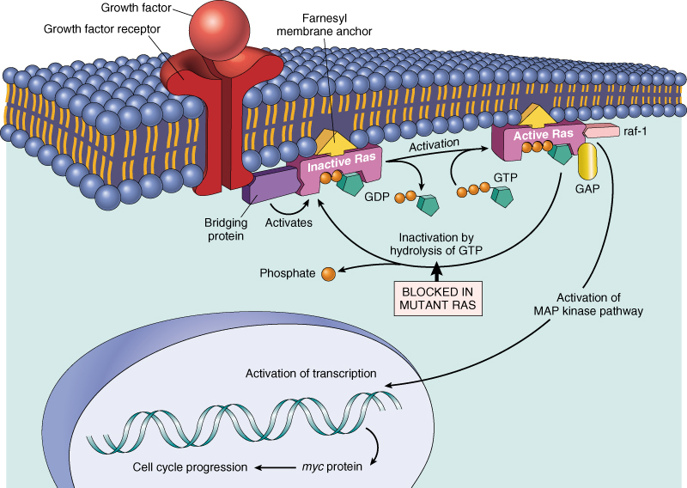
Notes:
Remember the cell cycle !!
Binding of a growth factor to its receptor on the cell membrane lead to activation of the growth factor receptor leading to activation of signal-transducing proteins that lead to Transmission of the signal to the nucleus and induction of the DNA transcription that end with entry of the cell in a cell cycle and cell division process.

Slide 12
B. Insensitivity to growth-inhibitory signals
Tumor suppressor genes control ( apply brakes) cells proliferation
If mutation caused disruption to them → cell becomes insensitive to growth inhibition→ uncontrolled proliferation
Examples: RB, TGF-β, APC, TP53
RB ( retinoblastoma ) gene :
  First tumor suppressor gene discovered initially in retinoblastomas
  and found also in breast carcinoma
  RB gene exists in “ active “ and “ inactive” forms
  If active→ will stop the advancing from G1 to S phase in cell cycle
  If cell is stimulated by growth factors → inactivation of RB gene →brake is released→ cells start cell cycle …G1 →S→M …then RB gene is activated again

Slide 13
B. Insensitivity to growth-inhibitory signals
TP53 ( P53 )
TP53 is called the “ guardian of the genome”
70% of human cancers have a defect in TP53
It has been reported with almost all types of cancers : e.g. lung, colon, breast
In most cases, mutations of TP53 are acquired, but can be inhereted, e.g : Li-Fraumeni syndrome
  It has multiple functions mainly :
    Tumor suppressor gene ( anti-proliferative )
    Regulates apoptosis
TP53 senses DNA damage and causes G1 arrest to give chance for DNA repair
Induce DNA repair genes
If a cell with damaged DNA cannot be repaired, it will be directed by TP53 to undergo apoptosis
With loss of TP53, DNA damage goes unrepaired
Mutations will be fixed in the dividing cells, leading to malignant transformation
Notes:
The syndrome is linked to mutations of the TP53 tumor suppressor gene.The mutations can be inherited, or can arise from de novo mutations early in embryogenesis, or in one of the parent's germ cells. This syndrome is also known as the Sarcoma, breast, leukaemia and adrenal gland (SBLA) syndrome.
Li–Fraumeni syndrome is characterized by:
-a diverse amount of cancers;
-early onset of cancer; and,
-development of multiple cancers throughout one's life.

Slide 14
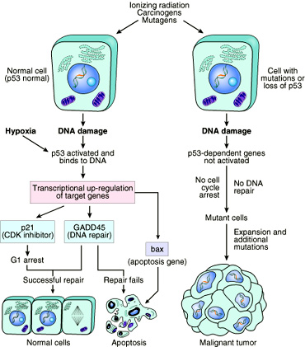

Slide 15
C-Genomic Instability
Due to defect in DNA repair genes.
Damage to DNA by chemical carcinogens activates signaling pathways leading to cell cycle arrest and allows time for DNA repair processes.
Human cells possess mechanisms for DNA repair that counter the extensiveness of DNA damage caused both by endogenous and environmental chemicals. These mechanisms include:
Base excision repair (BER): removes products of alkylation and oxidation.
Nucleotide excision repair (NER): excises oligonucleotide segments containing larger adducts
Mismatch repair (MR): scans DNA immediately after polymerization for misincorporation by DNA polymerases.
Oxidative demethylation transcription‐coupled repair (TCR): repairs lesions that block transcription.
Double‐strand break repair (DBR): avoids errors by copying the opposite DNA strand.

Slide 16
C-Genomic Instability
Lesions that are not repaired can stall DNA replication resulting in double‐strand breaks and chromosomal rearrangements. Alternatively small adducts can be bypassed by DNA polymerases, or undergo apoptosis by signaling the recruitment of immunologic and inflammatory host defense mechanisms.
The immunologic and inflammatory responses facilitate not only engulfment and clearance of damaged cells but also the resulting generation of reactive oxygen and nitrogen radicals that further damage cellular DNA.
Examples:
Familial breast cancer: Due to mutations in BRCA1 and BRCA2 genes These genes regulate DNA repair Account for 80% of familial breast cancer They are also involved in other malignancies

Slide 18
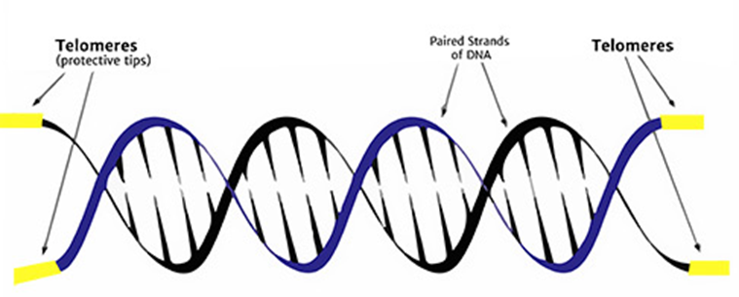
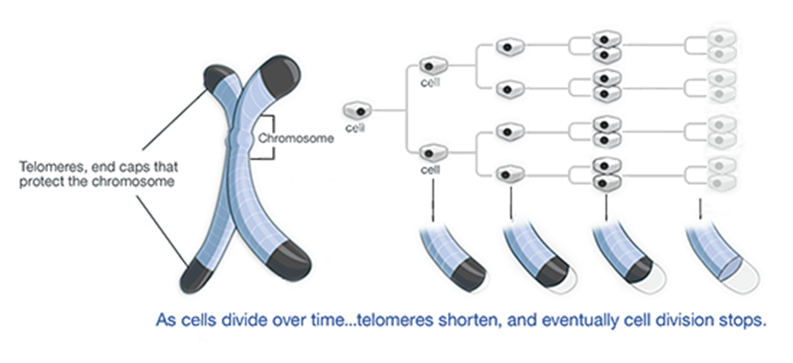
D-Limitless replicative potential
  Normally there is progressive shortening of telomeres at the ends of chromosomes
  Telomerase is active in normal stem cells but absent in somatic cells
  In tumor cells : activation of the enzyme telomerase
  , which can maintain normal telomere length.
  https://highered.mheducation.com/sites/9834092339/student_view0/chapter14/telomerase_function.html
Notes:
Telomeres is a region of repetitive nucleotide sequences at each end of a chromosome(the sequence of nucleotides in telomeres is TTAGGG is repeated approximately 2,500 times in humans, and they are shortened as we age. During chromosome replication, the enzymes that duplicate DNA cannot continue their duplication all the way to the end of a chromosome, so in each duplication the end of the chromosome is shortened. The telomeres are disposable buffers at the ends of chromosomes which are truncated during cell division; their presence protects the genes before them on the chromosome from being truncated instead. But telomeres can also be shortened by stress, smoking, obesity, lack of exercise and a poor diet

Slide 19
E-Sustained angiogenesis
Neovascularization has two main effects:
Perfusion supplies oxygen and nutrients
Newly formed endothelial cells stimulate the growth of adjacent tumor cells by secreting growth factors, e.g : PDGF, IL-1
Angiogenesis is required for metastasis
Notes:
Platelet-derived growth factor (PDGF)

Slide 20
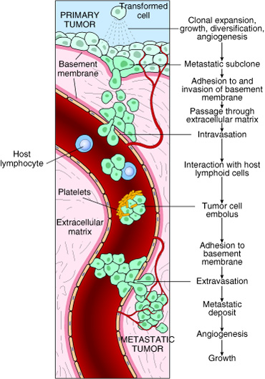
F-Ability to invade and metastasize

Slide 21
Molecular Basis
Of
Carcinogenesis

Slide 22
Molecular Basis of Carcinogenesis
Cancer results from accumulation of multiple mutations
Four cell cycle regulatory genes are the main targets of these mutations:
  Growth promoting genes [protooncogenes]
    Protooncogene > mutation > oncogene
  Growth inhibiting (Tumor supressors) genes
  Genes regulating apoptosis
  DNA repair genes
  All cancers have multiple genetic alterations, involving activation of several oncogenes and loss of two or more tumor suppressor genes

Slide 23
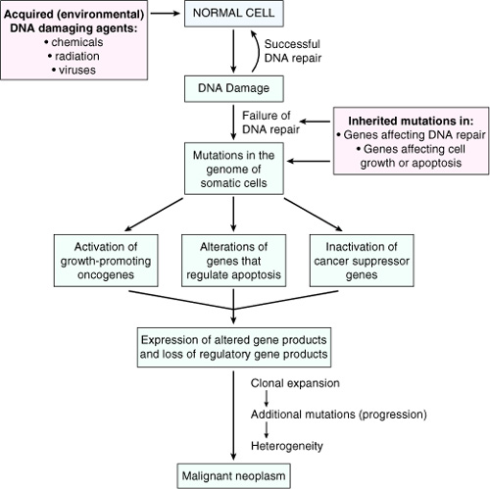

Slide 24
STAGES OF CARCINOGENESIS
Carcinogenesis is a complex process which can be divided into three distinct stages:
– Initiation,
– Promotion
– Progression
Changes in the genome's structure occur across the three stages.
Intiation result in fixed gene mutation.
During promotion stage, changes in gene expression take place with selective proliferation of initiated cells and the development of pre‐neoplastic cells.
During initiation and promotion, apoptosis and cell proliferation can occur at different rates, but remaining balanced. During progression, this balance is modified to the cell proliferation direction and from there malignancy arises.

Slide 25
1-Intitation
Initiation : is the point at which an irreversible genetic alteration, is introduced into a target cell by a genotoxic agent (some of these agents need bioactivation by HME first to be genotoxic ) that directly interact with DNA.
The initiated cell is not a neoplasic cell but has taken its first step towards this state, after successive genotypical and phenotypical changes.
Cell proliferation is essential for this stage, if cellular division occurs before DNA repair systems can act ,then the DNA injury becomes permanent and irreversible.
The initiated cell undergoes proliferation but not differentiation.
Not all cells of a living organism exposed to an initiator agent will be initiated even if they have suffered mutations.
Notes:
Cellular differentiation is the process of a cell changing from one cell type to another. Meaning a less specialized type becoming a more specialized type, such as during cell growth. Differentiation continues in adulthood as adult stem cells divide and create fully differentiated daughter cells during tissue repair and during normal cell turnover.

Slide 26

1-Initiation
(1) is essentially irreversible
(2) caused only by carcinogenic compounds
(3) occurs rapidly after carcinogen exposure
(4) alone does not result in tumor formation
Several exposures to an initiator may result in tumor without presence of a promoter.
carinogen
Intiation

Slide 27
2-Promotion
Promotion is a reversible stage, after a promoter's disappearance a regression in cell proliferation can occur, probably by apoptosis.
Promotion is the process whereby an initiated tissue or organ develop focal proliferations and it requires the presence of continuous stimulation =(The promoter must be present for weeks, months and years in order to be effective and its effectiveness depends on its concentration in the target tissue).
Promoters do not interact directly with DNA and produce their biological effects without being metabolically activated (However, promoters may indirectly damage DNA by oxidation). It enhance proliferation of cells that were initiated by genotoxic carcinogens
Some promoters are specific for a particular tissue, but others act simultaneously upon several tissues.
Notes:
Promotion
(1) reversible
(2) acts only after exposure to an initiating agent
(3) requires repeated administration of a promoter
(4) promotor is not carcinogenic in itself

Slide 28
2-Promotion
Promotors increase cell proliferation in susceptible tissues, thus contribute towards fixing mutations, enhance alterations in genetic expression and cause changes in cellular growth control as follow;
1. Selective proliferation of initiated cells:
– Increased responsiveness to and/or production of growth factors, hormones, and other active molecules.
– Decreased responsiveness to inhibitory growth signals
– Perturbation =Disturbance of intracellular signaling pathways.
2. Altered cell differentiation:
– Inhibition of terminal differentiation of initiated cells., and also cause acceleration of differentiation of uninitiated cells.
– Inhibition of apoptosis in initiated cells.
3. Toxicity/compensatory hyperplasia:
– Resistance to toxicity by initiated cells
Notes:
Perturbation اضطراب=Upset=disturbe

Slide 29
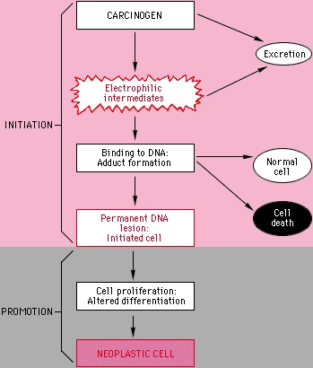
Chemical Carcinogenesis
  In general, chemical carcinogens are electrophiles or can be metabolically converted to electrophiles. (by metabolic activation ) These electrophiles can react with nucleophilic centers (predominantly N and O and to some extent S) in cellular macromolecules such as DNA, RNA and protein.

Slide 30
3-Progression
The sequence of lesions identified, via histopathology, between initiation and promotion are designated as preneoplastic lesions and/or benign neoplasias.
Their transformation into malign lesions is the last of the stages of carcinogenesis and is the most extended ‐ it is labelled progression.
During progression, cell proliferation is independent from the presence of stimulus.
A neoplasic phenotype is acquired through genetic (intiation) and epigenetic (promotion) mechanisms
Notes:
Carcinogenesis requires the malignant conversion of benign cells to a malignant state, and invasion and metastasis are manifestations of further genetic and epigenetic changes.
Molecular mechanisms of
tumor progression are not fully understood, but mutations and chromosomal aberrations are thought to be involved. The process may be accelerated by
repeated exposures to carcinogenic stimuli .The initiated cells proliferate causing a fast increase in the tumor size.

Slide 31
Initiation/promotion model of chemical carcinogenesis
Following a sub‐threshold dose of initiating carcinogen, chronic treatment with a tumor promoter will produce many tumors.
Initiation at a sub‐threshold dose alone will produce very few if any tumors.
Chronic treatment with a tumor promoter in the absence of initiation will produce very few if any tumors.
The order of treatment is critical as it must be first initiated and then promoted.
Initiation produces an irreversible change.
Promotion is reversible in the early stages.

Slide 32
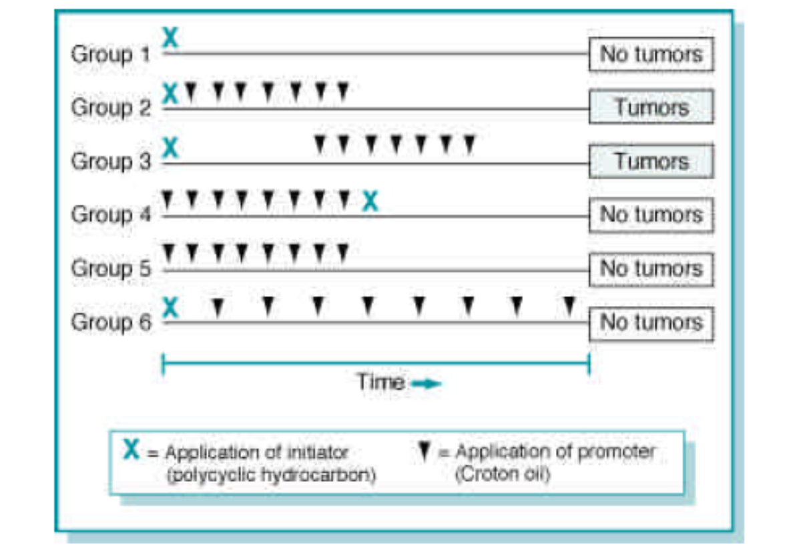
Initiation/promotion model of chemical carcinogenesis
Notes:
In group 6= enough time to allow apoptosis

Slide 33
Viral Carcinogenesis
Viruses contribute to the pathogenesis of human malignancies through the integration of viral genetic elements into the host DNA. These new genes are expressed by the host; they may affect cell growth or division, or disrupt normal host genes required for control of cell growth and division.
(i.e)Insertion of viral nucleic acids → it mimics or blocks normal cellular signals necessary for growth regulation =Alterations in the expression of Oncogenes, tumor suppressor genes and genes regulating DNA repair resulting in up-regulation of cell division → Carcinogenesis.
Human Papilloma Virus =Cervical neoplasia
Epstein-Barr virus =Burkitts Lymphoma, Nasopharyngeal carcinoma.
Hepatitis B & C virus =Hepatocellular carcinoma.

Slide 34
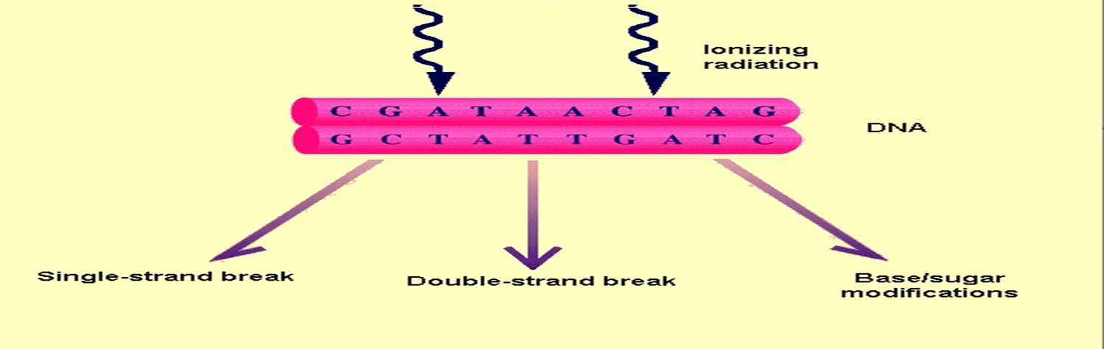
Radiation Carcinogenesis
Carcinogenesis can result from ionizing radiation and may develop from 2 different mechanisms;
1. Direct ionization – damages DNA and other molecules can cause direct somatic mutations
2. Secondary effectors such as oxygen free radicals can be formed by ionizing radiation. Oxygen free radicals can damage DNA and induce mutations.
Ultraviolet radiation from the sun is responsible for approximately 1million new cases of human basal and squamous cell skin cancer.
Otrher Examples
X Ray workers – Leukemia
Radio-isotopes – Thyroid carcinoma
Atomic explosion – Skin cancer, Leukemia
Notes:
• ROS can also be produced by various chemicals and cellular process including lipid peroxidation.

Slide 35


Chemical Carcinogenesis
Chemical Carcinogenes
Genotoxic Carcinogen
Epigentic carcinogen
Direct Acting
Indirect acting
Notes:
Many chemical carcinogens can alter DNA through covalent interaction (DNA adducts) or oxidative DNA damage.
Some chemical carcinogens are intrinsically reactive and can directly covalently bind to DNA, while others require metabolic via cytochromesP450 to produce reactive electrophilic intermediates capable of covalently binding to DNA.

Slide 36
IARC Carcinogen Categories
Group 1: The agent is carcinogenic to humans. (sufficient evidence of carcinogenicity in humans)
Group 2A: The agent is probably carcinogenic to humans. (limited evidence of carcinogenicity in humans and sufficient evidence of carcinogenicity in experimental animals)
Group 2B: The agent is possibly carcinogenic to humans.(limited evidence of carcinogenicity in humans and less than sufficient evidence of carcinogenicity in experimental animals)
Group 3: The agent is not classifiable as to its carcinogenicity to humans. (evidence of carcinogenicity is inadequate in humans and inadequate or limited in experimental animals)
Group 4: The agent is probably not carcinogenic to humans. (evidence suggesting lack of carcinogenicity in humans and in experimental animals)
Notes:
IARC=International Agency for Research on Cancer

Slide 37
1-Genotoxic (DNA-damaging) Agents
Genotoxic carcinogens are complete carcinogens and qualitatively and quantitatively change a cell's genetic information.
Following transmembrane diffusion some of them are electrophilic by their nature , while others are metabolized into electrophilic compounds that enter the nucleus and interact with nucleophilic sites (DNA, RNA and proteins) changing their structural integrity and establishing covalent bonds known as adducts.
The formation of adducts constitutes the first critical step of carcinogenesis and if these are not repaired before DNA replication then mutations may occur in the protooncogenes and tumour suppressor genes, which are essential for the initiation stage.

Slide 38
1-Genotoxic (DNA-damaging) Agents
These agents are DNA‐damaging agents whose administration to previously untreated animals leads to a statistically significant increased incidence of neoplasms of one or more histogenetic types”. They are divided into the following categories:
1– Direct‐acting carcinogens:
They are intrinsically reactive compounds that do not require metabolic activation by cellular enzymes to covalently interact with DNA.
• E.g. N‐methyl‐N‐nitrosourea
2– Indirect‐acting carcinogens:
They require metabolic activation by cellular enzymes to form the ultimate carcinogenic species that covalently binds to DNA (form adduct with DNA). Indirect chemicals are called “ procarcinogens “ and their active end products are called “ ultimate carcinogens”
• E.g. dimethyl nitrosamine, benzo[a]pyrene,
All direct acting and ultimate chemical carcinogens are highly reactive as they have electron-deficient atoms. They react with the electron rich atoms in RNA,DNA and other cellular proteins

Slide 39
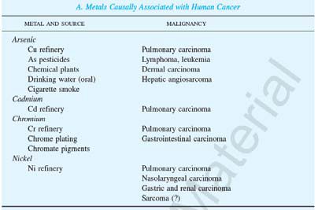
Genotoxic Carcinogen
1-Organic carcinogens
– Alkylating agents.
– Polycyclic aromatic hydrocarbons [isolated from
active crude tar as well as synthetic ones].
– Aromatic amines.
– Nitrosamines.
– Natural substances.
2– Inorganic carcinogens. Ni, Cr, Cd, As. although in many cases the definitive mechanism is unknown

Slide 41
2-Epigenetic (Non‐genotoxic) carcinogens
Epigenetic agents (Non‐genotoxic) carcinogens act as promoters and do not need metabolical activation.
They do not react directly with DNA ,do not alter the primary sequence of DNA, do not raise adducts.
These compounds modulate growth and cell death (alter the expression or repression of certain genes and/or produce perturbations in signal transduction pathways that influence cellular events related to proliferation, differentiation, or apoptosis), potentiate the effects of genotoxic compounds, do not show a direct correlation between structure and activity, and their action is limited by their concentration.
Non‐genotoxic carcinogens are classified as cytotoxic and mitogenic in function of whether their activity is mediated by a receptor or not.

Slide 42
2-Epigenetic (Non‐genotoxic) carcinogens
A. Mitogenic carcinogens such as phorbol esters, dioxins, and phenobarbital induce cell proliferation in target tissue through interaction with a specific cellular receptor.
B. Cytotoxic carcinogens cause cell death in susceptible tissues followed by compensatory hyperplasia, taking chloroform as an example.
Epigenetic agents can be divided into four major categories:
– Hormones: such as conjugated estrogens and diethyl stilbestrol
– Immunosuppressive xenobiotics: such as azathioprine and cyclosporin A.
– Solid state agents: plastic implants and asbestos.
– Tumor promoters: 12‐O‐tetradecanoylphorbol‐13‐ acetate, peroxisome proliferators, TCDD and phenobarbital.
Notes:
Some cancers may result from abnormal internal production of specific hormones. Alternatively, excessive production or the derangement of the homeostatic
mechanisms of an organism may result in neoplastic transformation.
• For example. the excessive production of gonadotropins and their constant stimulus of the ovarian fragment in the spleen result ultimately in neoplasia of the ovarian implant.

Slide 43
EPIGENETIC MECHANISMS INVOLVED
IN CHEMICAL CARCINOGENESIS
The most well understood epigenetic mechanisms involve DNA methylation and histone acetylation, methylation, and phosphorylation

Slide 44
Carcinogenesis

Slide 45
Endogenous Carcinogens
• Many normally generated reactive molecules that are intermediates in metabolism modify many cellular molecules including DNA and therefore are mutagens and carcinogens.
• However, not all mutagens seem to be carcinogens. What was unanticipated was the magnitude of DNA modification by normal cellular processes in the absence of exposure to environmental mutagens.

Slide 46
Remember
Chemical carcinogens: Most of them are mutagenic. i.e. cause mutations. RAS and TP53 are common targets
Ionizing radiation produces DNA damage through direct ionization of DNA to produce DNA strand breaks or indirectly via the ionization of water to reactive oxygen species that damage DNA bases.
UV rays of sunlight :Can cause skin cancers, it is capable to damage DNA, and with extensive exposure to sunlight, the repair system is overwhelmed→ skin cancer .
Viral oncogenes: carry genes that induce cell replication as part of the viral life cycle. Viral infection mimics or blocks normal cellular signals necessary for growth regulation

