Slide 1
Cushing's syndrome
Abdullah Alhowidi 434102376

Slide 2
Definition
Cushing's syndrome is a characteristic group of manifestations caused by excessive circulating free .cortisone

Slide 3
Pathophysiology
Regulation is by HPA axis
Hypothalamus secretes a hormone called CRH that stimulates the pituitary to release ACTH. ACTH then stimulates adrenals to make more cortisol.
As cortisol levels rise, a “negative feedback” mechanism lets the hypothalamus and pituitary gland know that there is enough cortisol, thus decrease their production of CRH or ACTH. This does not occur in a patient with Cushing’s
CRH secretion is under tight control of the hypothalamic suprachiasmic nucleus
Glucocorticoids bind receptors in the hypothalamus and
the pituitary and complete the negative feedback loop

Slide 4
Pathophysiology Cont’
Excess cortisol in the body will cause the liver to release more sugar, increased breakdown of muscle and fat for energy and also lowers the amount of energy used by the cells of the body.
It will also increase the anti-inflammatory effects and lowers the body's ability to protect itself.

Slide 5
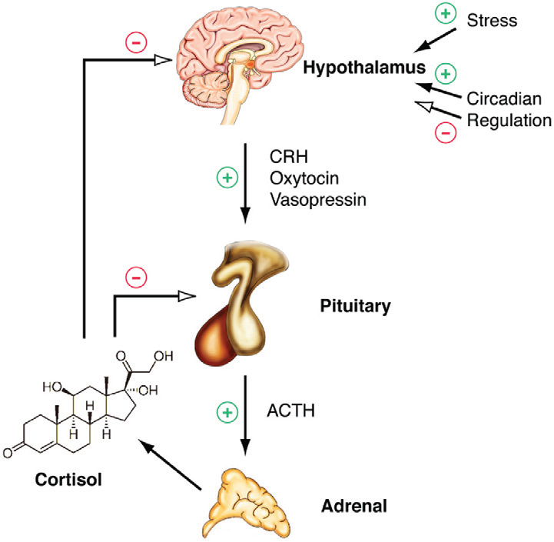

Slide 6
Causes
The cause of Cushing's syndrome is usually divided into two broad categories, Exogenous or endogenous
Exogenous causes
Most common cause is Prolonged use of glucocorticoids (e.g. prednisone) for diseases such as asthma and rheumatoid arthritis

Slide 7
cont
Endogenous causes
ACTH-dependent
Upto 85% of cases of endogenous
Pituitary tumor can secrete excess ACTH
A benign or malignant tumor on lung/other organ can also secrete excessive ACTH
Cushing’s due to a pituitary tumor is called Cushing’s Disease
All other causes are termed Cushing’s Syndrome.
ACTH-independent
Tumors of adrenal can secrete too much cortisol by themselves.
Relatively rare

Slide 8
Diagnoses of Cushing Syndrome
1. 24-hour urinary free cortisol level.
2.Low-dose dexamethasone suppression test

Slide 10
THANK YOU

