Slide 1
CE417: Construction Methods and Management
Tutorial #10
CH17:Construction Economics

Slide 2
Q1\A crawler tractor cost SR1,000,000 has an estimated salvage value of SR200,000 and has a 5 year life.
a. Find the annual depreciation and book value at the end of each year using sum-of-the-years’ –
digits method of depreciation.
A) Sum of the year digit of 5 years = 1 + 2 + 3 + 4 + 5 = 15
D1 =5/15(1000,000 – 200,000) = 266,666.67
D2 =4/15(1000,000 – 200,000) = 213,333.33
D3 =3/15(1000,000 – 200,000) = 160,000
D4 =2/15(1000,000 – 200,000) = 106,666.67
D5 =1/15(1000,000 – 200,000) = 53,333.33
Year | Depreciation | Book value(End of year)
0 | 0 | 1,000,000
1 | 266,667 | 733,333
2 | 213,333 | 520,000
3 | 160,000 | 360,000
4 | 106,667 | 253,333
5 | 53,3333 | 200,000

Slide 3
b. Calculate the average hourly owning cost for the second year of life of the tractor if the tractor is
operated 2000 hours during the year. The rate for interest, taxes, and insurance is 12% and the
rate for storage cost is 4%.
Depreciation cost = 213,333 SR/2000 hr = 106.66 SR/hr
Investment, tax, insurance, and storage (cost rate)= 12%+4%=16%
Average investment = (1000,000+200,000)/2 = SR 600,000
Cost = 600,000 (0.16)/2000= 48 SR/hr
Total Owning Cost= 106.66 + 48 = 154.66 SR/hr.

Slide 4
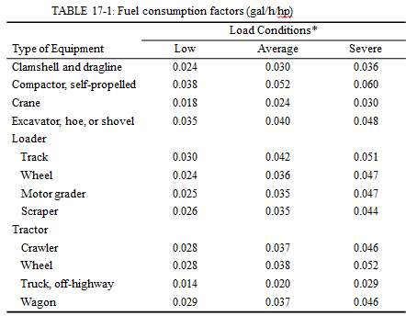
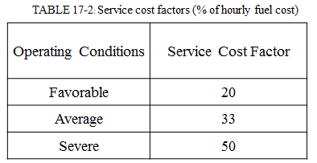
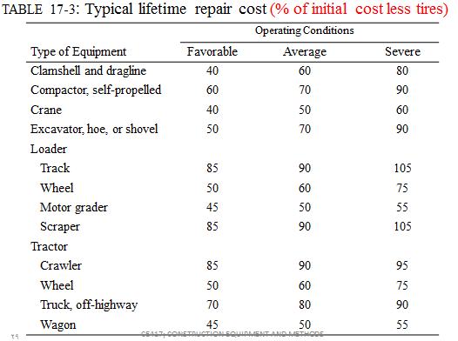
c. Calculate the average hourly operating costs for a crawler for the giving information :
Load conditions=average, Rated power = 415 hp ,Fuel price = SR 3.6 /gal ,Operator's wage = SR 25/hr
Fuel cost: (Table 17-1)
Estimated consumption = 0.037 x 415 = 15.35 gal/h Fuel cost = 15.35 ×3.6 = 55.27 SR/h
Service cost: (Table 17-2)
Service cost = 0.33 × 55.27= 18.23 SR/h
Repair cost: (Table 17-3)
Lifetime repair cost =0.90×(1,000,000-0) =900,000SR Repair cost=2/15×(900,000/2,000) = 60 SR/h
Operator cost:
Operator's wage = SR 25/hr
Total operating cost= 55.27+18.23+60+25=158.5 SR/h
Total O&O Cost = 154.66+158.5= 313.16 SR/hr.

Slide 5
Q2\ The Financial data for a project is shown below. Plot the accumulated project Expenditures , value of work and progress payments (Income) versus time. What the maximum negative cash flow
And when dose it occur? . Also, Draw the negative cash flow profile. The application of payment will be submitted by the contractor to the owner every month and payment will be at the middle of next months. The owner will deduct 10% from each payment as retention . All retention will be paid to the contractor with the final payment .
Month | End of moth Cumulative |  | Actual Receipt | Negative Cash Flow
 | Expenditure | Value of work |  | Before paid | After paid
1 | 12,000 SR | 8,000 SR
1.5 | 19,000 SR |  | 7,200 SR | 19,000 SR | 11,800 SR
2 | 26,000 SR | 22,000 SR
2.5 | 32,000 SR |  | 19,800 SR | 24,800 SR | 12,200 SR
3 | 38,000 SR | 34,000 SR
3.5 | 42,000 SR |  | 30,600 SR | 22,200 SR | 11,400 SR
4 | 46,000 SR | 50,000 SR
4.5 | 53,000 SR |  | 45,000 SR | 22,400 SR | 8,000 SR
5 | 60,000 SR | 68,000 SR
5.5 | 60,000 SR |  | 68,000 SR | 15,000 SR | -8000 SR

Slide 6
Note: the max. Negative cash flow is 24,800 SR and it is occur in month 2.5

Slide 7
Thank You
Questions Please

