Slide 1
CE417: Construction Methods and Management
Tutorial #2

Slide 2
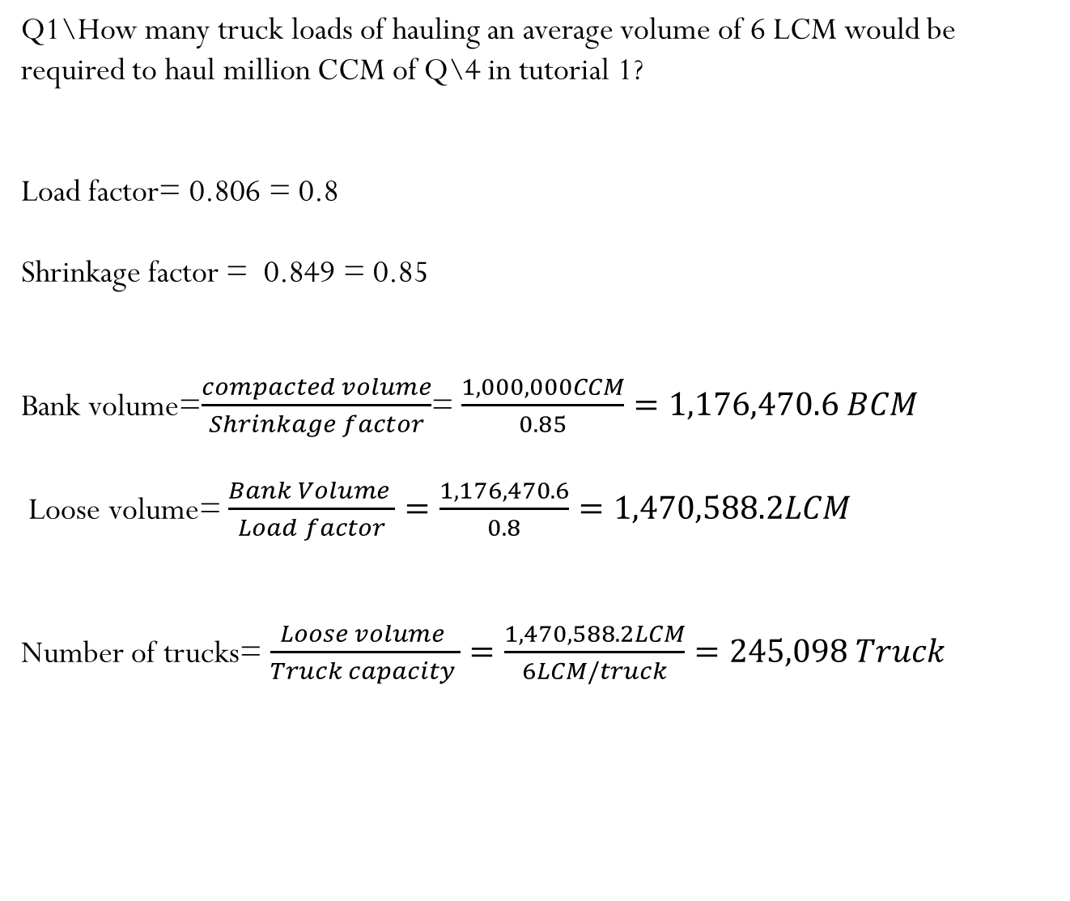
CH2: Earthmoving Materials and Operations
Q1\How many truck loads of hauling an average volume of 6 LCM would be required to haul million CCM of Q\4 in tutorial 1?
Load factor= 0.806 = 0.8
Shrinkage factor = 0.849 = 0.85
Bank volume=$\frac{compacted volume}{Shrinkage factor}$= $\frac{1,000,000CCM}{0.85}=1,176,470.6 BCM$
Loose volume= $\frac{Bank Volume }{Load factor}=\frac{1,176,470.6}{0.8}=1,470,588.2LCM$
Number of trucks= $\frac{Loose volume }{Truck capacity }=\frac{1,470,588.2LCM}{6LCM/truck}=245,098 Truck$

Slide 3
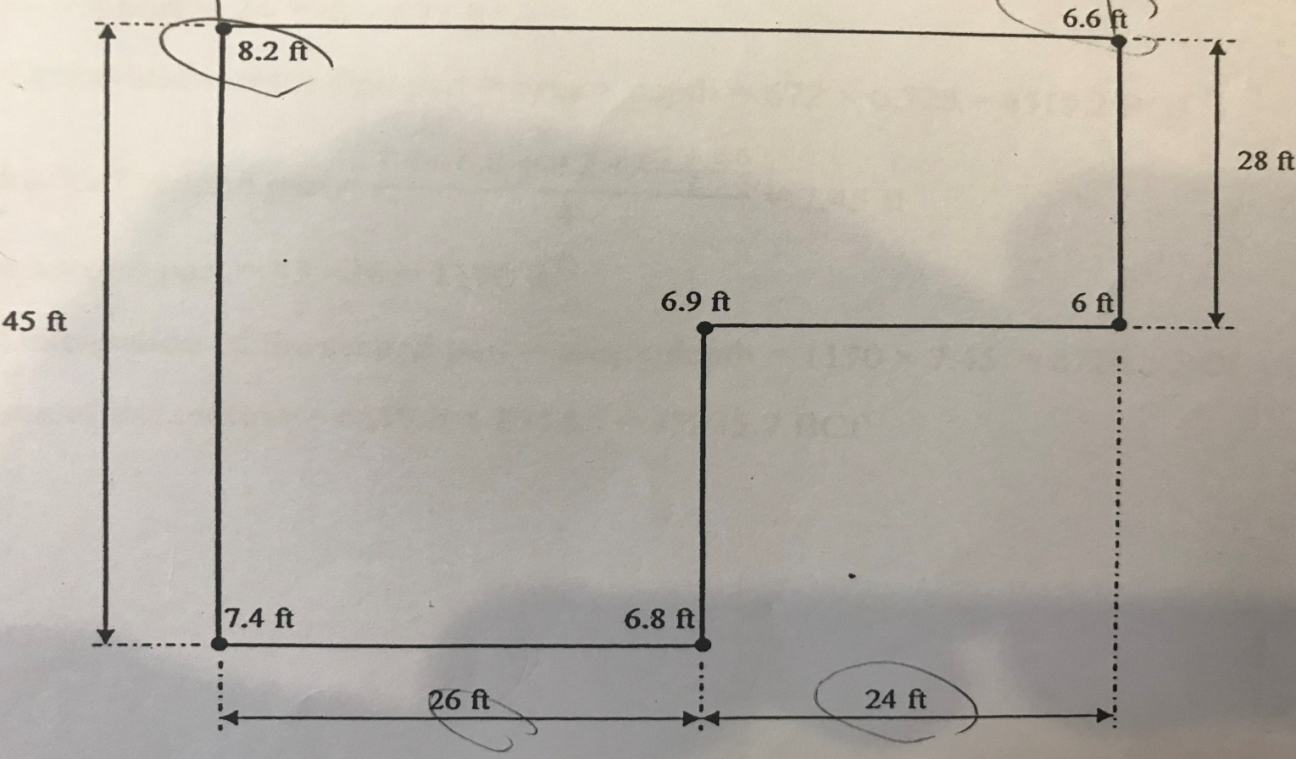

Q2\Calculate the volume of excavation in bank measure required for the basement shown?
By using interpolation $\frac{8.2−6.6}{26+24}=\frac{X}{24}≫X=0.768≫Depth=0.768+6.6=7.368 ft$
First part
second part

Slide 4
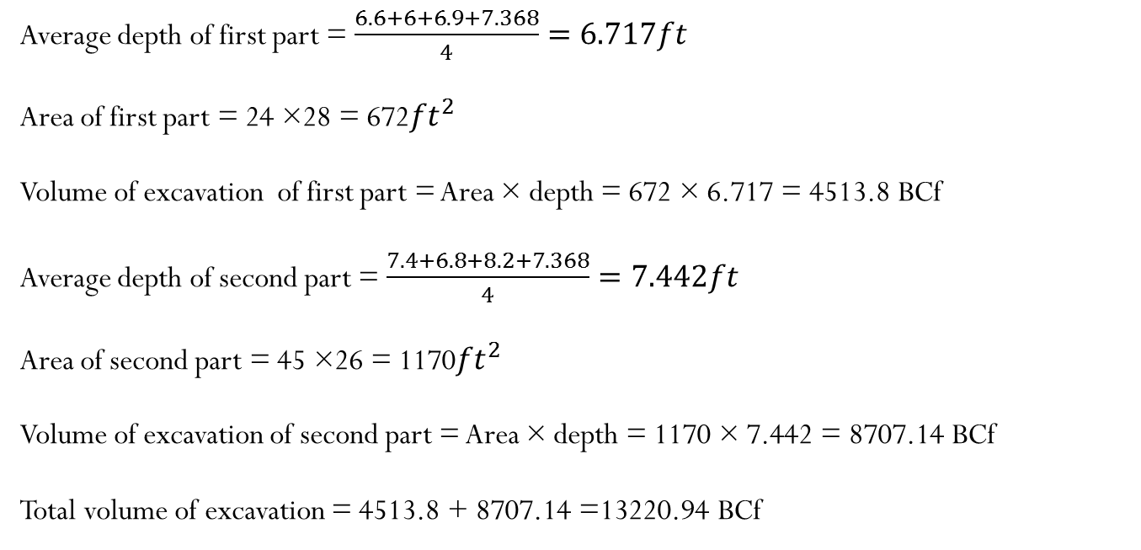
First part
second part
Average depth of first part = $\frac{6.6+6+6.9+7.368}{4}=6.717ft$
Area of first part = 24 ×28 = 672${ft}^{2}$
Volume of excavation of first part = Area × depth = 672 × 6.717 = 4513.8 BCf
Average depth of second part = $\frac{7.4+6.8+8.2+7.368}{4}=7.442ft$
Area of second part = 45 ×26 = 1170${ft}^{2}$
Volume of excavation of second part = Area × depth = 1170 × 7.442 = 8707.14 BCf
Total volume of excavation = 4513.8 + 8707.14 =13220.94 BCf

Slide 5
Q3\ Elevations of the normal ground with respect to a proposed highway are as following: (Assume width of the road= 1m)
Find the following:
1-Draw the highway profile and mass diagram.
2-The total volume of a cut , fill , waste and borrow.
3- The average length of haul in the balance sections.
Distance along centerline (m) | 0 | 500 | 1000 | 1500 | 2000 | 2500 | 3000 | 3500
Elevation(m) | 0 | -10 | 0 | 12 | 0 | -15 | 0 | 5
Volume($m^{3})$ | 0 | -2500 | -2500 | 3000 | 3000 | -3750 | -3750 | 1250
Cumulative Volume ($m^{3})$ | 0 | -2500 | -5000 | -2000 | 1000 | -2750 | -6500 | -5250

Slide 6
1-Draw the highway profile and mass diagram.

Slide 7
1-Draw the highway profile and mass diagram.
.
2-The total volume of a cut , fill , waste and borrow.
Total volume of cut = 7250 $m^{3}$ , Total volume of fill= 12500$m^{3}$
Borrow= 12500-7250=5250$m^{3} ,$Waste = Zero
3- The average length of haul in the balance sections.
Section 1 =916.6m
Section 2 = 166m

Slide 8
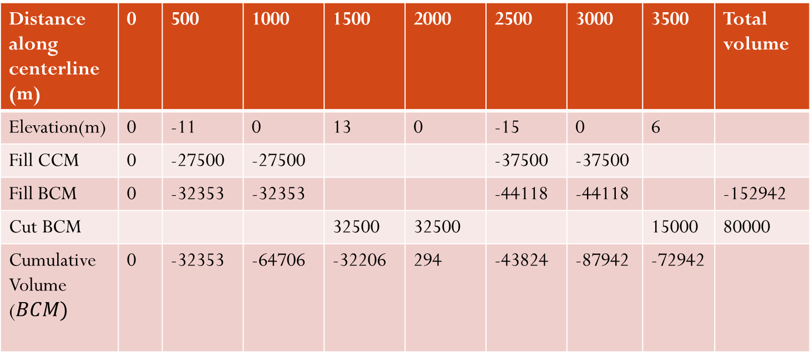
Q4\ Elevations of the normal ground with respect to a proposed highway are as following: (Assume width of the road= 10m & Shrinkage factor is 0.85)
Find the following:
1-Draw the highway profile and mass diagram.
2-The total volume of a cut , fill , waste and borrow.
3- The average length of haul in the balance sections
Distance along centerline (m) | 0 | 500 | 1000 | 1500 | 2000 | 2500 | 3000 | 3500 | Total volume
Elevation(m) | 0 | -11 | 0 | 13 | 0 | -15 | 0 | 6
Fill CCM | 0 | -27500 | -27500 |  |  | -37500 | -37500
Fill BCM | 0 | -32353 | -32353 |  |  | -44118 | -44118 |  | -152942
Cut BCM |  |  |  | 32500 | 32500 |  |  | 15000 | 80000
Cumulative Volume ($BCM)$ | 0 | -32353 | -64706 | -32206 | 294 | -43824 | -87942 | -72942

Slide 9
1-Draw the highway profile and mass diagram.

Slide 10
1-Draw the highway profile and mass diagram.
.
2-The total volume of a cut , fill , waste and borrow.
Total volume of cut = 80000BCM , Total volume of fill= 152942BCM
Borrow= 152942-80000=72942BCM$,$Waste = Zero
3- The average length of haul in the balance sections.
Section 1 =940m

Slide 11
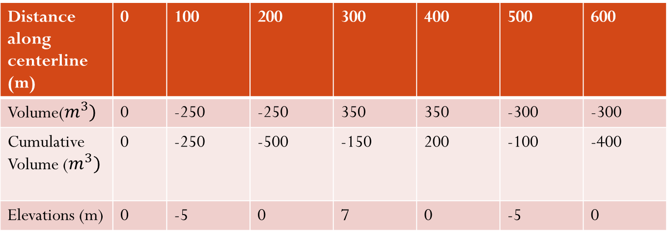
Q5\ Plot the highway profile & mass diagram for the given data , then find the total volume of cut , fill and waste or borrow. After that find average haul distance. : (Assume width of the road= 1m)
Distance along centerline (m) | 0 | 100 | 200 | 300 | 400 | 500 | 600
Volume($m^{3})$ | 0 | -250 | -250 | 350 | 350 | -300 | -300
Cumulative Volume ($m^{3})$ | 0 | -250 | -500 | -150 | 200 | -100 | -400
Elevations (m) | 0 | -5 | 0 | 7 | 0 | -5 | 0

Slide 12
1-Plot the highway profile.

Slide 13
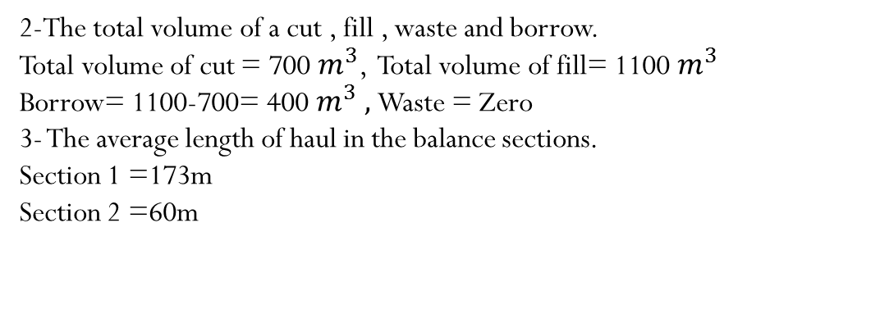
1-Plot the mass diagram.
.
2-The total volume of a cut , fill , waste and borrow.
Total volume of cut = 700 $m^{3}$, Total volume of fill= 1100 $m^{3}$
Borrow= 1100-700= 400 $m^{3} ,$Waste = Zero
3- The average length of haul in the balance sections.
Section 1 =173m
Section 2 =60m

Slide 14
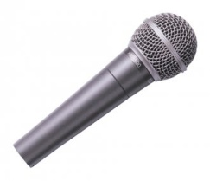
Thank You
Questions Please

