Slide 1
CE417: Construction Methods and Management
Tutorial #4

Slide 2
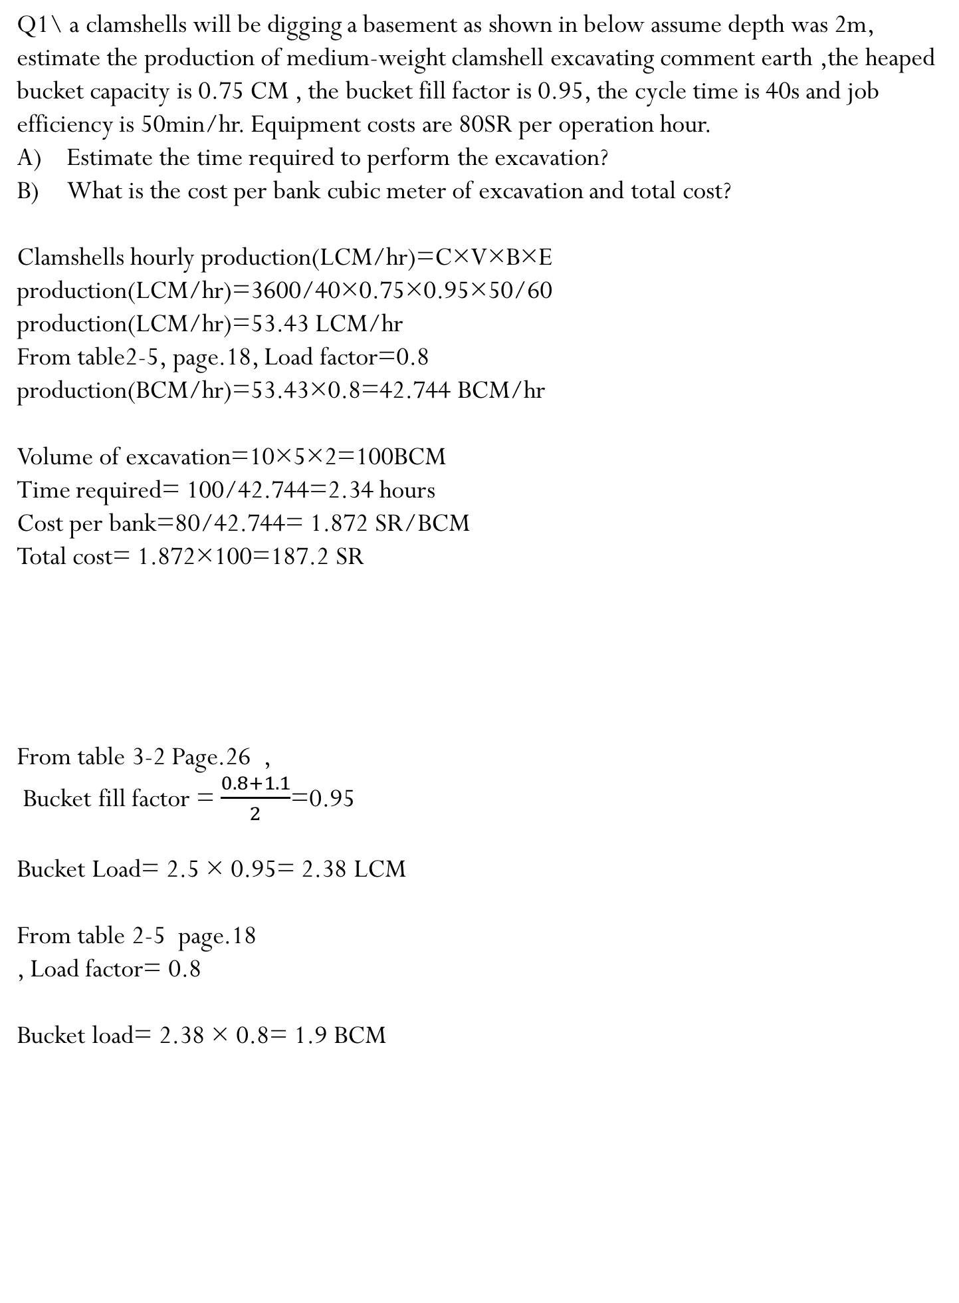
CH3: Excavating and Lifting
Q1\ a clamshells will be digging a basement as shown in below assume depth was 2m, estimate the production of medium-weight clamshell excavating comment earth ,the heaped bucket capacity is 0.75 CM , the bucket fill factor is 0.95, the cycle time is 40s and job efficiency is 50min/hr. Equipment costs are 80SR per operation hour.
Estimate the time required to perform the excavation?
What is the cost per bank cubic meter of excavation and total cost?
Clamshells hourly production(LCM/hr)=C×V×B×E
production(LCM/hr)=3600/40×0.75×0.95×50/60
production(LCM/hr)=53.43 LCM/hr
From table2-5, page.18, Load factor=0.8
production(BCM/hr)=53.43×0.8=42.744 BCM/hr
Volume of excavation=10×5×2=100BCM
Time required= 100/42.744=2.34 hours
Cost per bank=80/42.744= 1.872 SR/BCM
Total cost= 1.872×100=187.2 SR
From table 3-2 Page.26 ,
Bucket fill factor = $\frac{0.8+1.1}{2}$=0.95
Bucket Load= 2.5 × 0.95= 2.38 LCM
From table 2-5 page.18
, Load factor= 0.8
Bucket load= 2.38 × 0.8= 1.9 BCM
5m
10m

Slide 3
Thank You
Questions Please

