Slide 1


CE417: Construction Methods and Management
Tutorial #6

Slide 2
CH4:Loading and hauling
  Q1\A tractor scraper hauls its rated payload 1600 m up a 5% grade from the cut to fill and returns empty over the same route. The rolling resistance factor for the haul road is 60kg/ton. Estimate the scraper travel time.
  Solution:
  At hauling, scraper is loaded
  Grade = + 5%, rolling resistance factor = 60 Kg/ton
  Effective Grade % = Grade % + (Rolling Resistance factor kg/ton) / 10
  Effective Grade % = 5% + 60/10 = 11%
  From figure 4 – 4; Page.53
  Hauling time = 5.2 min.

Slide 3
  At retaining, scraper is empty
  Grade = −5 %, rolling resistance factor = 60 kg/ton
  Effective Grade % = −5% + 60/10 = 1%
  From figure 4 – 5;
  Retuning time = 1.9 min.
  Scraper travel time = hauling time + retuning time
  Scraper travel time = 5.2 + 1.9 = 7.1 min.

Slide 4
Q2\ Determine maximum speed of crawler tractor when the required pull (total resistance) is 60,000 lb (27240 kg) by Use the performance curve?
By using Figure 4-1 Page.50
  Speed are (1.6 km/h) for second gear and (2.4km/h) for first gear.
  The maximum possible speed is therefore (2.4 km/h) in first gear.

Slide 5
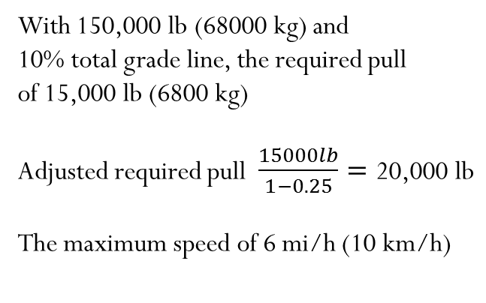
Q3\ Using the performance curve of Figure 4-2, determine the maximum speed of the vehicle if its gross weight is 150,000 lb (68000 kg),the total resistance is 10%, and the altitude derating factor is 25%?
  With 150,000 lb (68000 kg) and
  10% total grade line, the required pull
  of 15,000 lb (6800 kg)
Adjusted required pull $\frac{15000lb}{1−0.25}=\text{20}\text{,}\text{000 }\text{lb}$
The maximum speed of 6 mi/h (10 km/h)

Slide 6
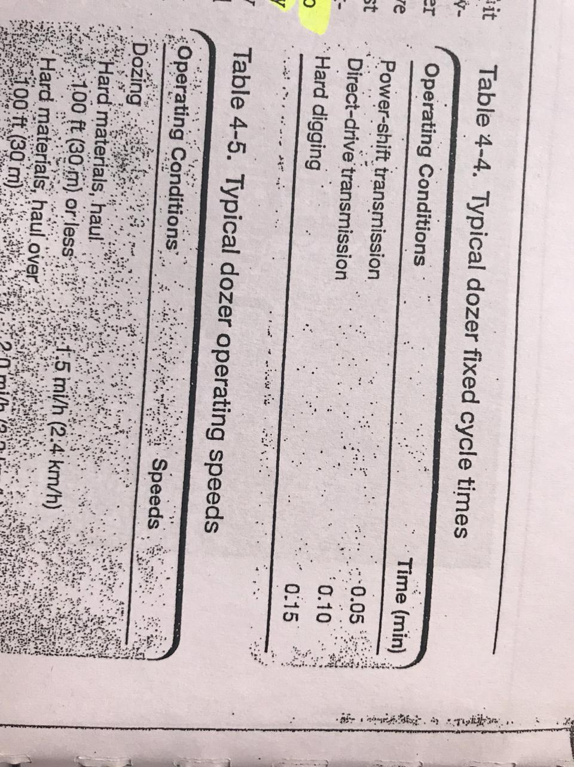
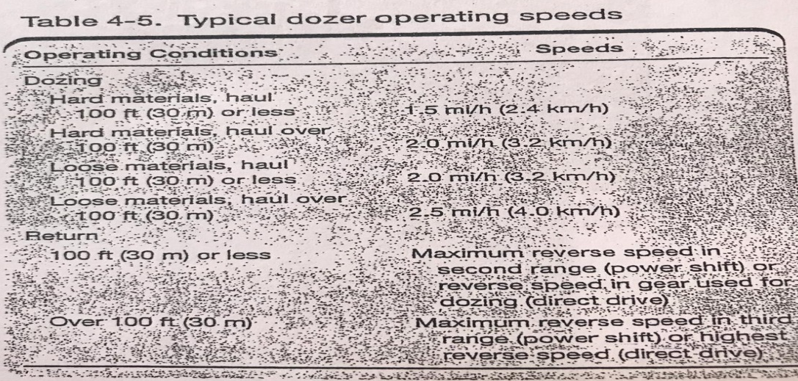

Q4\Estimate the production of the dozer with direct-driver transmission has Blade capacity of 9 LCM, the dozer excavating Hard common earth and pushing it distance of 40m , the highest reverse speed direct driver was 7km/h, job efficiency is 50min/h?
From Table 4-4 Page.56
Fixed time=0.1min
From Table 4-5 Page.56
Dozing speed= 3.2km/h
Dozing time=$\frac{40}{3.2×16.7}=0.75min$
Return time=$\frac{40}{7×16.7}=0.342min$
Cycle time=0.1+0.75+0.342=1.192min
Production(LCM/h)=9$×$(50/60)$×$(60/1.192)
Production(LCM/h)=377.51 LCM/h
(Note:1km/h=1000m/60min=16.66m/min)

Slide 7
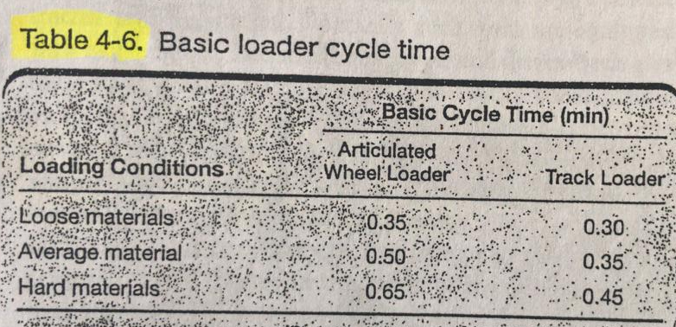
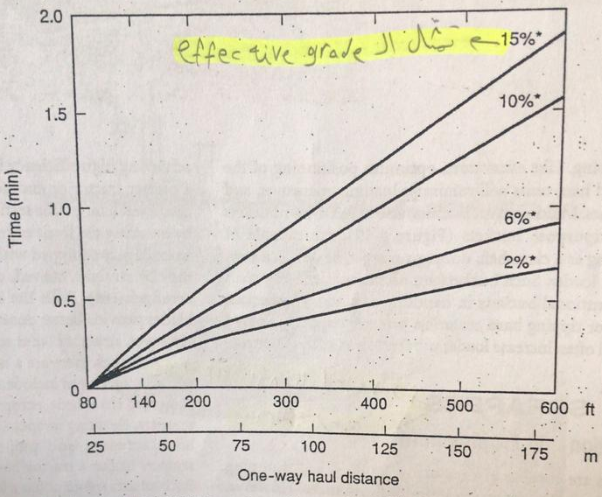

Q5\Estimate the hourly production of loader in (LCM/h) the bucket size was 2.68 LCM will excavating hard material ,the average haul distance is 150m, the effective grade is 10%, the bucket fill factor is 0.8 and job efficiency is 50min/h?
From Table 4-6 Page.61
Basic cycle time=0.65min
From Figure 4-16 page.61
Travel time=1.25min
Cycle time=0.65+1.25=1.9min
Production(LCM/h)=2.68$×$0.8$×$(60/1.9)$×$(50/60)
Production(LCM/h)=56.42 LCM/h

Slide 8


Thank You
Questions Please

