Slide 1
Chapter 3 Situation Assessment: The Company

Slide 2
Introduction
Strategies and tactics
Must be developed within an understanding of the overarching organizational context
Should contribute to the overall mission and goals

Slide 3
Introduction
Company assessment includes four related considerations:
Using guidance statements: missions and values
Assessing past performance and current strategy
Establishing preliminary objectives and targets
Identifying strategic gap(s) or planning gaps

Slide 4
Using Guidance Statements: Missions and Visions
Firms and business units begin their strategy formulation process with a mission or a vision statement
Mission statements establish purpose and values that shape an organizations vision
Vision statements are the forward-looking part of the mission

Slide 5
Using Guidance Statements: Missions and Visions
Mission/vision statements should include four elements:
The core purpose of the company
The core values of the company
The visionary goal
A vivid description of the envisioned future

Slide 6
Using Guidance Statements: Missions and Visions
In the strategic management, goals and objective are not the same:
Goals - desired results and conditions that are longer-term and general
Objectives - desired results or conditions that are short-term and specific
Goals are specified in mission and vision statements
Objectives are related to marketing plans, to specified time periods, and to specific marketing mixes

Slide 7
Using Guidance Statements: Corporate Social Responsibility
It is very important that marketing strategists consider corporate social responsibility
If the executive and the firm reject broader obligations, the rejection should be deliberate and explicit
Corporate social responsibility - a firm taking actions that appear to further some social good, beyond the interests of the firm and that which is required by law
It subsumes concerns for social and environmental outcomes

Slide 8
Changing Sentiment Toward Corporate Social Responsibility
Attitudes toward corporate social responsibility and the scope of “legitimate” commercial interests have evolved and continue to do so
One can search for opportunities to do business in socially and environmentally responsible ways that also enhance profitability and shareholder value

Slide 9
Stakeholder Theory
It broadens the understanding of the firm’s legitimate audiences and responsibilities
It asks two questions:
What is the firm’s purpose?
What is the firm’s obligations to its stakeholders?
Stakeholders - various groups of people or organizations that have an interest/ stake in the actions and the success of the firm
T hey can be internal or external

Slide 10
Stakeholder Theory
Stakeholders vary:
In their interest in the outcomes of the firm’s operations and in its success
In their power or influence over the firms actions

Slide 11
Stakeholder Theory
The fundamental premise of stakeholder analysis is a recognition that:
Firms have always had broader groups of interested parties than just shareholders
Stakeholders have:
Varying degrees of legitimate claims on the capabilities and resources of the firm
Legitimate power to influence the firm’s missions, visions, strategies, and actions

Slide 12
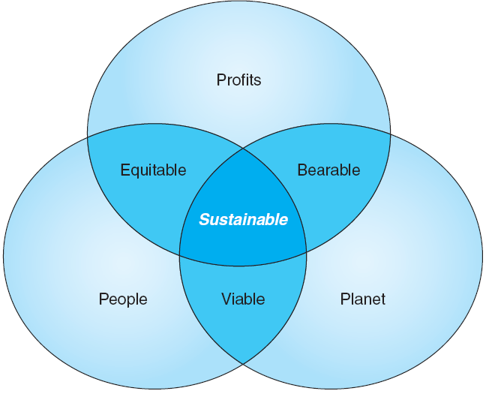
Figure 3-1 - The Triple Bottom Line
Notes:
The triple bottom line framework highlights three clusters of legitimate concerns for any business, and it is certainly useful for sorting out and clarifying otherwise disorganized considerations and stakeholders.
Challenges with this framework:
The development of valid metrics for nonfinancial outcomes.
How performance against the diverse metrics will be motivated and regulated.

Slide 13
Assessing Past Performance and Current Strategy
Challenge the present strategy, assessing its current competitiveness, and looking for areas of leverage are essential in developing the next strategies
Factors incorporated into assessment of past performance:
Review of ongoing financial and operating performance
Review of data from marketing information systems
The understanding of the firm’s existing competitive advantages and disadvantages vis-à-vis the competition

Slide 14
Assessing Past Performance and Current Strategy
Satisfaction, profitability, and loyalty are essential markers of quality from the customers’ perspective
Understanding a company’s competitive advantages is a crucial company-related consideration in creating and maintaining effective strategies

Slide 15
Table 3-1 - SMART Marketing-Plan Objectives
Notes:
Having clear marketing objectives enables a company to:
Focus and organize its efforts
Direct day-to-day activities and achieve consistency in decisions
Motivate people to strive for excellence
Provide a basis for assessment and control

Slide 16
Establishing Preliminary Objectives and Targets
Two distinct kinds of objectives are useful and common in developing marketing strategies:
Marketing related objectives
Financial objectives
Typical marketing objectives:
Sales volume and market share
Customer readiness variables
Customer behaviors and attitudes
Accounts and distribution

Slide 17
Establishing Preliminary Objectives and Targets
Typical financial objectives
Profits and return-on-investment
Costs of marketing
Inventory and logistics

Slide 18
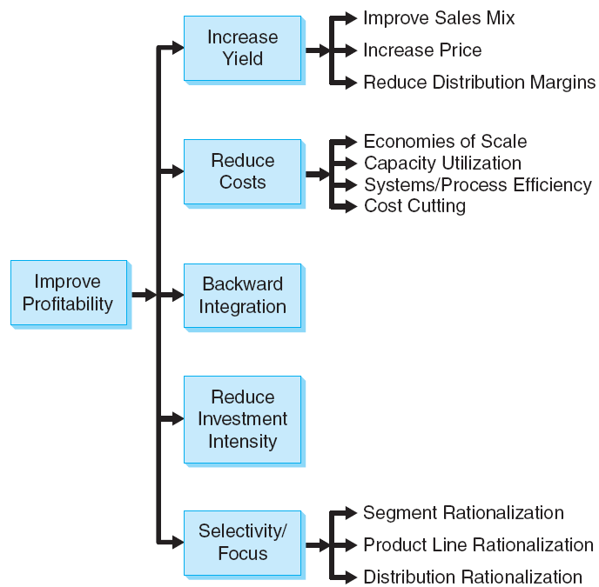
Figure 3-3 - Alternatives for Improving Profitability
Notes:
The figure shows the generic profitability improvement strategies.
A company might employ several of these strategies simultaneously.

Slide 19
Integrating Situation Assessment
Situation assessments are analytical
They assess, integrate, and organize vast and potentially overwhelming data into organized information that can be used to drive decision making and action
Situation assessment establishes the foundations for planning and strategy formulation

Slide 20
Integrating Situation Assessment
Tools for systematically managing and integrating situation assessment and to structure the product of that assessment in ways that facilitate strategic thinking
Relevance test
Scenario analysis

Slide 21
All rights reserved. No part of this publication may be reproduced, stored in a retrieval system, or transmitted, in any form or by any means, electronic, mechanical, photocopying, recording, or otherwise, without the prior written permission of the publisher. Printed in the United States of America.
Copyright © 2012 Pearson Education, Inc.
Publishing as Prentice Hall

