Slide 1
Chapter 14
Making Use of Associations Tests
Copyright © 2014 Pearson Education, Inc.
1

Slide 2
Learning Objectives
To learn what is meant by an “association” between two variables
To examine various relationships that may be construed as associations
To understand where and how cross-tabulations with Chi-square analysis are applied
•To become familiar with the use and interpretation of correlations
•To learn how to obtain and interpret cross-tabulations, Chi-square findings, and correlations with SPSS

Slide 3
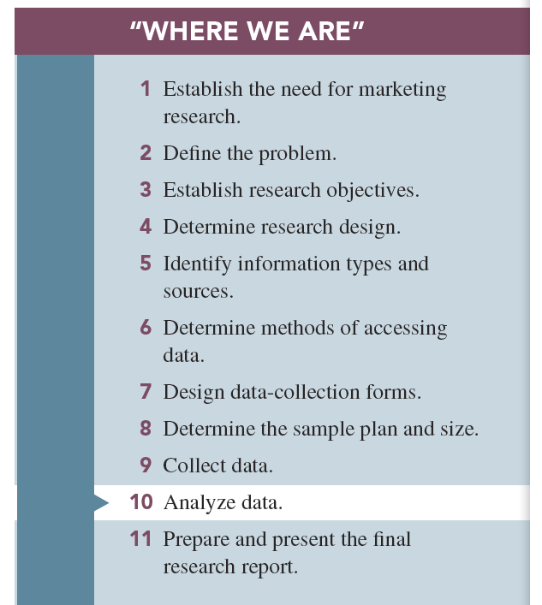

Slide 4
Significant Associations can help Managers make Better Decisions
Associative analyses: determine where stable relationships exist between two variables.
Associative analyses procedures are useful because they determine if there is a consistent and systematic relationship between the presence(label) or amount (level) of one variable and the presence ( lable) or amount (level) of another variable.

Slide 5
Types of Relationships Between Two Variables
Relationship: a consistent, systematic linkage between the levels or labels for two variables
“Levels” refers to the characteristics of description for interval or ratio scales.
“Labels” refers to the characteristics of description for nominal or ordinal scales.

Slide 6
There are four basic types of Relationships Between Two Variables
1-Nonmonotonic.
2- Monotonic.
3- Linear.
4- Curvilinear.
1-Nonmonotonic relationship: two variables are associated, but only in a very general sense. The presence (or absence) of one variable is associated with the presence (or absence) of another.

Slide 7
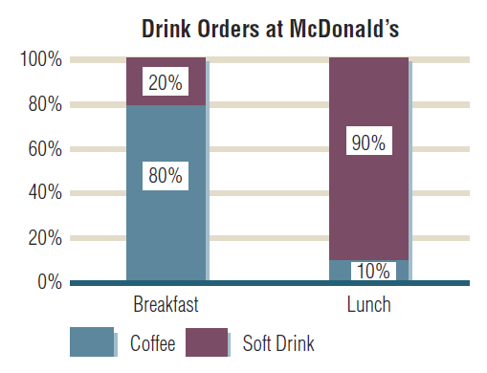
Example Relationship

Slide 8
2-Monotonic relationship: the general direction of a relationship between two variables is known.
- There are two types of monotonic relationship;
a)Increasing relationship; are those in which one variable increases as the other variable increases.
b)Decreasing relationship; are those in which on variable increases as the other variable decreases.

Slide 9
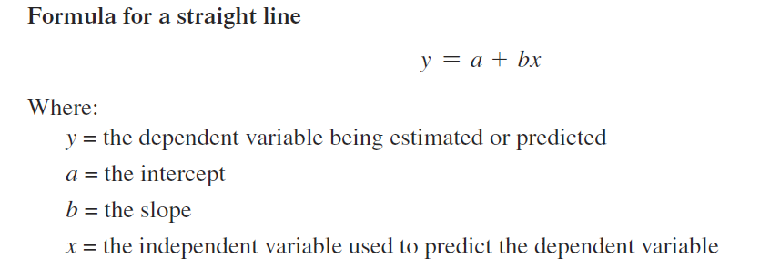
3- Linear relationship: “straight-linear association” between two variables.
- Linear relationship are quite precise.

Slide 10
4- Curvilinear relationship: are those in which one variable is associated with another variable , but the relationship is described by a curve rather than a straight line.
- The relationship may be an S-shape, a J-shape, or some other curved-shape pattern.

Slide 11
Characterizing Relationships Between Variables
Depending on its type, a relationship can usually be characterized in three ways by ;
1-Presence: whether any systematic (statistical) relationship exists between two variables
2-Direction or pattern: Direction means that you know if the relationship is positive or negative , While pattern means you know the general nature of the relationships.
3-Strength of association: how strong the relationship is : strong? Moderate? Weak?

Slide 13
Cross-Tabulations
Cross-tabulation and the Associated Chi-square value we are about to explain are used to assess if a nonmonotonic relationship exists between two nominally scaled variables.
Cross-tabulation: rows and columns defined by the categories classifying each variable; used for nonmonotonic relationships
Cross-tabulation cell: the intersection of a row and a column

Slide 14
Types of Frequencies and percentages in a Cross-Tabulations Table
Frequencies are the raw numbers in the cell.
Three types of numbers in each cell
1-Raw percentage
2-Column percentage
3-Row percentage

Slide 15
1-Raw percentages table are cell frequencies divided by the grand total.
2-Row percentages table are the row cell frequencies divided by its row total.
3-Column percentages table are the column cell frequencies divided by its column total.
*Column cell percent =Cell frequency / Total of cell frequencies in that column
*Row cell percent= cell frequency/ Total of cell frequencies in that row

Slide 16
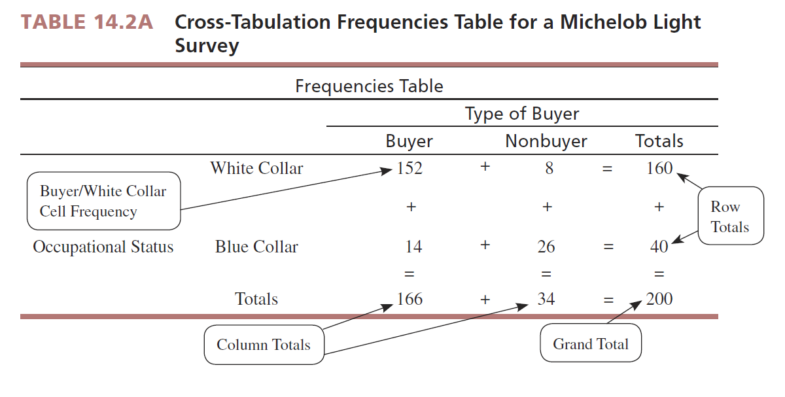

Slide 17
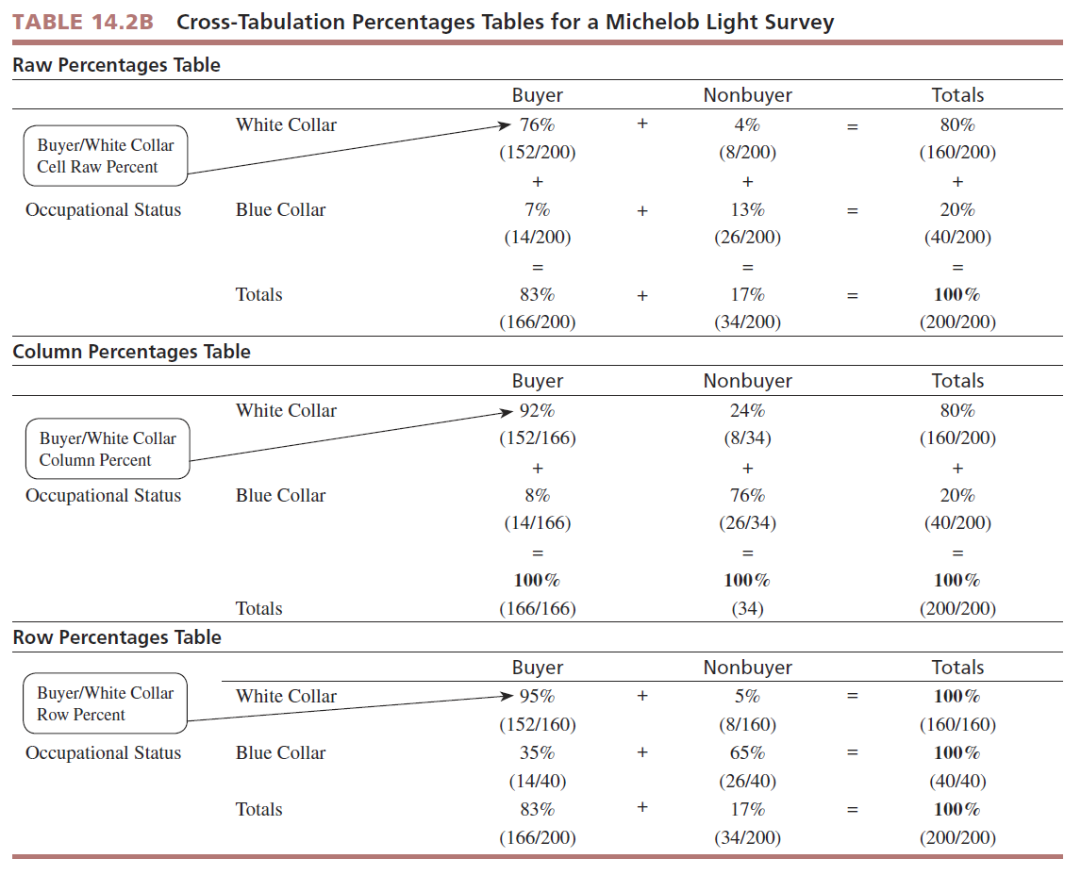

Slide 18
Chi-Square Analysis
Chi-square analysis: the examination of frequencies for two nominal-scaled variables in a cross-tabulation table to determine whether the variables have a significant relationship

Slide 19
Assesses non-monotonic association in a cross-tabulation table based upon differences between observed and expected frequencies.
The null hypothesis is that the two variables are not related.
Observed frequencies are the actual cell counts in the cross-tabulation table.
Observed frequencies are compared to expected frequencies.

Slide 20
Observed and Expected Frequencies
Observed Frequencies , which are the actual cell count in the cross-tabulation table.
Expected frequencies which are defined as the theoretical frequencies in each cell that are derived from this hypothesis of no association between the two variables.

Slide 21
The Computed X² Value
Computed Chi-square values:

Slide 22
The computed Chi-square value compares observed to expected frequencies.
The Chi-square statistic summarizes is the degree to which the observed frequencies depart from the expected frequencies is express in single number.

Slide 23
The Chi-Square Distribution

Slide 24
The Chi-square distribution is skewed to the right, and the rejection region is always at the right-hand tail of the distribution.
The shape of the distribution is dependent on degrees of freedom.
The computed Chi-Square value is compared to a table value to determine statistical significance.
Computer statistical programs look up table Chi-Square values and print out the probability of support for the null hypothesis.

Slide 25
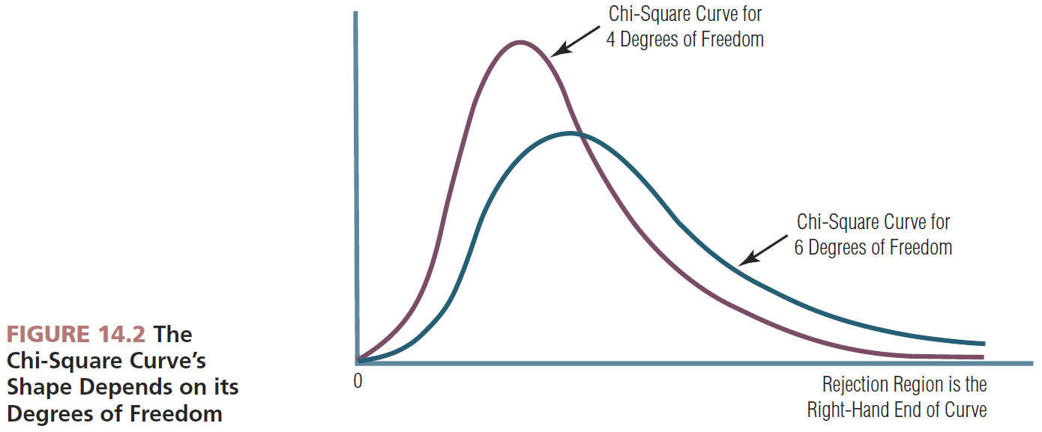

Slide 26
How to Interpret a Chi-square Result
Chi-Square analysis yields the amount of support for the null hypothesis if the researcher repeated the study many times with independent sample.
SPSS and other statistical analysis programs compare calculated to table values and show the probability for support of the null hypothesis.
A significant Chi-square means the researcher should look at the cross-tabulation row and column percentages to “see” the association pattern.

Slide 27
With SPSS, Chi-Square is an option under the “crosstabs” analysis routine .
With Chi-Square analysis , interpret the SPSS significance level as the amount of support for no association between the two variables being analyzed.

Slide 28
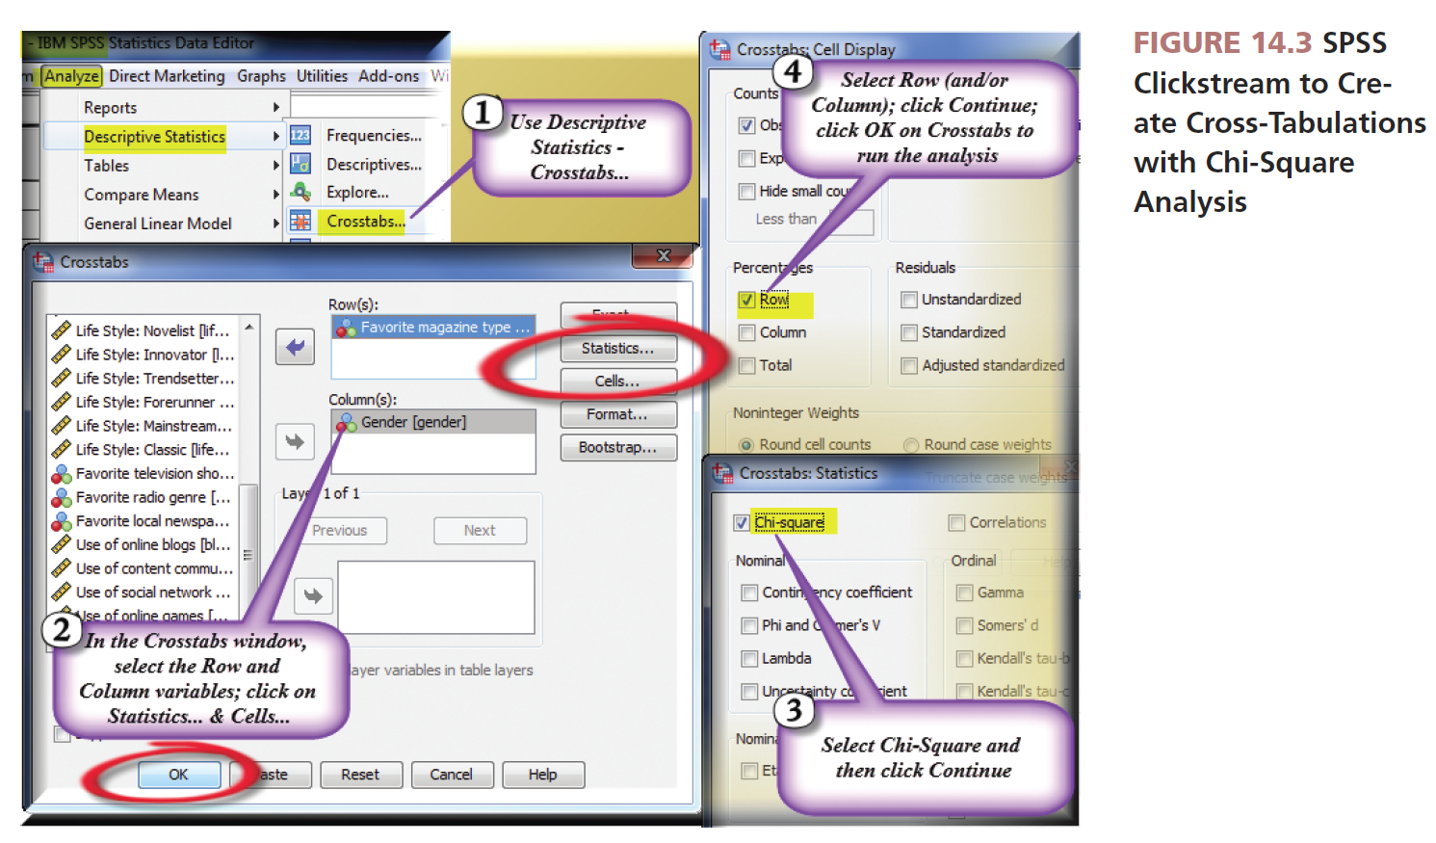
Source: Reprint courtesy of International Business Machines Corporation,©SPSS, Inc., an IBM Company.

Slide 29
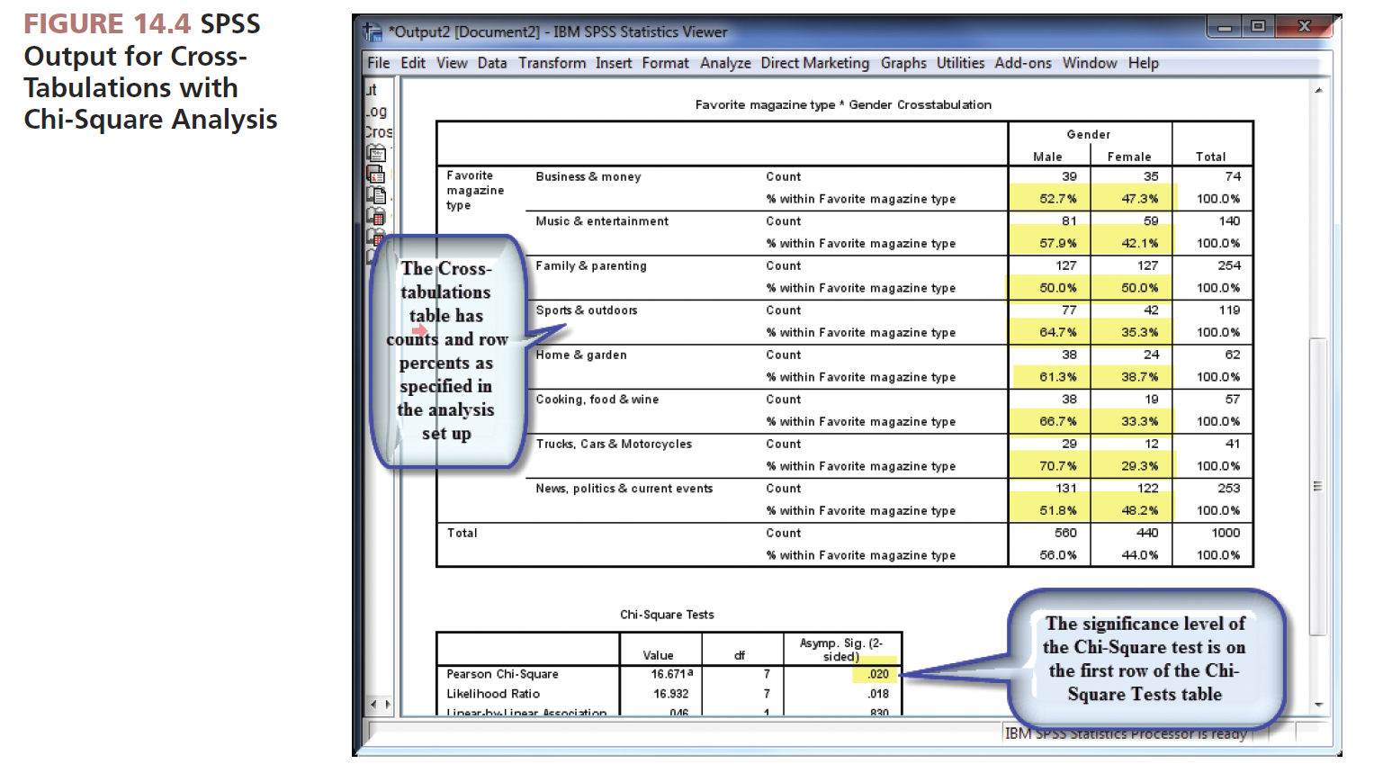
Source: Reprint courtesy of International Business Machines Corporation,©SPSS, Inc., an IBM Company.

Slide 30
• If the P value is ≤ to 0.05, this means there is little support for the null hypothesis (no association).
•Therefore, we have a significant association and have the PRESENCE of a systematic relationship between the two variables.

Slide 31
Reporting Gross-Tabulation Findings to Clients
Whenever the researcher finds a statistically significant cross-tabulation relationship , he moves to the presentation phase.
Researcher often turn to graphical presentation as pictures will show the relationships adequately.
Bar charts can be used to “see” a nonmontonic relationship.

Slide 32
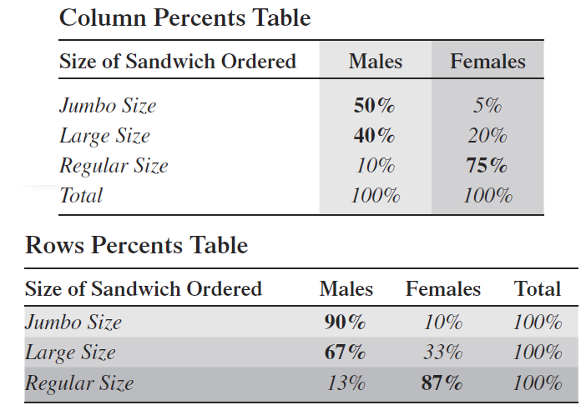
Whether to report row or column percents depends on research objectives.

Slide 33
Correlation Coefficients and Covariation
The correlation coefficient: an index number, constrained to fall between the range of −1.0 and +1.0
The correlation coefficient communicates both the strength and the direction of the linear relationship between two metric variables.
To use a correlation, you must first determine that it is statistically significant from zero.
Covariation: the amount of change in one variable systematically associated with a change in another variable

Slide 34
The Correlation Sign the Direct of the Relationship
A correlation indicates the strength of association between two variables by the absolute size of the correlation coefficient.
The direction of the association is communicated by the sign (+, −) of the correlation coefficient.

Slide 35
Graphing Covariation using Scatter Diagrams -Covariation can be examined with use of a scatter diagram.
FIGURE 14.5 A Scatter
Diagram Showing
Covariation

Slide 36
Graphing Covariation Using Scatter Diagrams

Slide 37
A correlation coefficient’s size indicates the strength of association between two variables.
The sign (+ or −) indicates the direction of the association.

Slide 38
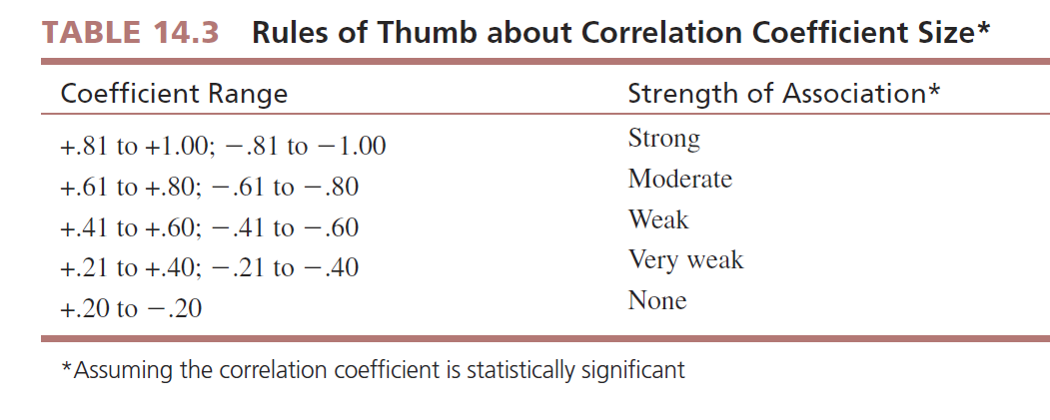

Slide 39
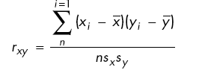
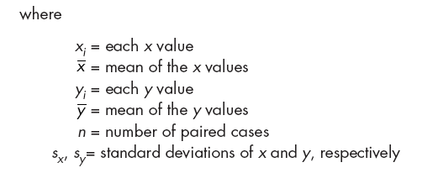
Pearson Correlation Coefficient (r)
Pearson Correlation Coefficient (r): measures the degree of linear association between the two variables

Slide 40
A positive correlation signals an increasing linear relationship whereas a negative correlation signals a deceasing one.

Slide 41
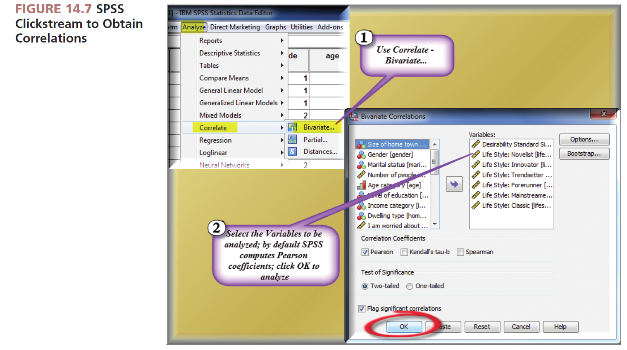
Source: Reprint courtesy of International Business Machines Corporation,©SPSS, Inc., an IBM Company.

Slide 42
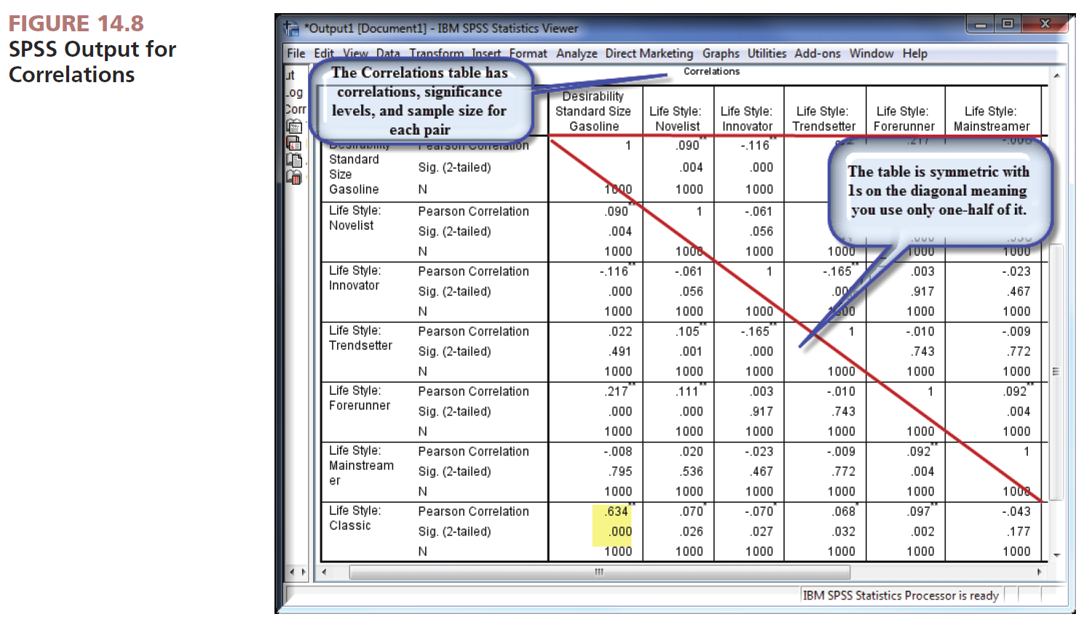
Source: Reprint courtesy of International Business Machines Corporation,©SPSS, Inc., an IBM Company.

Slide 43
Whenever you instruct SPSS to compute correlations, its output is a symmetric correlation matrix composed of rows and columns that pertain to each of the variables.
Each cell in the matrix contains three items;
1- The correlation coefficient.
2- The significance level.
3- The sample size.
*With correlation analysis, each correlation has unique significance level.

Slide 44
Special Considerations in Linear Correlation Procedures
Perhaps because the word Correlation is used in everyday language, statistical correlations are sometimes misunderstood by clients.
Four caution to keep in mind when working with correlations:
1-Assumes both variables share interval scaling at minimum.
2-Only takes into account the relationship between two variables, not interaction with other variables.
3-Does not demonstrate cause and effect.
4-Will not detect nonlinear relationships between variables.

Slide 45
Reporting Correlation Findings to Clients
The researcher must test to determine that a significant correlation has been found before reporting it.
To our knowledge, there is no marketing research industry standard on how to report statically significant correlations to clients.

Slide 46
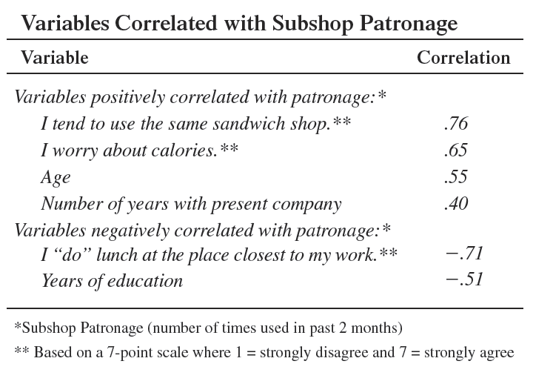
Reporting Example

