Slide 1
Chapter one
The Nature of strategic Management

Slide 2
- Defining strategic management
Strategic management can be defined as the art and science of formulating , implementing and evaluating cross-functional decisions that enable an organization to achieve its objectives .
- Strategic management focuses on integrating (management , marketing , finance , accounting , production , operations , research and development, and MIS ) to achieves organizational success .

Slide 3
The term strategic management is used synonymously with the term strategic planning . Is it right?

Slide 4
The purpose of strategic management is to exploit and create new and different opportunities for tomorrow

Slide 5
- Strategic plan is in essence , a company’s game plan
- A strategic plan results from tough managerial choices among numerous good alternatives .

Slide 6
Characteristics of strategic management:
1- strategic planning is not a reaction to short term changes , it is response to long term perspectives
2- strategic planning is qualitative in nature and reflects
a realistic imagination of how the future looks
3- it is not the plan for any single function , it is the integration of all major functions of the firm
4- it is not a normative statement , it is a road map which describes in general terms , the steps the firm should undertake to get there .
5- it is a set of practical , well-thought-out perspectives and actions on how to deal with uncertainties and ambiguities of the future .

Slide 7
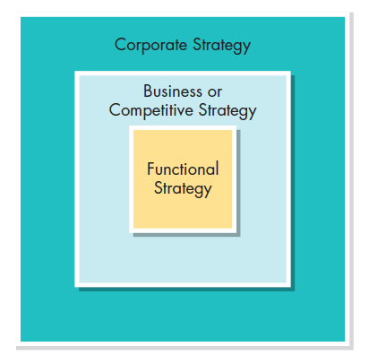
Hierarchy of Strategy
Notes:
the three types of strategy that are usually considered by a company are corporate strategy, business (or competitive) strategy,
and functional strategy.

Slide 8
Types of Strategy
Corporate Strategy
strategy for determining the firm’s overall attitude toward growth and the way it will manage its businesses or product lines
Business (or Competitive) Strategy
strategy, at the business-unit or product-line level, focusing on improving a firm’s competitive position

Slide 9
Types of Strategy
Functional Strategy
strategy by which managers in specific areas decide how best to achieve corporate goals through productivity

Slide 10
Stages of Strategic Management
Strategy formulation
Strategy implementation
Strategy evaluation

Slide 11
- Stages of strategic management
The strategic management process consists of three stages :
Strategy formulation
Strategy implementation
Strategy evaluation

Slide 12
1- Strategy formulation includes:
Developing a vision and mission
Identifying an organization’s external opportunities and threats
Determining internal strengths and weaknesses
Establishing long-term objectives
Generating alternative strategies, and choosing particular strategies to pursue.

Slide 13
- Strategy formulation issues include :
Deciding what new businesses to enter
What businesses to abandon
How to allocate resources
Whether to expand operations or diversify
Whether to enter international markets
Whether to merge or form a joint venture
How to avoid a hostile takeover

Slide 14
Why the strategy formulation is important ?
-Because no organization has unlimited resources , strategists must decide which alternative strategies will benefit the firm most.
-Top managers have the best perspective to understand fully the ramifications of strategy formulation decisions ; they have the authority to commit the resources necessary for implementation.

Slide 15
2- Strategy implementation requires:
Establish annual objectives
Devise policies
Motivate employees
Allocate resource

Slide 16
Strategy implementation often is called the “action stage” of strategic management.
- What is the most difficult stage in strategic management? And why?
Implementation strategy, because it's requires personal discipline, commitment, and sacrifice.
* Successful strategy implementation hinges upon managers’ ability to motivate employees, which is more an art than a science.

Slide 17
3- Strategy evaluation:
Reviewing external and internal factors.
Measuring performance.
Taking corrective actions.

Slide 18
Strategy Evaluation
Strategy Evaluation is the final stage in strategic management .
All strategies are subject to future modification because :
external and internal factors are constantly changing .
Today’s success is no guarantee of future success
New and different problems

Slide 19
Strategic Thinking
An article in Forbes recently discussed five different types of strategic leadership thinking :
Critical thinking or the mental process of objectively analyzing a situation by gathering information from all possible sources, and then evaluating both the tangible and intangible aspects, as well as the implications of any course of action.
Implementation thinking or the ability to organize ideas and identify actions in a way that they will be effectively carried out.

Slide 20
Strategic Thinking
Conceptual thinking or the ability to find connections or patterns between abstract ideas and then place the pieces together for a complete picture.
Innovative thinking involves generating new ideas or creative ways of approaching things to create possibilities and opportunities.
Intuitive thinking or the ability to take your perceptions and, without knowledge or evidence, factor it in to the final decision.

Slide 21
Integrating Intuition & Analysis
Strategic Thinking
-In the Arab world, there is a cultural tendency to emphasize the role of intuition and imagination in decision Making.
- Analytical thinking and intuitive thinking complement each other .

Slide 22
Adapting to Change
-The strategic management process is based on the belief that organization should continually monitor internal and external events and trends so that timely changes can be made as need .
-The strategic management process is aimed at allowing organization to adapt effectively to change over the long run.

Slide 23
Key Terms in Strategic Management
* Competitive advantage:
Strategic management is all about gaining and maintaining competitive advantage. This term can be defined as “anything that a firm does especially well compared to rival firm". When a firm can do something that rival firms cannot do, or owns something that rival firms desire, that can represent a competitive advantage.
A firm must strive to achieve sustained competitive advantage by:
1- Continually adapting to changes in external trends and events and internal capabilities competencies, and resources.
2- Effectively formulating, implementing, and evaluating strategies that capitalize upon those factors.

Slide 24
Key Terms in Strategic Management
* Strategists:
Strategists are the individuals who are most responsible for the success or failure of an organization.
Strategists have various job titles, such as:
CEO)) Chief executive Officer
CSO)) Chief strategy Officer
president
Owner
chair of the board
Executive director chancellor
Dean
Entrepreneur.

Slide 25
Key Terms in Strategic Management
* Vision and Mission Statements:
Vision statement that answers the question “What do we want to become?
- Developing a vision statement is often considered the first step in strategic planning.
- Example:
Vision of AlBilad Bank:
"To be the preferred choice of genuine Islamic banking solutions".

Slide 26
Mission statements are “enduring statements of purpose that distinguish one business from other similar firms. A mission statement identifies the scope of a firm’s operations in Product and market terms. "It addresses the basic question that faces all strategists:
“What is our business?
- A mission statement is a constant reminder to its employees of why the organization exists.
- Example:
Mission of AlBilad Bank:
"To strive through initiatives and innovation to provide our banking services on a genuine Islamic basis to meet the ambitions of our stakeholders: clients, employees and shareholders".

Slide 27
Key Terms in Strategic Management
* External Opportunities and Threats:
External opportunities and external threats refer to:
Economic, social, cultural, demographic, environmental, political, legal, governmental, technological, and competitive trends.
- Opportunities and threats may include the passage of a law, the introduction of a new product by a competitor, a national catastrophe, or the declining value of the dollar.
- Environmental scanning: identifying, monitoring, and evaluating external opportunities and threats are essential for success, conducting research, gathering, and assimilating external information.

Slide 28
Key Terms Opportunities & Threats
The basic tenet of strategic management:
Maximize External Opportunities
Strategy Formulation
Avoid/minimize impact of External Threats

Slide 29
Key Terms in Strategic Management
* Internal Strengths and Weaknesses:
Internal strengths and internal weaknesses are an organization’s controllable activities that are performed especially well or poorly.
-They arise in the : management, marketing, finance/accounting, production/operations, research and development, and management information systems.
--Internal factors can be determined in a number of ways such as:
Computing ratios, measuring performance, and comparing to past periods and industry averages.

Slide 30
Long Term Objectives
Long-term Objectives:
Are specific results that an organization seeks to achieve in pursuing its basic mission for more than one year
Objectives should be challenging, measurable, consistent, reasonable, and clear.
Annual Objectives:
Short-term milestones that firms must achieve to attain long-term objectives
28
Copyright © 2011 Pearson Education

Slide 31
Long Term Objectives
Long term objectives are essential for ensuring a firm’s success. They:
Provide direction
Help with evaluation
Create synergy
Focus coordination
Basis for planning, motivating, and controlling
29
Copyright © 2011 Pearson Education
Copyright © 2009 Pearson Education, Inc.
Publishing as Prentice Hall

Slide 32
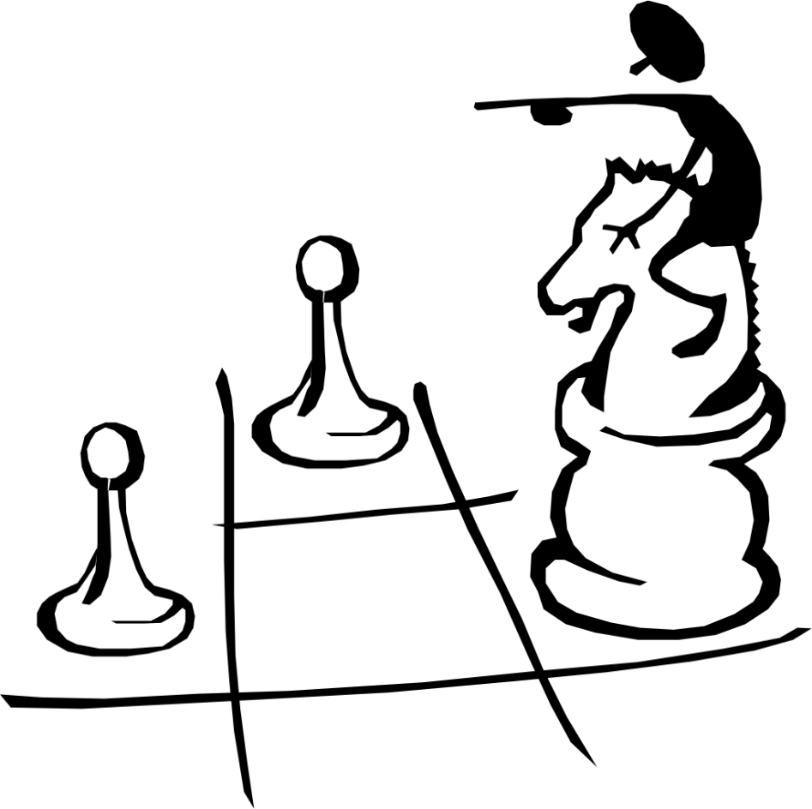
Strategies
Strategies are the means by which long-term objectives are achieved
Some examples of different strategies are:
Geographic expansion
Diversification
Acquisition
Market penetration
Retrenchment
Liquidation
Joint venture
Copyright © 2009 Pearson Education, Inc.
Publishing as Prentice Hall

Slide 33
Key Terms in Strategic Management
*Policies:
Means by which annual objectives will be achieved
Policies include guidelines, rules, and procedures established to support efforts to achieve stated objectives.
Ex: Non Smoking working environment
.

Slide 34
The strategic- management model
The Strategic Management Process
Dynamic & continuous
More formal in larger organizations
Good communication and feedback are needed
A change in any one of the major components in the model can necessitate a change in any or all of the other components

Slide 35
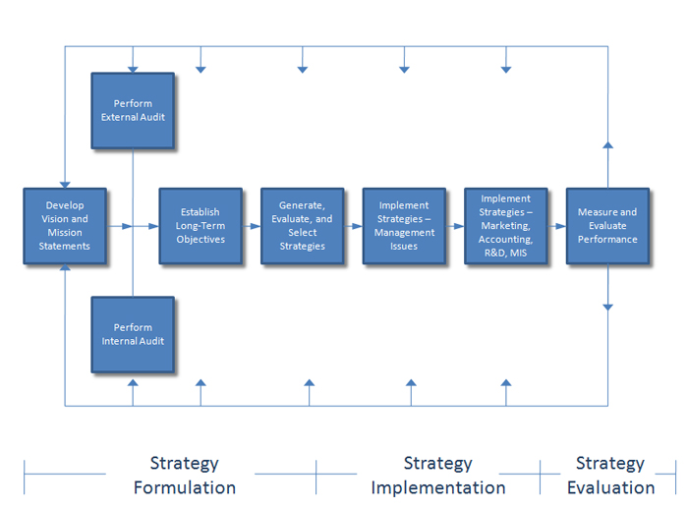
Strategic Management Model

Slide 36
Benefits of Strategic Management
Strategic Management:
Is proactive in shaping firm’s future
Initiates and influences firm’s activities
Helps to formulate better strategies that are systematic, logical, and rational
35
Copyright © 2011 Pearson Education

Slide 37
Benefits of Strategic Management
Financial Benefits
Improvement in sales
Improvement in profitability
Productivity improvement
Nonfinancial Benefits
Improved understanding of competitors’ strategies
Enhanced awareness of threats
Increased employee productivity
Reduced resistance to change
Enhanced problem-prevention capabilities
Ch 1 -33
36
Copyright © 2009 Pearson Education, Inc.
Publishing as Prentice Hall

Slide 38
Greenly stated that strategic management offers the following benefits:
Identification of opportunities
Objective view of management problems
Improved coordination & control
Minimizes adverse conditions & changes
Decisions that better support objectives
Effective allocation of resources
Reduces resources and time spent correcting erroneous decisions
38
Copyright © 2011 Pearson Education

Slide 39
Greenly stated that strategic management offers the following benefits:
Internal communication among personnel
Integration of individual behaviors
Clarify individual responsibilities
Encourages forward thinking
Cooperative approach to tackling problems and opportunities
Encourages favorable attitude toward change
Gives discipline to business management
39
Copyright © 2011 Pearson Education

Slide 40
Why Some Firms Do No Strategic Planning?
Reasons why some firms are resistant to strategic planning include:
Poor reward structures
Fire-fighting
Chief executives’ orientation
Lack of access to needed resources
Waste of time
Too expensive
Laziness
Content with success
Fear of failure
Overconfidence
Prior bad experience
Self-interest
Fear of the unknown
Honest difference of opinion
Suspicion
40
Copyright © 2011 Pearson Education
Notes:
Why Some Firms Do No Strategic Planning
Some firms do not engage in strategic planning, and some firms do strategic planning but
receive no support from managers and employees. Some reasons for poor or no strategic
planning are as follows:
• Lack of knowledge or experience in strategic planning—No training in strategic
planning.
• Poor reward structures—When an organization assumes success, it often fails to
reward success. When failure occurs, then the firm may punish.
• Firefighting—An organization can be so deeply embroiled in resolving crises and
firefighting that it reserves no time for planning.
• Waste of time—Some firms see planning as a waste of time because no marketable
product is produced. Time spent on planning is an investment.
• Too expensive—Some organizations see planning as too expensive in time and
money.
• Laziness—People may not want to put forth the effort needed to formulate a plan.
Content with success—Particularly if a firm is successful, individuals may feel there
is no need to plan because things are fine as they stand. But success today does not
guarantee success tomorrow.
• Fear of failure—By not taking action, there is little risk of failure unless a problem
is urgent and pressing. Whenever something worthwhile is attempted, there is some
risk of failure.
• Overconfidence—As managers amass experience, they may rely less on formalized
planning. Rarely, however, is this appropriate. Being overconfident or overestimating
experience can bring demise. Forethought is rarely wasted and is often the mark of
professionalism.
• Prior bad experience—People may have had a previous bad experience with planning,
that is, cases in which plans have been long, cumbersome, impractical, or inflexible.
Planning, like anything else, can be done badly.
• Self-interest—When someone has achieved status, privilege, or self-esteem through
effectively using an old system, he or she often sees a new plan as a threat.
• Fear of the unknown—People may be uncertain of their abilities to learn new skills,
of their aptitude with new systems, or of their ability to take on new roles.
• Honest difference of opinion—People may sincerely believe the plan is wrong.
They may view the situation from a different viewpoint, or they may have aspirations
for themselves or the organization that are different from the plan. Different people
in different jobs have different perceptions of a situation.
• Suspicion—Employees may not trust management.19

Slide 41
Pitfalls in Strategic Planning
Being aware of potential pitfalls of strategic planning and being prepared to address them is essential to success.
Some pitfalls to watch out for and avoid in strategic planning
Delegating planning to a planner rather than involving all managers.
Failing to involve key employees in all phases of planning
Failing to create a collaborative climate supportive of change
Viewing planning as unnecessary or unimportant
Becoming so engrossed in current problems that insufficient or no planning is done.
Being so formal in planning that flexibility and creativity are stifled
42
Copyright © 2011 Pearson Education

Slide 42
Some pitfalls to watch out for and avoid in strategic planning
Using strategic planning to gain control over decisions and resources
Doing strategic planning only to satisfy accreditation or regulatory requirements.
Failing to communicate the plan to employees, who continue to work in the dark.
Top managers making many intuitive decisions that conflict with the formal plan.
Too hastily moving from mission development to strategy formulation.
Top managers not actively supporting the strategic planning process
Failing to use plans as a standard for measuring performance

Slide 43
Guidelines for Effective Strategic Management
Strategic Management must:
Not become bureaucratic mechanism
Not become too formal, predictable, and rigid
Be a self-reflective learning process
Words supported by numbers, rather than numbers supported by words
Represent the medium for explaining strategic issues and organizational responses
45
Copyright © 2009 Pearson Education, Inc.
Publishing as Prentice Hall

