Slide 1
General Concepts About Computer

Slide 2
What Is A Computer?
We enter a picture to the computer and format it (change its color…) then the computer will produce the picture after it has been modified and stored it
We enter numbers to the computer the computer will calculate these numbers(add…) then the computer will produce the results and stored it
So the Computers can perform four general operations:
Input(data)
Process (depend on the program that we use)
Output (information)
Storage

Slide 3
What Is A Computer?
computer is an electronic device, that can accept data (input), manipulate data (process), and produce information (output) ,and it is operating under the control of instructions (software).

Slide 4
The difference between data and information
Data
Information

Slide 5
Exersize :
We enter Sales and Cost to the computer the computer will calculate these numbers(add…) then the computer will produce the total of the sales ,the total of the cost the Profits and stored it
Data :…………………………
Information : …………………………..
Process :…………………….

Slide 6
Advantages of computers :
Speed
Accurate
Save data
Economic
Network communication

Slide 7
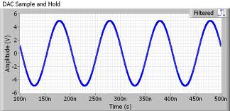
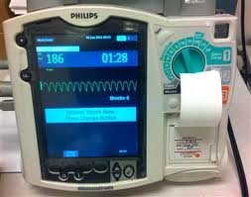
Type of computer according to their work
Analog computer:

Slide 8
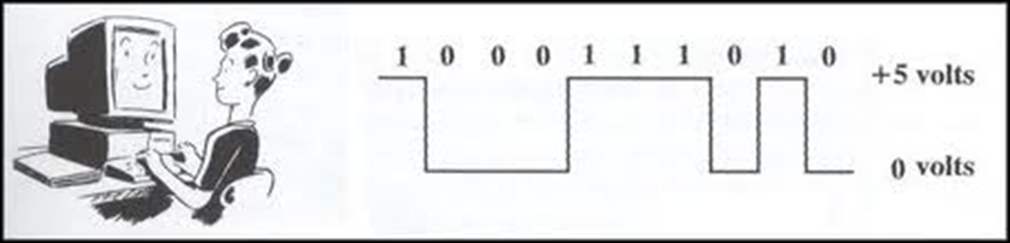
Type of computer according to their work
Digital computer:

Slide 9
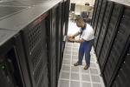

Type of computer according to their size
1- Super Computer

Slide 10
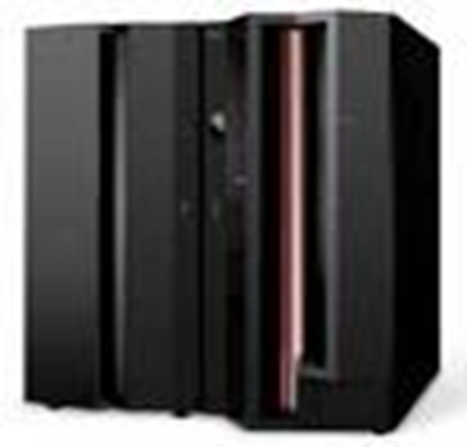
Type of computer according to their size
1- Main frames

Slide 11
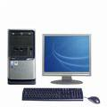
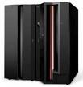

Slide 12
Type of computer according to their size
3- Mini Computer:

Slide 13

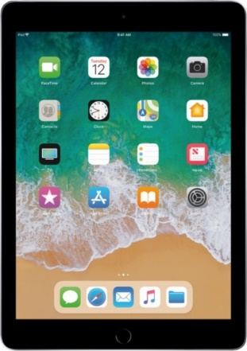
Type of computer according to their size
4- Micro Computer:
Pc , lap top…

Slide 14
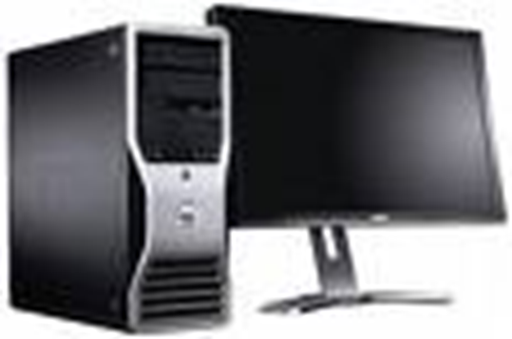
Type of computer according to their size
5-workstation computer :

Slide 15
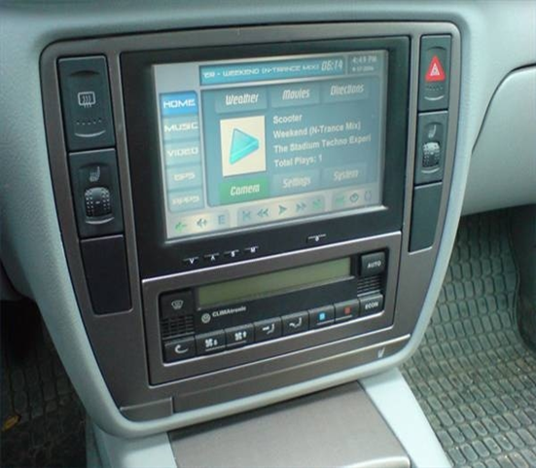
Type of computer according to their size
6-control computer :

