Slide 1
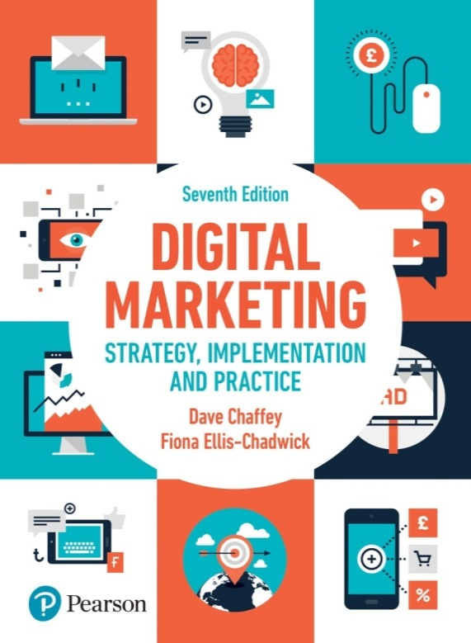
Chapter 6
Relationship marketing using digital platforms

Slide 2
Chapter 6 Relationship marketing using digital platforms
Main topics
Using social media to improve customer loyalty and advocacy
The challenge of customer engagement

Slide 3
Introduction
Building long-term relationships with customers is essential for any sustainable business. The advent of digital marketing means that comparing and switching providers of different services is easier than previously.
Research summarised by Reichheld and Schefter (2000) showed that acquiring online customers is so expensive (he suggested 20–30 per cent higher than for traditional businesses) that startup companies may remain unprofitable for at least two to three years.
The research also shows that by retaining just 5 per cent more customers, online companies can boost their profits by between 25 and 95 per cent

Slide 4
Customer relationship management (CRM): A marketing-led approach to building and sustaining long-term business with customers.
Marketing automation technology: Enables businesses to automate tasks in the marketing and sales process to deliver more relevant communications, typically delivered as personalised emails and website messages.

Slide 5
Marketing orchestration: Designing customer contact strategies to deliver the most relevant, most responsive messages integrated across different communications channels based on customer context. Communications strategies are managed by marketing automation systems using rules or Artificial Intelligence based on Big Data analysis rather than manually created campaigns.

Slide 6
Electronic customer relationship management (E-CRM) : Using digital communications technologies to maximise sales to existing customers and encourage continued usage of online services through techniques including database, personalised web messages, customer services, email and social media marketing. Today, CRM is synonymous with E-CRM.

Slide 7
Using social media to improve customer loyalty and advocacy
Social media marketing has many applications throughout the customer lifecycle, but arguably, it is most effective when it is used to develop existing relationships and encourage advocacy to create brand awareness and favourability. This advocacy is not limited to customers, it can also involve influencers, partners and employees.

Slide 8
What is social media marketing and why is it important?
Social media marketing is based on how we can use consumer-to-consumer (C2C) interactions to increase awareness of our brand through social media amplification while minimising negative mentions.
Social media amplification: A method of increasing awareness of a brand through organic and paid sharing of social media updates via social networks as organic social posts and adverts are displayed in the stream of social network users.
To apply this effectively for communications, we have to recognise that social media involves participation in discussions and sharing of ideas and content, which is often facilitated by social networks but can occur in other locations.

Slide 9
What is social media marketing and why is it important?
What is social CRM?
Social CRM :The process of managing customer-to-customer conversations to engage existing customers, prospects and other stakeholders with a brand and so enhance customer relationship management.
Social selling: A proactive approach to using social media to generate leads and sales, particularly applied to B2B marketing in LinkedIn, where it’s possible to identify prospects and connect with them.

Slide 10
Applications of social media across different business functions
Source: Altimeter (2010)
Notes:
Figure 6.1. Applications of social media across different business functions

Slide 11
This framework shows the value of social media in collecting customer insights across different business function:
1. Marketing. Monitoring, analysis and response of customer conversations through social listening tools.
2. Sales. Understanding where prospects are discussing selection of products and services offered by you and competitors and determining the best way to get involved in the conversation to influence sales and generate leads. Within B2B, LinkedIn is an obvious location that should be monitored and used proactively to generate leads and sales, a technique known as social selling

Slide 12
3. Service and support. Customer self-help through forums provided by you and neutral sites.
4. Innovation. Using conversations to foster new product development or enhance online offerings is one of the most exciting forms of social CRM.
5. Collaboration. This is e-business collaboration within an organisation through an intranet and other software tools to encourage all forms of collaboration that support business process.
6. Customer experience. This references the use of social CRM to enhance the customer experience and add value to a brand, which is implied by many of the other aspects above. It gives the examples of using VIP programmes offering collaboration between customers with shared characteristics to add value and create advocacy.

Slide 13
What are the main social media platforms?
These are the main types of social platforms:
1. Social networks. In most countries, the core social platforms where people interact through social networks are Facebook, Instagram and Snapchat for consumer audiences, LinkedIn for business audiences and Twitter for both.
2. Social publishing and news. Nearly all newspapers and magazines, whether broad or niche, now have an online presence with the option to participate through comments on articles, blogs or communities.
3. Social commenting in blogs. A company blog can form the hub of your social media strategy and you can look at tapping into others’ blogs, whether company or personal or through blog outreach

Slide 14
What are the main social media platforms?
4. Social niche communities. These are communities and forums independent of the main networks.
5. Social customer service. Services such as Get SatisfactionTM (www.getsatisfaction.com), as well as companies’ own customer-support forums, are increasingly important for responding to customer complaints, particularly in some sectors such as mobile phone and network providers.
6. Social knowledge. These are reference social networks such as Yahoo! Answers, QuoraTM and Wikipedia. They show how any business can engage its audience by solving their problems and subtly showing how products have helped others.
7. Social bookmarking. Bookmarking sites such as DeliciousTM (www.del.icio.us.com) are today relatively unimportant.

Slide 15
What are the main social media platforms?
8. Social streaming. Rich and streaming media sites including photos (e.g. Pinterest), video and podcasting.
9. Social search. When Google+ was launched search engines incorporated more social features such as voting for sites via a Google+1. With the wane in popularity of Google+ in recent years, these features are seen less commonly today.
10. Social commerce. Mainly relevant for the retail and travel sectors, social commerce involves reviews and ratings on products and sharing of coupons on deals.

Slide 16
The social media marketing radar
Source: Smart Insights (2015)
Notes:
Figure 6.2 The social media marketing radar

Slide 17
Social media activities requiring management
There are six activities to define goals and strategies for how social media can support each:
Listen and manage reputation;
Transform the brand through social media;
Acquire new customers;
Increase sales to existing customers;
Deliver customer service

Slide 18
Activity 1. Define listening and reputation strategy
To develop a social media listening approach, you need to understand social media usage for each of:
• your audience: who they are, how they participate, what they’re saying and sharing;
• your activity: through official social media channels and interactions through your site, but also through employee mentions;
• your competitors: for direct and indirect competitors, you need to review how their activities compare to yours;
• online publishers and other key intermediaries: these are a form of indirect competitor and are also important as influencers.

Slide 19
Activity 2. Transform the brand through social media
To fully exploit social media across the functions will require companies to make large changes to their brand, company structure and how everyone in the company communicates.
Some key areas for delivering this transformation are:
• Set scope for social media activities.
• Review social media capabilities and priorities.
• Governance: define who is responsible for social media.
• Reviewing the personality of your brand and setting a vision.

Slide 20
Activity 3. Acquire new customers using social media
For most marketers, the ultimate appeal of social media marketing is to use it to increase sales through reaching new prospects and converting them to customers.
In reality, for most businesses, social media marketing may be most important in serving existing customers or providing service, but you will set priorities according to what you think is important.

Slide 21
Activity 4. Increase sales to existing customers
Applying social media to increase sales to existing customers focuses on developing your customer communications strategy to encourage more social interactions on your site, leading to more social shares to gain the amplification effect

Slide 22
Activity 5. Enhance customer service through social media marketing
Guy Stephens talks about how specific customer-service activities should be managed, including:
• social listening to identify customers requiring service;
• outreach to answer customer questions or resolve problems;
• using service to improve product and service offerings;
• management of a company’s own service forums or other service platforms such as Get Satisfaction.

Slide 23
The challenge of customer engagement
The commercial aim of engagement is to maximise customer value through using customer interactions to lead to more profitable relationships.
Customer engagement: Repeated interactions through the customer lifecycle prompted by online and offline communications aimed at strengthening the long-term emotional, psychological and physical investment a customer has with a brand.
Media fragmentation: Describes a trend towards increasing choice and consumption of a range of media in terms of different channels such as web and mobile and also within channels – for example,more TV channels, radio stations, magazines, more websites. Media fragmentation implies increased difficulty in reaching target audiences.

Slide 24
The challenge of customer engagement
According to Forrester, engagement has four parts, which can be measured both online and offline:
Involvement. Forrester says that online this includes website visits, time spent, pages viewed.
Interaction. This is contributed comments to blogs, quantity/frequency of written reviews and online comments as well as comments expressed in customer service.
Intimacy. This is sentiment tracking on third-party sites including blogs and reviews, as well as opinions expressed in customer service calls.
Influence. This is advocacy indicated by measures such as likelihood to recommend, brand affinity and content forwarded to friends.

Slide 25
Benefits of using CRM to support customer engagement:
Targeting more cost-effectively
Permission marketing (inbound marketing)
Mass customisation of the marketing messages
Increased depth and breadth of information
Deeper customer understanding
Lower cost
Delivering loyalty programmes
Opportunities for gamification

Slide 26
Inbound marketing: The customer is proactive in actively seeking out a solution and interactions with brands are attracted through content, search and social media marketing.
Gamification: The process of applying game thinking and mechanics to engage an audience by rewarding them for achievements and sharing.

Slide 27
Marketing applications of CRM:
CRM systems support the following marketing applications:
1. Sales force automation (SFA): Sales representatives are supported in their account management through tools to arrange and record customer visits.
2. Customer service management: Representatives in contact centres respond to customer requests for information by using an intranet to access databases containing information on the customer, products and previous queries.

Slide 28
3. Managing the sales process:This can be achieved through e-commerce sites, or in a B2B context by supporting sales representatives by recording the sales process (SFA)
4. Customer communication management: Managing communications integrated across different channels including direct mail, email, mobile messaging, personalised web messages and social networks.
5. Analysis: Through technologies such as data warehouses and approaches such as data mining, customers’ characteristics, their purchase behaviour and campaigns can be analysed in order to optimise the marketing mix.

Slide 29
CRM technologies and data management
Three main types of customer data held in a CRM system:
Personal and profile data. These include contact details and characteristics for profiling customers, such as age and gender (B2C), and business size, industry sector and the individual’s role in the buying decision (B2B).
Transaction data. A record of each purchase transaction including specific product purchased, quantities, category, location, date and time and channel where purchased.
Communications interactions data. A record of which customers have been targeted by campaigns and their response to them (outbound communications). Also includes a record of inbound visits to a website, customer service and support enquiries and sales representative interactions.

Slide 30
Using ‘Big Data’ and Artificial Intelligence to support data-driven marketing
‘Big Data’ for marketing: ‘Big Data’ refers to applications to gain value from the increasing Volume, Velocity and Variety of data integrated from different sources. These enhance insight to deliver more relevant communications through techniques such as marketing automation and social CRM.
The two main benefits of Big Data for marketing are:
• identifying insights such as trends and patterns through analysis of large, complex interrelated data sets, which can inform future strategies and tactics;
• identifying success factors to make communications more relevant by improving messaging – for example, by selecting the best timing, copy or offers.

Slide 31
Using ‘Big Data’ and Artificial Intelligence to support data-driven marketing
The main application of Big Data in marketing is used to increase the relevance of communications using the marketing automation techniques such as predictive modelling are used to send more relevant, contextual emails or web personalised banners to customers in order to generate response.

