Slide 1
Modern Systems Analysis and Design Third Edition
Chapter 8
Structuring System Requirements:
Process Modeling
8.1

Slide 2
Process Modeling
Process modeling involves graphically representing the functions, or processes that capture, manipulate, store and distribute data between a system and its environment and among system components
Data flow diagrams (DFD)
A common and traditional form of process modeling technique
Graphically illustrate movement of data between external entities and the processes and data stores within a system
8.2

Slide 3
Process Modeling
Deliverables and Outcomes
Deliverables are simply stating what you learned during requirements determination
Primary deliverables from process modeling are a set of coherent, interrelated data flow diagrams
8.3

Slide 4
Data Flow Diagramming Mechanics
DFD’s are not as good as flowcharts to depict details of physical systems
Flowcharts are not very useful for depicting purely logical information flows
Four symbols are used to represent both physical and logical information systems
Definitions and Symbols
Two different standard sets of DFD symbols with each set consisting of four symbols that represent same things:
data flow, data store, processes, sources/sinks (external)
DeMarco and Yourdan
Gane and Sarson (used in the book)
8.4

Slide 5
Data Flow Diagramming Mechanics
Data Flow
Depicts data in motion and moving from one place to another in the system.
Example: results of query of database, contents of printed report
Data flow is data that move together
Data flow can be composed of many individual pieces of data that are generated at the same time and flows together
Data Store
Depicts data at rest
May represent one of many different physical locations for data:
File folder
Computer-based file
Notebook
Might contain data about customers, students, customer orders
8.5

Slide 6
Data Flow Diagramming Mechanics
Process
Depicts work or action performed on data so that they are transformed, stored or distributed
Source/Sink
Depicts the origin and/or destination of the data
Sometimes referred to as an external entity so they are outside system and define boundaries of system
Because they are external, many characteristics are not of interest to us
Data must originate from outside a system from one or more sources and system must produce information to one or more sinks
consist of – another organization, a person inside or outside business, another information system
8.6

Slide 7
Data Flow Diagramming Symbols
process
data store
source/sink
data flow
DeMarco & Yourdon Symbols
Gane & Sarson Symbols

Slide 8
Data Flow Diagramming Symbols
Data flow is shown as an arrow labeled with a meaningful name for data (all elements of data moving as part of one packet) in motion – sales receipt, customer order.
Source/Sink is shown as a square and has a name that states what external agent is – customer, teller.
Data store is shown as rectangle without its right vertical side and left side has a small box used to number the data store and inside the main part of rectangle is a meaningful label – student file.
Process is shown as a rectangle with rounded corners with a line dividing it into two parts – upper part has the number of process and lower part has name of process

Slide 9
Data Flow Diagramming Definitions
Context Diagram
The highest-level view of an organizational system that shows the system boundaries, external entities that interact with the system and the major information flows between the entities and the system
All context diagrams have only one process labeled “0”
No data stores appear on a context diagram
Level-0 Diagram
A data flow diagram (DFD) that represents a system’s major processes, data flows and data stores at a high level of detail
Each process has a number that ends in .0
DFD hides many physical characteristics of system
We do not know timing of when data flow is produced, how frequently it is produced, what volume of data is sent
8.9

Slide 10
Developing DFDs: An Example
Process names
should be clear yet concise
begin with an action verb, such as receive, generate, calculate
are same as verbs used in many computer programming languages – merge, sort, read, write
should capture essential action of the process in just few words yet describe the process’ action so that reading its name explains what process does
An Example
Hoosier Burger’s automated food ordering system
Context Diagram (Figure 8-4) contains no data stores
Next step is to expand the context diagram to show the breakdown of processes (Figure 8-5)
8.10

Slide 11
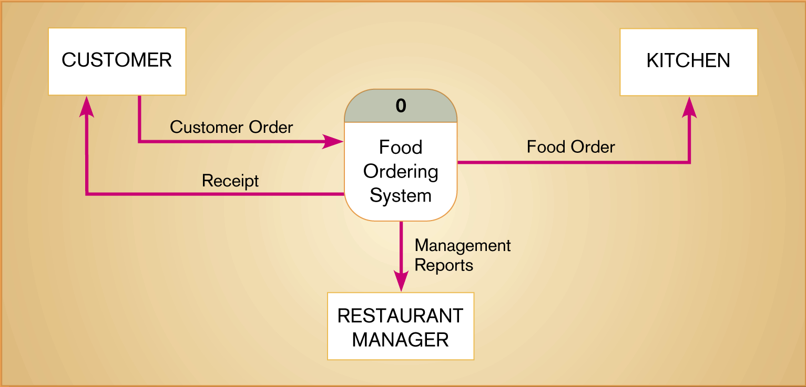
Figure 8-4 Context diagram of Hoosier Burger’s food ordering system
only one process
no data store
four data flows
three source/sinks
Single process “0” represents entire system
Conceptually data stores are inside one process
8.11

Slide 12
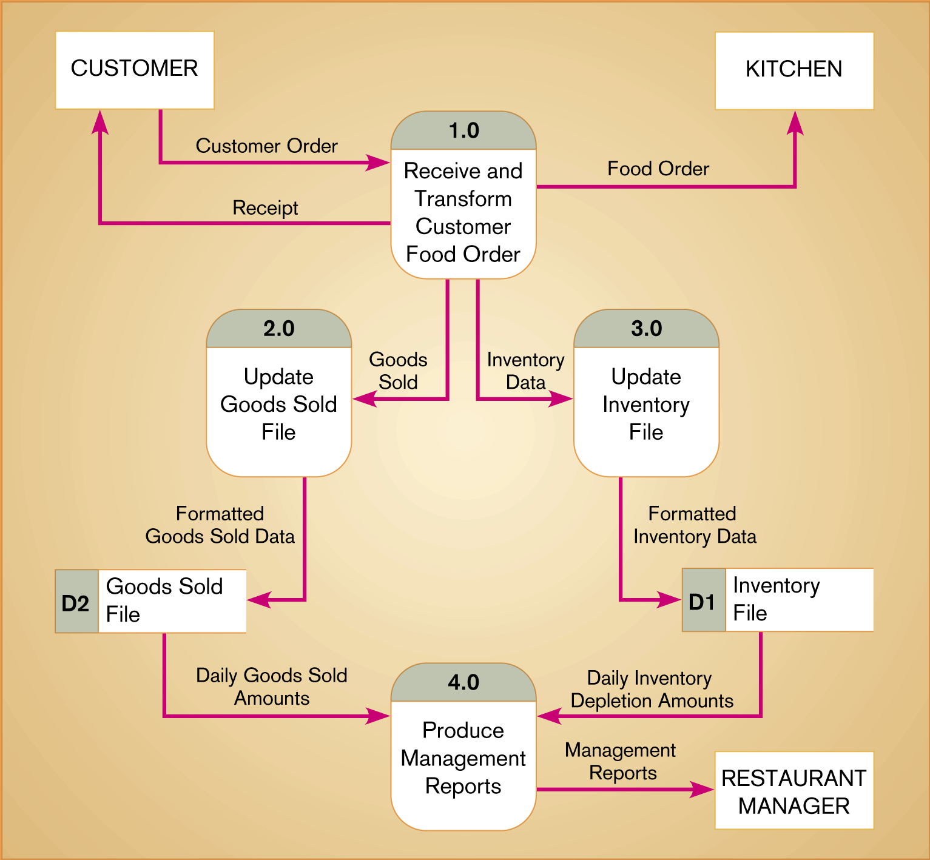
Figure 8-5 Level-0 DFD of Hoosier Burger’s food ordering system
coupled together (ready to accept)
decoupled by placing a buffer (data store)
8.12

Slide 13
Data Flow Diagramming Rules
Basic rules that apply to all DFDs
Inputs to a process are always different than its outputs – purpose of a process is to transform inputs to outputs
Objects on a DFD always have a unique name
In order to keep the diagram uncluttered, you can repeat data stores and sources/sinks on a diagram
Process:
A. No process can have only outputs ( we can’t make data from nothing). Having only outputs means it must be a source.
B. No process can have only inputs. Having only inputs means it must be a sink.
C. A process has a verb phrase label
8.13

Slide 14
Data Flow Diagramming Rules
Data store:
D. Data must be moved by a process and cannot move directly from one data store to another data store
E. Data cannot move directly from an outside source to a data store. Data must be moved by a process that receives data from the source and places data into data store.
F. Data cannot move directly to an outside sink from a data store. Data must be moved by a process.
G. A data store has a noun phrase label
Source/Sink:
H. Data cannot move directly from source to sink and has to be moved by a process else data flow is not shown on the DFD.
I. A source/sink has a noun phrase label
8.14

Slide 15
Data Flow Diagramming Rules
Data flow:
J. A data flow has only one direction of flow between symbols. It may flow in both directions between a process and a data store usually indicated by two separate arrows as this happens at separate times
K. A fork in a data flow means that exactly the same data goes from a common location two or more different processes, data stores, or sources/sinks.
L. A join in a data flow means that exactly the same data comes from any two or more different processes, data stores, or sources/sinks to a common location
M. A data flow cannot go directly back to the same process it leaves.
N. A data flow to a data store means update (delete or change)
O. A data flow from a data store means retrieve or use.
P. A data flow has a noun phrase label.

Slide 16
Decomposition of DFDs
Functional decomposition
An iterative process of breaking one single system to many component processes with finer and finer detail creating a set of charts in which one process on a given chart is explained in greater detail on another chart creating a set of hierarchically related charts
Each sub-process may again be broken down into smaller units
Lowest level of DFD is called a primitive DFD
Level-N Diagrams
A DFD that is the result of n nested decompositions of a series of subprocesses from a process on a level-0 diagram
Balancing DFDs
When decomposing a DFD, you must conserve inputs to and outputs from a process at the next level of decomposition
This conservation of inputs and outputs is called balancing
8.16

Slide 17
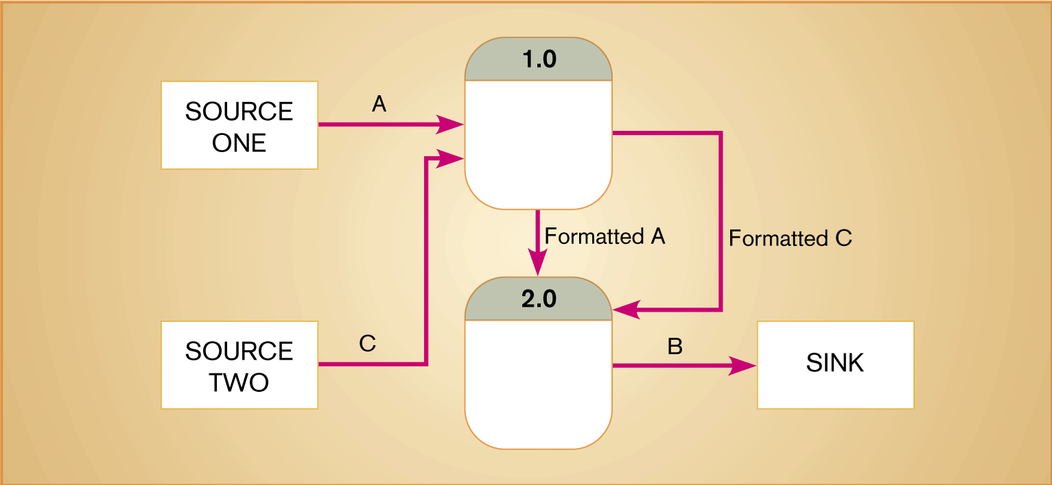
Figure 8-10 An unbalanced set of data flow diagrams (a) Context diagram (b) Level-0 diagram
8.17

Slide 18
Decomposition of DFDs
Level-1 Diagrams
no sources/sinks are represented, though may be included
Level-1, -2, or -n DFDs
represents one process on a level-n-1 DFD
Each DFD should be on a separate page
No DFD should have more than seven processes

Slide 19
Four Different Types of DFDS
Current Physical
process label includes an identification of the “technology” (people or systems) used to process the data
data flows and data stores are labeled with the name of the actual physical media on which data flow or in which data are stored such as file folders, or computer tapes
Current Logical
physical aspects of system are removed as much as possible
Current system reduced to data and processes that transform them
New Logical
Includes additional functions
Obsolete functions are removed
Inefficient data flows are reorganized
New Physical
Represents the physical implementation of the new system
8.19

Slide 20
Guidelines for Drawing DFDs
Completeness
DFD must include all components necessary for system
Each component must be fully described in the project dictionary or CASE repository (most CASE tools link project dictionary to diagram so that when a new process, data store, data flow, source/sink is defined an entry is automatically created for that element)
Incomplete DFDs – data flows not leading anywhere, data stores, processes, or external entities not connected to anything else
Consistency
The extent to which information contained on one level of a set of nested DFDs is also included on other levels
Inconsistent DFDs – level-1 diagram with no level-0 diagram; data flow attached to different objects in two different levels; data flow appearing in higher level but not on lower levels
8.20

Slide 21
Guidelines for Drawing DFDs
Timing
Time is not represented well on DFDs
No indication of whether a data flow occurs constantly in real time, once a week, once a year, no indication of when system would run
Best to draw DFDs as if the system has never started and will never stop.
Iterative Development
First DFD drawn is not perfect
Analyst should expect to redraw diagram several times before reaching the closest approximation to the system being modeled
Primitive DFDs
Lowest logical level of decomposition
Decision has to be made when to stop decomposition
8.21

Slide 22
Guidelines for Drawing DFDs
Rules for stopping decomposition
When each process has been reduced to a single decision, calculation or database operation like update, create
When each data store represents data about a single entity like customer, employee
When the system user does not care to see any more detail
When every data flow does not need to be split further to show that data are handled in various ways
When you believe that you have shown each business form or transaction, on-line display and report as a single data flow
When you believe that there is a separate process for each choice on all lowest-level menu options
8.22

