Slide 1
Chapter 1
Introduction

Slide 2
Objectives
Describe The database schema used in this course and the development environments
Review some basic concepts of SQL

Slide 3
Human Resource schema (HR) used in this course

Slide 4
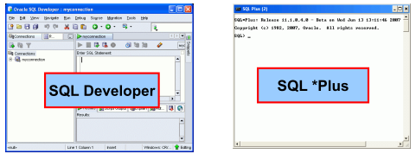
Development Environments
There are 2 development environment for this course:
Primary tool is Oracle SQL developer
SQL*Plus Command line interface

Slide 5
How to use HR sample schema
Display the SQL command prompt window. For example, on Windows, click Start, then Programs (or All Programs), then Oracle Database 11g Express Edition, and then Run SQL Command Line.
Connect as the SYSTEM user:
Type: connect
Enter user-name: system
Enter password: <password-for-system>
Enter the following statement to unlock the HR account:
SQL> ALTER USER hr ACCOUNT UNLOCK;
Enter a statement in the following form to specify the password that you want for the HR user:
SQL> ALTER USER hr IDENTIFIED BY hr

Slide 7
Reviews of restricting Data
The WHERE Clause can compare values in columns, literal values, arthmetic expressions and functions
WHERE clause format:
WHERE expr operator value
Comparison conditions: <, > ==,<>, <=
Three logical operator available:
And
Or
Not

Slide 12
Review of using subqueries
Subqueries can be placed after :
WHERE clause
FROM clause
HAVING clause
Single row subqueries use single row operators such as = , <>, <, >
Multiple row subqueries use operators IN, ANY, ALL
Example: select last_name
From employees
Where salary = (select Min(salary) from employees);

