Slide 1
Chapter 2: The Linux System Part 3

Slide 2
Chapter 2: The Linux System
Linux History
Design Principles
Kernel Modules
Process Management
Scheduling
Memory Management
File Systems
Input and Output
Interprocess Communication
Network Structure
Security

Slide 3
Scheduling

Slide 4
Scheduling
Scheduling is the job of allocating CPU time to different tasks within an operating system.
While scheduling is normally thought of as the running and interrupting of processes, in Linux, scheduling also includes the running of the various kernel tasks.
Running kernel tasks encompasses both tasks that are requested by a running process and tasks that execute internally on behalf of a device driver.
As of 2.5, new scheduling algorithm – preemptive, priority-based
Real-time range
nice value

Slide 5
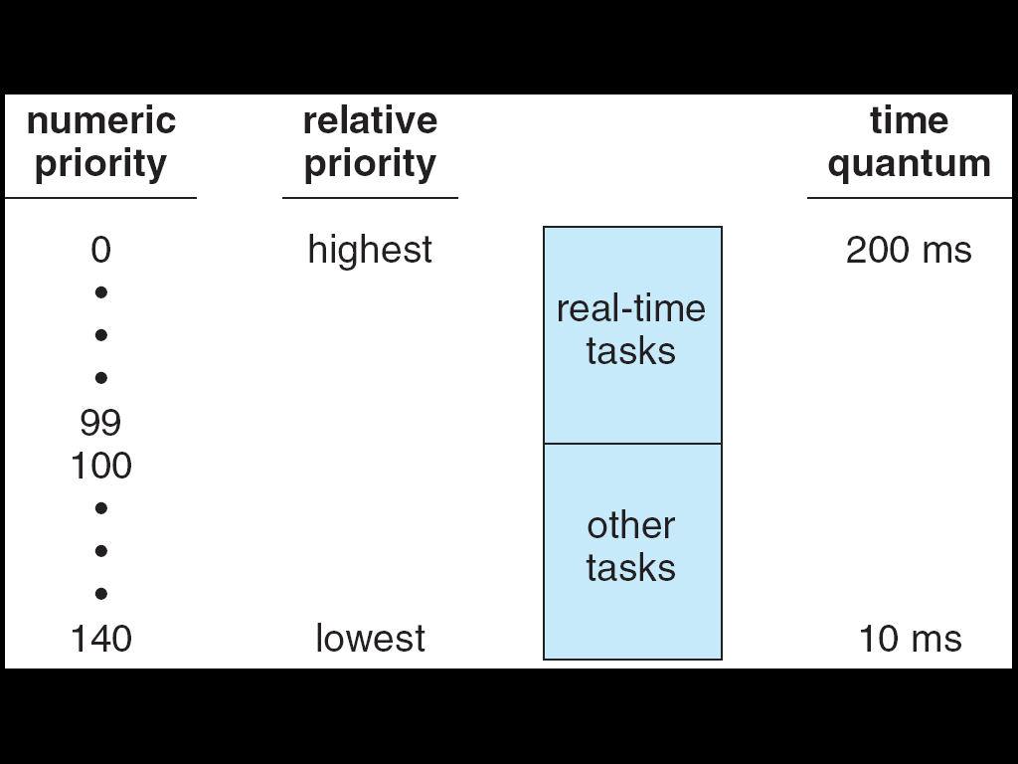
Relationship Between Priorities and Time-slice Length

Slide 6
Relationship Between Priorities and Time-slice Length
The Linux scheduler is a preemptive, priority-based algorithm with two separate priority ranges:
a real-time range from0 to 99
a nice value ranging from 100 to 140.
These two ranges map into a global priority scheme in which numerically lower values indicate higher priorities.
the Linux scheduler assigns higher-priority tasks longer time quanta and lower-priority tasks shorter time quanta.

Slide 7
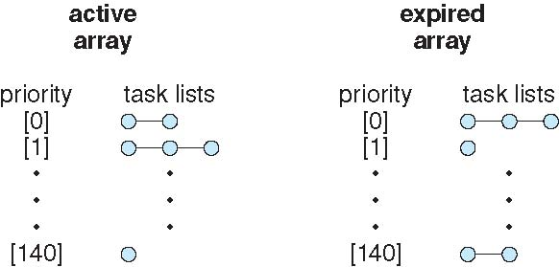
List of Tasks Indexed by Priority

Slide 8
List of Tasks Indexed by Priority
Each processor maintains its own run queue and schedules itself independently.
Each run queue contains two priority arrays—active and expired.
The active array contains all tasks with time remaining in their time slices, and the expired array contains all expired tasks.
Each of these priority arrays includes a list of tasks indexed according to priority.
The scheduler chooses the task with the highest priority from the active array for execution on the CPU.
On multiprocessor machines, this means that each processor is scheduling the highest-priority task from its own run queue structure.
When all tasks have exhausted their time slices (that is, the active array is empty),
the two priority arrays are exchanged as the expired array becomes the active array and vice versa.

Slide 9
List of Tasks Indexed by Priority
Linux’s real-time scheduling is simpler still.
Linux implements the two real time scheduling classes required by POSIX.1b: first-come, first-served (FCFS) and round-robin.
In both cases, each process has a priority in addition to its scheduling class.
Processes with different priorities can compete with one another to some extent in time-sharing scheduling;
in real-time scheduling, however, the scheduler always runs the process with the highest priority.
Among processes of equal priority, it runs the process that has been waiting longest.

Slide 10
List of Tasks Indexed by Priority
The only difference between FCFS and round-robin scheduling is that
FCFS processes continue to run until they either exit or block, whereas a round-robin process will be preempted after a while and will be moved to the end of the scheduling queue.
so round-robin processes of equal priority will automatically time-share among themselves.
Unlike routine time-sharing tasks, real-time tasks are assigned static priorities.

Slide 11
Process Scheduling
Linux uses two process-scheduling algorithms:
A time-sharing algorithm for fair preemptive scheduling between multiple processes.
A real-time algorithm for tasks where absolute priorities are more important than fairness.
A process’s scheduling class defines which algorithm to apply.

Slide 12
Process Scheduling (Cont.)
Linux implements the FIFO and round-robin real-time scheduling classes; in both cases, each process has a priority in addition to its scheduling class.
The scheduler runs the process with the highest priority; for equal-priority processes, it runs the process waiting the longest.
FIFO processes continue to run until they either exit or block .
A round-robin process will be preempted after a while and moved to the end of the scheduling queue, so that round-robin processes of equal priority automatically time-share between themselves.

Slide 13
Kernel Synchronization
A request for kernel-mode execution can occur in two ways:
A running program may request an operating system service, either explicitly via a system call, or implicitly, for example, when a page fault occurs
A device driver may deliver a hardware interrupt that causes the CPU to start executing a kernel-defined handler for that interrupt
Kernel synchronization requires a framework that will allow the kernel’s critical sections to run without interruption by another critical section.

Slide 14
Kernel Synchronization (Cont.)
Linux uses two techniques to protect critical sections:
1. Normal kernel code is nonpreemptible (until 2.4) – when a time interrupt is received while a process is executing a kernel system service routine, the kernel’s need_resched flag is set so that the scheduler will run once the system call has completed and control is about to be returned to user mode
2. The second technique applies to critical sections that occur in an interrupt service routines
– By using the processor’s interrupt control hardware to disable interrupts during a critical section, the kernel guarantees that it can proceed without the risk of concurrent access of shared data structures

Slide 15
Kernel Synchronization (Cont.)
To avoid performance penalties, Linux’s kernel uses a synchronization architecture that allows long critical sections to run without having interrupts disabled for the critical section’s entire duration
Interrupt service routines are separated into a top half and a bottom half.
The top half is a normal interrupt service routine, and runs with recursive interrupts disabled
The bottom half is run, with all interrupts enabled, by a miniature scheduler that ensures that bottom halves never interrupt themselves
This architecture is completed by a mechanism for disabling selected bottom halves while executing normal, foreground kernel code

Slide 16
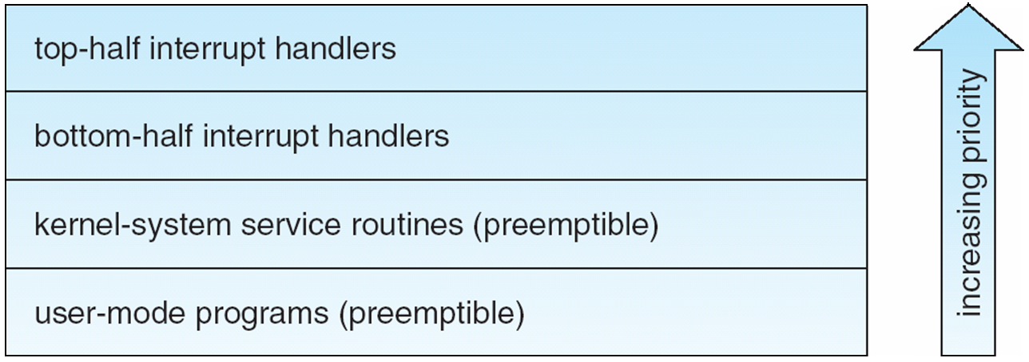
Interrupt Protection Levels
Each level may be interrupted by code running at a higher level, but will never be interrupted by code running at the same or a lower level.
User processes can always be preempted by another process when a time-sharing scheduling interrupt occurs.

Slide 17
Symmetric Multiprocessing
Linux 2.0 was the first Linux kernel to support SMP hardware; separate processes or threads can execute in parallel on separate processors.
To preserve the kernel’s nonpreemptible synchronization requirements, SMP imposes the restriction, via a single kernel spinlock, that only one processor at a time may execute kernel-mode code.

