Slide 1
Making Capital investment decision
Chapter 10
Reem Alnuaim

Slide 2
Course Roadmap
Chapter | Topic | Focus | Exam
15 | Raising Capital | All
14 | Cost of Capital | All
9 | Net Present Value and Other Investment Criteria | All | Mid-Term
11 | Project Analysis and Evaluation | All
16 | Financial Leverage and Capital Structure Policy | All
10 | Making Capital Investment Decision | All | Mid-Term
17 | Dividends Theory | All

Slide 3
Chapter Outline
Project Cash Flows: A First Look
Incremental Cash Flows
Pro Forma Financial Statements and Project Cash Flows
More about Project Cash Flow
Alternative Definitions of Operating Cash Flow
Some Special Cases of Discounted Cash Flow Analysis

Slide 4
Relevant Cash Flows
The cash flows that should be included in a capital budgeting analysis are those that will only occur (or not occur) if the project is accepted
These cash flows are called incremental cash flows
The stand-alone principle allows us to analyze each project in isolation from the firm simply by focusing on incremental cash flows

Slide 5
Asking the Right Question
You should always ask yourself “Will this cash flow occur ONLY if we accept the project?”
If the answer is “yes,” it should be included in the analysis because it is incremental
If the answer is “no,” it should not be included in the analysis because it will occur anyway
If the answer is “part of it,” then we should include the part that occurs because of the project

Slide 6
Common Types of Cash Flows
Sunk costs – costs that have accrued in the past
Opportunity costs – costs of lost options
Side effects
Positive side effects – benefits to other projects
Negative side effects – costs to other projects
Changes in net working capital
Financing costs
Taxes

Slide 7
Pro Forma Statements and Cash Flow
Capital budgeting relies heavily on pro forma accounting statements, particularly income statements
Computing cash flows – refresher
Operating Cash Flow (OCF) = EBIT + depreciation – taxes
OCF = Net income + depreciation (when there is no interest expense)
Cash Flow From Assets (CFFA) = OCF – net capital spending (NCS) – changes in NWC

Slide 8
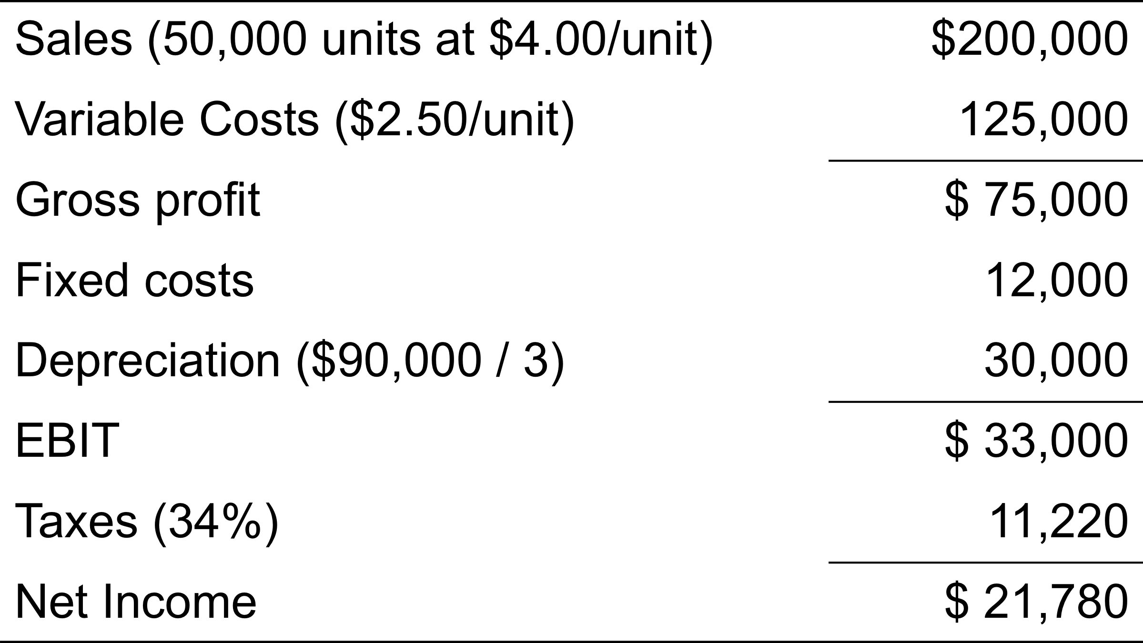
Table 10.1 Pro Forma Income Statement

Slide 9
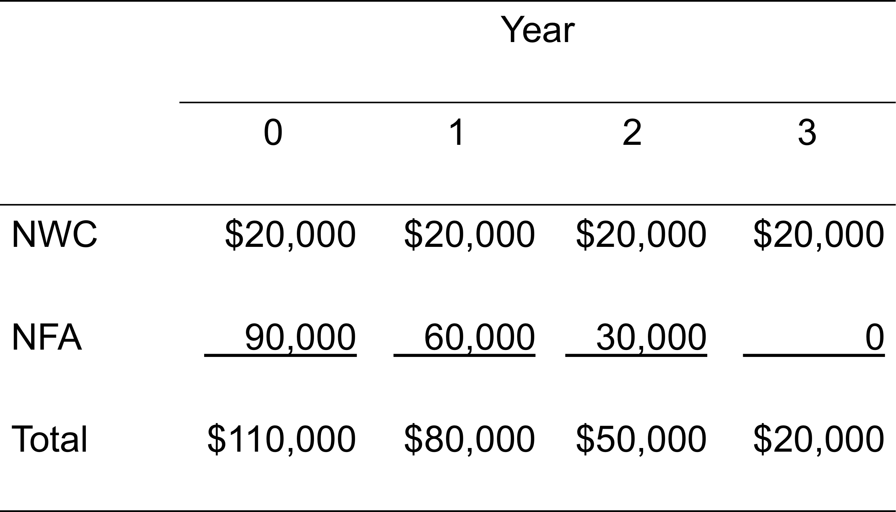
Table 10.2 Projected Capital Requirements

Slide 10
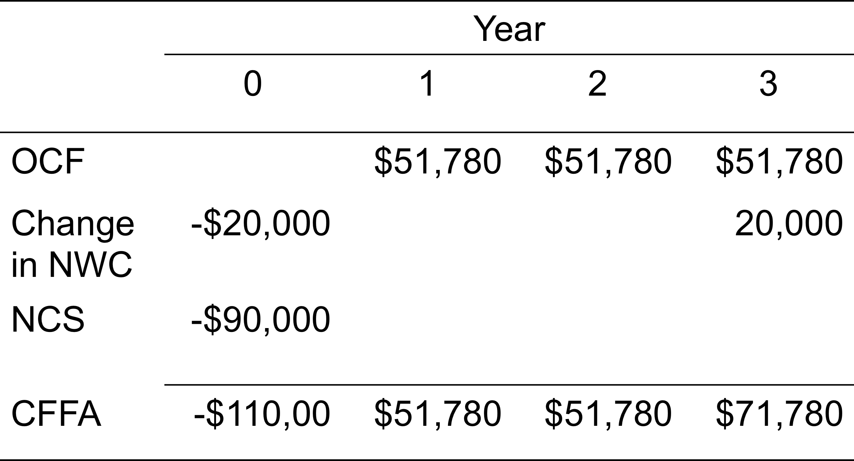
Table 10.5 Projected Total Cash Flows

Slide 11
Making The Decision
Now that we have the cash flows, we can apply the techniques that we learned in Chapter 9
Enter the cash flows into the calculator and compute NPV and IRR
CF₀ = -110,000; C01 = 51,780; F01 = 2; C02 = 71,780; F02 = 1
NPV; I = 20; CPT NPV = 10,648
CPT IRR = 25.8%
Should we accept or reject the project?

Slide 12
More on NWC
Why do we have to consider changes in NWC separately?
GAAP requires that sales be recorded on the income statement when made, not when cash is received
GAAP also requires that we record cost of goods sold when the corresponding sales are made, whether we have actually paid our suppliers yet
Finally, we have to buy inventory to support sales, although we haven’t collected cash yet

Slide 13
Depreciation
The depreciation expense used for capital budgeting should be the depreciation schedule required by the IRS for tax purposes
Depreciation itself is a non-cash expense; consequently, it is only relevant because it affects taxes
Depreciation tax shield = DT
D = depreciation expense
T = marginal tax rate

Slide 14
Computing Depreciation
Straight-line depreciation
D = (Initial cost – salvage) / number of years
Very few assets are depreciated straight-line for tax purposes
MACRS
Need to know which asset class is appropriate for tax purposes
Multiply percentage given in table by the initial cost
Depreciate to zero
Mid-year convention

Slide 15
After-tax Salvage
If the salvage value is different from the book value of the asset, then there is a tax effect
Book value = initial cost – accumulated depreciation
After-tax salvage = salvage – T(salvage – book value)

Slide 16
Example: Depreciation and After-tax Salvage
You purchase equipment for $100,000, and it costs $10,000 to have it delivered and installed. Based on past information, you believe that you can sell the equipment for $17,000 when you are done with it in 6 years. The company’s marginal tax rate is 40%. What is the depreciation expense each year and the after-tax salvage in year 6 for each of the following situations?

Slide 17
Example: Straight-line
Suppose the appropriate depreciation schedule is straight-line
D = (110,000 – 17,000) / 6 = 15,500 every year for 6 years
BV in year 6 = 110,000 – 6(15,500) = 17,000
After-tax salvage = 17,000 - .4(17,000 – 17,000) = 17,000

Slide 18
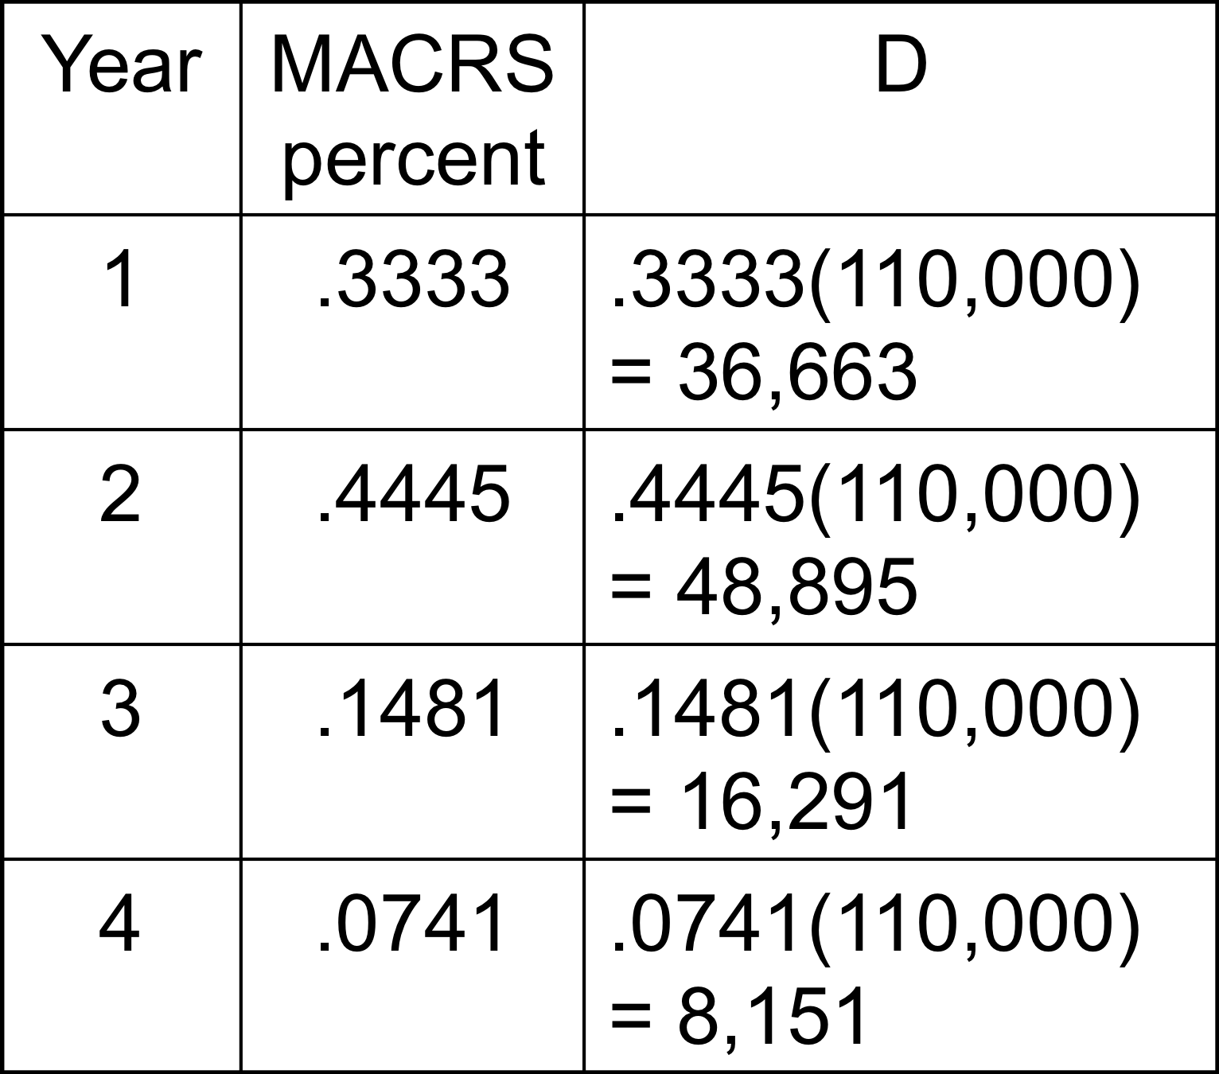
Example: Three-year MACRS
BV in year 6 = 110,000 – 36,663 – 48,895 – 16,291 – 8,151 = 0
After-tax salvage = 17,000 - .4(17,000 – 0) = $10,200

Slide 19
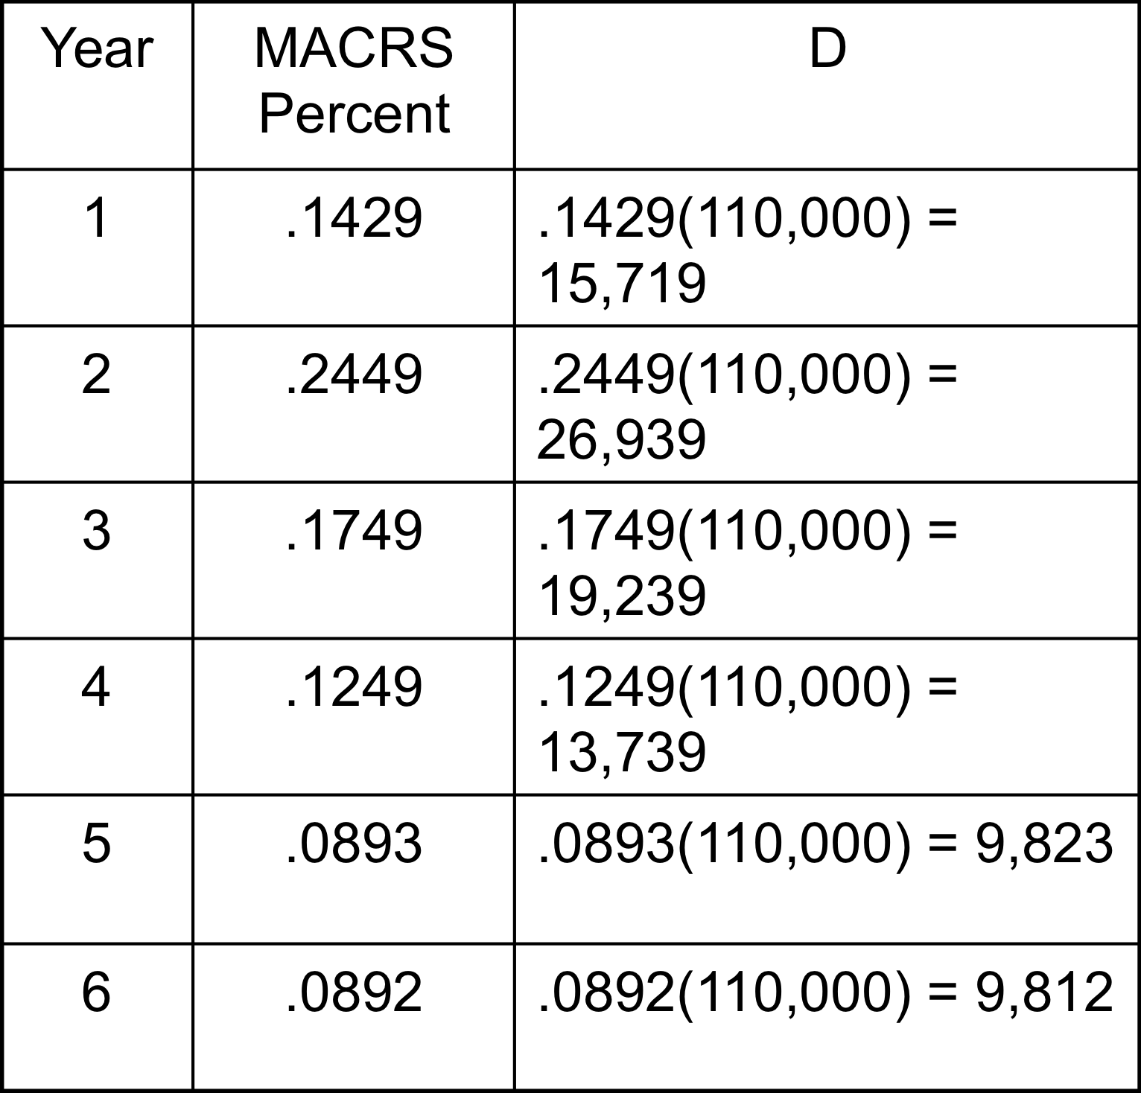
Example: Seven-Year MACRS
BV in year 6 = 110,000 – 15,719 – 26,939 – 19,239 – 13,739 – 9,823 – 9,812 = 14,729
After-tax salvage = 17,000 – .4(17,000 – 14,729) = 16,091.60

