Slide 1
variables and control statements in PL\SQL
Chapter 10

Slide 3
Use of Variables
Temporary storage: You can use the value stored in these variables for processing and manipulating the data
Variables are mainly used for storage of data and manipulation of stored values. Consider the SQL statement shown in the slide. The statement retrieves the first_name and department_id from the table. If you have to manipulate the first_name or the department_id , then you have to store the retrieved value.
Reusability is another advantage of declaring variables. After they are declared, variables can be used repeatedly in an application by referring to them in the statements.

Slide 4
Identifiers
Identifiers are used for:
Naming a variable
Providing conventions for variable names
– Must start with a letter
– Can include letters or numbers
– Can include special characters (such as dollar sign,
underscore, and pound sign)
– Must limit the length to 30 characters
– Must not be reserved words

Slide 5
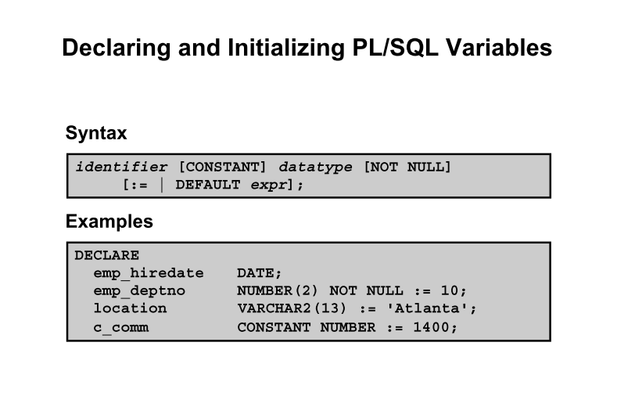

Slide 9
Guidelines for Declaring PL/SQL Variables
Impose the NOT NULL constraint when the variable must contain a value. You cannot assign nulls to a variable defined as NOT NULL . The NOT NULL constraint must be followed by an initialization clause.
pincode NUMBER(15) NOT NULL := 'Oxford';

Slide 10
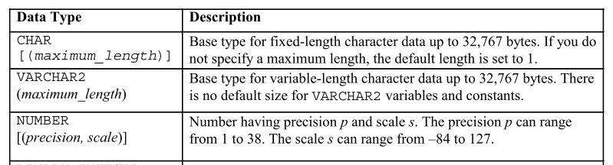
Data Types

Slide 11
%TYPE Attribute
The %TYPE attribute
Is used to declare a variable according to:
– A database column definition
– Another declared variable
• Is prefixed with:
– The database table and column
– The name of the declared variable

Slide 13
SQL Statements in PL/SQL
PL/SQL does not directly support data definition language (DDL) statements, such as
CREATE TABLE , ALTER TABLE , or DROP TABLE
Use the EXECUTE IMMEDIATE statement, which takes the SQL statement as an argument to execute your DDL statement.

Slide 14
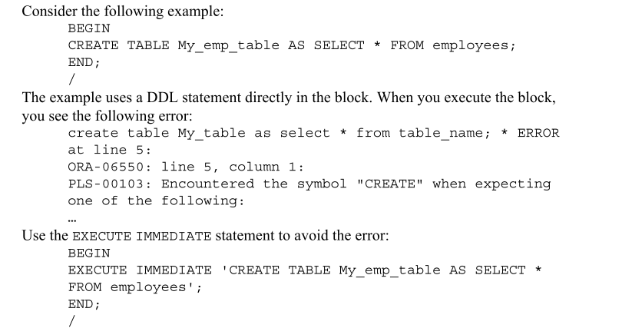

Slide 16
Guidelines for Retrieving Data in PL/SQL
• Terminate each SQL statement with a semicolon ( ; ).
• Every value retrieved must be stored in a variable using the INTO clause.
• The WHERE clause is optional and can be used to specify input variables, constants, literals, and PL/SQL expressions. However, when you use the INTO clause, you should fetch only one row; using the WHERE clause is required in such cases.
• Specify the same number of variables in the INTO clause as the number of database columns in the SELECT clause. Be sure that they correspond appositionally and that their data types are compatible.

