Slide 1
Financial Leverage and Capital Structure Policy
Chapter 16
Reem Alnuaim

Slide 2
Course Roadmap
Chapter | Topic | Focus | Exam
15 | Raising Capital | All
14 | Cost of Capital | All
9 | Net Present Value and Other Investment Criteria | All | Mid-Term
11 | Project Analysis and Evaluation | All
16 | Financial Leverage and Capital Structure Policy | All
10 | Making Capital Investment Decision | All | Mid-Term
17 | Dividends Theory | All

Slide 3
Capital Restructuring
What is meant by capital restructuring
What is the primary goal of financial managers?
Can leverage help in achieving such goals?

Slide 4
Capital Restructuring
We are going to look at how changes in capital structure affect the value of the firm, all else equal
Capital restructuring involves changing the amount of leverage a firm has without changing the firm’s assets
The firm can increase leverage by issuing debt and repurchasing outstanding shares
The firm can decrease leverage by issuing new shares and retiring outstanding debt

Slide 5
Capital Restructuring
How should a firm go about choosing its debt–equity ratio?
We assume that the guiding principle is to choose the course of action that maximizes the value of a share of stock.
When it comes to capital structure decisions, this is essentially the same thing as maximizing the value of the whole firm, and, for convenience, we will tend to frame our discussion in terms of firm value

Slide 6
FIRM VALUE AND STOCK VALUE: AN EXAMPLE
The following example illustrates that the capital structure that maximizes the value of the Firm is the one financial managers should choose for the shareholders, so there is no conflict in our goals.
To begin, suppose the market value of the J.J. Sprint Company is $1,000.
The company currently has no debt, and J.J. Sprint’s 100 shares sell for $10 each.
Further suppose that J.J. Sprint restructures itself by borrowing $500 and then paying out the proceeds to shareholders as an extra dividend of $500/ 100 = $5 per share.
This restructuring will change the capital structure of the firm with no direct effect on the firm’s assets.
The immediate effect will be to increase debt and decrease equity

Slide 7
for ease of presentation, we describe the impact of leverage in terms of its effects on earnings per share, EPS, and return on equity, ROE.
These are, of course, accounting numbers and, as such, are not our primary concern.
Using cash flows instead of these accounting numbers would lead to precisely the same conclusions, but a little more work would be needed. We discuss the impact on market values in a subsequent section.

Slide 8
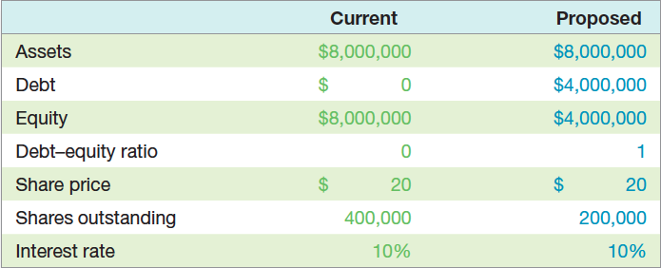

Slide 9
Choosing a Capital Structure
What is the primary goal of financial managers?
Maximize stockholder wealth
We want to choose the capital structure that will maximize stockholder wealth
We can maximize stockholder wealth by maximizing the value of the firm or minimizing the WACC

Slide 10
Financial Leverage
The extent to which a firm relies on debt
The more debt financing a firm uses in its capital structure, the more financial leverage it employs

Slide 11
Break-Even EBIT
Find EBIT where EPS is the same under both the current and proposed capital structures
If we expect EBIT to be greater than the break-even point, then leverage is beneficial to our stockholders
If we expect EBIT to be less than the break-even point, then leverage is detrimental to our stockholders

Slide 12
Ex 1 Page 569
Maynard, Inc., has no debt outstanding and a total market value of 250,000$. EBIT are projected to be 28,000$ if economic conditions are normal. If there is strong expansion in the economy, then EBIT will be 30 percent higher. If there is a recession, then EBIT will be 50 percent lower. Maynard is considering a 90,000$ debt issue with a 7 percent interest rate. The proceeds will be used to repurchase a share of stock. There are currently 5,000 shares outstanding. Ignore taxes for this problem
Calculate EPS under each of the three economic scenarios before any debt is issued. Also calculate the percentage changes in EPS when the economy expands or enters a recession.
Repeat part (a) assuming that the economy goes with recapitalization. What do you observe?

Slide 13
Ex 4 Page 542
James Corporation is comparing two different capital structures: an all equity plan (plan I) and a levered plan (plan II). Under plan I, the company would have 160,000 shares of stock outstanding. Under plan II, there would be 80,000 shares of stock outstanding and 2.8$ million in debt outstanding. The interest rate on the debt is 8 percent and there are no taxes.
If EBIT is 350,000$, which plan will result in the higher EPS?
If EBIT is 500,000$, which plan will result in the higher EPS?
What is the break-even EBIT?

Slide 14
Corporate borrowing & home made leverage
homemade leverage: The use of personal borrowing to change the overall amount of financial leverage to which the individual is exposed.

Slide 15
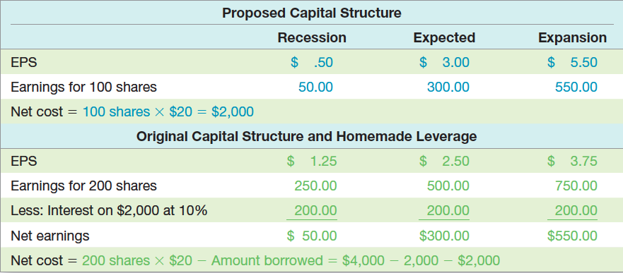
Proposed Capital Structure versus Original Capital Structure with Homemade Leverage

Slide 16
Proposed Capital Structure versus Original Capital Structure with Homemade Leverage
This example demonstrates that investors can always increase financial leverage themselves to create a different pattern of payoffs. It thus makes no difference whether Trans Am chooses the proposed capital structure.

Slide 17
Unlevering the Stock
suppose management adopts the proposed capital structure.
Further suppose that an investor who owned 100 shares preferred the original capital structure.
Show how this investor could “unlever” the stock to recreate the original payoffs.
To create leverage, investors borrow on their own. To undo leverage, investors must lend money.
In the case of Trans Am, the corporation borrowed an amount equal to half its value. The investor can unlever the stock by simply lending money in the same proportion.
In this case, the investor sells 50 shares for $1,000 total and then lends the $1,000 at10 percent. The payoffs are calculated in the following table:

Slide 19
Capital Structure and the Cost of Equity Capital
Modigliani and Miller (M&M)Theory of Capital Structure
Proposition I – firm value
Proposition II – WACC
The value of the firm is determined by the cash flows to the firm and the risk of the assets
Changing firm value
Change the risk of the cash flows
Change the cash flows

Slide 20
Capital Structure Theory Under Three Special Cases
Case I – Assumptions
No corporate or personal taxes
No bankruptcy costs
Case II – Assumptions
Corporate taxes, but no personal taxes
No bankruptcy costs
Case III – Assumptions
Corporate taxes, but no personal taxes
Bankruptcy costs

Slide 21
Case I – Propositions I and II
Proposition I
The value of the firm is NOT affected by changes in the capital structure
The cash flows of the firm do not change; therefore, value doesn’t change
Proposition II
The WACC of the firm is NOT affected by capital structure

Slide 22
Case I - Equations
WACC = R_{A} = (E/V)R_{E} + (D/V)R_{D}
R_{E} = R_{A} + (R_{A} – R_{D})(D/E)
R_{A} is the “cost” of the firm’s business risk, i.e., the risk of the firm’s assets
(R_{A} – R_{D})(D/E) is the “cost” of the firm’s financial risk, i.e., the additional return required by stockholders to compensate for the risk of leverage

Slide 23
Case I - Example
Data
Required return on assets = 16%; cost of debt = 10%; percent of debt = 45%
What is the cost of equity?
R_{E} = 16 + (16 - 10)(.45/.55) = 20.91%
Suppose instead that the cost of equity is 25%, what is the debt-to-equity ratio?
25 = 16 + (16 - 10)(D/E)
D/E = (25 - 16) / (16 - 10) = 1.5
Based on this information, what is the percent of equity in the firm?
E/V = 1 / 2.5 = 40%

Slide 24
The CAPM, the SML and Proposition II
How does financial leverage affect systematic risk?
CAPM: R_{A} = R_{f} + β_{A}(R_{M} – R_{f})
Where β_{A} is the firm’s asset beta and measures the systematic risk of the firm’s assets
Proposition II
Replace R_{A} with the CAPM and assume that the debt is riskless (R_{D} = R_{f})
R_{E} = R_{f} + β_{A}(1+D/E)(R_{M} – R_{f})

Slide 25
Business Risk and Financial Risk
R_{E} = R_{f} + β_{A}(1+D/E)(R_{M} – R_{f})
CAPM: R_{E} = R_{f} + β_{E}(R_{M} – R_{f})
β_{E} = β_{A}(1 + D/E)
Therefore, the systematic risk of the stock depends on:
Systematic risk of the assets, β_{A}, (Business risk)
Level of leverage, D/E, (Financial risk)

Slide 26
Case II – Cash Flow
Interest is tax deductible
Therefore, when a firm adds debt, it reduces taxes, all else equal
The reduction in taxes increases the cash flow of the firm
How should an increase in cash flows affect the value of the firm?

Slide 27
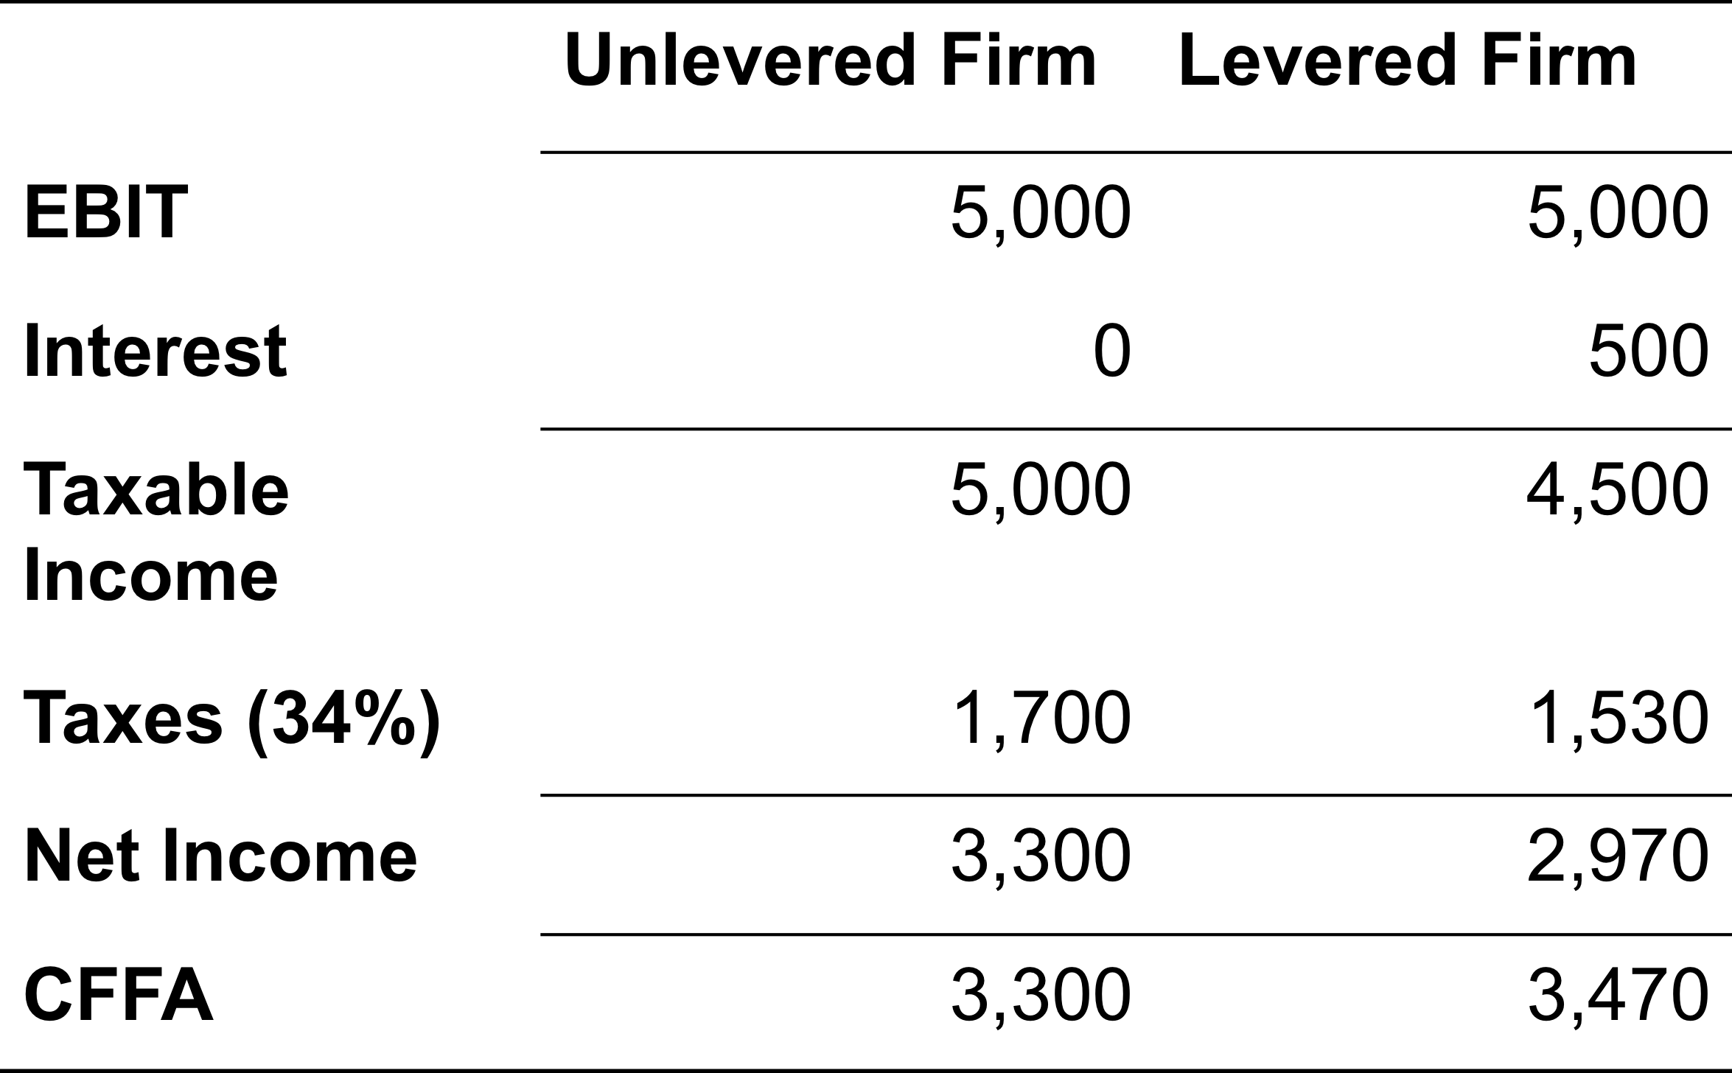
Case II - Example

Slide 28
Interest Tax Shield
Annual interest tax shield
Tax rate times interest payment
6,250 in 8% debt = 500 in interest expense
Annual tax shield = .34(500) = 170
Present value of annual interest tax shield
Assume perpetual debt for simplicity
PV = 170 / .08 = 2,125
PV = D(R_{D})(T_{C}) / R_{D} = DT_{C} = 6,250(.34) = 2,125

Slide 29
Case II – Proposition I
The value of the firm increases by the present value of the annual interest tax shield
Value of a levered firm = value of an unlevered firm + PV of interest tax shield
Value of equity = Value of the firm – Value of debt
Assuming perpetual cash flows
V_{U} = EBIT(1-T) / R_{U}
V_{L} = V_{U} + DT_{C}

Slide 30
Example: Case II – Proposition I
Data
EBIT = 25 million; Tax rate = 35%; Debt = $75 million; Cost of debt = 9%; Unlevered cost of capital = 12%
V_{U} = 25(1-.35) / .12 = $135.42 million
V_{L} = 135.42 + 75(.35) = $161.67 million
E = 161.67 – 75 = $86.67 million

Slide 31
Case II – Proposition II
The WACC decreases as D/E increases because of the government subsidy on interest payments
R_{A} = (E/V)R_{E} + (D/V)(R_{D})(1-T_{C})
R_{E} = R_{U} + (R_{U} – R_{D})(D/E)(1-T_{C})
Example
R_{E} = 12 + (12-9)(75/86.67)(1-.35) = 13.69%
R_{A} = (86.67/161.67)(13.69) + (75/161.67)(9)(1-.35) R_{A} = 10.05%

Slide 32
Example: Case II – Proposition II
Suppose that the firm changes its capital structure so that the debt-to-equity ratio becomes 1.
What will happen to the cost of equity under the new capital structure?
R_{E} = 12 + (12 - 9)(1)(1-.35) = 13.95%
What will happen to the weighted average cost of capital?
R_{A} = .5(13.95) + .5(9)(1-.35) = 9.9%

Slide 33
Case III
Now we add bankruptcy costs
As the D/E ratio increases, the probability of bankruptcy increases
This increased probability will increase the expected bankruptcy costs
At some point, the additional value of the interest tax shield will be offset by the increase in expected bankruptcy cost
At this point, the value of the firm will start to decrease, and the WACC will start to increase as more debt is added

Slide 34
Bankruptcy Costs
Direct costs
Legal and administrative costs
Ultimately cause bondholders to incur additional losses
Disincentive to debt financing
Financial distress
Significant problems in meeting debt obligations
Firms that experience financial distress do not necessarily file for bankruptcy

Slide 35
More Bankruptcy Costs
Indirect bankruptcy costs
Larger than direct costs, but more difficult to measure and estimate
Stockholders want to avoid a formal bankruptcy filing
Bondholders want to keep existing assets intact so they can at least receive that money
Assets lose value as management spends time worrying about avoiding bankruptcy instead of running the business
The firm may also lose sales, experience interrupted operations and lose valuable employees

Slide 36
Conclusions
Case I – no taxes or bankruptcy costs
No optimal capital structure
Case II – corporate taxes but no bankruptcy costs
Optimal capital structure is almost 100% debt
Each additional dollar of debt increases the cash flow of the firm
Case III – corporate taxes and bankruptcy costs
Optimal capital structure is part debt and part equity
Occurs where the benefit from an additional dollar of debt is just offset by the increase in expected bankruptcy costs

Slide 37
Managerial Recommendations
The tax benefit is only important if the firm has a large tax liability
Risk of financial distress
The greater the risk of financial distress, the less debt will be optimal for the firm
The cost of financial distress varies across firms and industries, and as a manager you need to understand the cost for your industry

Slide 38
The Value of the Firm
Value of the firm = marketed claims + nonmarketed claims
Marketed claims are the claims of stockholders and bondholders
Nonmarketed claims are the claims of the government and other potential stakeholders
The overall value of the firm is unaffected by changes in capital structure
The division of value between marketed claims and nonmarketed claims may be impacted by capital structure decisions

Slide 39
The Pecking-Order Theory
Theory stating that firms prefer to issue debt rather than equity if internal financing is insufficient.
Rule 1
Use internal financing first
Rule 2
Issue debt next, new equity last
The pecking-order theory is at odds with the tradeoff theory:
There is no target D/E ratio
Profitable firms use less debt
Companies like financial slack

Slide 40
Observed Capital Structure
Capital structure does differ by industry
Differences according to Cost of Capital 2008 Yearbook by Ibbotson Associates, Inc.
Lowest levels of debt
Computers with 5.61% debt
Drugs with 7.25% debt
Highest levels of debt
Cable television with 162.03% debt
Airlines with 129.40% debt

Slide 41
Bankruptcy Process – Part I
Business failure – business has terminated with a loss to creditors
Legal bankruptcy – petition federal court for bankruptcy
Technical insolvency – firm is unable to meet debt obligations
Accounting insolvency – book value of equity is negative

Slide 42
Bankruptcy Process – Part II
Liquidation
Chapter 7 of the Federal Bankruptcy Reform Act of 1978
Trustee takes over assets, sells them and distributes the proceeds according to the absolute priority rule
Reorganization
Chapter 11 of the Federal Bankruptcy Reform Act of 1978
Restructure the corporation with a provision to repay creditors

Slide 43
Ethics Issues
Suppose managers of a firm know that the company is approaching financial distress.
Should the managers borrow from creditors and issue a large one-time dividend to shareholders?
How might creditors control this potential transfer of wealth?

