Slide 1
Chapter 3
Vectors

Slide 2
Coordinate Systems
Used to describe the position of a point in space
Coordinate system consists of
  a fixed reference point called the origin
  specific axes with scales and labels
  instructions on how to label a point relative to the origin and the axes

Slide 3
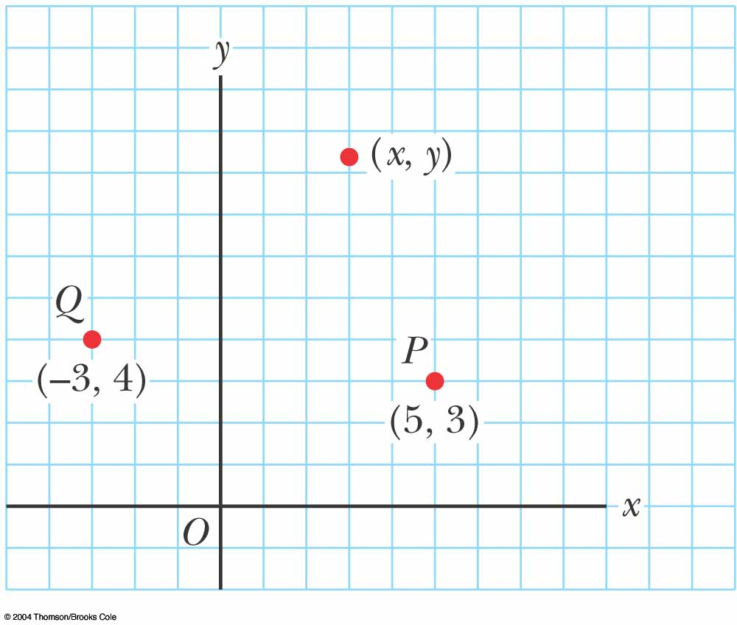
Cartesian Coordinate System
Also called rectangular coordinate system
x- and y- axes intersect at the origin
Points are labeled (x,y)

Slide 4
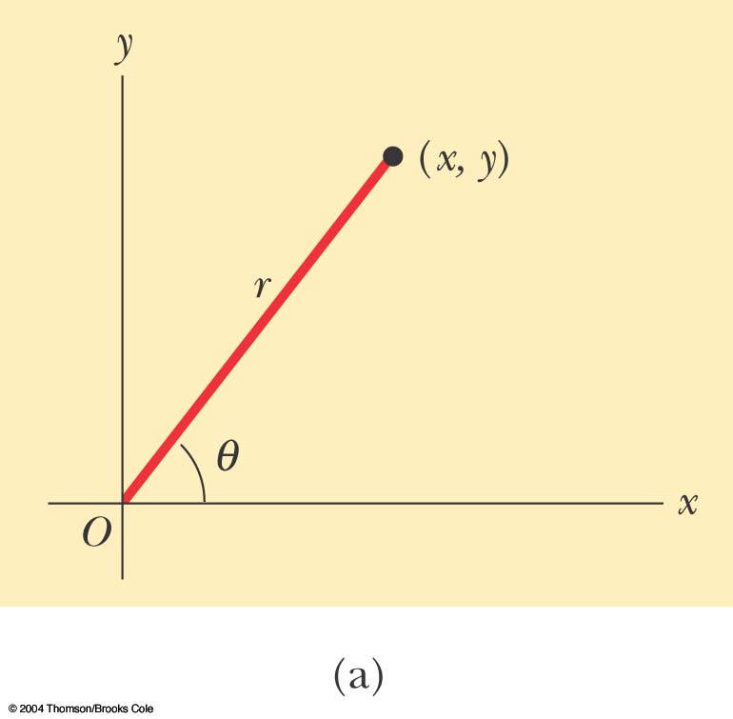
Polar Coordinate System
  Origin and reference line are noted
  Point is distance r from the origin in the direction of angle θ, ccw from reference line
  Points are labeled (r,θ)

Slide 5
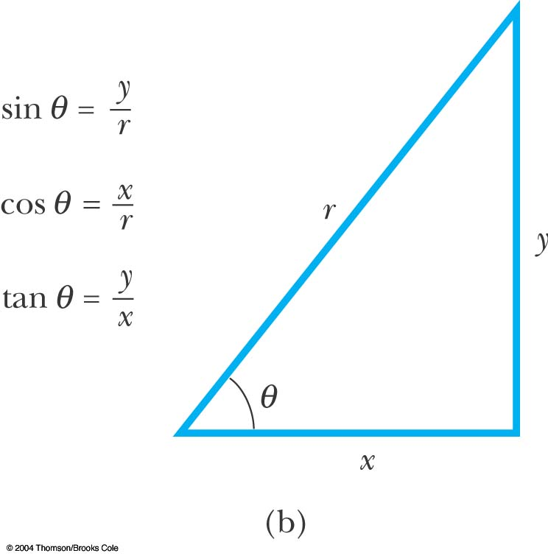
Polar to Cartesian Coordinates
Based on forming a right triangle from r and θ
x = r cos θ
y = r sin θ

Slide 6
Cartesian to Polar Coordinates
r is the hypotenuse and θ an angle
θ must be ccw from positive x axis for these equations to be valid

Slide 7
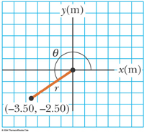
Example 3.1
The Cartesian coordinates of a point in the xy plane are (x,y) = (-3.50, -2.50) m, as shown in the figure. Find the polar coordinates of this point.
Solution: From Equation 3.4,
and from Equation 3.3,

Slide 8
Vectors and Scalars
A scalar quantity is completely specified by a single value with an appropriate unit and has no direction.
A vector quantity is completely described by a number and appropriate units plus a direction.

Slide 9
Vector Notation
When handwritten, use an arrow:
When printed, will be in bold print: A
When dealing with just the magnitude of a vector in print, an italic letter will be used: A or |A|
The magnitude of the vector has physical units
The magnitude of a vector is always a positive number

Slide 10


Slide 11
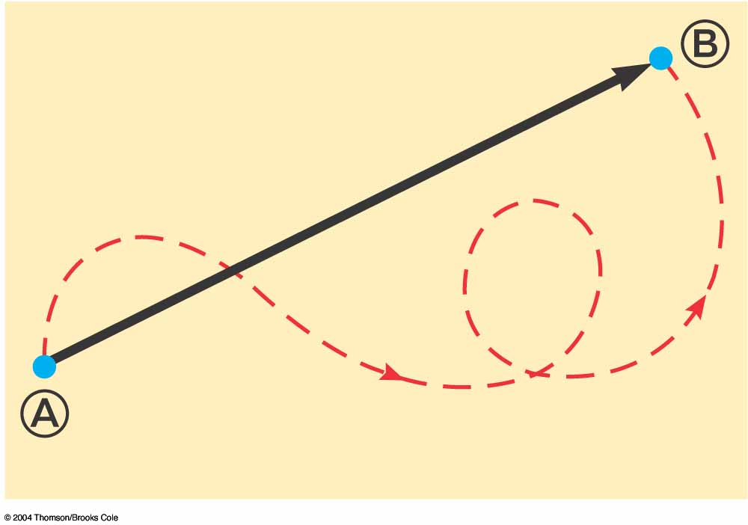
Vector Example
A particle travels from A to B along the path shown by the dotted red line
  This is the distance traveled and is a scalar
The displacement is the solid line from A to B
  The displacement is independent of the path taken between the two points
  Displacement is a vector

Slide 12
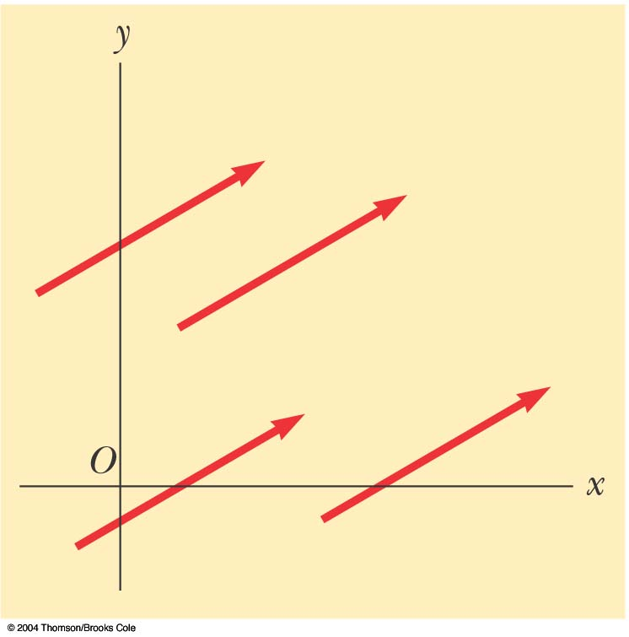
Equality of Two Vectors
Two vectors are equal if they have the same magnitude and the same direction
A = B if A = B and they point along parallel lines
All of the vectors shown are equal

Slide 13
Adding Vectors
When adding vectors, their directions must be taken into account
Units must be the same
Graphical Methods
  Use scale drawings
Algebraic Methods
  More convenient

Slide 14
Adding Vectors Graphically
Choose a scale
Draw the first vector with the appropriate length and in the direction specified, with respect to a coordinate system
Draw the next vector with the appropriate length and in the direction specified, with respect to a coordinate system whose origin is the end of vector A and parallel to the coordinate system used for A

Slide 15
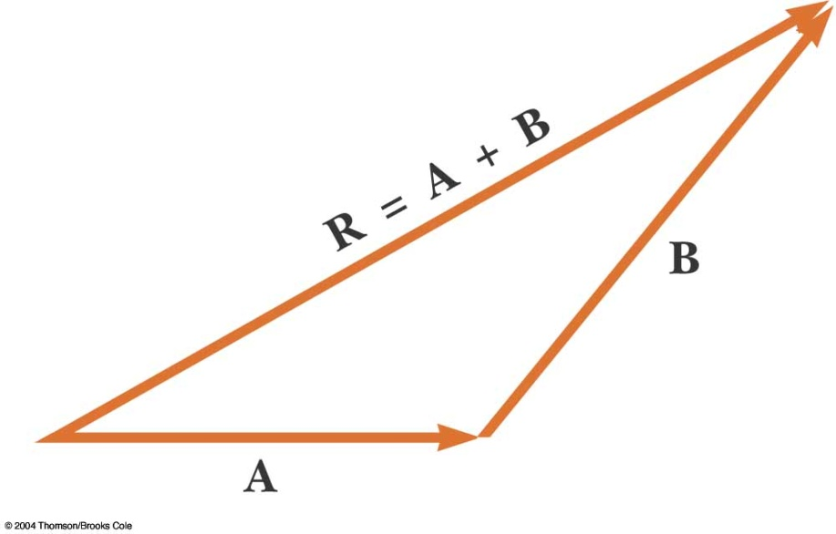
Adding Vectors Graphically, cont.
Continue drawing the vectors “tip-to-tail”
The resultant is drawn from the origin of A to the end of the last vector
Measure the length of R and its angle
  Use the scale factor to convert length to actual magnitude

Slide 16
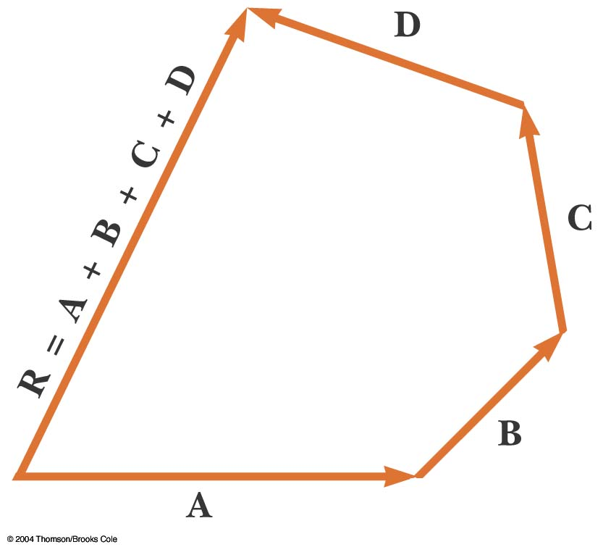
Adding Vectors Graphically, final
When you have many vectors, just keep repeating the process until all are included
The resultant is still drawn from the origin of the first vector to the end of the last vector

Slide 17
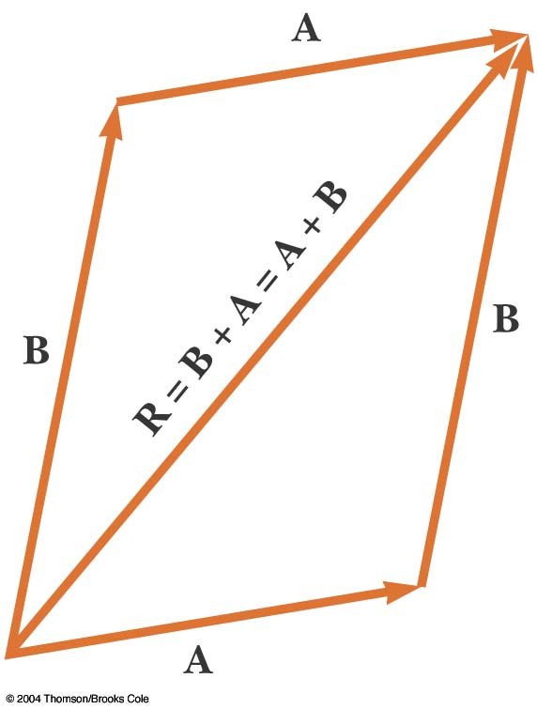
Adding Vectors, Rules
When two vectors are added, the sum is independent of the order of the addition.
  This is the commutative law of addition
  A + B = B + A

Slide 18
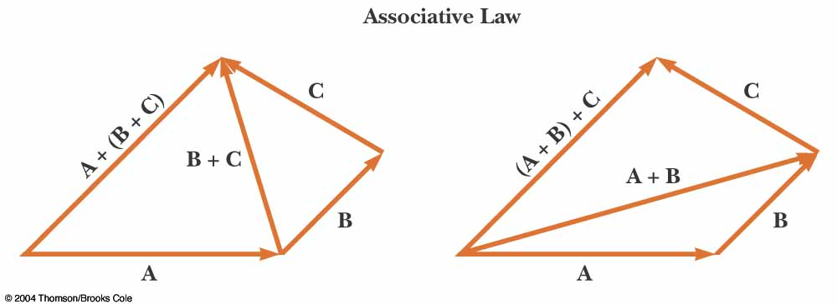
Adding Vectors, Rules cont.
When adding three or more vectors, their sum is independent of the way in which the individual vectors are grouped
  This is called the Associative Property of Addition
  (A + B) + C = A + (B + C)

Slide 19
Adding Vectors, Rules cont.
When adding three or more vectors, their sum is independent of the way in which the individual vectors are grouped
  This is called the Associative Property of Addition
  (A + B) + C = A + (B + C)

Slide 20
Adding Vectors, Rules final
When adding vectors, all of the vectors must have the same units
All of the vectors must be of the same type of quantity
  For example, you cannot add a displacement to a velocity

Slide 21
Negative of a Vector
The negative of a vector is defined as the vector that, when added to the original vector, gives a resultant of zero
  Represented as –A
  A + (-A) = 0
The negative of the vector will have the same magnitude, but point in the opposite direction

Slide 22
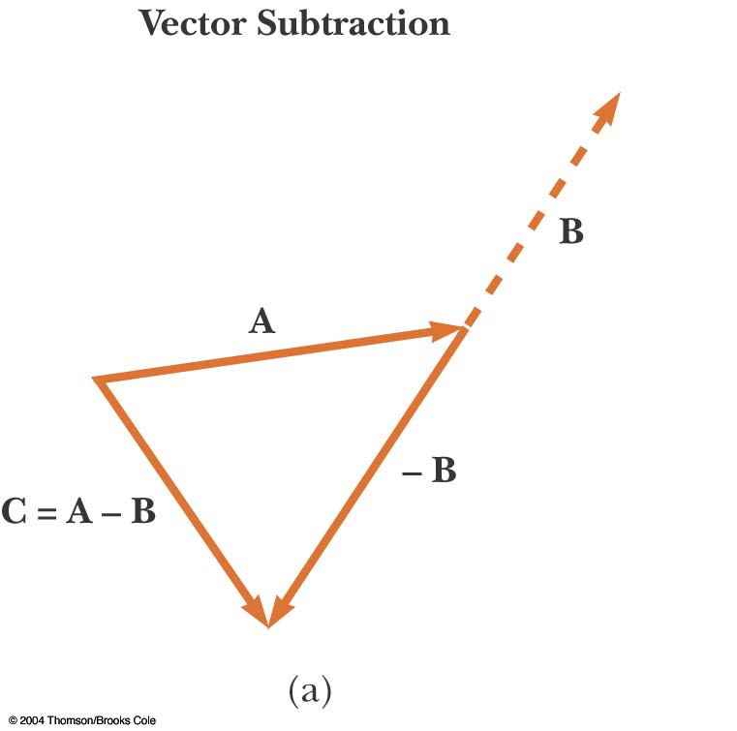
Subtracting Vectors
Special case of vector addition
If A – B, then use A+(-B)
Continue with standard vector addition procedure

Slide 23

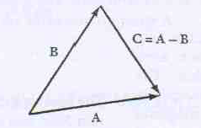

Slide 24
Multiplying or Dividing a Vector by a Scalar
The result of the multiplication or division is a vector
The magnitude of the vector is multiplied or divided by the scalar
If the scalar is positive, the direction of the result is the same as of the original vector
If the scalar is negative, the direction of the result is opposite that of the original vector

Slide 25
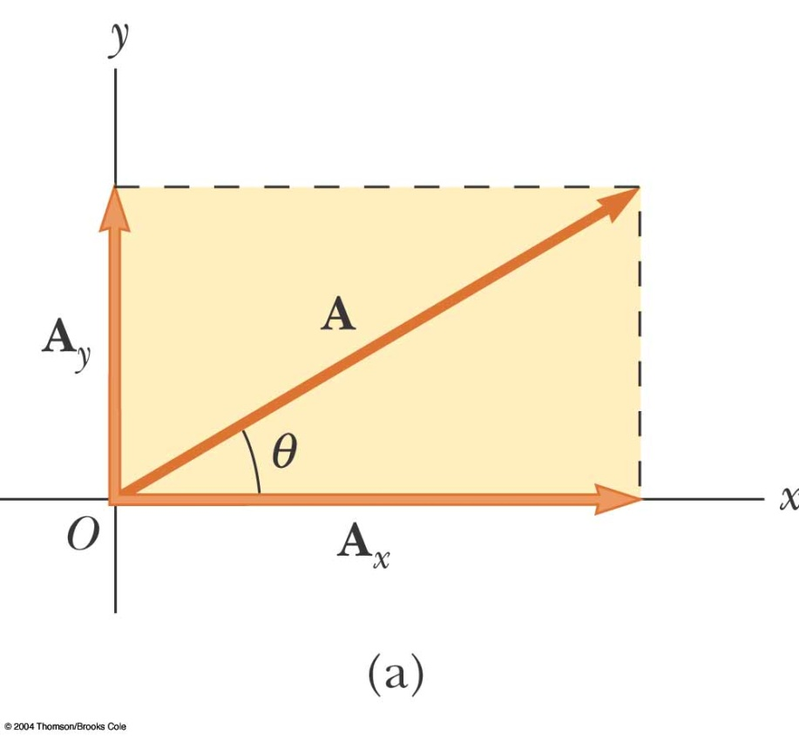
Components of a Vector
A component is a part
It is useful to use rectangular components
  These are the projections of the vector along the x- and y-axes

Slide 26
Vector Component Terminology
A_{x} and A_{y} are the component vectors of A
  They are vectors and follow all the rules for vectors
A_{x} and A_{y} are scalars, and will be referred to as the components of A

Slide 27
Components of a Vector, 2
The x-component of a vector is the projection along the x-axis
The y-component of a vector is the projection along the y-axis
Then,

Slide 28
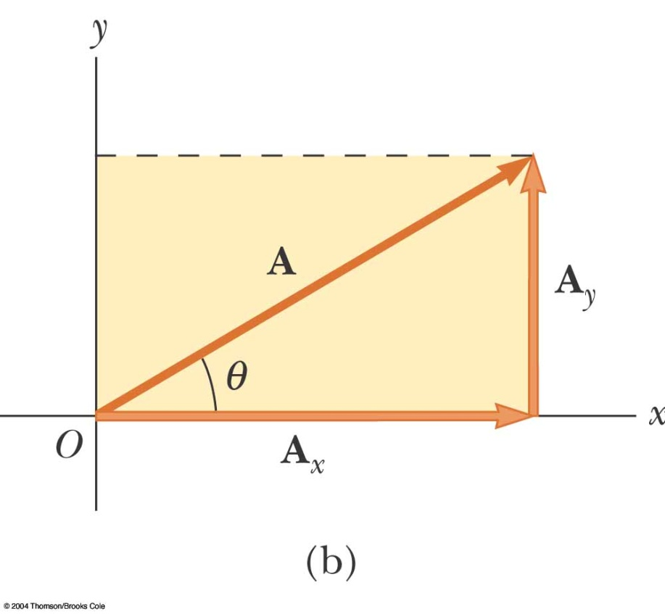
Components of a Vector, 3
The y-component is moved to the end of the x-component
This is due to the fact that any vector can be moved parallel to itself without being affected
  This completes the triangle

Slide 29
Components of a Vector, 4
The previous equations are valid only if θ is measured with respect to the x-axis
The components are the legs of the right triangle whose hypotenuse is A
  May still have to find θ with respect to the positive x-axis

Slide 30
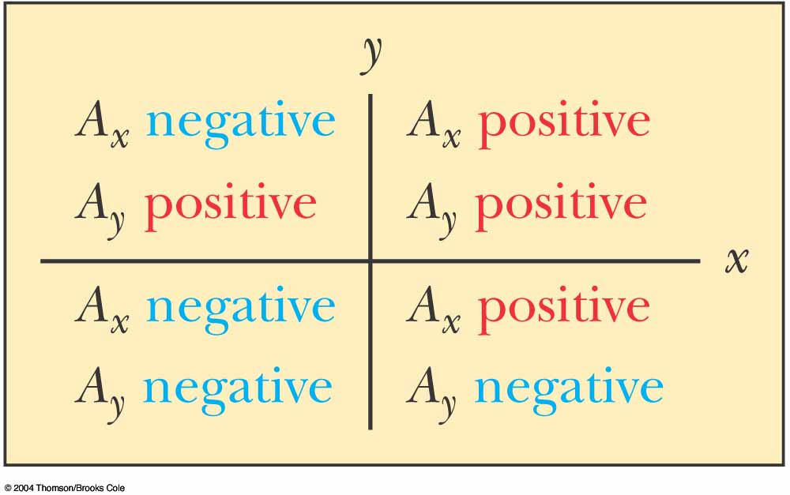
Components of a Vector, final
The components can be positive or negative and will have the same units as the original vector
The signs of the components will depend on the angle

Slide 31
Unit Vectors
A unit vector is a dimensionless vector with a magnitude of exactly 1.
Unit vectors are used to specify a direction and have no other physical significance

Slide 32
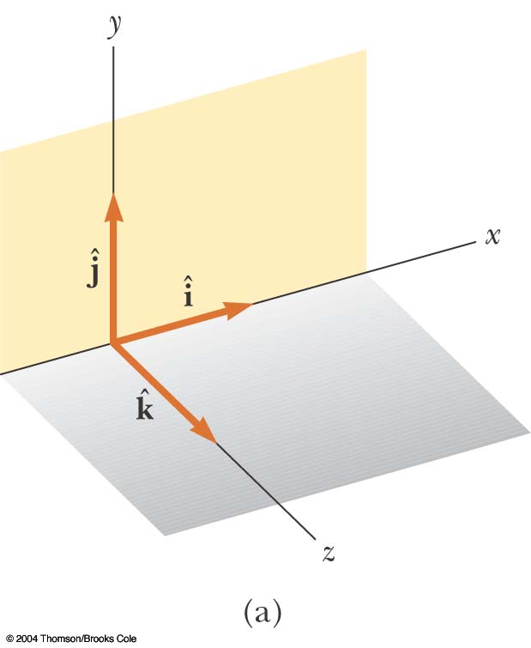
Unit Vectors, cont.
The symbols
represent unit vectors
They form a set of mutually perpendicular vectors

Slide 33
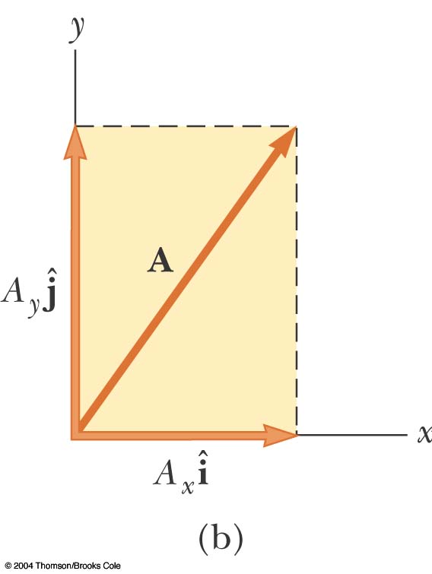
Unit Vectors in Vector Notation
A_{x} is the same as A_{x} and A_{y} is the same as A_{y} etc.
The complete vector can be expressed as

Slide 34
Adding Vectors Using Unit Vectors
Using R = A + B
Then
and so R_{x} = A_{x} + B_{x} and R_{y} = A_{y} + B_{y}

Slide 35
Trig Function Warning
The component equations (A_{x} = A cos θ and A_{y} = A sin θ) apply only when the angle is measured with respect to the x-axis (preferably ccw from the positive x-axis).
The resultant angle (tan θ = A_{y} / A_{x}) gives the angle with respect to the x-axis.
  You can always think about the actual triangle being formed and what angle you know and apply the appropriate trig functions

Slide 36
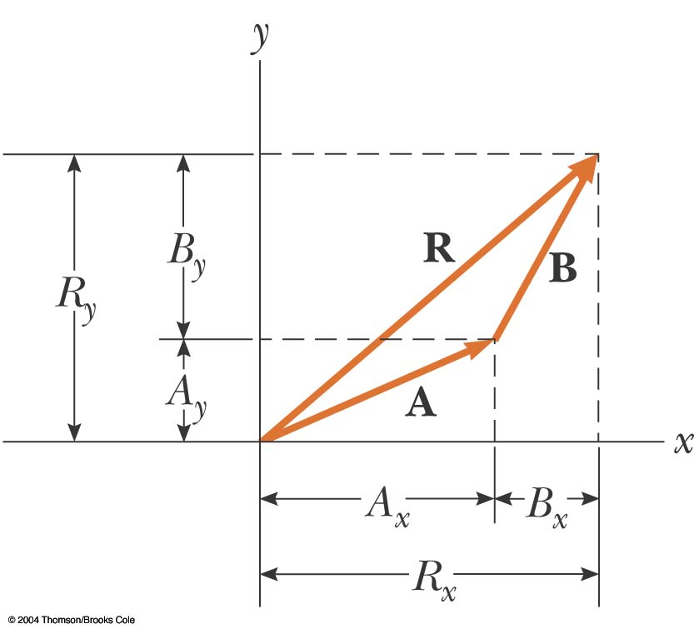
Adding Vectors with Unit Vectors

Slide 37
Adding Vectors Using Unit Vectors – Three Directions
Using R = A + B
R_{x} = A_{x} + B_{x} , R_{y} = A_{y} + B_{y} and R_{z} = A_{z} + B_{z}
etc.

Slide 38
Example 3.5: Taking a Hike
A hiker begins a trip by first walking 25.0 km southeast from her car. She stops and sets up her tent for the night. On the second day, she walks 40.0 km in a direction 60.0° north of east, at which point she discovers a forest ranger’s tower.

Slide 39
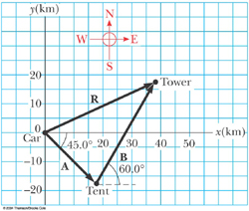
Example 3.5
(A) Determine the components of the hiker’s displacement for each day.
Solution: We conceptualize the problem by drawing a sketch as in the figure above. If we denote the displacement vectors on the first and second days by A and B respectively, and use the car as the origin of coordinates, we obtain the vectors shown in the figure. Drawing the resultant R, we can now categorize this problem as an addition of two vectors.

Slide 40
Example 3.5
We will analyze this problem by using our new knowledge of vector components. Displacement A has a magnitude of 25.0 km and is directed 45.0° below the positive x axis.
From Equations 3.8 and 3.9, its components are:
The negative value of A_{y} indicates that the hiker walks in the negative y direction on the first day. The signs of A_{x} and A_{y} also are evident from the figure above.

Slide 41
Example 3.5
The second displacement B has a magnitude of 40.0 km and is 60.0° north of east.
Its components are:

Slide 42
Problem Solving Strategy – Adding Vectors
Select a coordinate system
  Try to select a system that minimizes the number of components you need to deal with
Draw a sketch of the vectors
  Label each vector

Slide 43
Problem Solving Strategy – Adding Vectors, 2
Find the x and y components of each vector and the x and y components of the resultant vector
  Find z components if necessary
Use the Pythagorean theorem to find the magnitude of the resultant and the tangent function to find the direction
  Other appropriate trig functions may be used

Slide 44

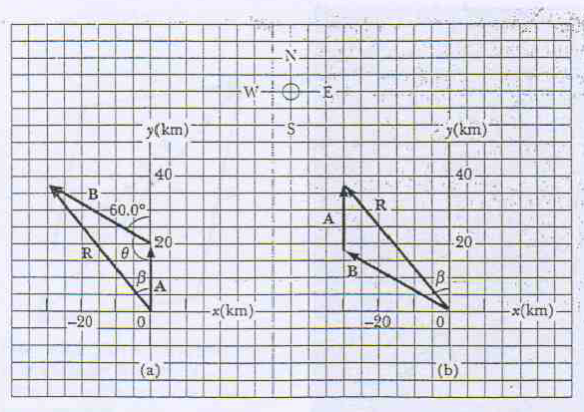


Slide 45
Q. Given the vectors
(a) draw the vector sum C = A + B
and the vector difference D = A − B.
(b) Calculate C and D, first in terms
of unit vectors and then in terms of
polar coordinates, with angles measured
with respect to the +x axis

