Slide 1
2 - IP Routing

Slide 2
Switch VS Router:
switches based on MAC address information. The only concern for our switch is to know when an Ethernet frame enters one of its interfaces where it should send this Ethernet frame by looking at the destination MAC address. Switches make decisions based on Data Link layer information (layer 2).
Routers have a similar task but this time we are going to look at IP packets and as you
might recall IP is on the Network layer (layer 3). Routers look at the destination IP
address in an IP packet and send it out the correct interface.

Slide 3
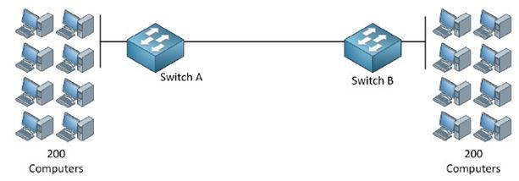
We have two switches and to each switch are 200 computers connected. Now if all 400
computers want to communicate with each switch has to learn 400 MAC addresses. The
need to know the MAC addresses of the computers on the left and right side.
Now think about a really large network…for example the Internet. There are millions of
devices! Would it be possible to have millions of entries in your MAC-address table? For
each device on the Internet? No way!

Slide 4
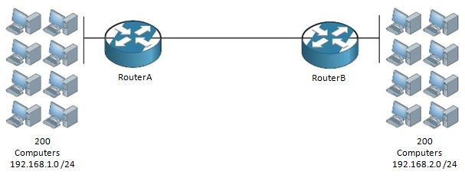
What we have here is our 200 computers on the left are connected to router A and in the
192.168.1.0 /24 network. Router B has 200 computers behind it and the network we use
over there is 192.168.2.0 /24.
Routers “route” based on IP information, in our example Router A only has to know that
network 192.168.2.0 /24 is behind Router B. Router B only needs to know that the
192.168.1.0 /24 network is behind Router A. Instead of having a MAC-address-table with 400 MAC addresses we now only need a single entry on each router for each other's networks.

Slide 5
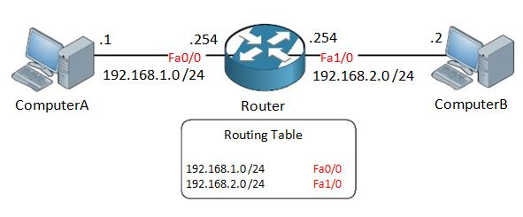
Whenever ComputerA wants to send something to ComputerB this will happen:
1. ComputerA sends an IP packet with destination IP address 192.168.2.2.
2. ComputerA checks its own IP address and subnet mask and concludes that
192.168.2.2 is in another subnet. As a result it will forward the IP packet to its
default gateway.
3. The router receives the IP packet, checks the destination IP address and scans the
routing table. IP address 192.168.2.2 matches the 192.168.2.0 /24 entry and the
router will forward the IP packet out if its FastEthernet 1/0 interface.
4. ComputerB receives the IP packet and life is good!

Slide 6
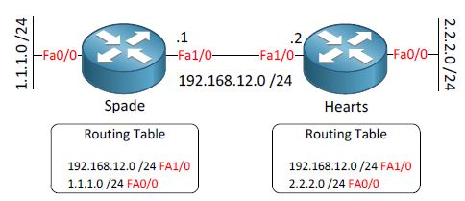
Now the big question is…how do router Spade and router Hearts know that there is a
network behind each other? There are 2 ways how they can learn this information:
Static Routing
Dynamic Routing
If you use static routing you will have to do everything by yourself. YOU tell the router
where to send IP packets for a certain network, this might be entertaining but it's a lot of
work. Dynamic routing means we use a routing protocol that will exchange network
information between routers. Let's start with a configuration example of static routes on
some real routers:

Slide 7
Static Routing:
We want to make sure that the headquarters can reach the 2.2.2.0 /24 network.

Slide 8
Static Routing:
1- First I'll go to enable mode and enter configuration mode.
2- Then I'll configure the IP addresses on the interfaces; don't forget to do a “no shutdown” on the interfaces.
Headquarters>enable
Headquarters#configure terminal
First I‟ll go to enable mode and enter configuration mode.
Headquarters(config)#interface FastEthernet 0/0
Headquarters(config-if)#no shutdown
Headquarters(config-if)#ip address 192.168.12.1 255.255.255.0
Branch>enable
Branch#configure terminal
Branch(config)#interface fastEthernet0/0
Branch(config-if)#no shutdown
Branch(config-if)#ip address 192.168.12.2 255.255.255.0
Branch(config-if)#exit
Branch(config)#interface fastEthernet 1/0
Branch(config-if)#no shutdown
Branch(config-if)#ip address 2.2.2.2 255.255.255.0

Slide 9
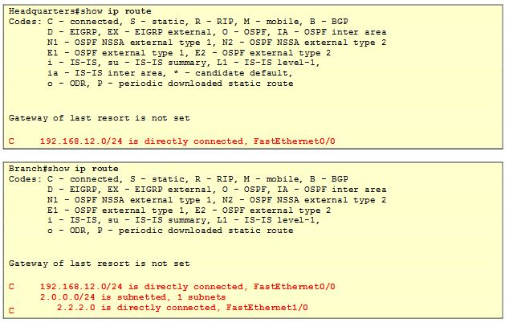
Use the show ip route command to view the routing table. This is what a router uses to
make decisions where to forward IP packets to. By default a router only knows its directly
connected networks. We configured an IP address with a subnet mask on the interface so
the router also knows the network address.·
Router Headquarters knows about network 192.168.12.0/24.
Router Branch knows about network 192.168.12.0/24 and 2.2.2.0/24.
At this moment our Headquarters router has no idea how to reach network 2.2.2.0/24
because there is no entry in the routing table. What will happen when we try to reach it?

Slide 10
Static Routing:
Let's use a static route to tell router Headquarters how to reach this network!
We use the ip route command to create a static route.
Let me break it down for you:
2.2.2.0 is the network we want to reach.
255.255.255.0 is the subnet mask of the network.
192.168.12.2 is called the next hop IP address. It's the IP address where we want
to send traffic to. In this example that's the branch router.
I'm telling router Headquarters that it can reach network 2.2.2.0 /24 by sending traffic to IP
address 192.168.12.2 (the Branch router).

Slide 12
Default Route:
the picture above our Headquarters router is connected to an ISP (Internet Service
Provider). There are many networks on the Internet so do we require all of those networks
on the Internet in our routing table? The answer is no because we can use a default route,
let me show you what it is:
Let me explain this one:
The first 0.0.0.0 is the network address; in this case it means all networks.
The second 0.0.0.0 is the subnet mask; all 0s means all subnet masks.
1.2.3.1 is the next hop IP address. In this case the IP address of the ISP router.

Slide 13
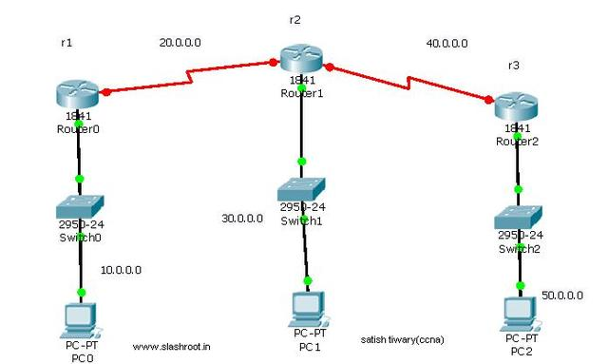
Home Work 4: note: all subnet mask is: 255.255.255.0

