Slide 1
Chapter 5
Sequences

Slide 2
Sequences
Object
Description
Table
Basic unit of storage; composed of rows
View
Logically represents subsets of data from one or more tables
Sequence
Generates numeric values
Index
Improves the performance of some queries
Synonym
Gives alternative names to objects

Slide 3
Sequences
A sequence:
Can automatically generate unique numbers or to recycle and use the same numbers again.
is a user-created database object that can be shared by multiple users to generate integers.
Can be used to create a primary key value
A sequence is generated and incremented (or decremented) by an internal Oracle routine. This can be time-saving because it Replaces application code
Speeds up the efficiency of accessing sequence values when cached in memory
Sequence numbers are stored and generated independent of tables. Therefore, the same sequence can be used for multiple tables.
2
4
6
8
10
1
3
5
7
9

Slide 4
CREATE SEQUENCE Statement: Syntax
Define a sequence to generate sequential numbers automatically:
CREATE SEQUENCE sequence
[INCREMENT BY n]
[START WITH n]
[{MAXVALUE n | NOMAXVALUE}]
[{MINVALUE n | NOMINVALUE}]
[{CYCLE | NOCYCLE}]
[{CACHE n | NOCACHE}];

Slide 5
CREATE SEQUENCE Statement: Syntax
In the syntax:
sequence Is the name of the sequence generator
INCREMENT BY n Specifies the interval between sequence numbers, where n is an integer (If this clause is omitted, the sequence increments by 1.)
START WITH n Specifies the first sequence number to be generated (If this clause is omitted, the sequence starts with 1.)
MAXVALUE n Specifies the maximum value the sequence can generate
NOMAXVALUE Specifies a maximum value of 10^27 for an ascending sequence and –1 for a descending sequence (This is the default option.)
MINVALUE n Specifies the minimum sequence value
NOMINVALUE Specifies a minimum value of 1 for an ascending sequence and –(10^26) for a descending sequence (This is the default option.)

Slide 6
CREATE SEQUENCE Statement: Syntax
CYCLE | NOCYCLE Specifies whether the sequence continues to generate values after reaching its maximum or minimum value (NOCYCLE is the default option.)
CACHE n | NOCACHE Specifies how many values the Oracle server pre-allocates and keeps in memory (By default, the Oracle server caches 20 values.)
To improve performance, SQL Server pre-allocates the number of sequence numbers specified by the CACHE argument. For an example, a new sequence is created with a starting value of 1 and a cache size of 15. When the first value is needed, values 1 through 15 are made available from memory.

Slide 7
Creating a Sequence
Create a sequence named DEPT_DEPTID_SEQ to be used for the primary key of the DEPARTMENTS table.
Do not use the CYCLE option.
CREATE SEQUENCE dept_deptid_seq
INCREMENT BY 10
START WITH 120
MAXVALUE 9999
NOCACHE
NOCYCLE;

Slide 8
NEXTVAL and CURRVAL
After you create your sequence, it generates sequential numbers for use in your tables. Reference the sequence values by using the NEXTVAL and CURRVAL
NEXTVAL returns the next available sequence value. It returns a unique value every time it is referenced, even for different users.
CURRVAL obtains the current sequence value.
NEXTVAL must be issued for that sequence before CURRVAL contains a value.

Slide 9
Rules for Using NEXTVAL and CURRVAL
You can use NEXTVAL and CURRVAL in the following contexts:
The SELECT list of a SELECT statement that is not part of a subquery
The SELECT list of a subquery in an INSERT statement
The VALUES clause of an INSERT statement
The SET clause of an UPDATE statement
You cannot use NEXTVAL and CURRVAL in the following contexts:
The SELECT list of a view
A SELECT statement with the DISTINCT keyword
A SELECT statement with GROUP BY, HAVING, or ORDER BY clauses
A subquery in a SELECT, DELETE, or UPDATE statement
The DEFAULT expression in a CREATE TABLE or ALTER TABLE statement

Slide 10
Using a Sequence
Insert a new department named “Support” in location ID 2500:
View the current value for the DEPT_DEPTID_SEQ sequence:
INSERT INTO departments(department_id,
department_name, location_id)
VALUES (dept_deptid_seq.NEXTVAL,
'Support', 2500);
SELECT dept_deptid_seq.CURRVAL
FROM dual;

Slide 11
Caching Sequence Values
Caching sequence values in memory gives faster access to those values.
Gaps in sequence values can occur when:
A rollback occurs
The system crashes
A sequence is used in another table

Slide 12
Modifying a Sequence
Change the increment value, maximum value, minimum value, cycle option, or cache option:
ALTER SEQUENCE dept_deptid_seq
INCREMENT BY 20
MAXVALUE 999999
NOCACHE
NOCYCLE;

Slide 13
Guidelines for Modifying a Sequence
You must be the owner or have the ALTER privilege for the sequence.
Only future sequence numbers are affected.
The sequence must be dropped and re-created to restart the sequence at a different number.
Some validation is performed. For example, a new MAXVALUE that is less than the current sequence number cannot be imposed.
To remove a sequence, use the DROP statement:
DROP SEQUENCE dept_deptid_seq;

Slide 14
Database Security

Slide 15
Database Security
Multi-user database systems like Oracle include security to control how the database is accessed and used for example security Mechanisms:
Prevent unauthorized database access
Prevent unauthorized access to schema objects
Control disk usage
Audit user actions

Slide 16
Database security
Data security
system security

Slide 17
System Security
covers access and use of the database at the system level, such as:
the username and password
the disk space allocated to users,
and the system operations that users can perform

Slide 18
Data security
covers access and use of the database objects and the actions that those users can have on the objects such as selecting data from a table or retrieving a value from a sequence

Slide 19
Privileges
Privileges are the right to execute particular SQL statements. The database administrator (DBA) is a high-level user with the ability to grant users access to the database and its objects
System privileges: Gaining access to the database
Object privileges: Manipulating the content of the database objects

Slide 20
schema
A schema is a collection of objects, such as tables, views, and sequences.
The schema is owned by a database user and has the same name as that user.

Slide 21
System Privileges
More than 100 privileges are available. • The database administrator has high-level system privileges for tasks such as: – Creating new users – Removing users – Removing tables – Backing up tables

Slide 22
Operations Authorized | System Privilege
Grantee can create other Oracle users (a privilege required for a DBA role). | CREATE USER
Grantee can drop another user. | DROP USER
Grantee can drop a table in any schema. | DROP ANY TABLE
Grantee can back up any table in any schema with the export utility | BACKUP ANY TABLE
Grantee can create tables in any schema. | CREATE ANY TABLE
Grantee can query tables, views, or snapshots in any schema | SELECT ANY TABLE

Slide 23
Creating Users
The DBA creates the user by executing the CREATE USER statement.
The user does not have any privileges at this point.
The DBA can then grant privileges to that user.
These privileges determine what the user can do at the database level.

Slide 24
Creating Users
The syntax for creating a user is:
CREATE USER user
IDENTIFIED BY password
DEFAULT TABLESPACE system
TEMPORARY TABLESPACE temp
QUOTA UNLIMITED on system;
Example:
CREATE USER demo
IDENTIFIED BY demo
DEFAULT TABLESPACE system
TEMPORARY TABLESPACE temp
QUOTA UNLIMITED on system;
User created.

Slide 25
User System Privileges
Once a user is created, the DBA can grant specific system privileges to a user. GRANT privilege TO user; • An application developer, for example, may have the following system privileges: – CREATE SESSION – CREATE TABLE – CREATE SEQUENCE – CREATE VIEW – CREATE PROCEDURE

Slide 26
User System Privileges

Slide 27
Granting System Privileges
The DBA can grant a user specific system privileges. Example:
GRANT create session, create table, create sequence, create view TO Demo;

Slide 28
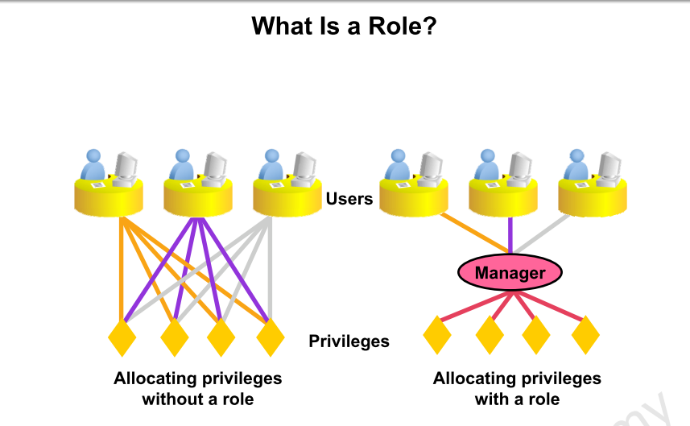

Slide 29
What Is a Role?
A role is a named group of related privileges that can be granted to the user.
This method makes it easier to revoke and maintain privileges.
user can have access to several roles, and several users can be assigned the same role

Slide 30
Creating and Assigning a Role
First, the DBA must create the role. Then the DBA can assign privileges to the role and users to the role. Syntax CREATE ROLE role;

Slide 31
Creating and Granting Privileges to a Role
Create a role CREATE ROLE manager;
Grant privileges to a role GRANT create table, create view TO manager;
Grant a role to users GRANT manager TO Maha, Nora;

Slide 32
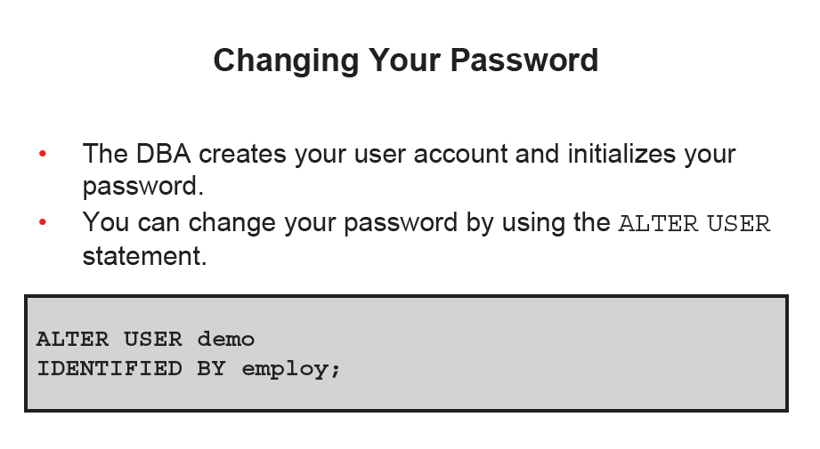

Slide 33
Object Privileges
An object privilege is a privilege or right to perform a particular action on a specific (object) table, view, sequence, or procedure
Each object has a particular set of grantable privileges. The table in the next slide lists the privileges for various objects

Slide 34
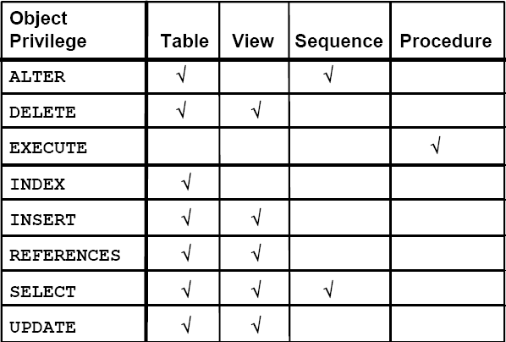
Object Privileges

Slide 35
Object Privileges
Object privileges vary from object to object.
An owner has all the privileges on the object.
An owner can give specific privileges on that owner’s object.
Syntax:
GRANT object_privilege [(columns)] ON object TO user [WITH GRANT OPTION];
If the grant includes WITH GRANT OPTION, then the grantee can further grant the object privilege to other users; otherwise, the grantee can use the privilege but cannot grant it to other users.

Slide 36
Granting Object Privileges
Grant query privileges on the EMPLOYEES table. GRANT select ON employees TO norah, sarah; • Grant privileges to update specific columns to users and roles. GRANT update (department_name, location_id) ON departments TO demo, manager;

Slide 37
Using the WITH GRANT OPTION and PUBLIC Keywords
Give a user authority to pass along privileges. GRANT select, insert ON departments TO demo WITH GRANT OPTION; • Allow all users on the system to query data from Alice’s DEPARTMENTS table. GRANT select ON alice.departments TO PUBLIC;

Slide 38
Guidelines
To grant privileges on an object, the object must be in your own schema, or you must have been granted the object privileges WITH GRANT OPTION . • An object owner can grant any object privilege on the object to any other user or role of the database. • The owner of an object automatically acquires all object privileges on that object.

Slide 39
How to Revoke Object Privileges
Remove privileges granted to other users by using the REVOKE statement. When you use the REVOKEstatement you prevent the user from doing specific actions depending on the privileges you revoke from the user.

Slide 40
How to Revoke Object Privileges
Syntax:
REVOKE privilege ,ALL
ON object FROM user,role,PUBLIC; Example:
REVOKE select, insert ON departments FROM demo;

Slide 41
How to Revoke Object Privileges
Privileges granted to others through the WITH GRANT OPTION clause are also revoked.
For example, if user A grants SELECT privilege on a table to user B including the WITH GRANT OPTION clause, user B can grant to user C the SELECT privilege with the WITH GRANT OPTION clause as well, and user C can then grant to user D the SELECT privilege. If user A revokes privilege from user B, then the privileges granted to users C and D are also revoked.

