Slide 1
Dynamic Routing:
Dynamic routing is where we use a routing protocol; routing protocols are cool because they take care of our work. Routing protocols will send network information to each other and they will keep it up-to-date. If there are any changes in the network our routers will update each other to reflect this new information.
A routing protocol is used between routers to exchange routing information and build the routing table.

Slide 2
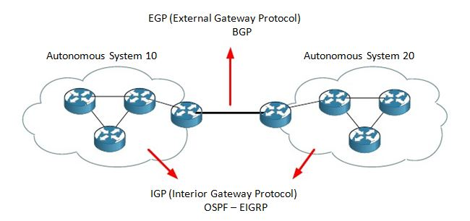
An autonomous system: is a collection of routers/networks that
belongs to a single administrative domain. the network you are responsible for. Your company network could be an autonomous system. Your internet service provider has its own network which is another autonomous system.
Interior gateway protocols(IGP): routing protocols that running Within an autonomous system .
External Routing protocols(EGP): routing protocols that running Between autonomous systems.
CCNA is only about interior gateway protocols and we are going to take a close look at OSPF and EIGRP.

Slide 3
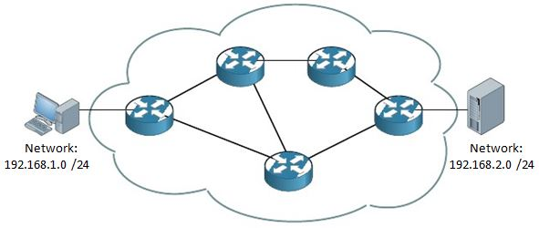
You are looking at an autonomous system with a bunch of routers. On the left side there's a computer in the 192.168.1.0 /24 network and on the right side a server in the 192.168.2.0 /24 network. Our computer wants to reach the server on the right side. It's up to our routers to “route” our IP packets towards the server…the question is; which path are we going to use to get there?
This depends on the routing protocol you are using; we have 2 different routing protocols namely OSPF and EIGRP. Each of them has a different view of the world and what they think is the shortest path to get from source to destination.

Slide 4
Interior routing protocols are divided in three different classes:
Distance Vector (RIP)
Link-State (OSPF)
Hybrid or Advanced Distance Vector (EIGRP)
Routing protocols can be classful or classless:
Classful routing protocols DO NOT send the subnet mask along with their updates.
Classless routing protocols DO send the subnet mask along with their updates.

Slide 5
Distance Vector Routing Protocols(RIP)
Before Cisco changed the exam(s) in 2013, CCNA students had to study 3 different routing
protocols:
RIP (Routing Information Protocol)
OSPF (Open Shortest Path First)
EIGRP (Enhanced Interior Gateway Routing Protocol)
Now you only have to learn about OSPF and EIGRP which makes sense since RIP is a very
old / outdated protocol and it's unlikely that you will see it on a network nowadays.

Slide 6
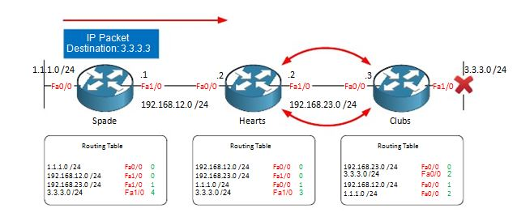
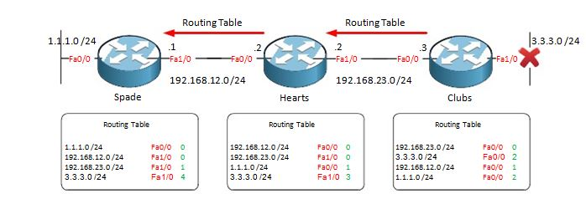
RIP:
uses hop count as its metric which is nothing more than counting the number of routers (hops) you have to pass to get to your destination.
Every 30 seconds our routers will send a full copy of their routing table to their neighbors who can update their own routing table.
A big Problem with RIP is Routing Loop:

Slide 7
Link-State Routing Protocols(OSPF)
OSPF (Open Shortest Path First) is a link state routing protocol.
OSPF runs on most routers that doesn’t necessarily have to be Cisco routers (unlike EIGRP which can be run only on Cisco routers).
Each OSPF router stores routing and topology information in three tables:
Neighbor table – stores information about OSPF neighbors
Topology table – stores the topology structure of a network
Routing table – stores the best routes

Slide 8
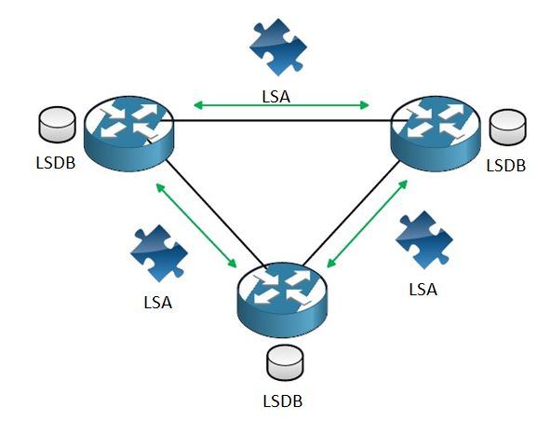
Link-state routing protocols are like your navigation system, they have a complete map of
the network. If you have a full map of the network you can just calculate the shortest path
to all the different destinations out there. This is cool because if you know about all the
different paths it's impossible to get a loop since you know everything! The downside is that this is more CPU intensive than a distance vector routing protocol.
Link-state routing protocols operate by sending link-state advertisements (LSA) to all
other link-state routers.
All the routers need to have these link-state advertisements so they can build their link-
state database or LSDB. Basically all the link-state advertisements are a piece of the
puzzle which builds the LSDB.

Slide 9
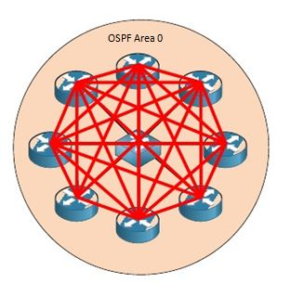
OSPF :
If you have a lot of OSPF routers it might not be very efficient that each OSPF router floods
its LSAs to all other OSPF routers. . Each of those routers is going to become OSPF neighbors with all of the other routers…sending hello packets, flooding LSAs and building the LSDB. This is what will happen

Slide 10
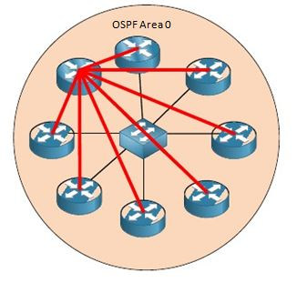
DR (Designated Router):
What if all our OSPF routers would just send their stuff to a single OSPF router who will then forward it to all the other OSPF routers? All our OSPF routers will know about all the routing information out there but we will have far less OSPF traffic. OSPF uses something called a DR (Designated Router). All our OSPF routers will only form a “full” neighbor adjacency with the DR and not with all the other routers.

Slide 11
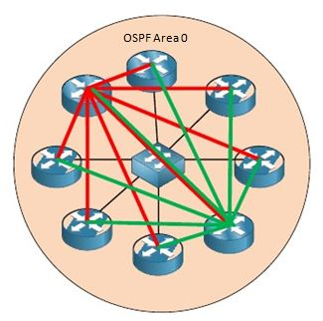
BDR (Backup Designated Router):
Since bad stuff can happen to our networks we want to have backup for our DR. If it
crashes the BDR (Backup Designated Router) will take over. All our OSPF routers will
only form full neighbor adjacencies with the DR and BDR and not with all other routers.

Slide 12
The LSDB (link-state database) is our full picture of the network, in network terms we call this the topology.
You could compare the LSDB to having a full map of your country.
Once every router has a complete map we can start calculating the shortest path to all the
different destinations by using the shortest-path first (SPF) algorithm.

Slide 13
OSPF areas
OSPF uses the concept of areas. An area is a logical grouping of contiguous networks and routers. All routers in the same area have the same topology table, but they don’t know about routers in the other areas. The main benefits of creating areas is that the size of the topology and the routing table on a router is reduced, less time is required to run the SFP algorithm and routing updates are also reduced.

Slide 14
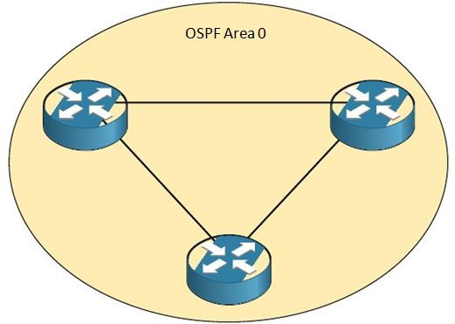
OSPF Area 0:
OSPF works with the concepts of areas and by default you will always have a single area,
normally this is area 0 or also called the backbone area.

Slide 15
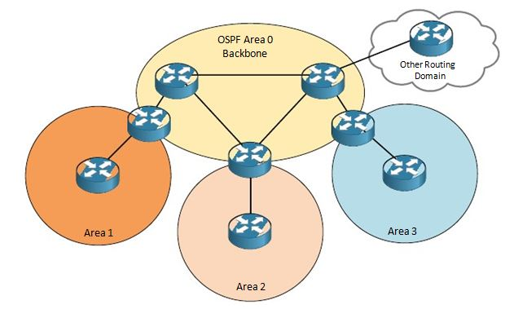
OSPF Multi-area:
You can have multiple areas however as in the picture above, we have area 1,2 and 3. All of
these areas must connect to the backbone area. If you want to go from area 1 to area 2
you must go through the backbone area to get there. It's impossible to go from area 1
directly to area 2; you always have to pass the backbone area!

Slide 16
OSPF Multi-area:
In the picture you also see on the top right something called “other routing domain”. This
could be another network running another routing protocol (perhaps EIGRP) and it's
possible to import and export routes from EIGRP into OSPF or the other way around, this is
called redistribution.
Routers in the backbone area (area 0) are called backbone routers.
Routers between 2 areas (like the one between area 0 and area 1) are called area
border routers or ABR.
Routers that run OSPF and are connected to another network that runs another
routing protocol (for example EIGRP) are called autonomous system border
routers or ASBR.

Slide 17
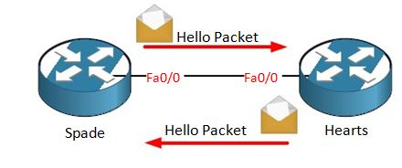
Routers have to be become neighbors first, once we have become neighbors we are going to exchange link-state advertisements. Once you configure OSPF your router will start sending hello packets. If you also receive hello packets from the other router you will become neighbors.

Slide 18
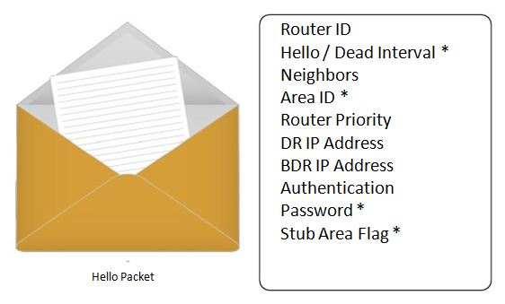

Slide 19
Router ID: Each OSPF router needs to have an unique ID which is the highest IP address on any active interface. More about this later.
Hello / Dead Interval: Every X seconds we are going to send a hello packet, if we don't hear any hello packets from our network for X seconds we declare you “dead” and we are no longer neighbors. These values have to match on both sides in order to become neighbors.
Neighbors: All other routers who are your neighbors are specified in the hello packet.
Area ID: This is the area you are in. This value has to match on both sides in order to become neighbors.
Router Priority: This value is used to determine who will become designated or backup designated router.
DR and BDR IP address: Designated and Backup Designated router, these are outside the scope of the CCNA so I‟m going to skip it.
Authentication password: You can use clear text and MD5 authentication for OSPF which means every packet will be authenticated. Obviously you need the same
password on both routers in order to make things work.
Stub area flag: Besides area numbers OSPF has different area types, this is outside the scope of the CCNA.

Slide 20
OSPF Configuration:
Clear OSPF Info:

Slide 21
Show commands:

Slide 22
Example:
ABR
ABR(config)#interface fastEthernet 0/0
ABR(config-if)#ip address 192.168.0.1 255.255.255.0
ABR(config-if)#no shutdown ABR(config-if)#interface fastEthernet 0/1
ABR(config-if)#ip address 192.168.1.1 255.255.255.0
ABR(config-if)#no shutdown
ABR(config-if)#interface serial 0/0
ABR(config-if)#ip address 10.0.0.1 255.255.255.252
ABR(config-if)#no shutdown
ABR(config)#router ospf 1
ABR(config-router)#network 192.168.0.0 0.0.0.255 area 15
ABR(config-router)#network 192.168.1.0 0.0.0.255 area 15
ABR(config-router)#network 10.0.0.0 0.0.0.3 area 0
HQ
HQ(config)#interface serial 0/0
HQ(config-if)#ip address 10.0.0.2 255.255.255.252
HQ(config-if)#no shutdown
HQ(config)#router ospf 1
HQ(config-router)#network 10.0.0.0 0.0.0.3 area 0
NORTH
NORTH(config)#interface fastEthernet 0/0
NORTH(config-if)#ip address 192.168.0.2 255.255.255.0
NORTH(config-if)#no shutdown
NORTH(config)#router ospf 1
NORTH(config-router)#network 192.168.0.0 0.0.0.255 area 15
SOUTH
SOUTH(config)#interface fastEthernet 0/0
SOUTH(config-if)#ip address 192.168.1.2 255.255.255.0
SOUTH(config-if)#no shutdown S
OUTH(config)#router ospf 1
SOUTH(config-router)#network 192.168.1.0 0.0.0.255 area 15

Slide 23
EIGRP overview
EIGRP (Enhanced Interior Gateway Routing Protocol) is an advanced distance vector routing protocol.
EIGRP which can be run only on Cisco routers

Slide 24
Configuring EIGRP
Only two steps are required: • enabling EIGRP by using the router eigrp ASN_NUMBER command • telling EIGRP which networks to advertise by using one or more network statements
The first command, router eigrp ASN_NUMBER, enables EIGRP on a router. ASN_NUMBER represents an autonomous system number and has to be the same on all routers running EIGRP, otherwise routers won’t become neighbors. The second command, network SUBNET, enables EIGRP on selected interfaces and specifies which networks will be advertised. By default, the network command takes a classful network number as the parameter.

Slide 25
example
You can verify that routers have become neighbors by using the show ip eigrp neighbors command on either router:

Slide 26
Differences between OSPF and EIGRP

Slide 27
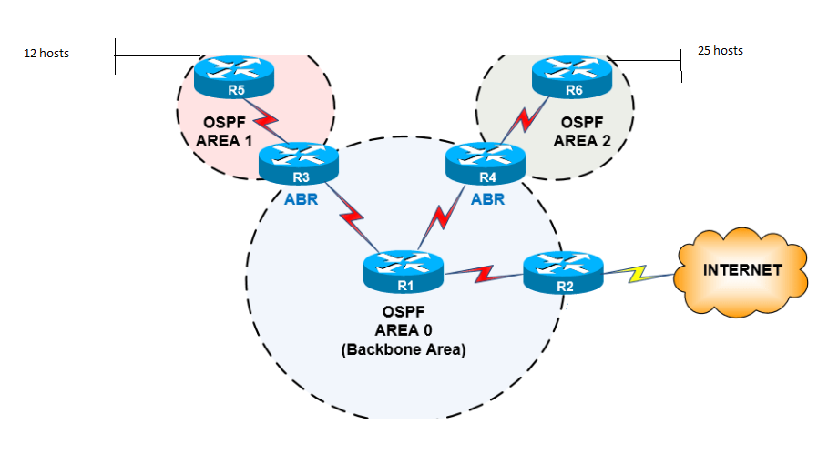
You have network 192.168.10.0/24 design and implement the following topology using OSPF

