Slide 1
Chapter 5
The Laws of Motion

Slide 2
Force
What is force?
It is a push or pull which changes or tries to change the state of an object.
Does non living exert force?
Yes, the force exerted by wind, the force exerted by rope on the hanging object etc
SI unit of force is Newton. Force is vector quantity.

Slide 3
Force
Forces are push or pull which cause any change in the velocity of an object.
A force is that which causes an acceleration
The net force is the vector sum of all the forces acting on an object
Also called total force, resultant force, or unbalanced force

Slide 4
Zero Net Force
When the net force is equal to zero:
The acceleration is equal to zero
The velocity is constant
Equilibrium occurs when the net force is equal to zero
The object, if at rest, will remain at rest
If the object is moving, it will continue to move at a constant velocity

Slide 5
Classes of Forces
Contact forces involve physical contact between two objects
Field forces act through empty space
No physical contact is required

Slide 6
Fundamental Forces
Gravitational force
Between two objects
Electromagnetic forces
Between two charges
Nuclear force
Between subatomic particles
Weak forces
Arise in certain radioactive decay processes

Slide 7
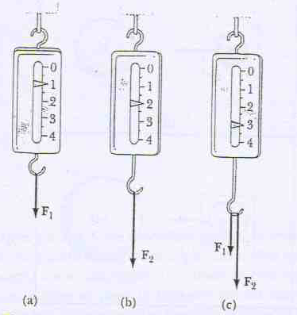
Measurement of the force
It is convenient to use the deformation of Spring to measure the force

Slide 8
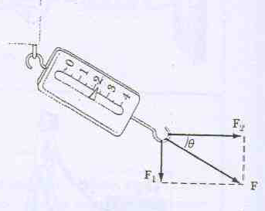

Slide 9
Newton’s First Law
This is also called the law of inertia
This is valid for certain observer or in certain reference frame called inertial reference frame.

Slide 10
First Law

Slide 11
Inertial Frames
Any reference frame that moves with constant velocity relative to an inertial frame is itself an inertial frame
A reference frame that moves with constant velocity relative to the distant stars is the best approximation of an inertial frame
We can consider the Earth to be such an inertial frame although it has a small centripetal acceleration associated with its motion

Slide 12
Inertia and Mass
The tendency of an object to resist any attempt to change its velocity is called inertia
Mass is that property of an object that specifies how much resistance an object exhibits to changes in its velocity

Slide 13
More About Mass
Mass is an inherent property of an object
Mass is independent of the object’s surroundings
Mass is independent of the method used to measure it
Mass is a scalar quantity
The SI unit of mass is kg

Slide 14
Mass vs. Weight
Mass and weight are two different quantities
Weight is equal to the magnitude of the gravitational force exerted on the object
Weight will vary with location

Slide 15
Newton’s Third Law
If two objects interact, the force F₁₂ exerted by object 1 on object 2 is equal in magnitude and opposite in direction to the force F₂₁ exerted by object 2 on object 1
F₁₂ = - F₂₁
Note on notation: F_{AB} is the force exerted by A on B

Slide 16
Newton’s Third Law, Alternative Statements
Forces always occur in pairs
A single isolated force cannot exist
The action force is equal in magnitude to the reaction force and opposite in direction
One of the forces is the action force, the other is the reaction force
It doesn’t matter which is considered the action and which the reaction
The action and reaction forces must act on different objects and be of the same type

Slide 17
Action-Reaction Examples, 1
The force F₁₂ exerted by object 1 on object 2 is equal in magnitude and opposite in direction to F₂₁ exerted by object 2 on object 1
F₁₂ = - F₂₁

Slide 18
Action-Reaction Examples, 2
The normal force (table on monitor) is the reaction of the force the monitor exerts on the table
Normal means perpendicular, in this case
The action (F_{g}, Earth on monitor) force is equal in magnitude and opposite in direction to the reaction force, the force the monitor exerts on the Earth

Slide 19
Newton’s Second Law
When viewed from an inertial frame, the acceleration of an object is directly proportional to the net force acting on it and inversely proportional to its mass
Force is the cause of change in motion, as measured by the acceleration
Algebraically, ΣF = m a

Slide 20
More About Newton’s Second Law
ΣF is the net force
This is the vector sum of all the forces acting on the object
Newton’s Second Law can be expressed in terms of components:
ΣF_{x} = m a_{x}
ΣF_{y} = m a_{y}
ΣF_{z} = m a_{z}

Slide 21
Free Body Diagram
In a free body diagram, you want the forces acting on a particular object
The normal force and the force of gravity are the forces that act on the monitor

Slide 22
Applications of Newton’s Law
Assumptions
Objects can be modeled as particles
Masses of strings or ropes are negligible
When a rope attached to an object is pulling it, the magnitude of that force, T, is the tension in the rope
Interested only in the external forces acting on the object
can neglect reaction forces
Initially dealing with frictionless surfaces

Slide 23
Objects in Equilibrium
If the acceleration of an object that can be modeled as a particle is zero, the object is said to be in equilibrium
Mathematically, the net force acting on the object is zero

Slide 24
Equilibrium, Example 1a
A lamp is suspended from a chain of negligible mass
The forces acting on the lamp are
the force of gravity (F_{g})
the tension in the chain (T)
Equilibrium gives

Slide 25
Equilibrium, Example 1b
The forces acting on the chain are T’ and T”
T” is the force exerted by the ceiling
T’ is the force exerted by the lamp
T’ is the reaction force to T
Only T is in the free body diagram of the lamp, since T’ and T” do not act on the lamp

Slide 26
Equilibrium, Example 2a
Example 5.4
Conceptualize the traffic light
Categorize as an equilibrium problem
No movement, so acceleration is zero

Slide 27
Equilibrium, Example 2b
Analyze
Need two free-body diagrams
Apply equilibrium equation to the light and find T₃
Apply equilibrium equations to the knot and find T₁ and T₂

Slide 28
Objects Experiencing a Net Force
If an object that can be modeled as a particle experiences an acceleration, there must be a nonzero net force acting on it.
Draw a free-body diagram
Apply Newton’s Second Law in component form

Slide 29
Newton’s Second Law, Example 1a
Forces acting on the crate:
A tension, the magnitude of force T
The gravitational force, F_{g}
The normal force, n, exerted by the floor

Slide 30
Newton’s Second Law, Example 1b
Apply Newton’s Second Law in component form:
Solve for the unknown(s)
If T is constant, then a is constant and the kinematic equations can be used to more fully describe the motion of the crate

Slide 31
Note About the Normal Force
The normal force is not always equal to the gravitational force of the object
For example, in this case
n may also be less than F_{g}

Slide 32
Inclined Planes
Forces acting on the object:
The normal force, n, acts perpendicular to the plane
The gravitational force, F_{g}, acts straight down
Choose the coordinate system with x along the incline and y perpendicular to the incline
Replace the force of gravity with its components

Slide 33
Multiple Objects
When two or more objects are connected or in contact, Newton’s laws may be applied to the system as a whole and/or to each individual object
Whichever you use to solve the problem, the other approach can be used as a check

Slide 34
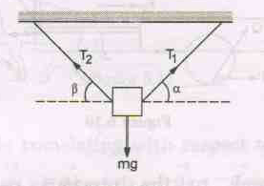
Questions

Slide 35
Multiple Objects, Example 1
First treat the system as a whole:
Apply Newton’s Laws to the individual blocks
Solve for unknown(s)
Check: |P₂₁| = |P₁₂|

Slide 36
Multiple Objects, Example 2
Forces acting on the objects:
Tension (same for both objects, one string)
Gravitational force
Each object has the same acceleration since they are connected
Draw the free-body diagrams
Apply Newton’s Laws
Solve for the unknown(s)

Slide 37
Multiple Objects, Example 3
Draw the free-body diagram for each object
One cord, so tension is the same for both objects
Connected, so acceleration is the same for both objects
Apply Newton’s Laws
Solve for the unknown(s)

Slide 38
Problem-Solving Hints Newton’s Laws
Conceptualize the problem – draw a diagram
Categorize the problem
Equilibrium (ΣF = 0) or Newton’s Second Law (ΣF = m a)
Analyze
Draw free-body diagrams for each object
Include only forces acting on the object

Slide 39
Problem-Solving Hints Newton’s Laws, cont
Analyze, cont.
Establish coordinate system
Be sure units are consistent
Apply the appropriate equation(s) in component form
Solve for the unknown(s)
Finalize
Check your results for consistency with your free- body diagram
Check extreme values

Slide 40
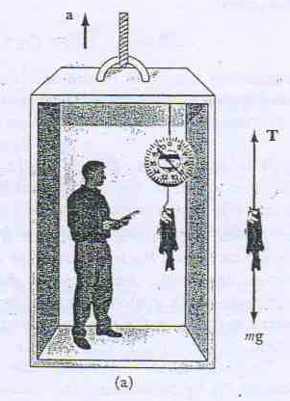
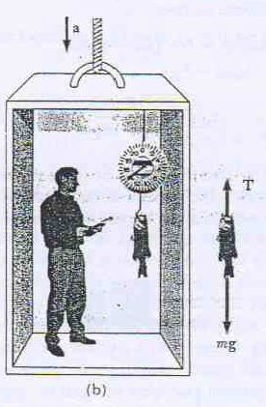
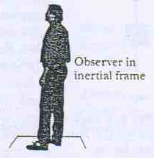
Problems on Newton’s Laws of Motion
Q.1

Slide 41
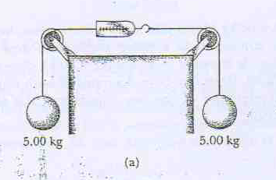
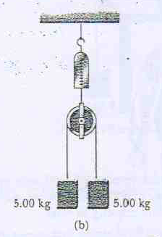
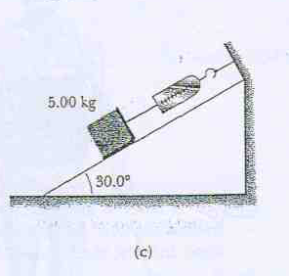
Q.4

Slide 42
Forces of Friction
When an object is in motion on a surface or through a viscous medium, there will be a resistance to the motion
This is due to the interactions between the object and its environment
This resistance is called the force of friction

Slide 43
Forces of Friction, cont.
Friction is proportional to the normal force
ƒ_{s} ≤ µ_{s} n and ƒ_{k}= µ_{k} n
These equations relate the magnitudes of the forces, they are not vector equations
The force of static friction is generally greater than the force of kinetic friction
The coefficient of friction (µ) depends on the surfaces in contact

Slide 44
Forces of Friction, final
The direction of the frictional force is opposite the direction of motion and parallel to the surfaces in contact
The coefficients of friction are nearly independent of the area of contact

Slide 45
Static Friction
Static friction acts to keep the object from moving
If F increases, so does ƒ_{s}
If F decreases, so does ƒ_{s}
ƒ_{s} ≤ µ_{s} n where the equality holds when the surfaces are on the verge of slipping
Called impending motion

Slide 46
Kinetic Friction
The force of kinetic friction acts when the object is in motion
Although µ_{k} can vary with speed, we shall neglect any such variations
ƒ_{k} = µ_{k} n

Slide 47
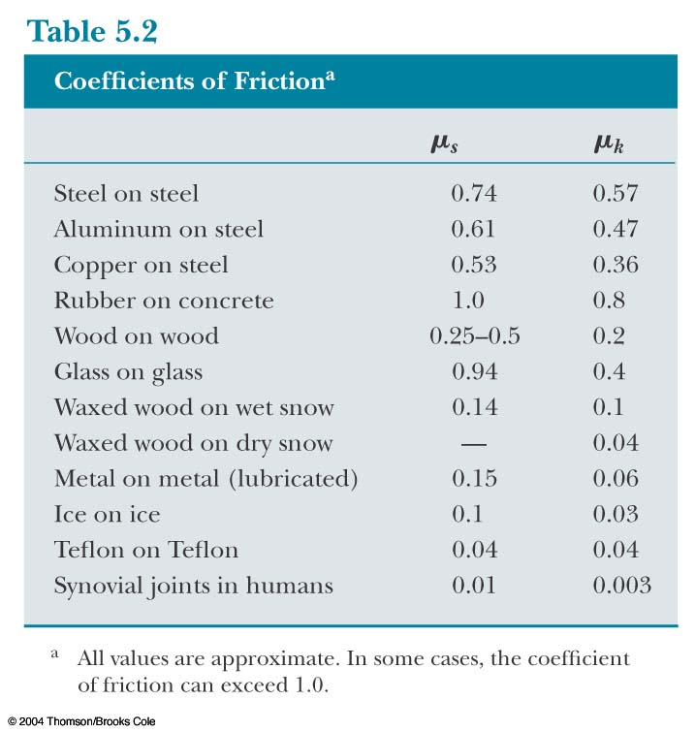
Some Coefficients of Friction

Slide 48
Friction in Newton’s Laws Problems
Friction is a force, so it simply is included in the ΣF in Newton’s Laws
The rules of friction allow you to determine the direction and magnitude of the force of friction

Slide 49
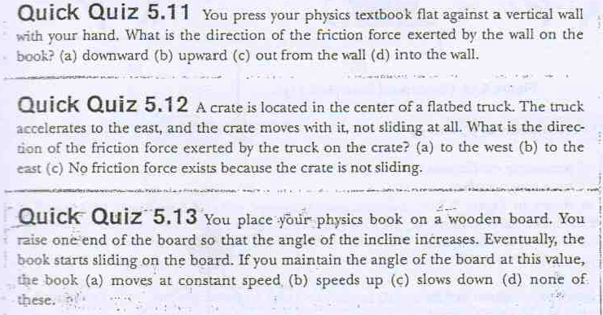

Slide 50
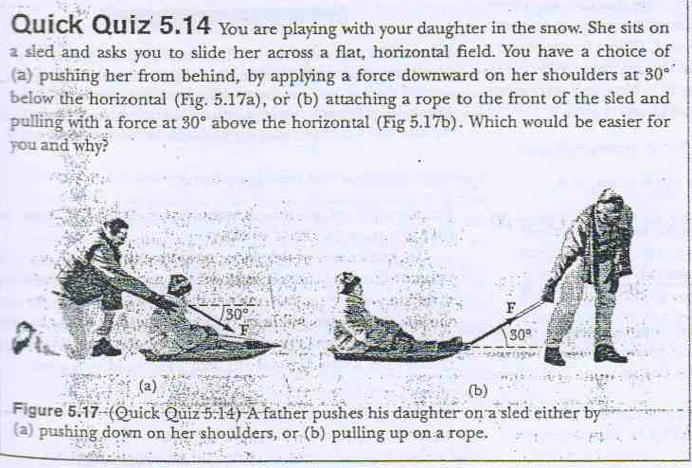

Slide 51
Friction Example, 1
The block is sliding down the plane, so friction acts up the plane
This setup can be used to experimentally determine the coefficient of friction
µ = tan θ
For µ_{s}, use the angle where the block just slips
For µ_{k}, use the angle where the block slides down at a constant speed

Slide 52
Friction, Example 2
Draw the free-body diagram, including the force of kinetic friction
Opposes the motion
Is parallel to the surfaces in contact
Continue with the solution as with any Newton’s Law problem

Slide 53
Friction, Example 3
Friction acts only on the object in contact with another surface
Draw the free-body diagrams
Apply Newton’s Laws as in any other multiple object system problem

Slide 54
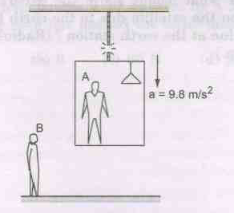

Slide 55
