Slide 1
Chapter 6:
Green Computing
~
the next wave in computing
Most of these slides are taken from Neha Sinha, 08BTCSE050 Lecture note .

Slide 2
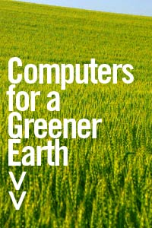
Introduction
The study and practice of designing, manufacturing, using, and disposing of computers, servers, and associated subsystems, such as monitors, printers, storage devices, and networking and communications systems —efficiently and effectively with minimal or no impact on the environment.

Slide 3
What is Green Computing?
Green computing is the study and practice of using computing resources efficiently.
The primary objective of such a program is to account for the “Triple Bottom Line”:(People, Planet , Profit).
The goals are similar to green chemistry which aims at promoting recyclability or biodegradability of products and factory waste.

Slide 4
Green Computing – Why ?
Maximized energy consumption.
Lack of green energy.
The extensive use of paper and other consumables used.
Higher extent of equipment disposal requirements.

Slide 5
History
The term “Green Computing" was probably coined shortly after the ‘Energy Star’ program began way back in 1992.
One of the first results of green computing was the “Sleep mode” function of computer monitors.
As the concept developed, green computing began to encompass thin client solutions, energy cost, accounting, virtualization practices, e-Waste, etc.

Slide 6
Pathway towards Greening
Green Use: Intelligent use of energy and information systems.
Green Disposal: Reduction of waste, reuse and refurbishment of hardware and recycling of out of use peripherals and other items.
Green Design: Efficient design of data centres and workstations.
Green Manufacture: Informed purchasing of components, peripherals and equipments manufactured with the environment in mind.

Slide 7
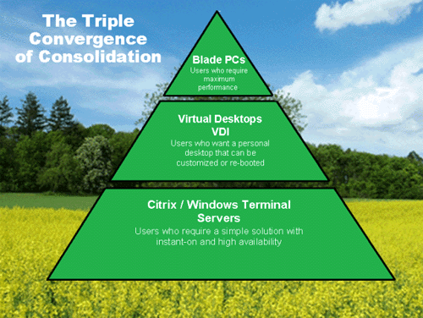
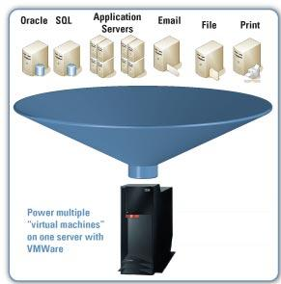
Approaches to
“Green Computing”
1. Virtualization
Computer virtualization is the process of running two or more logical computer systems on one set of physical hardware.

Slide 8
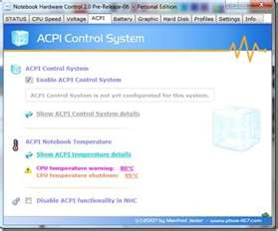
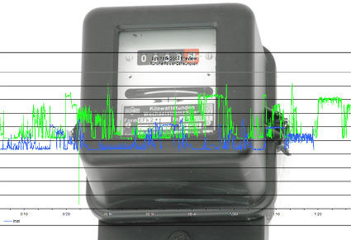
2. Power Management
ACPI allows an operating system to directly control the power saving aspects of its underlying hardware.
3. Power Supply
Climate savers computing initiative promotes energy saving and reduction of greenhouse gas emissions by encouraging development and use of more efficient power supplies.

Slide 9
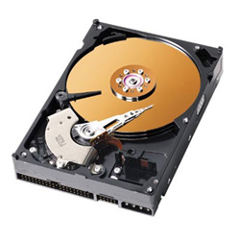
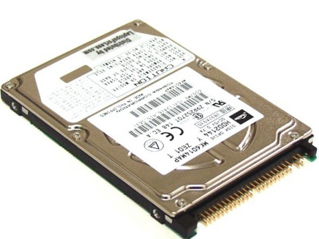
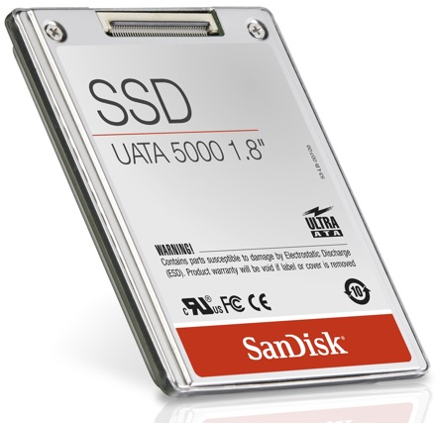
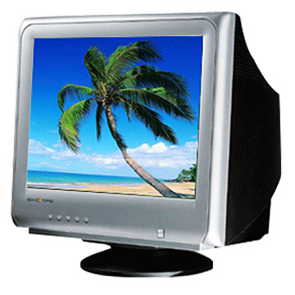
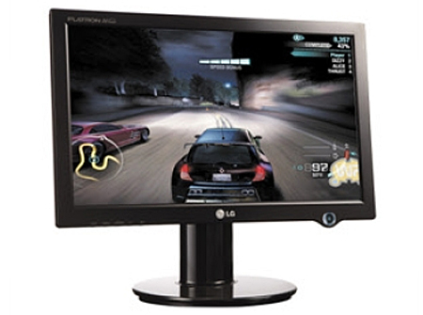
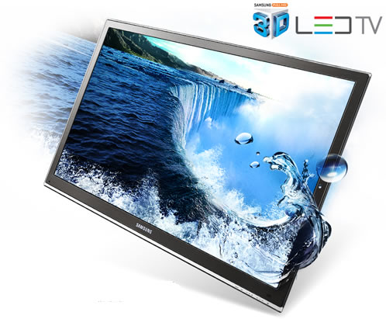
4. Storage
Desktop Hard Drive
Laptop Hard Drive
Solid State Drive
5. Display
Less Energy ☺
CRT Display
LCD Display
LED Display

Slide 10
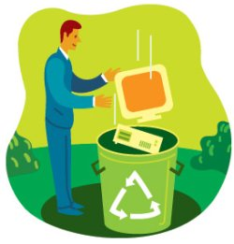
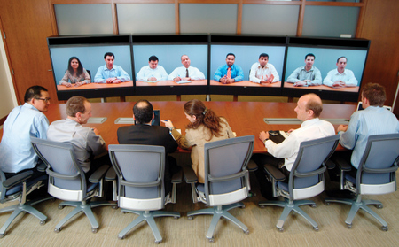
6. Material Recycling
Parts from outdated systems may be salvaged and recycled through certain retail outlets or private recycling centers.
7. Telecommuting
Teleconferencing technologies implemented in green computing initiatives have advantages like increased worker satisfaction, reduction of greenhouse gas emissions related to travel and increased profit margins.

Slide 11
Recent Implementation of
“Green Computing”
Blackle
Blackle is a search-engine site powered by Google Custom Search.
Blackle came into being based on the concept that when a computer screen is white, presenting an empty word page or the Google home page, your computer consumes 74W.
When the screen is black it consumes only 59W.

Slide 13
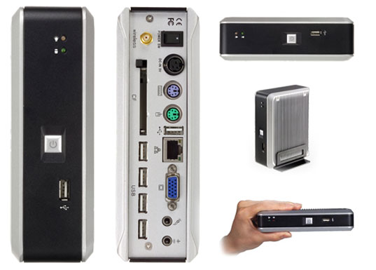
Zonbu Computer
The Zonbu is a new, very energy efficient PC.
The Zonbu consumes just one third of the power of a typical light bulb.
The device runs the Linux operating system using a
1.2 GHz processor and 512 MB of RAM.

Slide 14
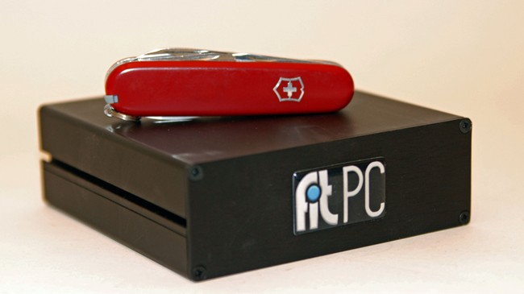
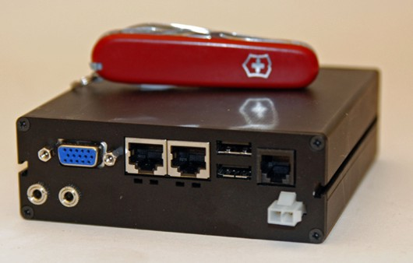
Fit- PC
Fit-PC is the size of a paperback and absolutely silent, yet fit enough to run Windows XP or Linux.
Fit-PC is designed to fit where a standard PC is too bulky, noisy and power hungry .
Fit-PC draws only 5 Watts, consuming in a day less
power than a traditional PC consumes in 1 hour.

Slide 15
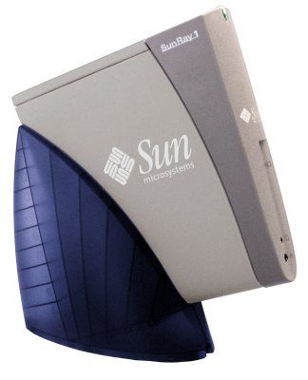
SunRay Thin Client
What does a thin client mean?
Thin clients like the Sun Ray consume far less electricity than conventional desktops.
A SunRay on a desktop consumes 4 to 8 watts of power, because most of the heavy computation is performed by a server.
Sunrays are particularly well suited for cost-sensitive environments such as call centres, education, healthcare, service providers and finance.

Slide 16
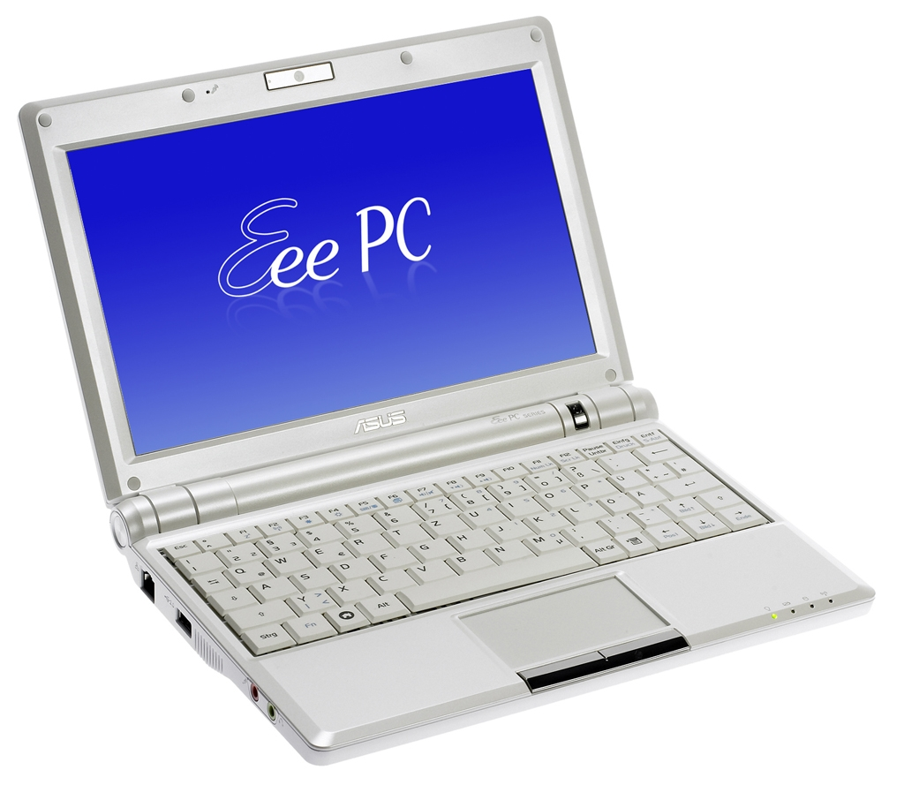
Asus Eee PC & ultra portables
Small Size.
Fairly low- power CPU.
Compact screen.
Low cost.
Uses flash memory for storage.

Slide 17
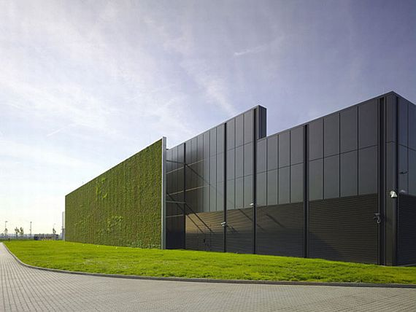
Role of I.T. Vendors

Slide 18
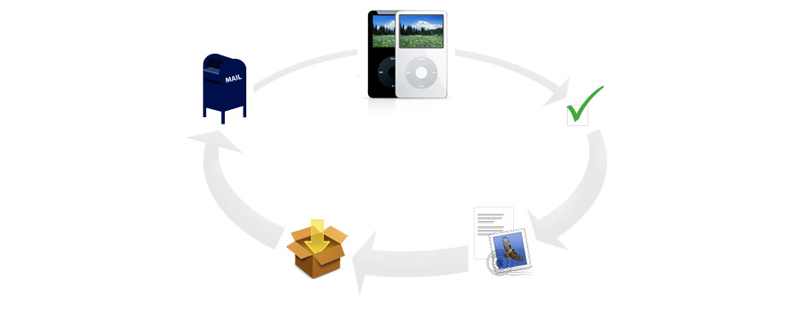
Awareness
Product Design
Materials
Energy Efficiency
Recycling

Slide 19
Global Education & Public Awareness Raising
People must understand the danger and responsibilities.
Governments, organizations, professional, and communities need to cooperate in developing and spreading the appropriate green practices.
Wall-E :An animated movie (science fiction) produced by PIXAR called “Wall E” the story predicts the future of our planet if we still act carelessly about current waste. The earth will covered with garbage and all humankind will leave the earth and live on the outer space. WALL-E, short for Waste Allocation Load Lifter Earth-class, is the last robot left on Earth. He spends his days tidying up the planet, one piece of garbage at a time.

Slide 20
Energy Can be saved by
Turning off idle PCs.
Lower power hardware.
Cloud computing services: SAAS, IAAS, PAAS?
Server virtualization.
Hardware as a service.
Dematerialization.
Energy efficient coding.
Energy efficient coding could cut energy use by up to 30%

Slide 21
Leading Companies in Green Computing
IBM Project Big Green
2900 servers, 30 mainframes, 80% saving.
Amazon infrastructure services
Amazon Elastic Compute Cloud.
Intel Green Processors
Intel has released in 2008 the most energy efficient, emission reduction device ever created.

Slide 22
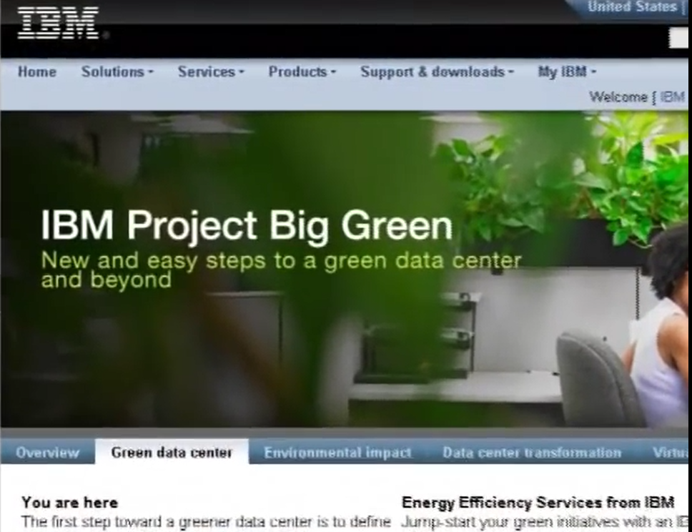
Green Solution by IBM, Intel, & Amazon
Amazon cloud services
Intel processors
IBM Project Big Green
Dematerialization by web downloads

Slide 23
Three Types of Cloud Computing
Cloud Computing is all about online sharing of resources.
Resources includes: software, hardware (infrastructure & platform), and data (storage).
Advantages: cost reduction, virtualization, increasing mobility & productivity.
Software as a Service (SAAS)
Allows users to run an existing online software (application). e.g. Google docs.
Platform as a Service (PAAS)
Allows users to create their own cloud applications using supplier-specific tools and programming languages offered by the cloud provider. e.g. Google force.com.
Infrastructure as a Service (IAAS)
Allows users to run whatever applications they require on the cloud hardware. (server virtualization). E.g. Amazon EC2

Slide 24
More Computing Solutions: Computer can be used to:
Increase business efficiency.
Computing has already saved more resources than it has consumed.
Travel Reduction.
By using video conferencing, many companies has replaced travel offices by meeting offices.
Dematerialization.
Digital downloads and web-based information services instead of physical products: Downloading applications and media instead of buying CDs.

Slide 25
Conclusion
So far, consumers haven’t cared about ecological impact when buying computers, they’ve cared only about speed and price .
New green materials are developed every year, and many toxic ones are already being replaced by them.
The greenest computer will not miraculously fall from the sky one day; it will be the product of years of improvements.
The features of a green computer of tomorrow would be like: efficiency, manufacturing and materials, recyclability, server model, self-powering and other trends.

Slide 26
Recommended Reading & Discussion
http://bipublication.com/files/csv1i120107.pdf
Give some example products (software, hardware and techniques ) for green computing.
Propose some ideas on how to effectively raise the awareness and utilization of green computing.

