Slide 1
Chapter 7
Using CASE Value expression

Slide 2
CASE Value expression
A CASE value expression allows you to set up a series of conditions that modify specified values returned by your SQL statement
You can change the way a value is represented or calculate a new value
Each value is modified according to the condition specified within the CASE expression

Slide 3
CASE Value expression Syntax
Using CASE with select statement
SELECT column name1, …,
CASE [ expression]
WHEN condition1 THEN result1
WHEN condition2 THEN result2
..[ELSE result]
END [as expression]
FROM table name;

Slide 4
Example 1
Represent the names for all employees and determine if its salary is low, high or medium according to the following table
Salary | Level
< 3000 | Low
Between 3000 and 7000 | Medium
7000 | high

Slide 5
Example 2
SELECT first_name, Last_name,
CASE
WHEN salary < 3000 THEN 'Low'
WHEN salary BETWEEN 3000 AND 7000 THEN 'Medium'
WHEN salary > 7000 THEN 'High'
ELSE 'N/A‘
END as “salary Level”
FROM employees;

Slide 6
Example 2
SELECT last_name, employee_id,
CASE department_id
WHEN 10 THEN 'Accounting'
WHEN 20 THEN 'Research'
WHEN 30 THEN 'Sales'
WHEN 40 THEN 'Operations'
ELSE 'Unknown'
END as "department name"
FROM employees
ORDER BY last_name;

Slide 7
Using CASE with UPDATE statements
Another handy use for the CASE value expression is in the SET clause of an UPDATE statement. For example, suppose you want to increase the salary for employees based on their job id

Slide 8
Using CASE with UPDATE statements
Update employees
Set salary =
Case job_id
When ‘AD_PRES’ then salary+100
When ‘AD_VP’ then salary+200
Else salary
End;

Slide 9
Database structure and space Management

Slide 10
Database Structure
An ORACLE database has both a physical and logical structure. By separating physical and logical database structure, the physical storage of data can be managed without affecting the access to logical storage structures.

Slide 11
Database structures
Logical
Physical

Slide 12
Logical Database Structure
Tablespace - stores related database objects
Segments - stores an individual database object, such as a table or an index
Extent - a contiguous unit of storage space within a segment
Data Block - smallest storage unit that the database can address. Extents consist of data blocks

Slide 13
Logical Database Structure
Tablespace
Segments
Extents
Extents
Data blocks

Slide 14
Table space
Each Database is logically divided into one or more table spaces
Table space can be online (accessible) {default} or offline (Not accessible(
You can create a new tablespace to increase the size of a database
The database Administrator can bring any tablespace in an oracle online or offline

Slide 15
Database, Tablespaces, and data files
Oracle stores data logically in tablespaces and physically in datafiles associated with the corresponding tablespace.

Slide 16
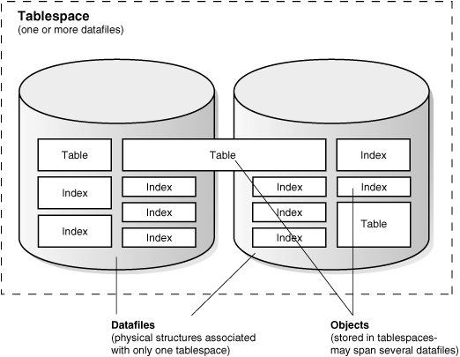

Slide 17
Database, Tablespaces, and data files
The relationship among databases, tablespaces, and data files :
1. Each database is logically divided into one or more tablespaces. 2. One or more data files are explicitly created for each tablespace to physically store the data of all logical structures in a tablespace. 3. The combined size of a tablespace's data files in the total storage capacity of the tablespace. 4. The combined storage capacity of a database's tablespaces is the total storage capacity of the database

Slide 18
Allocate More Space for a Database
The size of a tablespace is the size of the datafiles that constitute the tablespace. The size of a database is the collective size of the tablespaces that constitute the database.
You can enlarge a database in three ways:
Add a datafile to a tablespace
Add a new tablespace
Increase the size of a datafile
When you add another datafile to an existing tablespace, you increase the amount of disk space allocated for the corresponding tablespace

Slide 19
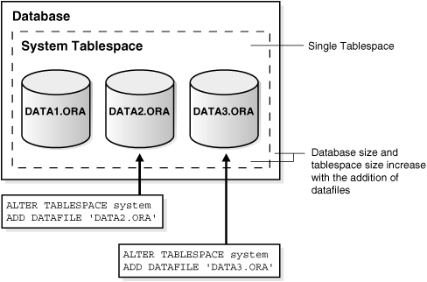

Slide 20
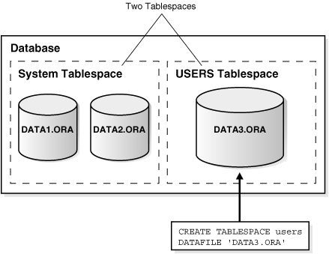

Slide 21
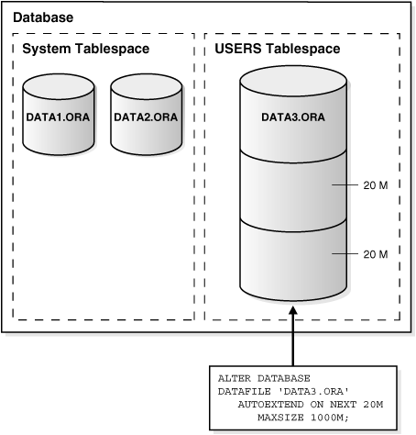

Slide 22
Create table space
CREATE TABLESPACE tablespace_name DATAFILE file_name [SIZE integer M] [REUSE]
DEFAULT STORAGE (
INITIAL integer M
NEXT integer M
MINEXTENTS integer
MAXEXTENTS integer
PCTINCREASE integer)
ONLINE or OFFLINE
PERMANENT or TEMPORARY;

Slide 23
Create table space
TABLESPACE : Tablespace in which you want the table to reside.
INITIAL SIZE: The size for the initial extent of the table.
NEXT SIZE: The value for any additional extents the table may take through growth.
MINEXTENTS and MAXEXTENTS: Identify the minimum and maximum extents allowed for the table.
PCTINCREASE: Identifies the percentage the next extent will be increased each time the table grows, or takes another extent.

Slide 24
Example
CREATE TABLESPACE tp DATAFILE 'df.ora' SIZE 10M DEFAULT STORAGE(
INITIAL 10K
NEXT 50K
MINEXTENTS 1
MAXEXTENTS 999
PCTINCREASE 10)
ONLINE
permanent;

Slide 25
Create Table
SQL Statement:CREATE TABLE table_name (column_name data_type [DEFAULT exp] [CONSTRAINT])
TABLESPACE tablespace_name
STORAGE (INITIAL size K or M
NEXT size K or M
MINEXTENTS value
MAXEXTENTS value
PCTINCREASE value);

Slide 26
Example
CREATE TABLE maha (
id NUMBER CONSTRAINT co_id PRIMARY KEY,
name varchar(20))
TABLESPACE tp STORAGE (
INITIAL 7000
NEXT 7000
MINEXTENTS 1
MAXEXTENTS 5
PCTINCREASE 5);

Slide 27
Table space
Most major RDBMSs have default settings for table sizes and table locations.
If you do not specify table size and location, then the table will take the defaults.
The defaults may be very undesirable, especially for large tables.

