Slide 1
CS1201: Programming Language 2
By:Nouf Aljaffan
Edited by : Nouf Almunyif
Classes and objects

Slide 2
Object
You can look around you now and see many examples of real-world objects: your cat, your desk, your television set, your bicycle.
These real-world objects share two characteristics: they all have state and they all have behavior
For example, dogs have state (name, color, breed, hungry) and dogs have behavior (barking, fetching).

Slide 3
Object
Software objects are modeled after real-world objects in that they, too, have state and behavior.
A software object maintains its state in variables and implements its behavior with methods.
An object combines data and operations on the data into a single unit.

Slide 4
CLASSES
The Class is the foundation of C++ support for the OOP (Object-Oriented Programming ).
It is the core of many of its more advanced features.
In C++, the mechanism that allow you to combine data and operations on the data into a single unit is called a class.
A class is a collection of fixed number of components. The components of a class are called the members of the class.

Slide 5
CLASSES
class definition:
classMembersList consists of variable (attribute) and/or functions (method) declarations .
class classIdentifier //name
{
classMembersList
};

Slide 6
Members Declaration
Each class containing data members and member functions
Data :
If a member of a class is a variable
It is declared like any other variable
You cannot initialize a variable when you declare it
functions:
If a member of a class is a function
Only Function prototype is listed.
Or, the body of a member function is defined inside a class declaration, it is declared inline.

Slide 7
CLASSES
class car //name
{
string color ;
String model;
Double price ;
Void print (){
Cout <<“ the car information “<< color <<model<< price<< endl;)
};
classMembersList consists of variable (attribute) and/or functions (method) declarations .

Slide 8
Cont. Classes
Members of a class are classified into one of three categories:
Private (default) : not accessible outside the class.
Protected: not accessible outside the class.
Public: accessible outside the class.
Note:
The keyword of category name is followed by colon (:) .
In the definition of a class, you cannot initialize a variable when you declare it.
In C++, a class is a definition. No memory is allocated for the class itself; memory is allocated for the class objects (class instances) when you declare them.

Slide 9
Define a Class Type
class class_name
{
permission_label:
member;
permission_label:
member;
...
};
class Rectangle
{
private:
float width;
float length;
public:
void setWidth(float w);
void setLength(float l);
float calcArea();
};
Header
Data Members
Body
Member Functions

Slide 10
Accessing Class Members
Operators to access class members
Dot member selection operator (.)
Object
Reference to object
Example:
Rectangle r;
r.setWidth(3);

Slide 11
Example
Void main( )‏
{ Cat MyCat;
MyCat.setAge(3);
MyCat.setWeight(2);
MyCat.gender=“m”
cout << "My cat\‘ s age is " << MyCat.getAge();
cout << " and weighs " << MyCat.getWeight() << " kg\n“ ;
cout << “and its gender “ << MyCat.gender;
}
#include <iostream>
using namespace std;
class Cat {
private:
int age;
int weight;
public:
Char gender;
void setAge (int yrs) { age = yrs; }
void setWeight (int kgs) { weight = kgs; }
int getAge() { return age; }
int getWeight() { return weight; }
};

Slide 12
Accessibility Example1
…
Service obj;
obj.memberOne = 10;
obj.memberTwo = 20;
obj.doOne();
obj.doTwo();
…
class Service {
private:
int memberTwo;
void doTwo() {……}
public:
int memberOne;
void doOne() {…….}};
Main Program
Service Class
Notes:
This is a simple example of public and private modifiers. See how the client can access the public data member and method.

Slide 13
Accessibility Example2
#include <iostream>
#include <string>
using namespace std;
class Course {
// Data Member
public:
string studentName;
string courseCode ;
};
void main() {
Course course1, course2;
// assign values to course1
course1.courseCode= "CSC1201";
course1.studentName= "Muna AlKebir";
//assign values to course2
course2.courseCode= "csc1301";
course2.studentName= "Salwa AlAmri";
cout<< course1.studentName << " has the course "<<course1.courseCode<< endl;
cout<<course2.studentName << " has the course "<<course2.courseCode<< endl;
}

Slide 14
Accessibility Example 3
#include <iostream>
#include <string>
using namespace std;
class Course {
private:
string studentName;
string courseCode ;};
void main() {
Course course1, course2;
//assign values to course1
course1.courseCode= “CSC1201“;
course1.studentName= “Muna AlKebir“;
//assign values to course2
course2.courseCode= “CSC1301“;
course2.studentName= “Salwa AlAmri“;
cout<<course1.studentName << " has the course “<<course1.courseCode<<endl;
cout<<course2.studentName << " has the course “<< course2.courseCode<<endl;
}

Slide 15
Constructors Vs. Destructor
Constructor
Destructor
Constructors guarantee that the member variables are initialized when an object is declared.
Constructors automatically execute when a class object enters its scope.
The name of a constructor is the same as the name of the class.
A class can have more than one constructor.
A constructor without parameters is called the default constructor.
Destructor automatically execute when a class object goes out of scope.
The name of a destructor is the tilde (~), followed by the class name (no spaces in between).
A class can have only one destructor.
The destructor has no parameters.
Constructors and Destructor are functions without any type. As a result, they cannot be called like other functions.
Note : A function can return a value of type class.

Slide 16
Example # 1
#include <iostream>
using namespace std;
class Circle {
private:
float radius;
public: //prototype only !
// constructors
Circle(){radius=0;}
Circle(float r){ setRadius(r); }
// destructor
~Circle(){cout<<" ending object...\n"; }
void setRadius(float r){
if ( r >=0.0)‏
radius=r;
else
radius=0.0;
}
float getRadius(){return radius; }
float area(){return 3.14*radius*radius;}
float perimeter(){return 2 * 3.14 * radius;}
};

Slide 17
Example # 1
int main()‏{
float x;
cout<<" Enter the radius of the circle: ";
cin>>x;
Circle C1(x);
cout<<"\n the area of the circle is: "<<C1.area()<<endl;
cout<<" and the perimeter is:"<<C1.perimeter()<<endl;
return 0;
}

Slide 19
Implementing class Functions
There are two ways:
Member functions defined outside class:
Using Binary scope resolution operator (::)
ReturnType ClassName::MemberFunctionName( ){..}
Member functions defined inside class
When the body of a member function is defined inside a class declaration, it is declared inline.

Slide 20
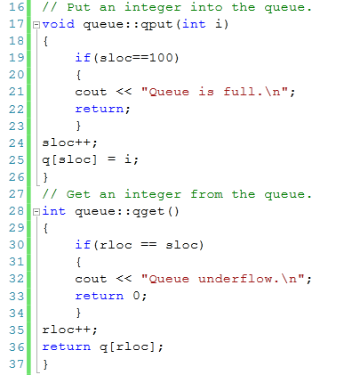
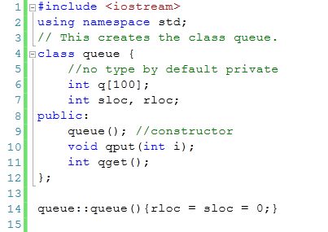
Example #1

Slide 21
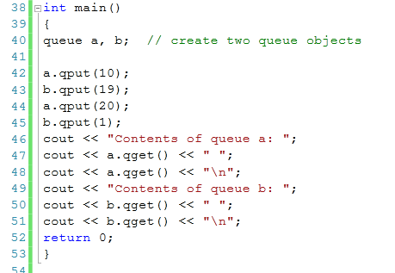

Slide 22
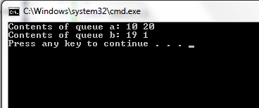
Output

Slide 23
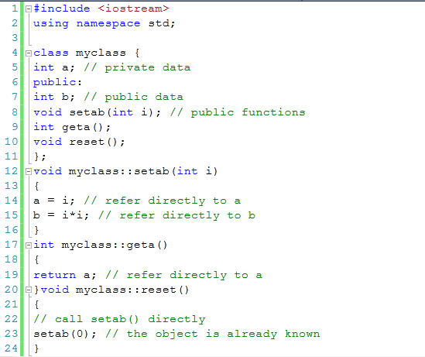
Example

Slide 24
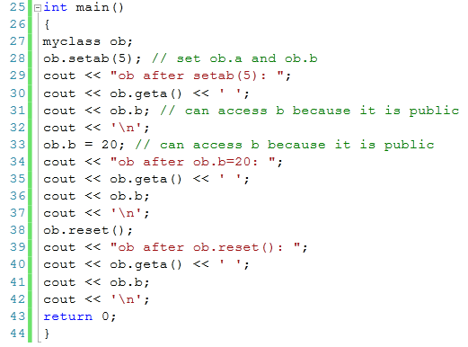
Example

Slide 25
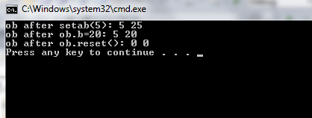
Example

Slide 26
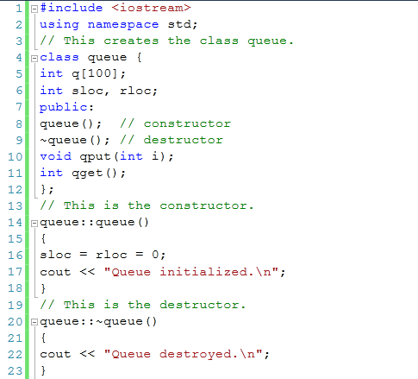
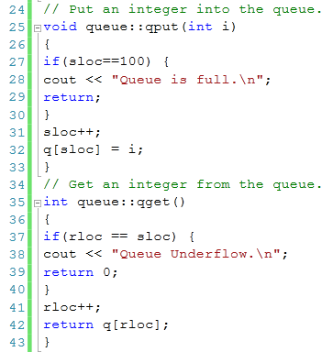
Example

Slide 27
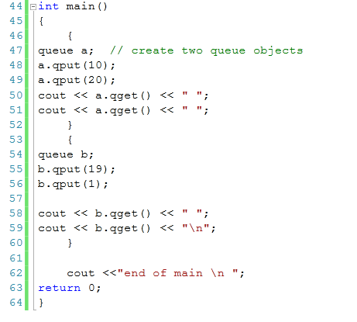

Slide 28
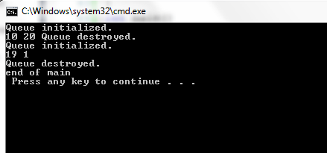
Output:

