Slide 1
CLASSIFICATION OF HYPERLIPIDEMIA
Presented By : Moaath A. Alsheikh Medical Student @KSU
Maiat48@gmail.com
25.2.2016

Slide 3
Type I
Familial chylomicronemia: AR inheritance, childhood disease
Pathogenesis: deficiency of CPL or apoCII (normally activates CPL)
Chylomicrons are primarily increased in early childhood. VLDL also increases later in life.
Clinical findings: presents with acute pancreatitis (chylomicrons block the circulation and cause rupture of pancreatic vessels)
Laboratory findings: increase in serum TG (>1000 mg/dL; primarily chylomicrons). Turbid supranate (chylomicrons) and clear infranate with refrigeration. Normal (usual case) to moderately increased serum CH.

Slide 4
Type II
Type IIa: increase in serum CH (>260 mg/dL) and LDL (>190 mg/dL). Serum TG <300 mg/dL.
Type IIb: increase in serum CH (>260 mg/dL) and LDL (>190 mg/dL). Serum TG >300 mg/dL.
Acquired causes of type II hyperlipoproteinemia
Primary hypothyroidism: decreased synthesis of LDL receptors
Blockage of bile flow: bile contains CH
Nephrotic syndrome: increased liver synthesis of CH
Genetic causes of type II hyperlipoproteinemia
Polygenic hypercholesterolemia (type IIa): most common type (85% of cases). Multifactorial (polygenic) inheritance. Alteration in regulation of LDL levels with primary increase in serum LDL and TG <300 mg/dL.
Familial combined hypercholesterolemia (type IIb): AD inheritance. CH and TG begin to increase around puberty. Associated with metabolic syndrome. Increase in CH and TG >300 mg/dL. Decrease in HDL.
Familial hypercholesterolemia (type IIa): AD inheritance. Deficiency of LDL receptors. Achilles tendon xanthoma, xanthelasma (yellow plaques on eyelid. Premature CAD and stroke. Increase in serum CH and LDL. Serum TG <300 mg/dL. Decrease in HDL.

Slide 5
Type III
Familial dysbetalipoproteinemia or “remnant disease”: AR inheritance
Pathogenesis: deficiency of apoE. Decreased liver uptake of IDL and chylomicron remnants.
Palmar xanthomas in flexor creases. Increased risk for CAD and peripheral vascular disease.
Both serum CH and TG >300 mg/dL. LDL <190 mg/dL. Confirm diagnosis with ultracentrifugation to identify remnants, lipoprotein electrophoresis, identify apoE gene defect.

Slide 6
Type IV
Acquired causes of type IV hyperlipoproteinemia
Excess alcohol intake: most common cause; increased production of VLDL, decreased activity of CPL.
Oral contraceptives: estrogen increases synthesis of VLDL.
Diabetes mellitus: decreased adipose and muscle CPL (decreased VLDL clearance; decreased insulin responsible for decreased synthesis of CPL). Increased LDL; decreased HDL.
Chronic renal failure: increased synthesis of VLDL and decreased clearance of VLDL.
Thiazide diuretics, β-blockers: inhibition of CPL (decreases clearance of VLDL).
Familial hypertriglyceridemia: AD inheritance. Most common hyperlipoproteinemia.
Pathogenesis: increased production of VLDL (most common), decreased clearance of VLDL.
Increased risk for CAD and peripheral vascular disease.
Eruptive xanthomas .Increase in TG (>300 mg/dL). Serum CH normal to moderately increased (250–500 mg/dL). Serum LDL <190 mg/dL. Decrease in HDL (inverse relationship with VLDL). Turbid infranate after refrigeration.

Slide 7
Type V
Most commonly familial hypertriglyceridemia + an exacerbating disorder: e.g., diabetic ketoacidosis, alcoholism.
Pathogenesis: increase in chylomicrons and VLDL due to decreased activation and release of CPL.
Hyperchylomicronemia syndrome.
Eruptive xanthomas (same as those in type IV).
Increased incidence of acute pancreatitis.
Lipemia retinalis: retinal vessels look like milk, blurry vision.
Dyspnea and hypoxemia: impaired gas exchange in pulmonary capillaries
Hepatosplenomegaly
Increase in serum TG (usually >1000 mg/dL). Normal serum CH and LDL.
Turbid supranate and infranate after refrigeration.

Slide 8
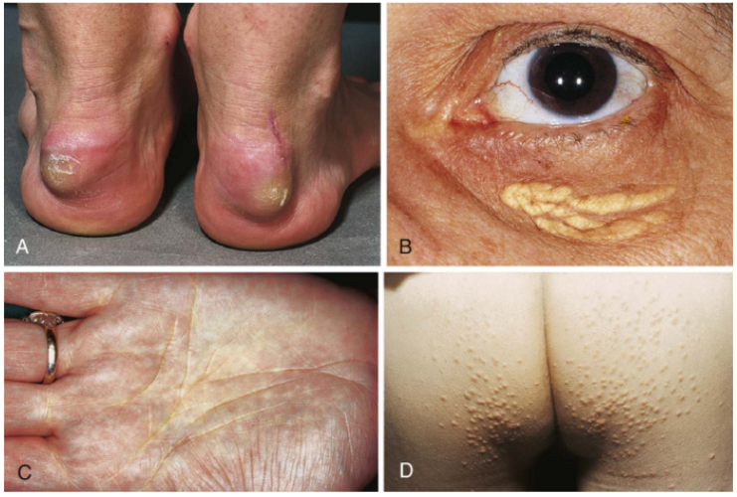

Slide 9
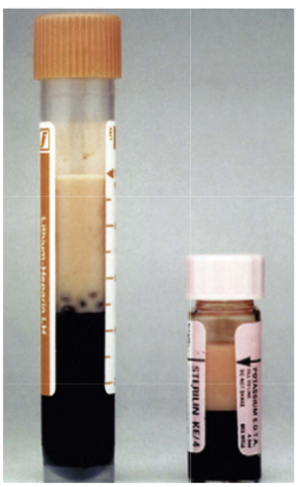

Slide 10
This information about the classification of hyperlipidemia was taken from Pathology Review
Written By Edward F. Golijan
THANK YOU

