Slide 1
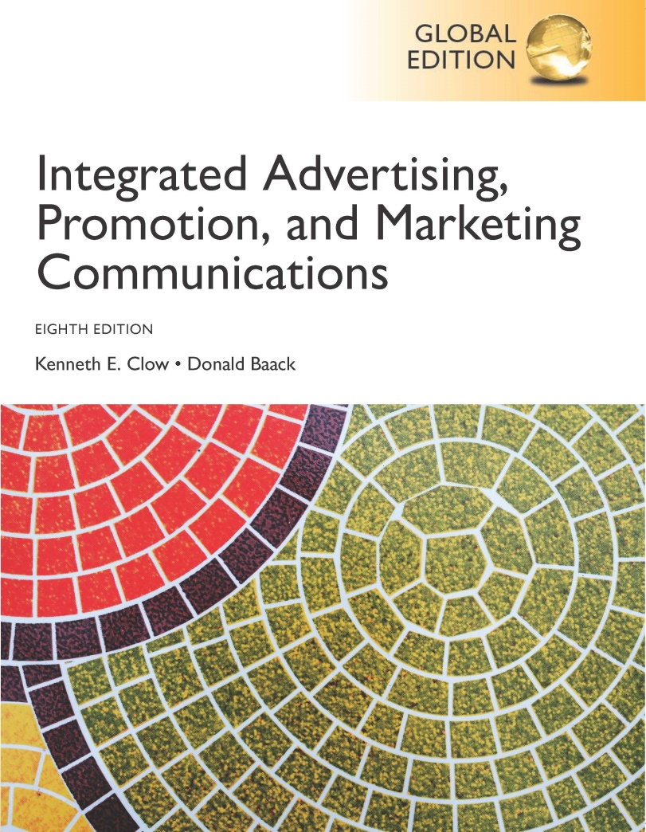
Integrated Advertising, Promotion, and Marketing Communications
Eighth Edition, Global Edition
Chapter 1
Integrated Marketing Communications
Copyright © 2018 Pearson Education Ltd. All Rights Reserved
Notes:
Chapter 1 provides an overview of integrated marketing communications, the basic communications model, and the organization of the textbook. The chapter also provides information on current trends in marketing communications.

Slide 2
Chapter Objectives
How does communication take place?
What is an integrated marketing communications program?
Which trends are affecting marketing communications?
What are the components of an integrated marketing communications program?
What is meant by GIMC?
Notes:
These are the objectives for Chapter 1.

Slide 3
Chapter Overview
Highly competitive global marketplace
Wide variety of media available
Clear communications needed
Customers bombarded with communications
Integrated advertising and communications
Notes:
This chapter provides an overview of integrated marketing communications. It is a highly competitive and global marketplace, and firms are looking for ways to stand out. Brands are looking for means to become a part of customers’ evoked sets. Companies have a wide variety of media from which to choose, both traditional and nontraditional. Because customers are bombarded with so many marketing messages, it is vital for a company to stand out with a clear, consistent, and integrated message.

Slide 4
Lean Cuisine
“Diet” not popular term
New products, new messages
“Frozen, How Fresh Stays Fresh”
Social media – “Weigh This”
Goal to shed the idea of a “diet” food
Notes:
As the term “diet” became unpopularity, Lean Cuisine needed to embark on a new path. In an effort to connect with consumers, Lean Cuisine developed new products and launched a new image campaign entitled “Frozen, How Fresh Stays Fresh.” A new social media campaign was also launched entitled “Weigh This” that sought to shift people’s relative importance of weight compared to other aspects of life. The goal was to change the image from a diet food to fresh food that was frozen.

Slide 5
Figure 1.1 Communication Process
Notes:
The communication process consists of five stages, or components. The sender is the individual or company that wants to send a marketing message to consumers or to other businesses. It can be an advertisement, a brochure, or even a salesperson. Encoding is the process of taking the message and putting it into an ad, brochure, or sales presentation. The transmission device is the television, the paper on which the brochure is printed, or the salesperson at the retail store. The receiver is the consumer or business buyer. Decoding is the process of interpreting the marketing message. Effective communication has taken place if the message that is decoded is the same as was encoded. But, often noise occurs and distorts the message. Noise can be anything and can occur at any stage. Senders can obtain feedback from receivers and use the information to start the process again.

Slide 6
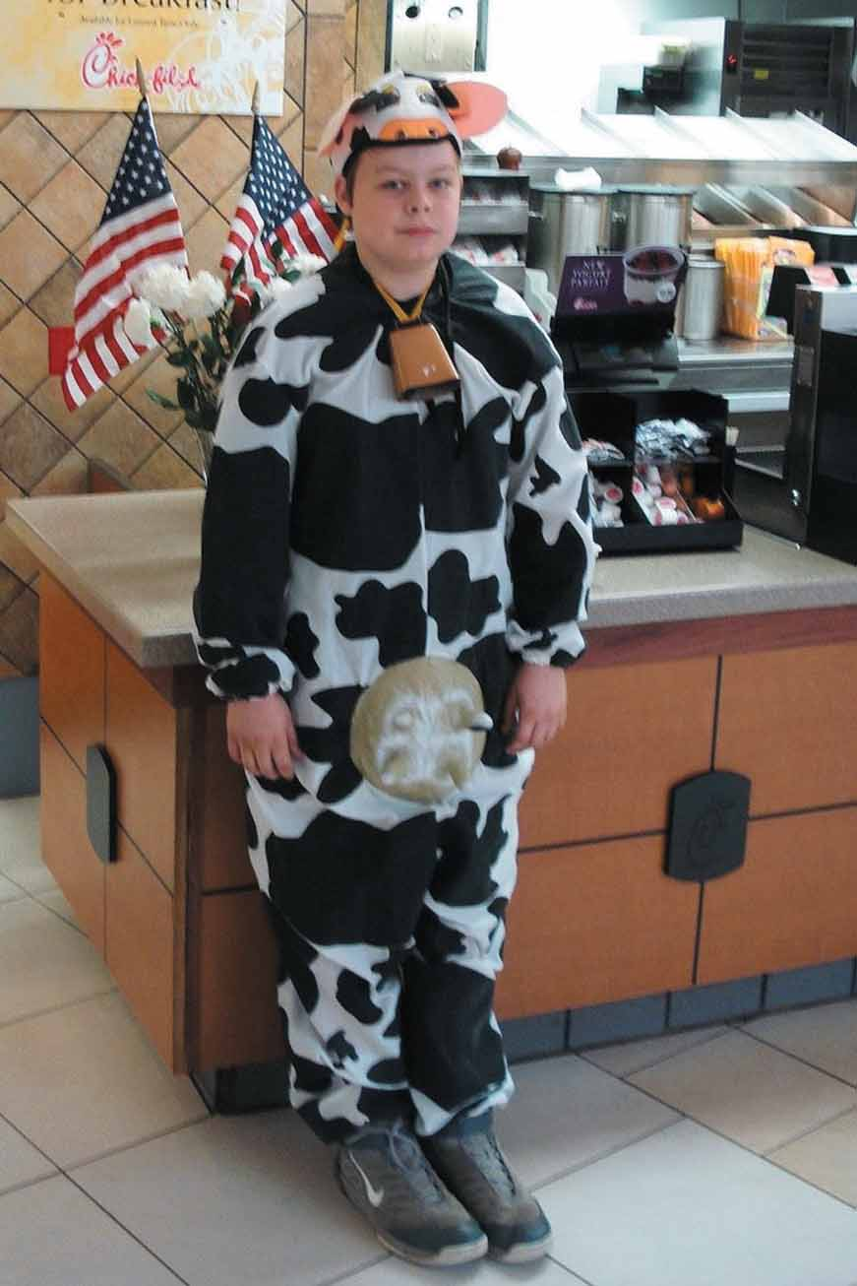
Chick-fil-A Social Media
Integrates online with offline
Engage customers primary goal
Store openings announced via social media
“Cow Appreciation Day”
“Eat Mor Chikin” offline advertising
Notes:
Social media has become an important marketing medium for businesses. A brand that has successfully used social media is Chick-fil-A. The online message has been carefully integrated with the offline marketing thrust of the brand. It provides a venue for posting announcements about store openings, special deals, and coupons.

Slide 7
Figure 1.2 Examples of Communication Noise
Talking on the phone during a commercial on television
Driving while listening to the radio
Looking at a sexy model in a magazine ad and ignoring the message and brand
Scanning a newspaper for articles to read
Talking to a passenger as the car passes billboards
Scrolling past Internet ads without looking at them
Becoming annoyed by ads on a social media site
Ignoring tweets on Twitter because they are irrelevant
Being offended by the message on a flyer for a local business
Notes:
These are examples of noise that can impact effective communication and prevent the encoded message from being heard at all or lead to the message being decoded differently than was intended.

Slide 8
Integrated Marketing Communications
Integrated Marketing Communications is the coordination and integration of all marketing communication tools, avenues, and sources within a company into a seamless program which maximizes the impact on consumers and other end-users at a minimal cost. The IMC includes all business-to-business, channel, customer, external communications, and internal communications.
Notes:
Definition of integrated marketing communications. Key components are:
Coordination and integration of all marketing communication tools and venues
Seamless marketing program designed to maximize impact at lower costs
Includes all b-to-b, channel, customer, external, and internal communications

Slide 9
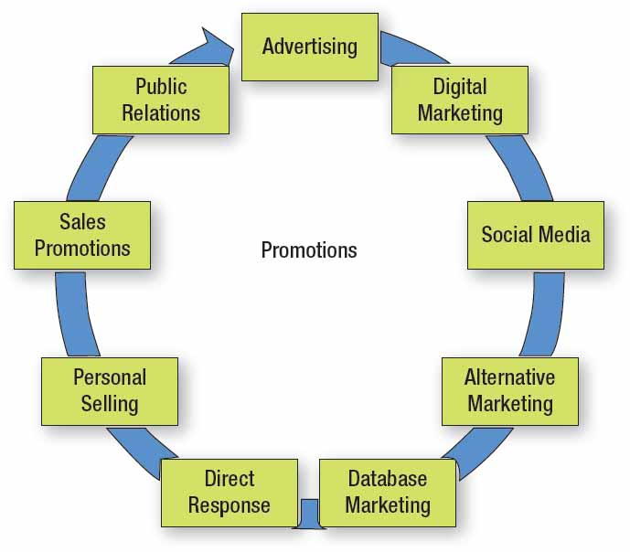
Figure 1.3 The Components of Promotion
Notes:
The traditional marketing mix consists of product, price, promotion, and distribution. Traditionally, the promotion component consisted of advertising, sales promotions, and personal selling. Today, it has expanded to include database marketing, direct response marketing, sponsorship marketing, digital marketing, social media, alternative marketing, and public relations. The venues for reaching consumers have increased beyond advertising.

Slide 10
Figure 1.4 Steps of a Marketing Plan
Current situational analysis
SWOT analysis
Marketing objectives
Target market
Marketing strategies
Marketing tactics
Implementation
Evaluation of performance
Notes:
In understanding integrated marketing communications, it helps to review the steps in a marketing plan. The current situational analysis and SWOT set the stage for setting marketing objectives and choosing the target market. Once these are set, the marketing person can develop strategies and tactics. IMC will be part of the overall marketing strategy to reach consumers. It will also be part of the tactics, which are the plans for achieving the objectives and carrying out the strategies. Implementation and evaluation conclude the marketing planning process.

Slide 11
Figure 1.5 Trends Affecting Marketing Communications
Emphasis on accountability and measurable results
Explosion of the digital arena
Integration of media platforms
Shift in channel power
Increase in global competition
Increase in brand parity
Emphasis on customer engagement
Notes:
With global competition has come a greater scrutiny of advertising and marketing budgets. This has led to a greater emphasis on accountability of expenditures and measurable results. The drive for measurable results is one of the factors that has led to the explosion of the digital arena, which includes social media. Measuring the impact of digital expenditures is easier than for traditional advertising. Because consumers now access information from smartphones, tablets, and other media platforms, companies must integrate their marketing communications across all platforms. With greater access to information, consumers now have considerably more channel power. With the rise of the Internet, competition now comes from the entire world. This global competition has increased the level of brand parity now seen across most product categories. To decrease brand parity and build some brand equity, brands are putting greater emphasis on customer engagement.

Slide 12
Accountability and Measurable Results
Want results from marketing budgets
Effort led by CEOs, CFOs, and CMOs
Advertising agencies expected to deliver results
Emerging social media changes communication
Emerging alternative methods and media
Less reliance on mass TV ads
Notes:
Companies want ad agencies and marketing officers to be accountable for their expenditures. CEOs, CFOs, and CMOs want measureable results. Show us the proof that the $50 million ad campaign is working and will translate into sales. In the past, once an ad agency was hired, they stayed with a client for a number of years because they knew the brand. Now, companies want results. If not, then a new agency will be chosen. With the rise in popularity of social media, there is less reliance on mass TV advertising. Agencies continue to explore alternative ways of reaching consumers where it is less cluttered than mass media.

Slide 13
Integration of Digital Media
Emergence of
Interactive Web sites, blogs, and social networks
Smartphones, tablets
Companies shifting expenditures from traditional to digital media
Social media allows interaction
Notes:
Alternative media has become the new buzz phrase in advertising, especially online. The Internet provides an interactivity with consumers. Websites, blogs, and social networks all provide two-way communications. Smartphones are replacing cell phones, so consumers now have the Internet with them at all times, increasing the ways and means of reaching them. As a result, companies are shifting dollars from traditional media to digital media.

Slide 14
Integration of Media Platforms
Consumers integrate platforms
5 hours 16 minutes → non-television screens
4 hours 31 minutes → television
Ways consumers integrate media formats
Content grazing
Investigative spider-webbing
Quantum journey
Social spider-webbing
Notes:
Consumers now spend more time with non-television screens than they do watching TV. Research by Ipsos OTX identified 4 ways that consumers interact with multiple media formats. Content grazing involves looking at two or more screens simultaneously to access different content. Investigative spider-webbing occurs when consumers pursue specific content across multiple platforms. Quantum journey focuses on completing a specific task across multiple platforms. Social spider-webbing occurs when consumers share content across multiple devices.

Slide 15
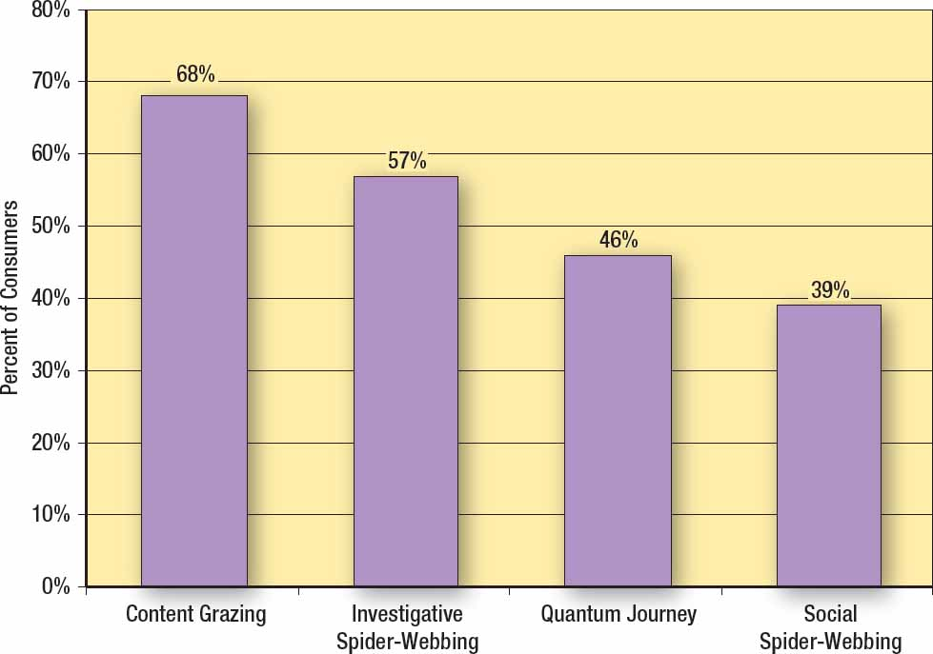
Figure 1.6 Pathways Consumers Use to Interact Across Media Devices
Source: Based on Mark Walsh, “Microsoft Highlights Usage Across Device Pathways,” Online Media Daily, March 14, 2013, http://www.mediapost.com/publications/article/195786/
Notes:
In the survey by Ipsos OTX, consumers were asked how they integrate across multiple platforms. Content grazing is the most frequently method used, at 68%. Social spider-webbing is the least used, 39%. Respondents were able to select more than one method of interacting, thus producing percentages that add to more than 100%.

Slide 16
Changes in Channel Power
Retailers
Control channel
Control shelf space
Have purchase data
Determine products and brands on shelves
Consumers
Internet shifts power to consumers
Multiple methods of making purchases
Notes:
Channel power has changed and is continuing to change. For the first 60 or so years in the 1900s, channel power resided with the manufacturers, such as Procter & Gamble. It then shifted to retailers, especially large chain retailers like Wal-Mart. Retailers controlled shelf space, had purchase data, and determined what products and brands went on the shelves. Consumers had to buy whatever brands a retailer stocked. Power is now beginning to shift to consumers, primarily because consumers do not have to purchase from the local retail store. They have options. Retailers who realize this are providing multiple ways for consumers to purchase and receive products.

Slide 17
Increases in Global Competition
Information technology and communication has changed the marketplace.
Products can be purchased from multiple locations.
Customers want both low prices and high quality.
Manufacturers and retailers must work together.
Notes:
Advances in communication technology have led to the rise of global competition. Every business competes in some way with global firms, either directly or indirectly, either for customers or for supplies. Products can be purchased from multiple locations. As a result, the level of competition has increased, and the prices of products have fallen. The challenge businesses now face is that consumers want it all. They want the lower prices created by global competition, but they also want quality. To provide this to consumers, manufacturers and retailers must work together. They must become partners with mutual goals that benefit both parties.

Slide 18
Increase in Brand Parity
Brands viewed as being equivalent
Consumers select from a group of brands
Quality and characteristics less important
Price more important
Decline in brand loyalty
Notes:
With brand parity, consumers see the brands as about equal in quality and attributes. Rather than having one brand that is viewed as being superior, consumers often have a group of brands they feel are equal and would meet their needs. As a result, in brand parity situations, quality and characteristics become less important since these are viewed as being equal. That makes price often the determining factor. The rise in brand parity has led to a decline in brand loyalty.

Slide 19
Emphasis on Customer Engagement (1 of 2)
Marketers seek to engage customers
Contact points important
Digital media now part of IMC
Two-way communication
Strive to develop emotional commitment
Notes:
With the increase in brand parity and the decline in brand loyalty, companies have placed greater emphasis on customer engagement. Contact points between customers and the product are examined in an effort to improve communication and the relationship. Digital media is now a critical component of IMC plans because it provides two-way communication. It is no longer sufficient to talk to customers, you must develop a dialogue with customers. The goal – a deeper emotional commitment on the part of consumers towards the brand.

Slide 20
Emphasis on Customer Engagement (2 of 2)
Understanding customer engagement also applies to nonprofits such as the Red Cross
Notes:
Customer engagement is vital to the success of brands. It is also important for nonprofits, such as the Salvation Army.

Slide 21
Figure 1.7 Five Reasons Why Integrated Marketing Works
Unifies strategy and message across channels
Streamlines timing
Connects with multiple audiences
Creates meaningful insights
Maximizes impact
Notes:
Technomic Consumer Brand Metric monitors 120 restaurants across 60 attributes. For this survey, 78,743 people responded to three metrics about restaurant advertising – has memorable advertising, has advertising I can relate to, and has advertising that makes me hungry. The bar chart shows the results of the survey. Subway had the highest composite score (73.3) followed by Olive Garden (72.9).

Slide 22
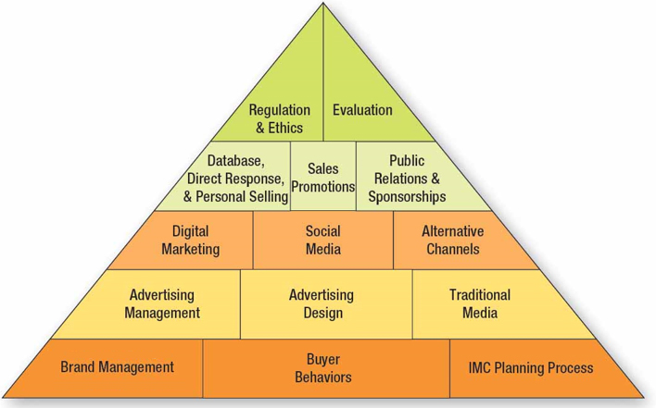
Figure 1.8 Overview of IMC Text
Notes:
This pyramid represents the structure of the text. At the bottom level are issues such as brand management, buyer behaviors, and the IMC planning process. Section 2 deals with advertising issues, section 3 with digital marketing, social media, and alternative channels, and level 4 with database and direct response marketing, sales promotions, and public relations. The book concludes with discussions on regulations, ethics, and an evaluation of the IMC effort.

Slide 23
International Implications
Goal – to coordinate marketing efforts
Greater challenge due to national and cultural differences
Standardization versus Adaptation
“Think globally, but act locally”
Notes:
Because of the increase in global competition, firms must coordinate marketing efforts across multiple countries. Because of cultural differences and language differences, it is a greater challenge. Firms can use a standardized approach which means the same approach and message is used in every global market. This works only for global brands that are worldwide and well known. An alternative is adaptation, which means firms adapt their marketing communications to each country, region, and culture. The idea is to “think globally, but act locally.”

Slide 24
Blog Exercises
American Eagle
Chick-fil-A
Integrated Marketing
Notes:
The blog exercises for Chapter 1 include American Eagle, Chick-fil-A, and videos about integrated marketing. Links are embedded in the text for each.

Slide 25
Copyright

