Slide 1
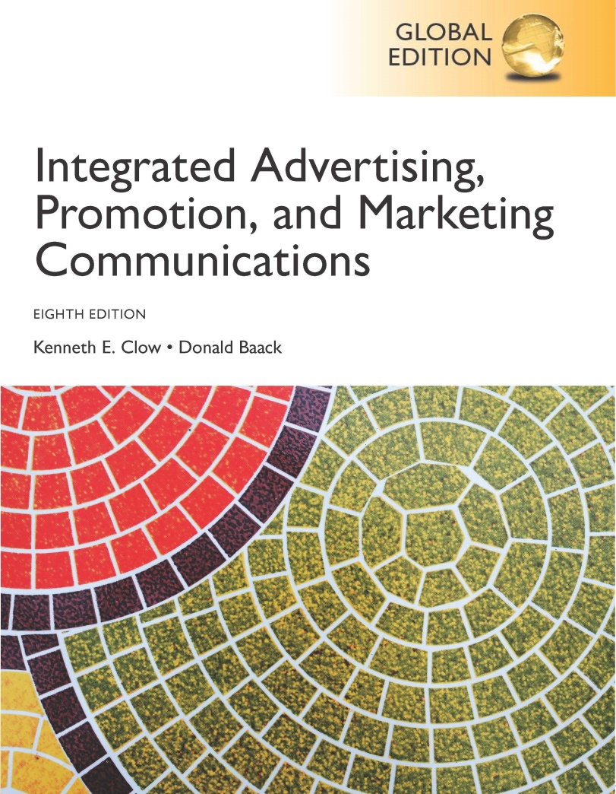
Integrated Advertising, Promotion, and Marketing Communications
Eighth Edition, Global Edition
Chapter 5
Advertising Campaign Management
Copyright © 2018 Pearson Education Ltd. All Rights Reserved
Notes:
Advertising is still an important component of most integrated marketing communications plans. This chapter addresses issues involved in managing the advertising component of the IMC plan.

Slide 2
Chapter Objectives (1 of 2)
Why is an understanding of advertising theories important in the advertising management process?
What is the relationship of advertising expenditures to advertising effectiveness?
When should a company employ an external advertising agency rather than completing the work in-house?
How do companies choose advertising agencies?
Notes:
These are the objectives for Chapter 5.

Slide 3
Chapter Objectives (2 of 2)
What are the primary job functions within an advertising agency?
What are the advertising campaign parameters that should be considered?
How does a creative brief facilitate effective advertising?
What are the implications of advertising management in the global arena?
Notes:
Additional objectives for Chapter 5.

Slide 4
Zhender Communications
Full-service agency
Challenges traditional thinking
Innovation
Campaign integration
Best place to work
Notes:
Zhender Communications is a full-service agency that offers strategic planning as well as advertising services. The agency serves a number of clients whose ads appear in this textbook. The goal is to remain at the forefront of innovation to develop new ways to reach consumers. The agency believes in campaign integration as a way to connect with a client’s audience. In addition to its advertising expertise, Zhender has been recognized as a “best place to work.”

Slide 5
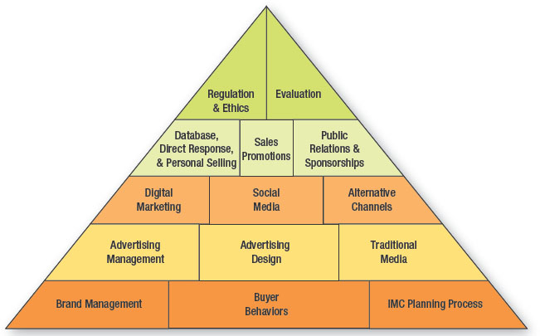
Figure 5.1 Overview of Integrated Marketing Communications
Notes:
Section 2 deals with advertising issues. Chapter 5 examines advertising management, Chapter 6 looks at designing advertisements, and Chapter 7 discusses traditional media.

Slide 6
Chapter Overview
Advertising management
Advertising theory
Relationship of advertising expenditures to success
Choosing an advertising agency
Advertising parameters
Creative brief
Notes:
This chapter presents an overview of managing the advertising function. Advertising theory lays the groundwork as does an understanding of the relationship between advertising expenditures and success. The chapter then provides information on how to select an advertising agency. Advertising parameters are discussed followed by the components of a creative brief.

Slide 7
Hierarchy of Effects Model (1 of 3)
Awareness
Knowledge
Liking
Preference
Conviction
Purchase
Notes:
The hierarchy of effects model consists of these six steps.

Slide 8
Hierarchy of Effects Model (2 of 3)
Steps are sequential
Some experts question if sequential
Consumers spend time at each step
Brand loyalty involves all six steps
Similar to attitude formation
Cognitive → affective → conative
Cognitive – awareness, knowledge
Affective – liking, preference, conviction
Conative – actual purchase
Notes:
The six steps are sequential, although some experts question if they are really sequential. But, the basic model says they are sequential and that consumers spend some time at each step. For instance, before a consumer can like a brand, they first must be aware of it and develop some knowledge of it. To develop brand loyalty, consumers must go through all six steps. It is similar to attitude formation and the cognitive-affective-conative sequence. Awareness and knowledge are the cognitive component of attitude. Liking, preference, and conviction are the affective component. The conative component of attitude is the purchase.

Slide 9
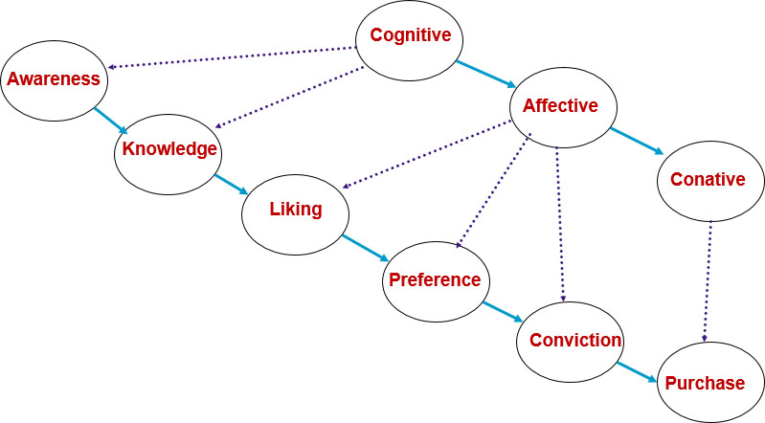
Hierarchy of Effects Model (3 of 3)
Notes:
This model shows the relationship between the hierarchy of effects model and the attitude sequence formation.

Slide 10
Figure 5.2 Personal Values
Comfortable life
Equality
Excitement
Freedom
Fun, exciting life
Happiness
Inner peace
Mature love
Personal accomplishment
Pleasure
Salvation
Security
Self-fulfillment
Self-respect
Sense of belonging
Social acceptance
Wisdom
Notes:
In designing ads, it is important to remember people have values, and much of their consumption behavior is motivated by a desire to fulfill these values in their lives.

Slide 11
Means-End Theory
Means-end chain
Message (means) lead to end state (personal values)
Means-End Conceptualization of Components of Advertising Strategy (MECCAS)
Product attributes → benefits → personal values
Notes:
The second theory that is important to consider is the means-end theory. The basic concept is that a means, the message, leads to an end-state, or personal value. The actual name of the theory is “Means-End Conceptualization of Components of Advertising Strategy”, or MECCAS. The model suggests that product attributes lead to consumer benefits, which in turn connect to personal values.

Slide 12
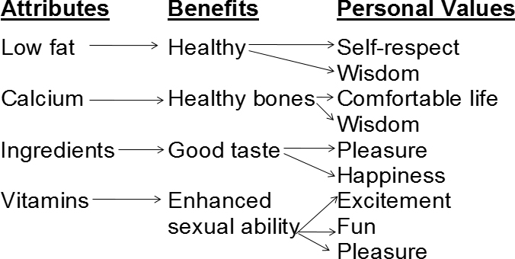
Figure 5.3 Means-End Chain for Milk (1 of 2)
Notes:
This figure illustrates a means-end chain for milk. An attribute of milk, being low fat, provides the benefit of health. The personal values consumers receive from good health are self-respect and wisdom. Another attribute, calcium, provides the benefit of healthy bones, which in turn leads to a comfortable life and shows wisdom on the part of the consumer. The key to a means-end chain is looking at the benefits each attribute generates then connecting those benefits to various personal values.

Slide 13
Figure 5.3 Means-End Chain for Milk (2 of 2)
Means-End Chain
Notes:
This advertisement for milk illustrates the last means-end chain. The specific message is that milk has calcium, which is important in bone development for both the mother and her baby.

Slide 14
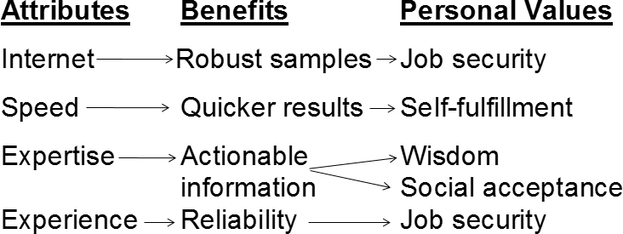
Figure 5.4 B-to-B Means-End Chain for Greenfield Online (1 of 2)
Notes:
This is a means-end chain for a marketing research firm, such as ReRez. The company is promoting marketing research. The first attribute is that Rerez does marketing research using the Internet which provides the benefit of robust samples. For a marketing person in a company, using robust samples can provide job security. Another aspect of the service, speed, leads to quicker results. This can provide the benefit of self-fulfillment since the information needed is provided quickly. Other personal values that are tapped through the benefits suggested include social acceptance and wisdom.

Slide 15
Figure 5.4 B-to-B Means-End Chain for Greenfield Online (2 of 2)
Means-End Chain
Notes:
This is the ad for ReRez based on the previous means-end chain.

Slide 16
Verbal and Visual Elements
Balance between visual and verbal
Visual processing
Easier to recall
Stored both as pictures and words
Concrete vs. abstract
Radio visual imagery
Visual esperanto
International ads
B-to-B advertisements
Notes:
Most ads seek to have a balance between visual and verbal, but usually one will be more dominant than the other. In recent years, advertisers have seen a move to more visuals and less emphasis on verbal content. One reason for the change is that visual processing is easier for consumers to recall. Visuals are stored in the brain both as pictures and as words. Concrete images tend to be remembered better than abstract visuals. If consumers can create a mental image or picture, it actually is superior to seeing the visual in terms of recall. So radio ads that can make listeners use their imagination and picture the product work very well. Visual esperanto is the ability of a visual to transcend cultures and languages by conveying the same meaning. It is especially beneficial in international ads where advertisers want to convey the same message to every market in the world. Business-to-business ads in the past emphasized verbal content, but in recent years B-to-B ads have moved to more visuals.

Slide 17
Factors Impacting Relationship Between Promotions and Sales
The goal of the promotion
Threshold effects
Diminishing returns
Carryover effects
Wear-out effects
Decay effects
Random events
Notes:
A number of factors influence the relationship between promotions and sales. The goal of the promotion may be to increase brand awareness or build brand image. If so, there will be less impact on sales than with some of the other objectives. Threshold effects are present at the point where the advertising or communication begins to affect consumer responses in a positive direction. Carryover effects refer to an ad’s message being remembered or carried over to the time when the product is needed and the consumer is thinking about the purchase. Wear-out effects occur when an ad or message becomes old and stale and the consumer no longer pays attention to it. Decay effects occur when a company quits advertising, and the brand name begins to fade in people’s memories. Sales can also be impacted by just random events, such as a major snow storm.

Slide 18
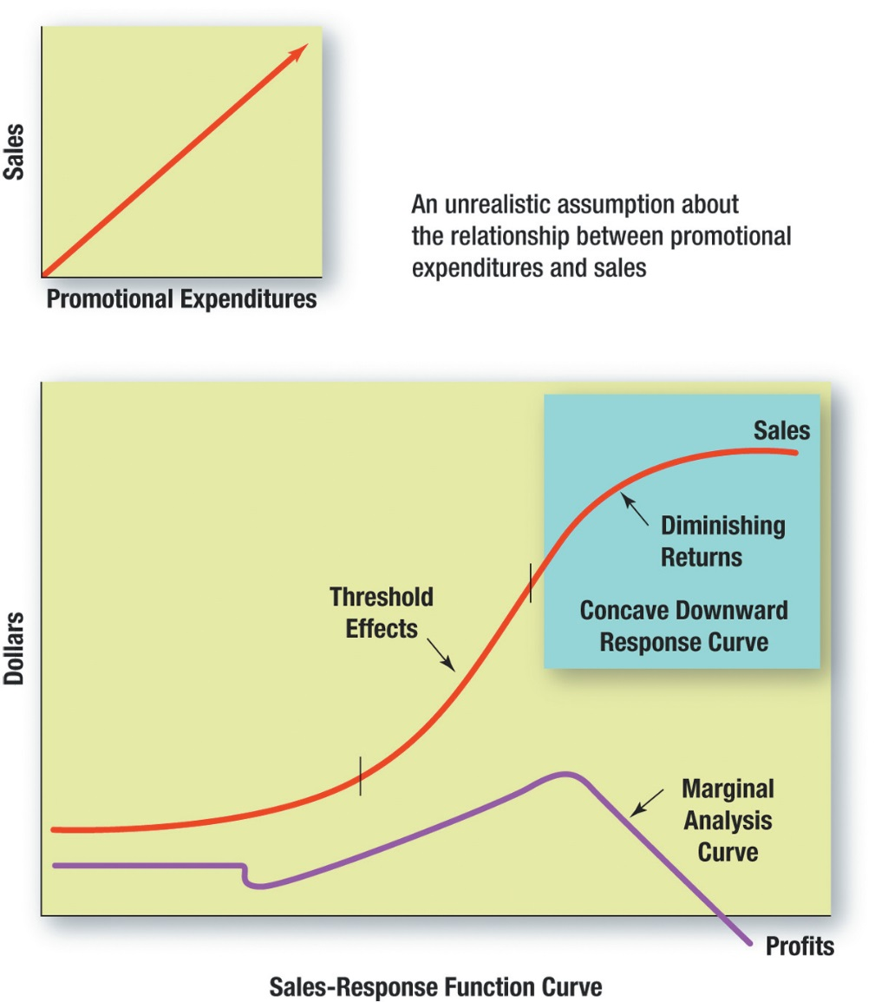
Figure 5.5 Relationship Between Advertising and Marketing Expenditures and Sales and Profit Margins
Notes:
The straight line is an unrealistic assumption about the relationship between expenditures and sales. The bottom curve is more indicative of what happens. Advertising dollars are spent and for awhile nothing happens. Then consumers begin to pay attention and start purchasing the product, the threshold effect. As more advertising dollars are spent, diminishing returns occur. With each additional dollar in advertising, the impact is less and less. This is the concave downward response curve.

Slide 19
Threshold Effects
Ad designed to encourage action.
Notes:
This ad for Cub Cadet features a $50 appreciation bonus designed to encourage action.

Slide 20
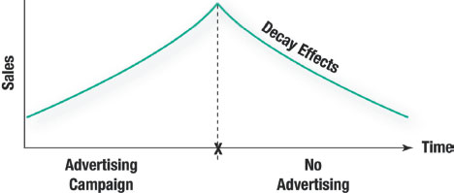
Figure 5.6 A Decay Effects Model
Notes:
This curve illustrates decay effect. During the advertising campaign, sales often continue to climb. Then the campaign ends and consumers begin to forget the brand name, thus it starts decaying.

Slide 21
Figure 5.7 Advantages of In-House versus Outside Agency
Advantages of In-House
Lower costs
Consistent brand message
Better understanding of product and mission
Faster ad production
Work closer with CEO
Lower turnover rate in the creative team
Advantages of Outside Agency
Reduce costs
Greater expertise
Outsider’s perspective
Access to top talent
Source: Adapted from Rupal Parekh, “Thinking of Pulling a CareerBuilder? Pros and Cons of Bringing an Account In-House,” Advertising Age, http://adage.com/print?article_id136701, May 18, 2009
Notes:
Companies have to decide whether they will perform the advertising work in-house or obtain an outside advertising agency. Each has advantages. With an in-house staff, normally costs are lower. It is easier to ensure a consistent brand message across campaigns and across various products within the company. In-house staff have a better understanding of the product and the mission of the company. They usually will work closer with the CEO. With in-house, moving from creative to production is normally faster since the company has direct control of the employees. There is also a lower turnover in the creative team, which provides greater consistency across campaigns. Outside agencies also offer some advantages. Costs may be lower if the in-house team lacks the expertise and a lot of time and effort is wasted in doing the work. Outside agencies have greater expertise and an outsider’s perspective, which can be extremely valuable in generating fresh ideas and creating effective campaigns. With agencies, firms may have access to some of the top talent. While it may cost more to use an agency, the superior work produced is normally worth the price.

Slide 22
Figure 5.8 Services Provided by Full-Service Agencies
Advice about how to develop target markets
Specialized services for business markets
Company image and theme guidance
Selecting logos and taglines
Advertising planning
Planning and purchasing of media
Notes:
Full-service agencies provide a wide array of services for clients, everything from strategy development to actual ad preparation. Full-service agencies can offer advice and guidance on developing target markets, a brand’s image, logo and tagline development. Most full-service agencies can provide guidance on business markets as well as consumer markets. Media planning and buying is also done with a full-service agency, or one of its subsidiaries.

Slide 23
External Advertising Agencies
Advertising agencies
Media service companies
Direct marketing agencies
Consumer and trade promotion specialists
Online and digital agencies
Social media agencies
Public relations agencies
Notes:
Advertising agencies come in all sizes and shapes. They range from boutiques that offer only one type of service or serve one type of client to full-service agencies that offer the full spectrum of services. Advertising agencies will often provide other marketing services. Media services companies provide media planning and media buying services. Direct marketing agencies work with all types of direct response marketing campaigns. Some agencies specialize in consumer or trade promotions, or even focus on a specific type of promotion, such as couponing. Public relations firms handle both positive and negative publicity events. A growing number of agencies handle only online or social media.
A recent phenomenon that has occurred is the whole-egg theory, first mentioned by Young & Rubicam Agency. The idea of the whole-egg is that an advertising agency should provide full marketing services for a company and assist in integrating every aspect of the company’s marketing effort.

Slide 24
Budget Allocation Considerations In-House vs. Advertising Agency
Size of account should match size of agency
75-15-10 Rule
75% - Media buys
15% - Creative work (agency)
10% - Ad production
Notes:
Costs are a major consideration in selecting an outside agency. The size of the account should match the size of the agency. Smaller accounts may be lost with a large agency and a large account would overwhelm a small agency. The 75-15-10 is a good guide to use. When looking at the total cost of an advertising campaign, 75% of the money should be spent on media buys, 15% on creative work by the agency, and 10% on production of the ads.

Slide 25
Crowd Sourcing In-House vs. Advertising Agency
New alternative
Outsource creative
Doritos
Harley Davidson
Overall cost not lower
Advantages
Involves consumers
Generates buzz
Notes:
Crowdsourcing is a recent alternative to choosing an advertising agency. Crowdsourcing involves seeking ideas from the public and even videos of ad productions. Two companies that have successfully used crowdsourcing are Harley Davidson and Doritos. Unilever used it for its meat snack product, Peparami. Doritos has used it in the Super Bowl. While it would appear the costs would be much lower, they are not. Most crowdsourcing involves a contest and a website. Then the entries have to be judged, and in most cases, the ad is professionally produced once the idea has been selected. But, the advantages of crowdsourcing include getting consumers involved and generating buzz among individuals as the entries are posted and passed along to other people.

Slide 26
Figure 5.9 Steps in Selecting an Advertising Agency
Set goals
Select process and criteria
Screen initial list of applicants
Reduce list to two or three viable agencies
Request creative pitch
Notes:
Choosing an agency requires time and effort. While companies can shortcut the process, such an approach often results in the best agency not being hired. The first step is to select goals. Then the company should decide on a process and criteria before contacting any agencies. Once proposals have been received, the list can be narrowed down to two or three viable agencies. A creative pitch is then requested from each of the agencies to determine the best choice.

Slide 27
Choosing an Agency
Goal Setting
Set before contacting agencies
Provides direction
Reduces biases
Notes:
Goal setting should occur before contacting any agencies. Doing so will prevent any biases towards a particular agency. Also, the goals provide direction. It will help the company understand what it wants from an agency and where the company wants to go.

Slide 28
Figure 5.10 Evaluation Criteria in Choosing an Ad Agency
Size of the agency
Relevant experience of the agency
Conflicts of interest
Creative reputation and capabilities
Production capabilities
Media purchasing capabilities
Other services available
Client retention rates
Personal chemistry
Notes:
The second step in the process is setting the evaluation criteria. Again, this should be done prior to talking to any agencies. As has already been discussed, the size of the agency is important. The agency should have experience in the industry, but not be representing a direct competitor. This would be a conflict of interest. Creative reputation and capabilities should be considered since the primary role of the agency is to generate creative ideas. The product and media purchasing capabilities are not essential. Some agencies do this, while others use subsidiaries or contract the tasks out to boutique shops. Client retention rates may be important, but with the turnover among agencies today, it has lost a lot of importance. Personal chemistry is important because individuals from the two companies must work together and generate ideas that will move the brand forward and accomplish objectives that have been set.

Slide 29
Creative Pitch
2 to 3 finalists
Formal presentation → shootout
Specific problem/situation
Expensive for agencies
Notes:
Once the list has been narrowed down to two or three finalists, it is time to ask for a creative pitch (or shootout). Agencies are given a specific problem to address. Creative pitches are expensive for agencies, so companies need to be serious about an agency when requesting a pitch. From the creative pitches, the company should select the agency that offers the best plan.

Slide 30
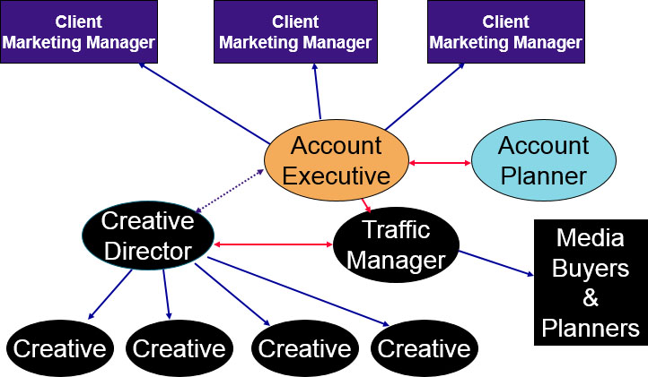
Key Advertising Personnel
Notes:
In the advertising agency, there are some key individuals. The account executive is the liaison between the company and the agency. The account executive represents the client within the agency. Account planners are the voice of the consumer and assist in overall planning and strategic direction of the campaign. Their role is to see the total picture. The creative director is responsible for the creative aspect of the campaign and works with the agency’s creative staff. The traffic manager’s role is to manage the campaign scheduling to ensure the campaign is finished on time. As with the Oscar Mayer campaign, multiple components mean juggling numerous deadlines and schedules. Media buyers and planners are involved in the selection and purchase of media.

Slide 31
Figure 5.12 Advertising Campaign Parameters
Advertising goals
Media selection
Tagline
Consistency
Positioning
Campaign duration
Notes:
Effective advertising campaigns require careful planning and attention to these parameters. Advertising goals have to be set based on communication and marketing objectives. Media selection not only must fit with the advertising goals but has a big influence on advertising design. A tagline needs to be developed, if not already in place. Consistency across campaigns and within a campaign is important to ensure the target audience is hearing the same, consistent message. Other decisions to consider include how the brand will be positioned and the duration of the campaign.

Slide 32
Figure 5.13 Advertising Goals
To build brand awareness
To inform
To persuade
To support other marketing efforts
To encourage action
Notes:
Advertising objectives include building brand awareness, informing consumers, persuading them about a brand, supporting other marketing efforts like couponing or a contest, and encouraging action.

Slide 33
Build Brand Awareness Advertising Goals
Brand image begins with awareness
Consumers recognize the brand
Business-to-business
Especially important in modified rebuy situations
Successful brands possess
Top-of-mind
Top choice
Brand equity leads to top-of-mind & top choice
Notes:
A primary goal of advertising is to build brand image, to enhance a brand’s equity with consumers. The process begins with brand awareness. If consumers are not aware of a brand, then brand image advertising can’t succeed. Brand awareness and brand image are especially important in modified rebuy situations because companies may not always seek every qualified bidder. Successful brands possess two characteristics. Top-of-mind are the brands a consumer mentions first when asked about brands in a particular product category. Top choice is the brand within a product category that consumers prefer the most. To be top choice requires top-of-mind. Brand equity leads to top-of-mind and top choice.

Slide 34
Persuasion Advertising Goals
Notes:
A common goal of advertising is to persuade consumers that a particular brand is superior to others and should be that top choice. This ad for Flair Jewelers says “Nobody Does ‘I Do’ Like We Do.”

Slide 35
Media Selection
Media-usage habits of target market
Audience characteristics of media
Business-to-business media
Earlier involvement of media companies
Notes:
One of the challenging tasks of advertising management is to select the media that will be used. More information about this process will be presented in Chapter 7. But, at this point, it is important to realize that to pick the right combination of media requires understanding the media habits of the target market then matching those habits with the audience characteristics of each media. This process is used in business-to-business media as well as in consumer media. Because of the importance of placing ads in the right media, companies are now involving media companies at an earlier stage of the ad development process rather than after the campaign has already been completed.

Slide 36
Taglines
Key phrase
Memorable
Conveys uniqueness
Consistency across platforms
Shorter than in past
Revised or new taglines
Notes:
Taglines are connected with brands and sometimes are better known than a brand’s logo. It is a key phrase that should tell what the brand is about. It should be memorable and convey something that is unique. The tagline should be consistent across multiple media platforms. Over time, taglines have become shorter. Revising taglines can be tricky and must be managed carefully.

Slide 37
Consistency
Transfer to long-term memory
Visual consistency key
Repetition enhances recall
Variability theory
Different environments
Can vary content
Multiple media
Notes:
Repeatedly seeing a specific visual image, headline, copy, or tagline helps embed a brand into a person’s long-term memory. Visual consistency is especially important in moving an ad to long-term memory. Repetition enhances both ad recall as well as brand recall. Variability theory states that seeing an advertisement in different environments enhances recall and recognition. Advertisers can vary the ad content while maintaining consistency across the campaign or campaigns. Different media can also be used. Seeing an ad on television and then in a magazine or billboard enhances recall more than seeing multiple ads within the same medium.

Slide 38
Positioning
Maintain consistent position
Link in cognitive map
Avoids ambiguity
Message stays clear
Notes:
Maintaining consistent product positioning throughout a brand’s life makes it easier for individuals to embed the brand within their cognitive map. Consistent positioning avoids ambiguity and provides a clear, consistent message that is always the same.

Slide 39
Campaign Duration
Goal is to embed in long-term memory
Too short impedes retention
Too long can make it stale
Typical length is 6 months
Length varies
Notes:
The goal of an ad campaign is to embed the brand and the message into a person’s long-term memory and cognitive map structure. If the campaign is too short, it impedes retention. It also leads to greater costs. If the campaign is too long, it can become stale and consumers will ignore the message. It is also possible the campaign can create negative feelings from hearing it too much. For most campaigns, about 6 months is effective. But, there are exceptions. Some campaigns last for years with only minor adjustments. Other campaigns wear out sooner.

Slide 40
Figure 5.15 The Creative Brief
The objective
The target audience
The message theme
The support
The constraints
Notes:
The last step in advertising management is writing a creative brief. The appearance of creative briefs will vary among advertising agencies and clients, but most contain these five elements: the objective of the campaign, the target audience, the message theme, any support that can be used, and any constraints. The creative brief is prepared by the agency with the help of the account executive or account planner from the agency and the brand manager from the client. It is a document used by the creative team at the agency to prepare the advertising campaign, so it needs to be clear and provide enough information so that the creative team understands what the client wants.

Slide 41
The Objective
To Persuade
Notes:
The first component of the creative brief should be to state the objective of the campaign. Campaigns designed to increase brand awareness will look different from campaigns designed to build brand image, encourage immediate action, or stimulate sales. The objective for this advertisement is to persuade individuals buying or building a home to use JD Bank for their mortgage.

Slide 42
The target audience
To Persuade
Notes:
Information about the target audience is critical. It should be more than just demographics.

Slide 43
The Message Theme (1 of 2)
Unique selling point
“Left brain” advertisement
Logical, rational side of brain
Manages numbers, letters, words, concepts
Use rational appeal
“Right-brain” advertisement
Emotional side of brain
Manages abstract ideas, images, feelings
Use emotional appeal
Notes:
The message theme should be the one (not multiple) unique selling point the client wants its target audience to get. When considering message themes, it helps to think about the difference between left brain messages and right brain messages. The left side of the brain is logical and where people manage numbers, letters, words, and concepts. Left brain advertising focuses on rational appeals that require thought, the cognitive component of attitude. The right side of the brain is where the emotions lie. The right side manages abstract ideas, images, and feelings. So right brain advertising should use an emotional appeal, the affective component of attitude.

Slide 44
The Message Theme (2 of 2)
The message theme of this ad is “Weaver is the firm of choice for companies and individuals with dreams and goals as big as Texas.”
Notes:
The creative brief needs to contain the primary message theme the client wants to convey to its target market.

Slide 45
The Support
The support claims in this ad are the “Best” awards shown at the bottom of the ad.
Notes:
Ads will often provide support for their product. It is the responsibility of the client to provide any support that might be used in an advertising campaign. If an automobile was designated as Motor Trend’s car of the year, that is valuable support that can be included to support brand image advertising. In this ad, St. Francis Medical Center received five different awards for being the best.

Slide 46
The Constraints
Legal and mandatory restrictions
Corporate restrictions
Disclaimers
Notes:
Constraints are things advertising can’t say or do, or things that must be included in ads. For some products, there are legal and mandatory restrictions that must be included. For drugs, companies must tell consumers about all of the possible side effects. For tobacco products there must be a warning from the Surgeon General. Companies may have other constraints, such as the logo must appear in all ads, or the logo must be in a specific color or shape. Disclaimers or warranty statements may also be included in ads. Most of the constraints are either legal requirements or company-imposed requirements to protect from lawsuits.

Slide 47
International Implications
62% of advertising budgets spent outside of U.S.
Two major differences
Process of agency selection
Preparation of international advertising campaigns
Preplanning research varies
Understanding of languages and cultures
Media selection varies
Notes:
Approximately 62% of advertising budgets are spent outside of the United States. The two major differences are the process of selecting an agency and the preparation needed for an international advertising campaign. Preplanning will also vary across countries. When developing global ad campaigns, you have to pay close attention to language and culture differences. Translating to another language is not sufficient. Media selection also varies in other countries. The mix that is used in the U.S. is not the same as it would be in Japan, Peru, Spain, or Germany.

Slide 48
Blog Exercises
Oreo Cookies
John Deere
Advertising Agencies
Notes:
The blog exercises for Chapter 5 include Oreo cookies, John Deere, and videos about advertising agencies. Links are embedded in the text for each.

Slide 49
Copyright

