Slide 1
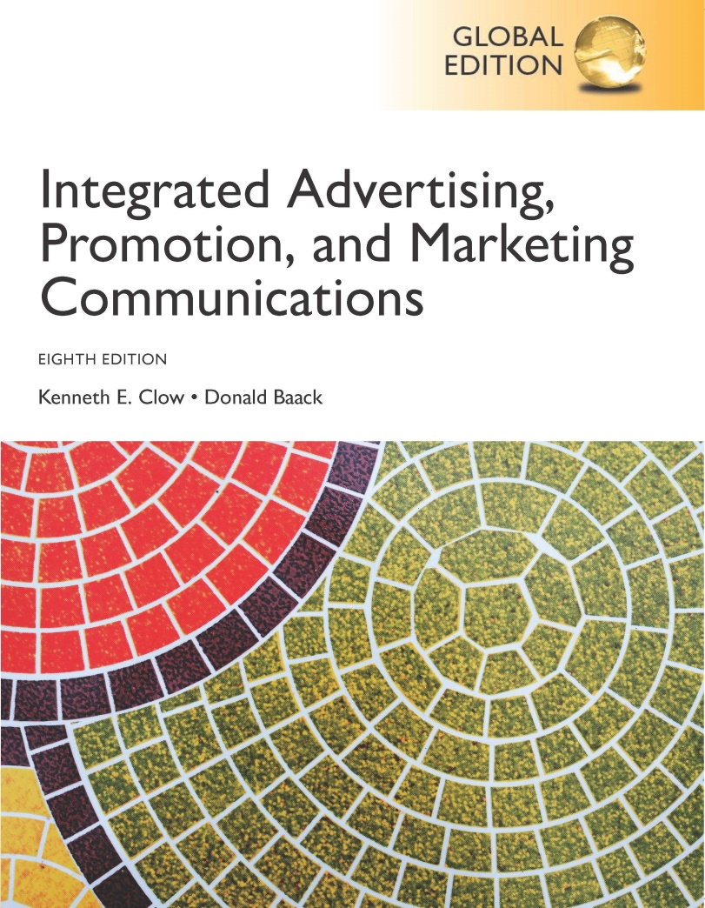
Integrated Advertising, Promotion, and Marketing Communications
Eighth Edition, Global Edition
Chapter 7
Traditional Media Channels
Copyright © 2018 Pearson Education Ltd. All Rights Reserved
Notes:
Chapter 7 examines traditional media, which includes the broadcast media of television and radio, outdoor media, and the print media of magazines and newspapers.

Slide 2
Chapter Objectives (1 of 2)
What is a media strategy?
What elements and individuals are involved in media planning?
How do the terms used to describe advertising help the marketing team design effective campaigns?
What are some of the primary advertising objectives?
What are the advantages and disadvantages associated with each traditional advertising medium?
Notes:
These are the objectives for Chapter 7.

Slide 3
Chapter Objectives (2 of 2)
How can the marketing team use the media mix to increase advertising effectiveness?
What are the key issues associated with media selection for business-to-business markets?
What issues are associated with media selection in international markets?
Notes:
These are the objectives for Chapter 7.

Slide 4
Coca-Cola
United all Coke trademark brands
“Taste the Feeling”
Movement toward a healthier brand image
Integrated campaign
Television
Print
Social media
Cultural-diverse markets
Notes:
To celebrate Oreo’s 100th birthday, the brand’s agency (The Martin Agency) developed a campaign entitled “Wonderfilled Oreos.” While television ads were the central component of the campaign, it also included print, themed events, and social media. The group Chitty Bang performed a special piece called “Wonderfilled Anthem.” The musical television campaign highlighted ads that centered on making bad things good.

Slide 5
Chapter Overview
Nature of media strategy
Media planning
Media buying
Media choices
B-to-B media selection
International media concerns
Notes:
Chapter 7 presents information about the traditional media channels. The chapter begins with information about the nature of media strategy. Media planning, media buying, and media choices are then discussed. The chapter concludes with material about B-to-B media selection and international media concerns.

Slide 6
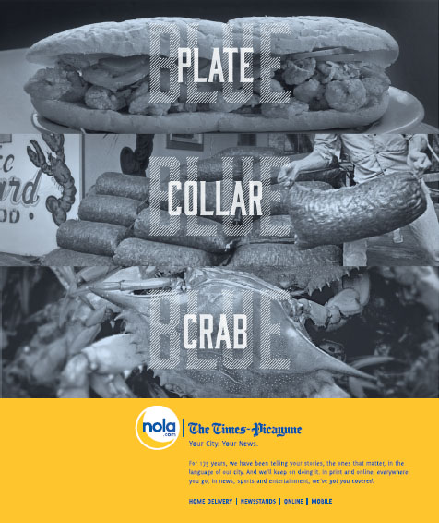
Media Strategy
Process of analyzing and choosing media for advertising and promotional campaigns.
Notes:
Media strategy involves analyzing and choosing media for an advertising and promotions campaign. Choosing the best media to speak to potential customers is a challenge. It involves matching a target audience to the media audience of specific programs.

Slide 7
Media Planning
Analysis of target market
Focus on consumer behavior
Understanding purchase process
Study media choices
Listening and viewing habit
Notes:
Media planning begins with a careful analysis of the target market. It involves understanding the process consumers use in making purchases, the consumer behavior events that guide those choices. It involves studying the media choices the target market makes and understanding their listening and viewing habits. To match the media to the target market requires understanding the target market.

Slide 8
Figure 7.1 Examples of Times Individuals Are Exposed to Advertisements (1 of 2)
A favorite wake-up radio station or one that is listened to during the commute to work
A favorite morning news show or newspaper
Trade or business journals that are examined while at work
A radio station that is played during office hours at work
Favorite computer sites that are accessed during work
Notes:
This slide presents examples of when individuals are exposed to advertising. Throughout the entire day a typical consumer is exposed to various forms of advertising in various media.

Slide 9
Figure 7.1 Examples of Times Individuals Are Exposed to Advertisements (2 of 2)
Favorite magazines that are read during the evening hours
Favorite television shows that are watched during the evening hours
Internet sites that are accessed during leisurely hours
Shopping, dining, and entertainment venues that are frequented
Notes:
This slide presents examples of when individuals are exposed to advertising. Throughout the entire day a typical consumer is exposed to various forms of advertising in various media.

Slide 10
Figure 7.2 Components of a Media Plan
Marketing analysis
Advertising analysis
Media strategy
Media schedule
Justification and summary
Notes:
The marketing analysis provides a comprehensive review of the marketing program and where advertising fits into the plan. An advertising analysis states the primary advertising strategy and budget to be used, as well as the advertising objectives. The media strategy spells out the media to be used and the creative considerations. The media schedule notes when ads will appear in individual media vehicles. The media planning concludes with a justification and summary of the media plan.

Slide 11
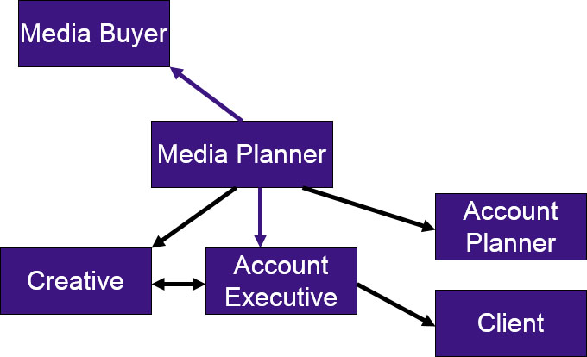
People Involved in Media Selection
Notes:
The media planner formulates the media program stating when and where ads will be placed. Media planners work closely with the creative staff, the account executive, account planners, and media buyers. The creative needs to know which media will be used and even the media vehicle as the ad is being prepared. The media buyer takes the media plan and purchases the actual space and time.

Slide 12
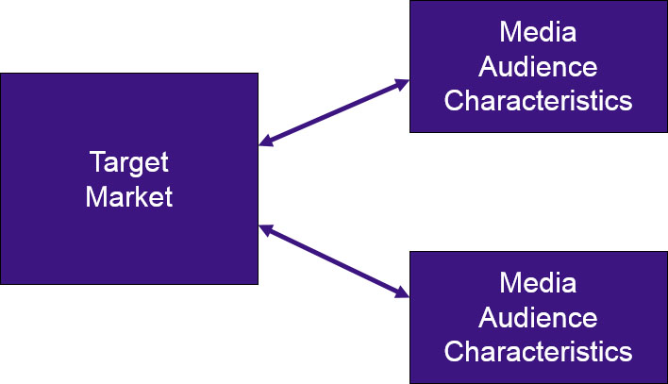
Media Planner (1 of 2)
Notes:
The media planner needs to understand the characteristics of the target audience. Those characteristics then need to be matched with media audience characteristics. Ads are more likely to be noticed and have an effect if they are placed on media and on programs that are watched or viewed by the target audience. A target market that likes sports should be matched with programs about sports.

Slide 13
Media Planner (2 of 2)
An ad for JD Bank targeted to farmers and individuals with acreage who may need a tractor.
Notes:
The media planner’s responsibility is to match the target market for this ad to print publications that have a similar target audience.

Slide 14
Media Buyers
Purchase space and negotiate rates
Placement important consideration
Little connection between agency size and price
Spot ad – one time placement
Small agencies tend to know local markets
Effectiveness related to
Quality of media choices
Creativity
Financial stewardship
Agency’s culture and track record
Relationship with media reps
Notes:
Media buyers actually purchase the space and negotiate rates for ads. Placement is important and is part of the media buyer’s responsibility to ensure a good location for ads. Research has shown there is little connection between the size of the agency and the price negotiated. Being a large agency does not guarantee lower prices. A spot ad is a one-time placement of an advertisement. The rates are negotiated individually with television stations, so prices vary considerably. The effectiveness of media buyers is determined by the quality of the media choice, the creativity of the media buyer in negotiating and placing ads, financial stewardship of the buyer, the agency’s culture and track record in buying media, and in the relationships the media buyer develops with the media reps.

Slide 15
Advertising Terminology (1 of 2)
Reach
Number in target audience exposed
Typically 4-week period
Frequency
Average number of exposures
Opportunities to see (OTS)
Cumulative exposures
Placements x frequency
Gross rating points (GRPs)
Measures impact of intensity of media plan
Vehicle rating x OTS (number of insertions)
Notes:
Reach represents the number of people, households, or businesses in a target audience that are exposed to a media vehicle or message schedule at least once during a specified time period, which is usually four weeks. Frequency is the average number of times an individual, household, or business is exposed to a particular advertisement within a specified time period, again usually within four weeks. Opportunities to see (OTS) refer to the cumulative exposures achieved in a given time period. A brand that places three ads on a television show that is televised weekly will produce 12 OTS (3 shows x 4 weeks). Gross rating points (GRPs) measure the impact or intensity of a media plan. Gross rating points are calculated by multiplying a vehicle’s rating by the OTS.

Slide 16
Advertising Terminology (2 of 2)
Costs
Cost per thousand (CPM)
CPM allows for cost comparisons
Ratings and Cost per Rating Point (CPRP)
Ratings measure percent of target market exposed by medium
CPRP allows for comparisons across media
Cost of media buy / vehicle’s rating
Weighted CPM
Continuity
Continuous campaign
Pulsating campaign
Flighting (or discontinuous) campaign
Impressions
Gross impressions – total audience exposed to add
Notes:
Cost for media is often per one thousand (CPM), which allows for easy comparisons across vehicles and even media. Ratings measure the percent of a target market that is exposed to a medium. Cost per rating point allows for comparisons across media. It is calculated by dividing the cost of the media buy by the vehicle’s rating. An alternative is to use the weighted (or demographic) CPM, which is calculated by multiplying the cost of the media buy by 1,000, then dividing by the actual audience reached. Continuity refers to the exposure pattern or schedule used in the campaign. A continuous campaign uses media in a steady stream throughout the entire campaign. Pulsating has expenditures throughout the entire campaign, but will also have bursts when extra spending occurs. Flighting (or discontinuous) spends money on media at different times during the campaign and none at other times. Gross impressions represent the total exposures of an audience to an advertisement. If an ad was shown four times on a television show with an audience of 2 million people, then the total gross impressions would be 8 million.

Slide 17
Figure 7.4 Hypothetical Media Information for Select Magazines
Target Market (20 million)
Publication | 4C Base Rate | Total Paid & Verified Circulation | CPM | Percent of Readers Fit Target Market | Number of Readers Fit Target Market | Rating (Reach) | Cost per Rating Point (CPRP)
Better Homes and Gardens | $506,380 | 7,648,600 | $66.21 | 13.51% | 1,033,000 | 5.2 | $98,041
Glamour | $219,190 | 2,320,325 | $94.47 | 24.65% | 572,000 | 2.9 | $76,640
Good Housekeeping | $387,055 | 4,652,904 | $83.19 | 10.81% | 503,000 | 2.5 | $153,899
National Geographic | $225,455 | 4,495,931 | $50.15 | 26.96% | 1,212,000 | 6.1 | $37,204
Reader's Digest | $185,300 | 7,114,955 | $26.04 | 18.62% | 1,325,000 | 6.6 | $27,970
Southern Living | $198,800 | 2,855,973 | $69.61 | 10.57% | 302,000 | 1.5 | $131,656
Sports Illustrated | $392,800 | 3,201,524 | $122.69 | 16.77% | 537,000 | 2.7 | $146,294
TIME | $320,100 | 3,376,226 | $94.81 | 18.60% | 628,000 | 3.1 | $101,943
Notes:
This table provides hypothetical media information for select magazines. The CPM is calculated by dividing the cost by the total readership then multiplying by 1,000. For this example, the target market consists of 20 million. The fifth column identifies the percent of the readership that fits the target market. For example, 13.51% of Glamour’s readership fits the target market of this product. The next column is the 13.51% times the total readership for Glamour, which means 2.48 million readers of Glamour fit the target audience for this product. The rating (reach) is the number of readers who fit the target market divided by the total market (20 million). For Glamour the 2.48 million was divided by 20 million yielding a reach of 12.4, or 12.4%. Thus, 12.4% of the target market reads Glamour. The cost per rating point is the cost of the ad divided by the rating. For Glamour, it is $842,658/12.4.

Slide 18
Figure 7.5 Calculating Weighted CPM
Target Market (20 million)
Publication | 4C Base Rate | Total Paid & Verified Circulation | CPM | Percent of Readers Fit Target Market | Number of Readers Fit Target Market | Weighted (Demographic) CPM
Better Homes and Gardens | $506,380 | 7,648,600 | $66.21 | 13.51% | 1,033,000 | $490.20
Glamour | $219,190 | 2,320,325 | $94.47 | 24.65% | 572,000 | $383.20
Good Housekeeping | $387,055 | 4,652,904 | $83.19 | 10.81% | 503,000 | $769.49
National Geographic | $225,455 | 4,495,931 | $50.15 | 26.96% | 1,212,000 | $186.02
Reader's Digest | $185,300 | 7,114,955 | $26.04 | 18.62% | 1,325,000 | $139.85
Southern Living | $198,800 | 2,855,973 | $69.61 | 10.57% | 302,000 | $658.28
Sports Illustrated | $392,800 | 3,201,524 | $122.69 | 16.77% | 537,000 | $731.47
Notes:
This table shows the weighted CPM, which is the advertising costs multiplied by 1,000 then divided by the actual audience reached. So for Better Homes & Gardens, it is ($506,380*1000) / 1,033,000.

Slide 19
Achieving Advertising Objectives (1 of 3)
Three-Exposure Hypothesis
Herbert Krugman
Minimum of 3 exposures to be effective
Intrusion value
Recency Theory
Clutter, 3 exposures not enough
Selective attention and focus
Pay attention only to certain ads
One ad exposure may be enough
Requires continuous advertising
Increase exposure through adding reach
Notes:
The three-exposure hypothesis was introduced by Herbert Krugman. The hypothesis states that it takes at least three exposures to an ad for it to have an affect. It also is based on the idea that advertising has intrusion value, that is viewers will pay attention to an ad even if they don’t want to. Most advertisers feel three exposures are not enough and that advertising today does not always display intrusion value. Consumers have selective attention and focus. They pay attention to only certain ads. According to recency theory, one ad exposure may be enough if the person has an interest in that product or for some other reason pays attention to the ad. Recency theory suggests advertising needs to be continuous since most of the time ads are ignored. According to recency theory, increasing exposure through adding reach is more important than adding frequency.

Slide 20
Achieving Advertising Objectives (2 of 3)
Effective reach and frequency
What percent of audience must be exposed?
How many times must audience be exposed?
Too few ads – not effective
Too many ads – wasted resources
Size and placement of ads
Number and type of media
Computer models to optimize schedule
Notes:
Effective reach is the percent of the audience that must be exposed to an advertisement to achieve a specific objective. Effective frequency is the number of times an audience must be exposed to an advertisement to achieve a specific objective. If there are too few ads or reach is too low, then the campaign is not effective. If the ads are seen too many times, then resources are being wasted. The size and placement of ads impact exposure and impact effective reach and effective frequency. The number and type of media also impact effectiveness. Advertisers today have computer models that will help them optimize media schedules.

Slide 21
Achieving Advertising Objectives (3 of 3)
Brand recognition
Emphasis on visual product presentation
Recognize brand
Brand recall
Frequency more important than reach
Repetition important
Notes:
To achieve a high level of brand recognition, advertisers want to focus on visual presentation of the product. The goal is for viewers to recognize the ad, the product, and the brand when they are shown the ad. The brand name does not have to be recalled. If advertisers want to increase recall, then the brand does need to be part of the evoked set and in the person’s long-term memory. Frequency is more important than reach in enhancing recall. The more they hear the brand name, repetition, the more likely it will be remembered.

Slide 22
Figure 7.6 Brand Recognition Versus Brand Recall
Objective | Brand Recognition | Brand Recall
Goal | Create/strengthen mental linkages | Place brand in evoked set
Method | Increase reach | Increase frequency (repetitions)
Best media | Television | Television
Blank | Outdoor | Radio
Blank | Magazines | Newspapers
Blank | Internet | Internet
Blank | Direct mail | Blank
Notes:
This table provides a summary of the differences between brand recognition and brand recall. For brand recognition, the goal is to create or strengthen mental linkages in the cognitive maps of individuals. Increasing reach works best. For brand recall, the goal is to make the brand part of the evoked set of consumers and that is best done through repetition, increasing frequency.

Slide 23
Figure 7.7 Television Advertising
Advantages
High reach
High frequency potential
Low cost per contact
High intrusion value
Quality creative opportunities
Segmentation through cable
Disadvantages
High level of clutter
Low recall due to clutter
Channel surfing during ads
DVRs skipping ads
Short amount of copy
High cost per add
Notes:
Television for many years had the reputation of being the glamour advertising medium. To some, TV still remains the best medium. But, its luster has faded for many products. A survey by Nielsen notes that the average consumer watches 31 hours of TV per week. This table summarizes the advantages and disadvantages of TV. It can reach a large audience at a relatively low cost per contact, but that overall cost is high for many brands. Clutter is the number one problem facing TV. Channel surfing and shifting to other media are also concerns.

Slide 24
Nielsen Ratings
In the United States, the total number of households with television sets is approximately 109.7 million. To calculate the rating of an TV episode, if the number of households tuned to the show was 17.8 million, then the rating would be:
Next, if the advertiser were interested in the percentage of households that actually were watching television at that hour, the program’s share could be calculated. If 71 million of the 109.7 million households had a television turned on during the hour in which the show aired, the share would be:
Notes:
The cost of TV ads is still determined by Nielsen TV ratings. The ratings are calculated by dividing the number of households watching a program by the total number of households, which in the U.S. is now about 109.7 million. The share is the number of households watching the program divided by the number of households with the TV turned on.

Slide 25
C3 Ratings
Rating for actual commercial time slot
Rating plus viewing within 3 days
Now used for advertising rates
Calculated for all ads within a pod
Criticism – ads within pod not equal
First position – 28% higher awareness
On Demand C3
Notes:
The commercial C3 rating is for actual commercial time plus any viewing within three days after the original ad runs. The C3 rating is now used to determine advertising rates. It is calculated by averaging the viewing of commercials within a pod. Critics assert that not all ads within a pod are viewed equally. For instance, the first slot has a 28% higher awareness level. Nielsen plans to extend C3 rating to “On Demand C3” which will produce a rating for each commercial.

Slide 26
Figure 7.8 Cost of 30-Second Ad Based on C-3 Ratings
Sunday Night Football | $623,425
The Walking Dead | $413,695
Big Bang Theory | $327,885
Blacklist | $294,586
American Idol | $266,333
The Voice | $262,041
Modern Family | $226,935
State of Affairs | $224,060
Scandal | $217,423
Source: Adapted from “TV Ad Prices: Football, Walking Dead, Big Bang Theory, Blacklist Top the List,” (http://variety.com/2014/tv/news/tv-ad-prices-football-walking-dead-big-bang-theory-blacklist-top-the-list-1201314484/), September 26, 2014.
Notes:
This table shows the costs of 30-second spots on various TV shows.

Slide 27
Ratings Provider
AC Nielsen
DMAs
Demographic information
Nielsen Media Research
Starch INRA
Mediamark Research
Burke Marketing Research
Notes:
The primary provider of ratings is AC Nielsen. In addition to national ratings, Nielsen provides ratings for DMAs. Data is gathered through diaries, audience meters, and people meters. Demographic data can be obtained from agencies such as Nielsen Media Research, Starch INRA, Mediamark Research, and Burke Marketing Research.

Slide 28
Local and Regional Television Advertising
Excellent for local and regional companies
National brands – spot TV ads
75% national time sold during sweeps week
Can generate higher GRPs at lower costs
Notes:
Local and regional television is excellent for local and regional companies. National brands can advertise on these stations by purchasing spot TV space. About 75% of national time slots are sold during sweeps week. By selecting local channels to supplement the national time, companies can generate higher GRPs at a lower cost.

Slide 29
Dynamic Advertising
TV networks, cable, satellite
Utilize subscriber information
Target ads to specific subscribers
Based on specific criteria
Based on location
Notes:
Dynamic advertising allows a company, such as DirecTV or Comcast, to obtain subscriber information from marketing research firms and combine it with the company’s data to send targeted ads to subscribers that meet specific criteria and live in targeted areas.

Slide 30
Social Media and Television
Trends for consumers
Less time watching television
More time online
High social media users watch more TV
75% consumers multi-task watching TV
Bluefin Labs – online buzz and TV shows
Notes:
Consumers are spending more time online and less time watching television. But for high social media users, the time spent watching TV is actually higher. Deloitte Research found that 75% of consumers multi-task while watching TV – 42% online, 29% talking on phones, and 26% sending text messages. Bluefin Labs found a connection between online buzz about brands and television shows being watched.

Slide 31
YouTube and Television
Television ads posted on YouTube
Simultaneous rollout (in-stream)
YouTube pre-rollout
Super Bowl – teaser ads
Result in higher recall
200% higher recall for both TV and YouTube
150% higher recall YouTube only
Notes:
Many companies are now posting TV ads on YouTube. Some are posted simultaneously, others are pre-rolled on YouTube, especially during the Super Bowl. Research shows recall higher – 200% of viewing on both YouTube and TV and 150% higher for YouTube only. More than 3 billion consumers watch YouTube daily.

Slide 32
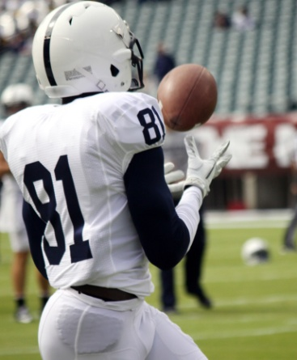
Super Bowl Advertising
Biggest advertising event of year
110 million plus viewers
Brand building opportunity
Many Super Bowl ads pre-roll in social media
Teaser ads
Extended ad with additional information
Immediate feedback
Monitor social buzz
Notes:
The Super Bowl is the biggest advertising event of the year with many of the 110 million plus viewers watching the game to see the ads. In the past, ads were kept secret until the Super Bowl. Now, many ads are pre-rolled through social media, YouTube, and Facebook. Teaser ads are often used but sometimes extended ads with additional content and information are used. Social media allows for immediate feedback and monitoring of social buzz.

Slide 33
Figure 7.9 Radio Advertising
Advantages
Recall promoted
Narrower target markets
Ad music can match audience
High segmentation potential
Flexibility in making ads
Modify ad to local conditions
Intimacy with DJs
Mobile – listen anywhere
Creative opportunities with sound and music
Disadvantages
Short exposure time
Low attention
Difficult to reach national audiences
Target duplication with several stations using the same format
Information overload
Notes:
Approximately 80% of Americans still listen to radio. Radio still reaches about 93% of Americans. Radio is especially important for smaller, local businesses. This table identifies the advantages and disadvantages of radio. Audiences can be segmented based on station format, and many listeners form an attachment to DJs. The major problem is short exposure and low attention. Radio is often used as background music.

Slide 34
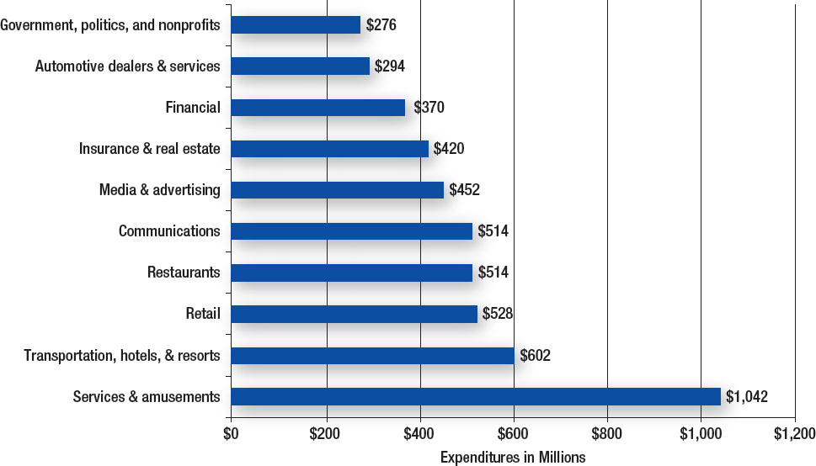
Figure 7.10 Expenditures on Out-of-Home Advertising
Source: Adapted from “Outdoor Advertising Expenditures, 2009 January-June,” TNS Media Intelligence/CMR OAAA, September 2009.
Notes:
Services and amusements are the big spenders on outdoor advertising. The next largest category is transportation, hotels, and resorts.

Slide 35
Figure 7.11 Out-of-Home Advertising
Advantages
Select key geographic areas
Accessible for local ads
Low cost per impression
Broad reach
High frequency on major commuter routes
Large visuals possible
Digital capabilities
Disadvantages
Short exposure time
Brief messages
Little segmentation possible
Clutter
Notes:
Out-of-home media is more than just billboards. It includes signs on cabs, buses, park benches, fences of stadiums and arenas, and even a blimp flying over a major event. Advances in technology have dramatically changed out-of-home advertising. This table shows the advantages and disadvantages. Out-of-home has the advantage of geographic selectivity and is excellent for local ads, broad reach, and a low cost per impression. The problem is a very short exposure time, especially for highway billboards, so the message has to be extremely brief.

Slide 36
Figure 7.12 Magazine Advertising
Advantages
High market segmentation
Targeted audience by magazine
Direct-response techniques
High color quality
Long life span
Read during leisure
Longer attention to ads
Availability of special features
Disadvantages
Declining readership
Clutter
Long lead time
Little flexibility
High cost
Notes:
Magazines can still be the best choice for advertising. Research indicates magazines are a strong driver of purchase intentions and visits to websites. Magazines work especially well when blended with other media. Magazines offer high segmentation, high-quality color, and a long life span. Magazines often are kept for months and read and reread. Disadvantages are the high cost, the high level of clutter, and the very little flexibility in modifying ads.

Slide 37
Figure 7.13 Newspaper Advertising
Advantages
Geographic selectivity
High flexibility
High credibility
Strong audience interest
Longer copy
Cumulative volume discounts
Coupon and special-response features
Disadvantages
Poor buying procedures
Short life span
Clutter
Poor quality reproduction
Internet competition
Aging readership
Notes:
Newspapers are still important for local businesses and providing coupons to consumers. Newspapers have a high level of credibility and strong audience interest. They are especially effective for reaching older consumers. The problem with newspapers is that younger consumers do not read newspapers, instead they go online for news. There is major clutter and a very short life span. Newspapers are not kept and reread like magazines.

Slide 38
Media Mix
Select proper blend of media
Media planners and media buyers
Media multiplier effect
Consumer audience
Business-to-business audience
Notes:
Selecting the proper blend of media outlets for advertisements is crucial. The work of media planners is especially important. It is their task to match target markets with media audiences, to know what media a specific target market uses. The media multiplier effect suggests that combining two or more media increases the impact of an advertising campaign more than any one medium by itself. This is true in both the consumer market and the B-to-B market.

Slide 39
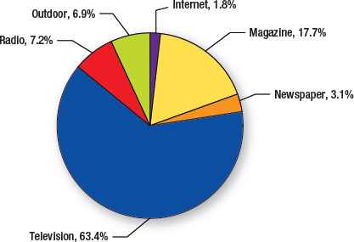
Figure 7.14 U.S. Advertising Expenditures by Media for Coca-Cola
Source: Adapted from Marketer Trees 2009, http://adage.com/marketertrees09, December 28, 2009.
Notes:
This graph provides an illustration of the multiple media used by Coca-Cola. Television accounts for 63.4% of their media buys, the vast majority. But, Coca-Cola also spends on radio, outdoor, the Internet, magazines, and newspapers.

Slide 40
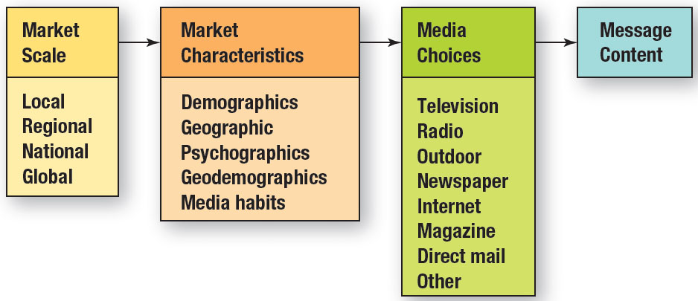
Figure 7.15 Developing Logical Combinations of Media
Notes:
Developing logical combinations of media takes planning. It starts by deciding the scale of the media market – local, regional, national, or global. Next comes an understanding of the market characteristics – demographics, geographic location, psychographic profile, and media habits. From this information, decisions can be made about which media is the best – TV, radio, outdoor, newspaper, magazines, or direct mail. Last, comes the content.

Slide 41
Media Selection in B-to-B Markets
B-to-B ads looking more like consumer ads
Reasons for shift
Decision makers also consumers
Decision makers difficult to reach
Clutter in B-to-B traditional media
Increase in advertising through consumer media
Trade publications still important
Business magazines
Notes:
Business-to-business ads are looking more and more like consumer ads. Sometimes it is impossible to tell if an advertisement is a B-to-B ad or a consumer ad. There are three major reasons for the shift. First, decision makers in businesses are also consumers. Second, decision makers in businesses are very difficult to reach. Third, the clutter in B-to-B media makes it hard to stand out. Not only has the appearance of B-to-B ads changed, but so has the media. Companies are using more consumer magazines, consumer TV shows, and consumer media. The idea is to reach business buyers outside of the work environment. However, trade publications and business magazines are still extremely important.

Slide 42
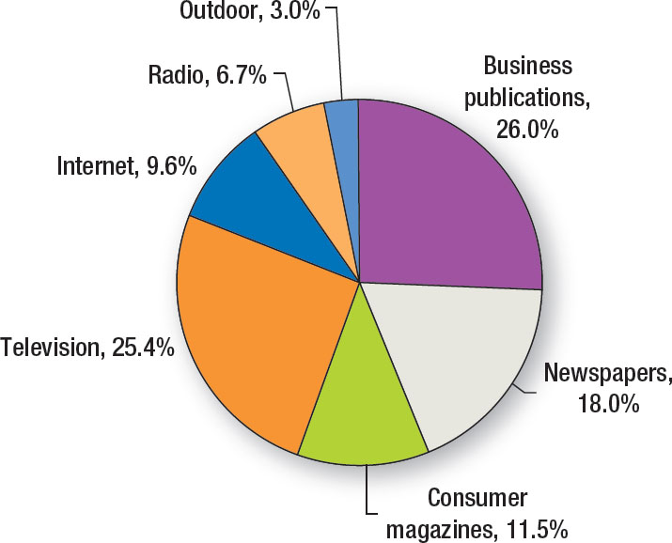
Figure 7.16 Business-to-Business Advertising Expenditures
Source: Based on Kate Maddox, “Top 100 B-to-B Advertisers Increased Spending 3% in ‘06,” B to B, Vol. 92, No. 11 (September 10, 2007), pp. 25-30.
Notes:
Business publications account for 26% of B-to-B advertising expenditures. But, television is now very close, with 25.4%. Notice that consumer magazines account for 11.5%.

Slide 43
International Implications
Media importance varies.
Media viewing habits vary across countries.
Media buying is different.
Cultural mores vary.
Notes:
The importance of different types of media varies widely throughout the world. Media habits of people in other countries are not the same as those in the United States. The media buying process is different. Culture is a major force in these differences.

Slide 44
Blog Exercises
Durcacell
Geico
Media
Notes:
The blog exercises for Chapter 7 include Duracell batteries, Geico insurance, and videos examining traditional media.

Slide 45
Copyright

