Slide 1
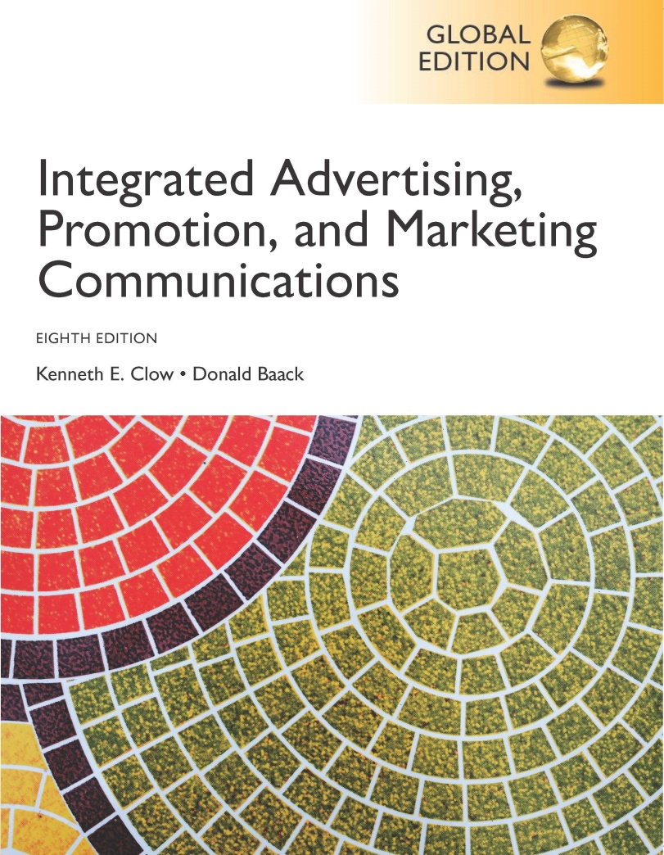
Integrated Advertising, Promotion, and Marketing Communications
Eighth Edition, Global Edition
Chapter 12
Sales Promotions
Copyright © 2018 Pearson Education Ltd. All Rights Reserved
Notes:
This chapter focuses on sales promotions, which include both consumer promotions and trade promotions.

Slide 2
Chapter Objectives
What are the differences between consumer and trade promotions?
How can the various forms of consumer promotions help to pull consumers into the stores and push products onto the store shelves?
How do different types of customers respond to consumer promotions?
What types of trade promotions can help push products onto retailers’ shelves and eventually to end users?
What concerns exist for manufacturers considering trade promotions programs?
What issues complicate international sales promotions programs?
Notes:
These are the objectives for Chapter 12.

Slide 3
Dubai Shopping Festival
35 million visitors
“One Family, One World, One Festival,”
Integrated marketing campaign
Sponsorships and sales promotion tie-ins
Boosts tourism and development
Notes:
Huggies brand is owned by Kimberly-Clark. Through its website, Huggies offers assistance to parents. The Huggies Big Kid Academy provides various tools to assist parents in potty training their children. Huggies engages in a fully integrated marketing campaign with advertising, sponsorships, and promotions. In terms of sales promotions, Huggies uses both consumer and trade promotions. The brand utilizes traditional coupon approaches plus Facebook and social media promotions. The brand also offers contests through a tie-in with Disney.

Slide 4
Chapter Overview
Consumer promotions
Individuals/businesses that use product
Trade promotions
Directed to channel members
Possible erosion of brand equity
Can differentiate a brand
Use varies – product life cycle
Notes:
Consumer promotions are incentives directed to a firm’s customers and can be consumers or businesses that purchase the products for consumption. Trade promotions are directed to channel members to push products through the distribution channel. The primary danger of sales promotions is that they erode brand equity and focus more on price. Sales promotions can be used to differentiate a brand, but firms must be careful about over-reliance on promotions. The use of sales promotions varies with the product life cycle. The greatest emphasis on promotions would come in the maturity stage.

Slide 5
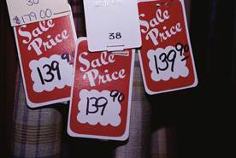
Figure 12.1 Types of Consumer Promotions
Coupons
Premiums
Contests and sweepstakes
Refunds and rebates
Sampling
Bonus packs
Price-offs
Notes:
Enticing a consumer to take the final step and make a purchase constitutes a primary goal for consumer promotions. Advertising often creates the interest and excitement that brings consumers to the store. Promotions can then be used to encourage the actual purchase. This slide lists the major forms of consumer promotions.

Slide 6
Coupons
$500 billion per year
2.8 billion redeemed per year (0.85%)
Average value was $1.94
Savings of $4.9 billion
Coupons used by 72% of households
Notes:
Coupons offer a price reduction to the consumer. It may be a percentage off of the retail price, or absolute amount. Companies issued $500 billion in coupons and 2.8 billion were redeemed, a redemption rate of 0.85%. The average value of coupons was $1.94. That equates to about $5.9 billion in savings. Coupons are used at some level in about 72% of households.

Slide 7
Coupon Distribution
Manufacturers issue about 80%
Free-standing inserts – 90%
Free-standing and print most popular
Consumer makes conscious effort to clip
Create brand awareness
Encourage purchase next trip to store
Digital coupons growing in popularity
Users more affluent, better educated
Notes:
Manufacturers issue about 80% of all coupons. Most coupons are sent through print media with free-standing inserts (FSI) accounting for about 90% of all coupons distributed. The advantage of using FSIs is that consumers must make a conscious effort to clip the coupon. This helps create brand awareness and encourages a purchase on the next trip to the store. Digital (online) coupons are growing in popularity. They are easy to find and print. The users of digital coupons are more affluent and better educated than users of printed coupons. Coupons are also now being sent to cell phones and used on smartphones.

Slide 8
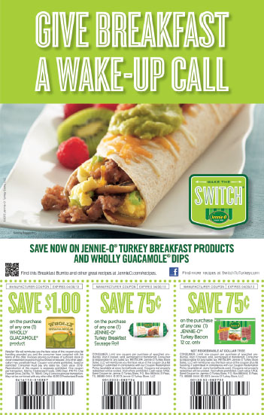
Figure 12.2 Methods of Distributing Coupons
Print media
FSI
Direct mail
On- or in-package
In-store
Scanner-delivered
Digital
Employee delivered
Notes:
Coupons can be delivered in a variety of ways. Free-standing inserts are the most common, with 88% of all coupons being distributed in this way. They can also be distributed through direct mail. They can be placed on packages or inside packages. They can be in the store on shelves, or in bins, or delivered by the scanner at the time of checkout. Coupons can be digital or delivered by employees of an organization.

Slide 9
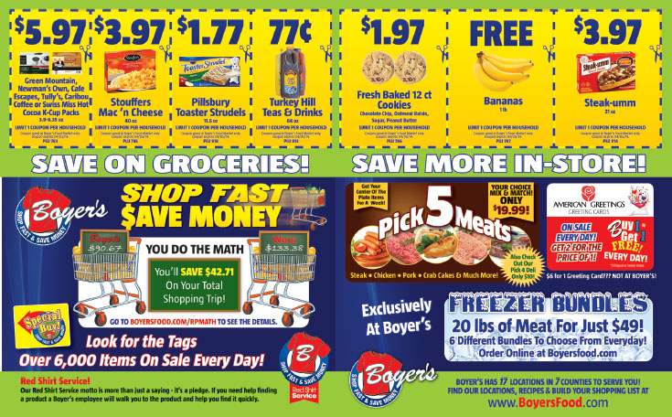
Coupons for brands sold at Boyer’s.
Notes:
This newspaper circular for Boyer’s illustrates coupon issuance for grocery stores.

Slide 10
Types of Coupons
Instant-redemption
Lead to trial purchases
Bounce-back
Encourages repeat purchases
Scanner-delivered
Encourages brand switching
Cross-ruffing
Notes:
Coupons can be divided into four major types. Instant-redemption coupons are typically placed on the outside of a package or attached to a store shelf and can be redeemed immediately. Instant-redemption coupons encourage trial purchases since the discount is immediate. Bounce-back coupons are inside a package and encourage repeat purchases because they cannot be used until the package is opened. Scanner-delivered coupons are triggered by an item purchased. The coupon is either for a competing brand or for another variety or flavor than was purchased. The most common motive for scanner-delivered coupons is to encourage brand switching on the next trip to the store. Cross-ruffing coupons are placed on one item for another item, such as a coupon for dip placed on a bag of potato chips.

Slide 11
Disadvantages of Coupons
Reduced revenues
80% used by brand preference consumers
Necessary evil
Notes:
The big disadvantage of coupons is reduced revenues. Companies are giving customers a reduction in price, which means they earn less money. Also, 80% of coupons are used by brand preference consumers, which means they likely would have purchased that brand anyway. The coupon just offers it to them cheaper. But, most manufacturers say it is one of those necessary evils to stay in business. Customers expect coupons. Competitors use coupons so companies have to use them to keep competitors from taking sales away.

Slide 12
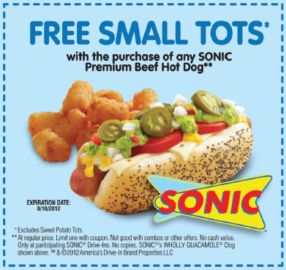
Figure 12.3 Types of Premiums
Free-in-the-mail
In- or on-package
Store or manufacturer
Self-liquidating
Notes:
Premiums are prizes, gifts, or other special offers that consumers receive when purchasing a product. The key to premiums is that consumers pay full price for the product. Four different types of premiums are used. Free-in-the-mail premiums are free to consumers who mail in X number of box tops or labels. In- or on-package premiums are located in the package or on the package and are received upon purchase. Store or manufacturer premiums can vary in how they are delivered. They can be prizes in kid’s meals at a fast food restaurant or a golf bag with the purchase of a new set of clubs. Self-liquidating premiums require a small amount of money with the proof-of-purchase. The amount paid usually covers the cost of the item and may even pay for shipping.

Slide 13
Figure 12.4 Keys to Successful Premium Programs
Match the premium to the target market
Carefully select the premium
Avoid fads, try for exclusivity
Premium reinforces the firm’s product and image
Integrate the premium with other IMC tools
Especially advertising and POP displays
Don’t expect premiums to increase short-term profits
Notes:
Matching the premium to the target market is important. It needs to be something the target market wants. Try for exclusivity and avoid fads. The premium should reinforce the firm’s products and image, not be a distraction. It helps to integrate the premium offer with other IMC tools, such as advertising and POP displays. While premiums can attract customers, don’t expect it to boost short-term profits. In fact, in most cases, companies will lose money on premiums.

Slide 14
Contests and Sweepstakes (1 of 3)
Contests
Require activity, skill
Can require purchase to enter
Some states illegal
Sweepstakes – random chance
Must publish odds of winning
Cannot require purchase
Can enter as many times as desired
Notes:
The terms contests and sweepstakes tend to be used interchangeably, but there is a difference. Contests require some type of activity or skill. They can require a purchase to enter, at least in most states. However, in some states, it is illegal to require a purchase to enter. Sweepstakes rely on random chance. Laws require the odds of winning each prize to be printed in advance and made available at every location where the sweepstakes can be entered. Companies cannot require a purchase to enter, although they can limit people to one entry per visit.

Slide 15
Contests and Sweepstakes (2 of 3)
Perceived Value
Consumers selective
Perceived value important
Extrinsic value – attractiveness of prize
Intrinsic value – fun, skill
Small, incremental rewards
Scratch-and-win tickets
Notes:
People enter contests and sweepstake because they find them interesting. A few will enter because of the prizes. Consumers are selective on which ones they enter. They do not enter every contest or sweepstake they see. Extrinsic value is the attractiveness of the prize. The more attractive, the more likely to enter. Intrinsic value is the fun or skill of playing. This is more important in contests than sweepstakes. Small, incremental rewards given sporadically will encourage people to keep participating. Scratch-and-win tickets are popular because people know instantly if they are winners or losers.

Slide 16
Contests and Sweepstakes (3 of 3)
Internet and Social Media
Popular venue
Increase intrinsic value – interactive games
Data-capturing capabilities
Lower costs
Goals
Encourage traffic
Boost sales – questionable
Intrinsic rewards draw consumers back
Notes:
The Internet and social media have become popular venues for sweepstakes and contests. The Internet allows for interactive games, which increase the intrinsic value of playing. Companies can capture data from individuals who play, which can be analyzed and used to plan marketing programs. The Internet is also cheaper.
The goals of contests and sweepstakes should be to encourage traffic to a website or to a retail location. It is doubtful they will boost sales, but they will create awareness and exposure. Intrinsic rewards usually draw people back, not the extrinsic rewards.

Slide 17
Refunds and Rebates
Refunds – soft goods
Rebates – hard goods
Hassle to redeem
Now expected by consumers
Redemption rates
30% overall
65% for rebates over $50
Notes:
The terms refund and rebate are used interchangeably, but do have different meanings. Refunds are for soft goods, and rebates are for hard goods. People do not like refunds and rebates because typically they are a hassle to redeem and involve waiting 6-8 weeks for the check. For some products, rebates have been used for so long that customers expect them and will hardly make a purchase without one. Automobiles and printers are two products people now expect a rebate and will not make a purchase without some type of rebate. Redemption rates are low, less then 30% overall. But, if the rebate is for more than $50, the redemption rate jumps up to 65%.

Slide 18
Sampling
Delivery of free good or service
Business-to-business samples to prospects
Service sampling
Consumer survey
33% who tried a sample made purchase during shopping trip
58% would buy product again
25% bought sample instead of intended brand
Notes:
Sampling involves delivering a free good or service with the hope the person or business will like the brand and purchase it in the future. Businesses use sampling extensively to encourage prospects to try the brand and compare it to the brand they are currently using. Services can also provide samples, such as a 7-day free membership at a fitness center or free initial consultation with a lawyer or dentist. According to a consumer survey of people who tried a sample, 33% made a purchase of the brand during that shopping trip, 58% would buy it again, and 25% bought the sample instead of the intended brand.

Slide 19
Figure 12.5 Methods of Distributing Samples
In-store distribution
Direct sampling
Response sampling
Cross-ruff sampling
Media sampling
Professional sampling
Selective sampling
Notes:
Samples can be distributed in a variety of ways. They can be given to customers as they shop in a store. They can be sent in the mail or delivered as a result of a request. An example of a cross-ruffing sample would be a dryer sheet in a box of detergent or attached to the detergent box. Media samples are distributed through the media, such as the newspapers. Small items, such as perfume, can be attached inside of a magazine page. Professional sampling would be a drug company delivering samples to doctors, or a vendor supplying samples of raw materials to a manufacturer. Selective sampling normally occurs at special events, such as a rodeo or state fair, where a company may distribute a sample of a drink or candy bar for people to try.

Slide 20
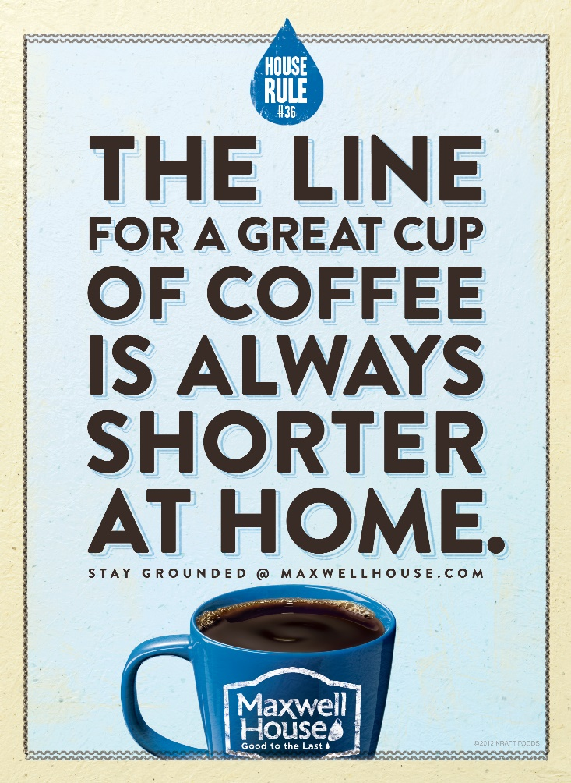
Benefits of Sampling
Introduce new products
Generate interest
Generate leads
Collect information
Internet sampling
Boost sales
Notes:
Sampling is an excellent means of introducing a new product. It can generate interest and leads, especially for B-to-B operations. It can be a way of collecting information, especially for response sampling. Sampling can boost sales through people buying the brand immediately, or on their next trip. Many consumers search the Internet for information, and companies can provide an opportunity for them to request a sample at that time.

Slide 21
Successful Sampling Programs
Central part of IMC plan
Encourage trial purchases
Most effective for
New products
New versions of current products
Current products to new markets
Target right audience at right venue
Mass sampling not cost effective
Notes:
Successful sampling programs are a central part of an IMC plan. It is an excellent means of encouraging trial purchases. It is most effective for new products, new versions of products, and current products to new markets. It is important to target the right audience at the right venue to ensure success. Mass sampling is not cost effective. Firms need to target their sampling programs.

Slide 22
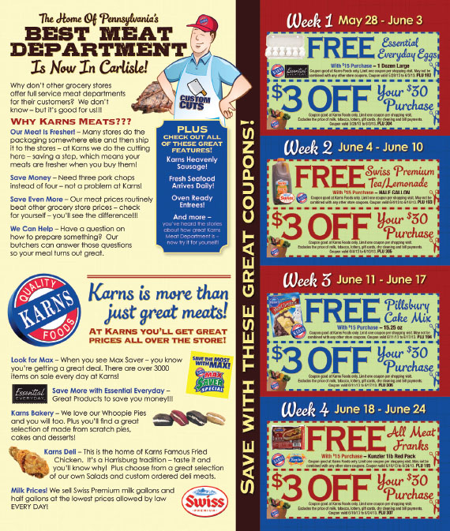
Bonus Packs
Extra product in special package
Typical bonus
20% to100% percent
Most common
30% bonus
Notes:
When an additional or extra number of items are placed in a special package, it is a bonus pack. Typical bonuses range from 20% to 100%, with 30% being the most common.

Slide 23
Figure 12.6 Bonus Pack Objectives
Increase usage of a product
Match or preempt competition
Stockpile the product
Develop customer loyalty
Attract new users
Encourage brand switching
Notes:
Companies use bonus packs for a variety of reasons. Bonus packs are used to increase usage of the product. If consumers have extra potato chips, they are likely to eat more. Bonus packs can be used to match or preempt the competition. Consumers can stockpile the item so an offer by a competitor is no longer attractive. Bonus packs can enhance brand loyalty, especially if consumers feel they are getting a good deal with the bonus pack. They can attract new users, but most likely these are individuals who have tried the brand in the past and have a favorable attitude towards the brand. Bonus packs can also encourage brand switching, but under the same scenario as a new user.

Slide 24
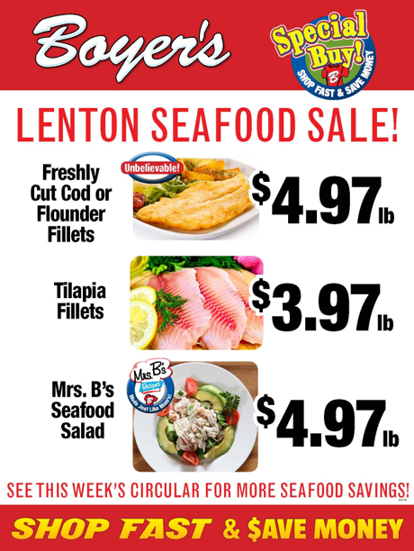
Price-Offs (1 of 2)
Temporary price reduction
Notes:
A price-off is a temporary price reduction. It can be marked on the item or its package, or displayed on the shelf or near the item.

Slide 25
Price-Offs (2 of 2)
Benefits of price-offs
Excellent for stimulating sales
Entices trial purchases
Lower financial risk
Encourages brand switching
Encourages stockpiling
Problems with price-offs
Negative impact on profits
Encourages greater price sensitivity
Potential negative impact on brand image
Notes:
Price-off promotions are the best and quickest method to stimulate sales. A price reduction can also entice consumers to try a product because the financial risk has been reduced. With the lower price, a price-off promotion can encourage brand switching and product stockpiling. The benefit of customers stockpiling is they may consume more of the product. The major disadvantages is that a price-off will reduce profits. It normally takes a 20% to 40% boost in sales to offset just a 5% price reduction. Price-offs encourage greater price sensitivity. Consumers become reluctant to pay full price for the item. Long-term, price-offs can have a negative impact on brand image.

Slide 26
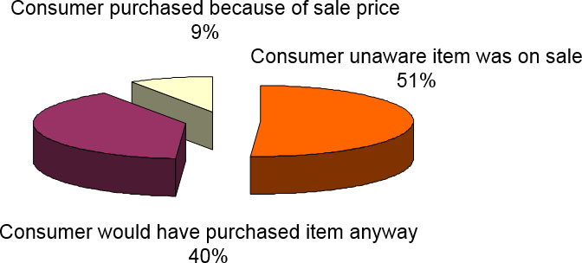
Impact of Price-off on Consumer Purchase
Bonus Slide
Source: “Studies Indicate Coupons are an Effective Promotional Tool,” Santella & Associates, August 2009)
Notes:
(Bonus Slide, not in textbook) It is interesting to look at the impact a price-off has on a purchase decision. Most consumers, 51%, were not aware the item was on sale when they purchased it. Another 40% would have purchased the product anyway. That means only 9% of consumers purchased the item because of the price-off.

Slide 27
Overlays and Tie-Ins
Overlay
2 or more promotions
Intra-company tie-in
Products within a company
Inter-company tie-in
Partnering with another company
Notes:
At times, companies combine two or more consumer promotions into a single campaign, called an overlay. It may involve a promotion for a sweepstake or contest with a coupon attached to encourage purchasing the product. A common overlay involves passing out coupons at the same time consumers are given a sample of the product. Tie-ins are when two or more companies or products are promoted within a single campaign. An intra-company tie-in involves products within one company. Inter-company tie-ins involve two or more companies working together.

Slide 28
Figure 12.8 Types of Consumers - Promotions
Promotion-prone
Brand-loyal
Brand-preferred
Price-sensitive
Notes:
Consumers can be divided into four groups based on their propensity to use promotions. Consumers tend to fall into one of the four groups, but it will also vary by product. Someone who is brand loyal for ketchup may be price-sensitive for coffee. Promotion-prone consumers regularly respond to various consumer promotions and like to purchase products when they are on-deal. Brand-loyal consumers purchase only one particular brand of a product and will not substitute a competing brand regardless of the type of promotion being offered. Brand-preference consumers have a small set of brands for which they have a strong preference. Promotions for one of these select brands will impact which brand is purchased. Price-sensitive consumers purchase whichever brand has the lowest price and use promotions that reduce the price.

Slide 29
Planning Consumer Promotions (1 of 2)
Support brand image and position strategy
Consider target audience
Promotion-prone consumers
Respond to deals
Price-sensitive consumers
Price primary factor in purchases
Deals that reduce price
Notes:
In planning consumer promotions, firms must always support the brand image and position strategy and choose promotions that reinforce the image and position that is desired. It is also important to consider the target audience and the types of promotions they are the most receptive to. In terms of types of consumers, promotion-prone consumers respond to deals and will switch to a brand being offered on-deal. That means a competitor can offer a deal, and the promotion-prone consumer will immediately switch. Price-sensitive consumers don’t care about the brand name. They just want the cheapest product. While promotions will boost sales from these two groups, neither group is loyal and as a result not attractive in the long run.

Slide 30
Planning Consumer Promotions (2 of 2)
Brand-loyal consumers
Purchase only preferred brand
Brand-preference consumers
Small set of preferred brands
Deals for one of preferred brands
Varies by product
Tendency towards one type
Brand-preference consumers best target
Notes:
Brand-loyal consumers will stay with a brand and don’t need a promotion to make a purchase. If they are brand loyal to a competing brand, a promotion is not going to sway them to make a purchase. The best group to pursue is brand-preference consumers. They have a small set of brands they prefer, and deals for one of those brands can modify purchase behavior. They also can be encouraged to become more brand loyal. While consumers tend to be one of the four types, it also varies across product categories. Of the four groups, the brand-preference consumers are the best target.

Slide 31
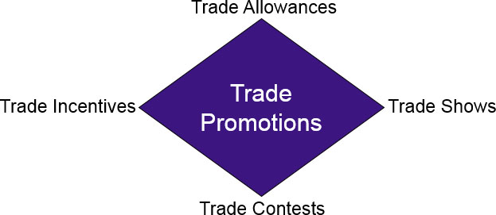
Trade Promotions
For Manufacturers
Account for 70% of marketing budget
Often 2nd largest expense
Account for 17.4% of gross sales
Notes:
Trade promotions are incentives given to channel members to push products through the channel. For manufacturers, trade promotions account for about 70% of the marketing budget. It is the second largest expense after cost-of-goods sold. It now accounts for about 17.4% of the gross sales of a manufacturer. Trade promotions can be classified into four groups: trade allowances, trade incentives, trade contests, and trade shows. Consumers never see trade promotions and most have never heard of them, but they have a huge impact on what brands are placed on retail shelves.

Slide 32
Trade Allowances
Financial incentives to channel members
Off-invoice allowances
Discount
Encourages order by channel members
Account for 35% of all trade dollars
Retailers reluctant to purchase off-deal
Competitive pressure to continue
Notes:
The largest category of trade promotions is trade allowances, which are financial incentives directed to a channel member to stock a particular brand of product. The major type of trade allowance is an off-invoice allowance, which is a discount on the product to encourage channel members to place an order. Off-invoice allowances account for 35% of all trade dollars, by far the largest category of trade promotions. Because off-invoice allowances are used so much, retailers are reluctant to purchase products off-deal. Pressure from competitors who offer deals keeps the cycle going where manufacturers have to keep offering allowances.

Slide 33
Slotting and Exit Fees
Slotting fees
Funds charged by retailers to stock items
Retailer justification
Cost to add new products to inventory
Requires shelf space
Simplifies decision about new products
Adds to bottom line
Manufacturer objections
Form of extortion
Diverts money from advertising and marketing
Detrimental to small manufacturers
Exit fees
Monies paid to remove items from shelves
Notes:
The most controversial form of trade allowance is the slotting fee, which is a fee charged by retailers to stock new products. Retailers have four reasons for charging slotting fees which can amount to millions of dollars. The average cost, in slotting fees, for a manufacturer to launch a new product is $1.5 to $2 million. Retailer justifications are 1) it costs money to add a new product to inventory; 2) it requires shelf space which means other products have to be taken off or less space allocated; 3) it simplifies the decision process since manufacturers will not introduce new products unless they are sure they will sell; and 4) it adds to the bottom line, profit. Manufacturers argue that slotting fees are a form of extortion, divert money they could spend on advertising and marketing, and are detrimental to small manufacturers who can’t afford the fees. A small number of retailers will charge an exit fee instead, which is payment of monies to remove an item if it does not sell and has to be removed from inventory.

Slide 34
Trade Allowance Complications
Failure to pass allowances on to retail customers
Only occurs 52% of the time
Retailers like only one brand on-deal at a time
Retailers can schedule and promote on-deal brands
Forward buying
Pass savings on or pocket higher margin
Additional carrying costs
Diversion
Pass savings on or pocket higher margin
Additional shipping costs
Notes:
A major problem with trade allowances is that retailers do not always pass along the savings to customers. That only occurs 52% of the time. Retailers like one brand to be on-deal all of the time so price-sensitive customers will always have one brand to purchase. Trade allowances permit retailers to schedule promotions and promote deals to their customers. Another problem is forward buying, which involves retailers purchasing additional merchandise when it is on-deal to sell later when it is off-deal. This allows them to earn extra money. The disadvantage is the carrying costs of the extra inventory. Another problem is diversion, which is buying a product on-deal in one part of the country and shipping it to another part of the country where it is off-deal. This does not occur nearly as often as forward buying because of the cost of shipping.

Slide 35
Trade Contests
Used to achieve sales targets
Funds known as “spiff money”
Rewards can be prizes or cash
Can be designed for various channels
Some organizations do not allow trade contests because of a possible conflict of interest
Notes:
For industries that use sales people, trade contests can be used to spur sales. Funds used in trade contests are known as “spiff money.” Rewards for winning can be cash, but prizes seem to work better. Trade contests can be designed for various channels, or for various companies within one channel. While it can be an incentive for salespeople to push a brand, some organizations do not allow trade contests because they see them as a conflict of interest. Salespeople may not do what is best for customers, or for the company.

Slide 36
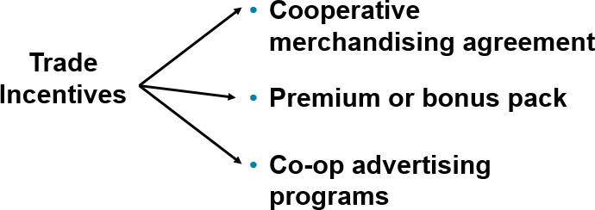
Figure 12.12 Trade Incentives
Channel members must perform some marketing function to receive funds.
Notes:
For trade incentives the channel member must perform some type of marketing function to receive the funds. Most trade incentives are with retailers. The three types are cooperative merchandising agreements, premium or bonus packs, and cooperative advertising programs.

Slide 37
Trade Incentives
Cooperative merchandising agreement
Formal agreement
Popular with manufacturers
Retailer must perform marketing functions
Manufacturer maintains control
Longer-term commitments
Benefit retailers
Schedule calendar promotions
Premiums and bonus packs
Free merchandise for orders
Notes:
A cooperative merchandising agreement is a formal agreement between a manufacturer and a channel member (normally a retailer) that specifies the marketing functions the channel member will perform in exchange for the financial incentive. They are popular with manufacturers because the retailer must perform some marketing functions, manufacturers have control, and it is a long-term commitment. Retailers like them because they can schedule calendar promotions to ensure one brand is always on sale. The problem is that retailers want the price allowance – just give us the discount, we don’t want to perform any marketing functions! Another trade incentive is the premium or bonus pack, which is free additional merchandise with an order. For example, for every 100 cases ordered another 5 are given free.

Slide 38
Cooperative Advertising
Manufacturer pays part of retailer’s ad costs
Retailer must follow specific guidelines
No competing brands
Retailers accrue monies
Amount is based on sales
Allows retailers to expand advertising
Manufacturers gain exposure in local markets
Notes:
The most used and well-known trade incentive is cooperative advertising. Manufacturers pay a part of the cost of retail advertisements in exchange for promoting the manufacturer’s brand. To earn the co-op dollars, the retailer must meet the manufacturer’s guidelines. Also, no competing brands can be in the ad. Retailers accrue co-op dollars based on sales. Co-op advertising allows retailers to expand their advertising budget since the manufacturer will pick up 50% to 80% of the costs. Manufacturers like co-op ads because their brand is being promoted in local markets by retail stores.

Slide 39
Trade Shows
Business-to-Business
Manufacturers (sellers)
Display merchandise
Seek prospects
Retailers (buyers)
Compare merchandise
Seek vendors
Few deals finalized at trade shows
International attendees want to make deals
Increase in international trade shows
Regional and niche shows
Provide better prospects
Lower costs
Notes:
Trade shows are used extensively in business-to-business marketing programs. It allows sellers to display merchandise and to seek prospects. It allows buyers to compare merchandise of various manufacturers and to see vendors for their stores. Few deals are ever finalized at trade shows. It is more of an opportunity to meet, look, and learn. International attendees, however, want to make deals so American companies must be aware of this difference. The number of international trade shows has increased as global competition has increased. There has also been a movement away from really large national shows to smaller regional and niche shows. Such shows make it easier for companies to locate good prospects, and the costs are much lower.

Slide 40
Figure 12.13 Categories of Buyers at Trade Shows
Education seekers
Reinforcement seekers
Solution seekers
Buying teams
Power buyers
Notes:
Buyers at trade shows can be divided into five categories. Education seekers want to browse, look, and learn but are not interested in buying. Reinforcement seekers want reassurance they made the right decision in past purchases. Solution seekers seek solutions to specific problems and are in the buying mode if they find the right solution. Buying teams seek vendors for their businesses and are usually ready to talk sales. Power buyers are upper management or key purchasing agents with the authority to buy. By differentiating the type of buyer, companies can concentrate on those most likely to buy at the trade show, or immediately following the trade show.

Slide 41
Trade Promotion Concerns
Corporate reward structure
Used for short-term sales goals
Tend to be used outside of IMC Plan
Costs
Over-reliance to push merchandise
Difficult to reduce – competitive pressures
Potential erosion of brand image
Notes:
Trade promotions are problems! Often corporate reward structures push sales, and an easy way to stimulate sales is some type of consumer or trade promotion. Trade promotions often are not part of the IMC plan. While trade promotions can boost sales, it often results in higher costs and lower profits. Trade promotions encourage an over-reliance on promotions to push merchandise with channel members and with consumers. It then becomes difficult to reduce their usage because competitors are using promotions to keep up with each other. The end result is a potential erosion of brand image.

Slide 42
International Implications
Adapt to each country
Legal restrictions vary
Cultural values differ
Emphasis will vary
Notes:
Sales promotions can be a challenge internationally. Legal restrictions and culture can impact which promotions can be used and should be used. Emphasis will vary. Each promotion has to be adapted to what is best in that country.

Slide 43
Blog Exercises
Papa John’s
Brookshire’s
Consumer Promotions
Notes:
The blog exercises for Chapter 12 include Papa John’s, Brookshire’s, and consumer promotions.

Slide 44
Copyright

