Slide 1
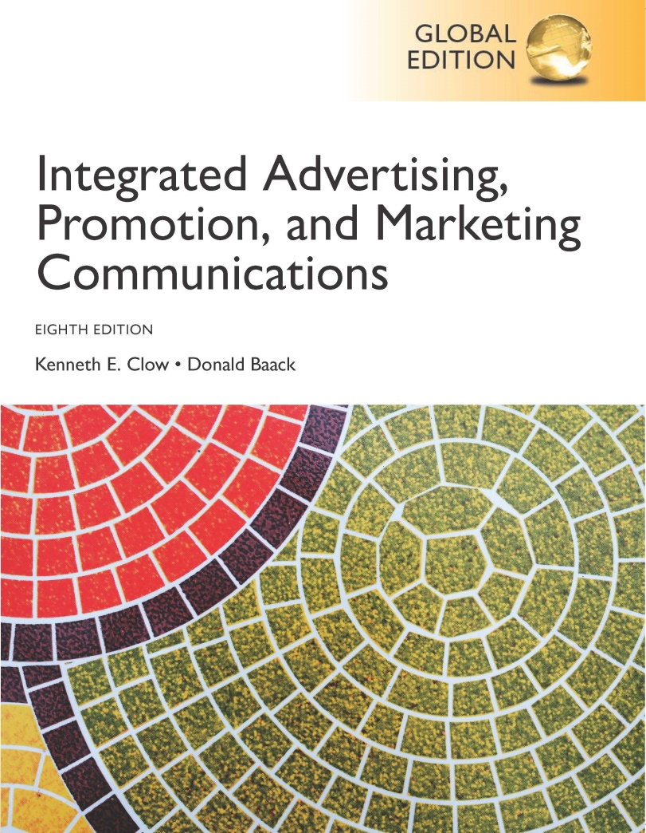
Integrated Advertising, Promotion, and Marketing Communications
Eighth Edition, Global Edition
Chapter 14
Regulations and Ethical Concerns
Copyright © 2018 Pearson Education Ltd. All Rights Reserved
Notes:
The field of marketing and advertising have long been the subject of scrutiny from the public, special interest groups, and the government. This chapter examines legal regulations and ethical concerns that have been raised about marketing.

Slide 2
Chapter Objectives (1 of 2)
Which agencies and laws regulate marketing communications?
What are the relationships between puffery, deception, and substantiation?
What legal remedies can be used to correct deceptive communications practices?
How do the three major industry regulatory agencies help keep advertising and business practices from injuring customers or other businesses?
Notes:
These are the objectives for Chapter 14.

Slide 3
Chapter Objectives (2 of 2)
What ethical criticisms have been registered against advertising and marketing practices?
Which marketing tactics raise ethical concerns?
How can marketers apply the various ethical frameworks and ethics programs to their activities and actions?
What international issues influence the discussions of legal and ethical marketing activities?
Notes:
Additional objectives for Chapter 14.

Slide 4
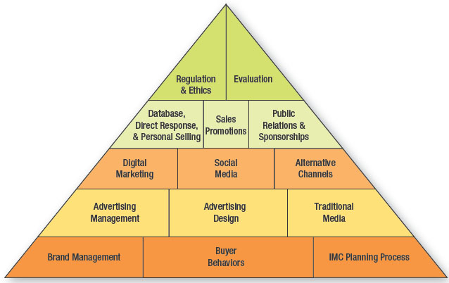
Figure 14.1 Overview of Integrated Marketing Communications
Notes:
The last section of the text covers regulations and ethical issues in marketing communications (Chapter 14) and an evaluation of marketing communications (Chapter 15)

Slide 5
Reebok Pays $25 Million Settlement
Easy Tone and Run Tone products
Sold more than 10 million pairs
Made specific claims
FTC investigation
Ruled claims were unsupported
Reebok disagreed with FTC
Skechers - $41 million settlement
Notes:
Reebok’s Easy Tone and Run Tone shoes are popular with 10 million pair sold worldwide and 5 million in the United States. Reebok made claims that the shoes would tone a person’s hamstrings, calves, and butt. FTC investigated the claims and fined Reebok $25 million. According to the FTC, Reebok’s claims were not sufficiently supported. Reebok complied with the FTC ruling, but disagreed with the decision. Reebok believed the claims were sufficiently supported. Skechers agreed to pay $41 million after the FTC felt similar claims were not supported.

Slide 6
Chapter Overview
Legal environment
Regulations
Industry oversight
Ethics and advertising
Ethics and marketing
Responding to ethical challenges
Notes:
The chapter first presents material about the legal environment governing marketing followed by industry oversight. Ethics and advertising and ethics and marketing are discussed as well as how marketers are responding to ethical challenges.

Slide 7
Figure 14.2 Governmental Regulatory Agencies
Food & Drug Administration (FDA)
Federal Communications Commission (FCC)
U.S. Postal Service (USPS)
Bureau of Alcohol, Tobacco, and Firearms (ATF)
Federal Trade Commission (FTC)
Notes:
The Food & Drug Administration (FDA) regulates and oversees the packaging and labeling of products. It also oversees advertising on food packages and the advertising of drugs. The Federal Communications Commission (FCC) regulates the television, radio, and telephone industries and grants operating licenses for radio and television stations. The FCC does not have jurisdiction over the content of advertising, but does oversee the amount of advertising directed towards children. Currently, TV stations are limited to 12 minutes per hour during weekdays and 10 minutes per hour on weekends. The U.S. Postal Service (USPS) has jurisdiction over all mailed marketing materials and investigates cases of mail fraud. The Bureau of Alcohol, Tobacco, and Firearms (ATF) oversees the sale, distribution, and advertising of alcohol, tobacco, and firearms. The Federal Trade Commission (FTC) is the primary agency that oversees marketing and advertising.

Slide 8
Federal Trade Commission (FTC)
Created in 1914 by passage of Federal Trade Commission Act
Presides over marketing communications
Originally – enforced antitrust laws
Given power to
Stop unfair and deceptive advertising practices
Levy fines
Granted FTC access to courts
Notes:
The FTC was created in 1914 by the passage of the Federal Trade Commission Act. It oversees all marketing communications materials. The original intent of the FTC was to enforce antitrust laws. Then in 1938 the Wheeler-Lea Amendment was passed expanding the power of the FTC to stop unfair and deceptive advertising practices and to levy fines. The FTC was also granted access to the courts to enforce the agency’s decisions.

Slide 9
Unfair and Deceptive Marketing Practices
1938 Wheeler-Lea Amendment
FTC authority to investigate
FTC to stop unfair and deceptive practices
FTC power to levy fines
An advertisement or communication is deceptive or misleading if:
A substantial number of people or a typical person is left with false impression or misrepresentation
The misrepresentation induces people or the typical person to make a purchase
Notes:
The 1938 Wheeler-Lea Amendment gave the FTC three powers: 1) to investigate cases of unfair and deceptive advertising, 2) to stop unfair and deceptive marketing practices, and 3) to levy fines. An advertisement is deemed to be deceptive or misleading when it meets these two tests: a substantial number of people or a typical person is left with a false impression or misrepresentation of the product, and that false impression induces people or the typical person to make a purchase. Companies can be charged with unfair and deceptive advertising even if they did not intend to mislead. In other words, intent is not a factor in the decision.

Slide 10
Deception versus Puffery
Puffery
An exaggerated statement
Not factual statement
Claim is a factual statement
Puffery statements include
Best, greatest, and finest
Better – puffery or claim?
Papa John’s – “Better ingredients, better pizza”
Progresso – “Discover the better taste of Progresso”
Notes:
It is important to understand the difference between puffery and deception. Puffery is an exaggerated claim about your product and is not intended to be a factual statement. The FTC understands companies brag about the greatness of their products and have the right to do so. A claim is a factual statement about a product and must be substantiated. Puffery includes the words best, greatest, and finest. These are okay. In the past, the word better was considered puffery. The word has recently come under court and FTC investigations because it implies a comparison and that one brand performs better than another. As such, the FTC says you have to be able to prove that it does, which then makes better a claim rather than puffery.

Slide 11
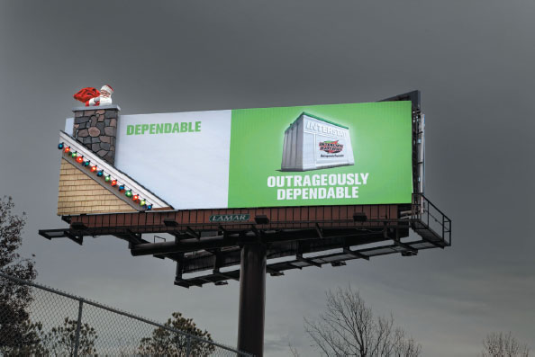
Ads Using Puffery
Notes:
Both of these ads use puffery. Interstate states its batteries are “outrageously dependable” and Karns states its meat department is the “best.”

Slide 12
Substantiation of Claims (1 of 2)
Claim or promise must be substantiated
Endorser must be truthful
Must represent endorser’s personal experience or opinion
Expert endorsement must be based on legitimate tests
Notes:
Claims or promises in advertising must be substantiated. If an endorser is used, then the endorser must be truthful. It must represent his/her personal experience and personal opinion. Any expert endorsement that is used must be based on legitimate tests that would be accepted by anyone in that industry.

Slide 13
Substantiation of Claims (2 of 2)
Willie Robertson Duck Dynasty
Claim or promise must be substantiated
Endorser must be truthful
Must represent endorser’s personal experience or opinion
Expert endorsement must be based on legitimate tests
Notes:
The statement made in this advertisement by Willie Robertson must meet the two tests of substantiation – must be truthful and his personal experience.

Slide 14
Principles Substantiation of Claims
Consumers read ads broadly
Evidence must be for actual product
Evidence from accepted experts
FTC and courts will consider totality of evidence
Notes:
When looking at the substantiation of claims, the FTC utilizes four principles to decide if an ad has been adequately substantiated. First, the FTC assumes consumers read ads broadly and do not pay much attention to small print and qualifying language. So, hiding a disclaimer or qualifying statement in small print is not acceptable. Second, the evidence must be for the actual product and if a comparison is used, for the actual comparison product. It cannot be for a product that is similar. Third, any evidence from experts must be from individuals that are considered experts in their chosen industry. Fourth, the FTC and courts will consider all of the evidence available. If a company has one study that shows it is superior in some way, but four other studies show it is not, the FTC would accept the other studies as greater evidence.

Slide 15
How Investigation Begins
Complaints can be lodged by any of the following
Consumers
Businesses
Congress
Media
Notes:
Complaints for unfair and deceptive marketing or advertising can be lodged by anyone−consumers, businesses, Congress, or the media. Businesses are a major source of filings with the FTC because they want to protect their brand, so statements made by competitors, even if they are not comparative ads, will often be challenged.

Slide 16
FTC Process (1 of 4)
Consent order
Company agrees to stop
Does not admit guilt
Notes:
When the FTC feels an ad is deceptive or misleading, it will first issue a consent order. With a consent order, the company agrees to stop the ad or marketing practice, but does not admit guilt. Most companies follow a consent order issued by the FTC.

Slide 17
FTC Process (2 of 4)
Consent order
Administrative complaint
Filed if no consent order agreement
Formal proceeding
Administrative judge
Both sides submit evidence
Cease and desist order
Full commission
U.S. Court of Appeals
U.S. Supreme Court
Notes:
Most companies follow a consent order issued by the FTC. But, if the company feels the consent order is wrong and wants to appeal the decision or the company does not abide by the consent order and continues the marketing practice, the next step is an administrative complaint. The administrative complaint is before an administrative judge and is handled just like a court proceeding. Both sides can present evidence and argue their case. If the FTC feels the marketing practice is unfair or deceptive after the administrative hearing, then it will issue a cease and desist order, which means the company must stop. It no longer matters if they agree or not. If the company appeals the case, the next level would be before the full FTC commission. From there it would go the U.S. Court of Appeals and then to the U.S. Supreme Court. Most cases stop with a consent order, a few will go to the cease and desist order, very few every get appealed any further.

Slide 18
Figure 14.3 FTC Investigation Process
Investigation
Consent order or FTC settlement
Administrative complaint
Cease and desist order
Full commission hearing
U.S. Court of Appeals
U.S. Supreme Court
Notes:
The 1st step in the process is an investigation by the FTC. If the FTC feels a violation has occurred, it will result wit either a consent order or FTC settlement. If the company does not agree or wishes to appeal, it goes to an administrative complaint. In this step it is very much like a courtroom with attorneys. If the FTC concludes a violation has occurred, they will issue a cease and desist order to stop the practice. The next step in the process is a hearing before the full commission. Appeals at that point would go to the U.S. Court of Appeals then to the U.S. Supreme Court.

Slide 19
FTC Process (3 of 4)
Courts and legal channels
Court system to stop unfair and deceptive practices
Company violates a cease and desist order
Actions of company so severe immediate action is needed
Other legal entities – state/federal attorney generals
Corrective advertising
Used rarely
Used when discontinuing false ads is not enough
Notes:
The FTC was given power to use the legal and court system whenever it was deemed necessary. The two most common situations where the FTC uses a court is when a company violates a cease and desist order or when the actions of a company are so severe that the FTC wants to stop the company from operating immediately. The FTC will also solicit the support and cooperation of state and federal attorney generals. The FTC has the power to require corrective advertising, which means the company must run a series of ads to correct the false and deceptive advertising and bring people back to the neutral state before the deceptive advertising. Since this is very difficult to do, corrective advertising is seldom ordered. But, if it is, companies are usually required to spend the same amount of money on the corrective advertising as they did on the deceptive advertising.

Slide 20
FTC Process (4 of 4)
Trade regulation rulings
Applies to entire industry
Holds public hearing
Accepts both oral and written arguments
FTC ruling about bloggers
Notes:
The FTC will also issue trade regulation rulings, which apply to all firms within an industry. Normally, before issuing the rulings, the FTC will hold public hearings and hear both oral and written arguments. Recently, the FTC issued a trade regulation that bloggers who are compensated by a company must clearly state such on their blog or website.

Slide 21
Industry Oversight of Marketing
Council of Better Business Bureau
Bureau keeps record of complaints
Provides summary report on companies
Agencies of the CBBB
National Advertising Division (NAD)
National Advertising Review Board (NARB)
Children’s Advertising Review Unit (CARU)
Notes:
The FTC cannot handle all complaints, so the advertising industry has developed an industry system for overseeing advertising and marketing practices. The industry oversight process is voluntary. Companies do not have to abide by any decision that is made, but most companies will because if it is turned over to the FTC or courts, the case is more difficult to win since the industry has already stated its opinion. The Council of Better Business Bureau will keep a record of complaints against companies. If a consumer requests information about a company, then the CBBB will issue a summary report about the company. It does not release the content of every complaint. To investigate complaints about advertising, the CBBB has three agencies – the NAD, the NARB, and the CARU.

Slide 22
National Advertising Division (NAD)
Receives complaints
Role is to investigate validity of complaint
Collects information and evaluates
If guilty, requests discontinuation of ad
No legal authority
95% of companies abide by ruling
225-250 cases a year
Rulings
Ad not fully substantiated – 50% to 60%
Ad fully substantiated - less than 5%
Notes:
The NAD receives complaints about advertising and marketing practices. The agency’s role is to investigate the validity of the complaint and to collect information to determine if the complaint is valid and if claims made in the marketing practice or advertisement are substantiated. If after evaluating the evidence the NAD feels the ad or marketing practice is deceptive or claims have not been substantiated sufficiently, the agency requests the company to stop the ad or marketing practice. The NAD has no legal authority, but 95% of companies abide by the ruling. The NAD hears about 225-250 cases a year. In 50% to 60% of the cases, the NAD rules the ads are not sufficiently substantiated and must be discontinued. Only in about 5% of the cases does the NAD say the ad is okay.

Slide 23
National Advertising Review Board (NARB)
Appeal from NAD or not resolved by NAD
Advertising professionals and civic leaders
Order similar to consent order of FTC
Appeals or refusals to accept go to FTC
Business-to-business disputes common
Only 4 referrals to FTC in last 25 years
Notes:
The National Advertising Review Board (NARB) hears cases that are appealed from the NAD or cannot be resolved by the NAD. The NARB is made up of advertising professionals and civic leaders. If the NARB issues an order, it is very similar to the consent order of the FTC. The company agrees to stop the ad or marketing practice but does not admit guilt. The NARB ruling is not legal, just like the NAD. Any appeals or refusals to accept the decision of the NARB are referred to the FTC. In the last 25 years, only four cases have been referred to the FTC. The most common disputes heard by the NARB are complaints from one business about the marketing and advertising of a competitor.

Slide 24
Children’s Advertising Review Unit (CARU)
Cases involving children 12 and under
Online privacy practices of websites
Operates similar to the NAD
Prescreens ads directed to children
Examines 300 ads per year
Children under 12 do not have reasoning power
Notes:
The CARU is a special agency of the CBBB for handling issues in marketing and advertising that deal with children ages 12 and under. The CARU is especially involved in monitoring privacy practices on websites that children visit. The CARU operates in a similar way as the NAD. But, in addition to hearing cases involving advertising and marketing to children, the CARU will prescreen ads directed to children. The company examines about 300 ads per year and provides advice to companies on the appropriateness of the ads. The CARU operates under the basis that children 12 and under do not have the reasoning powers of adults, and as a result advertisers need to act responsibly. What adults would quickly see as puffery and not real, children may not.

Slide 25
Figure 14.5 CARU Guidelines for Advertising to Children
Ads for toys should not create unreasonable expectation. Toys should look and act as they would if a child was playing with it.
Ads should not blur between fantasy and reality.
Ads should have clear and visible disclosures about what items come with a toy and what items do not.
Items that require adult supervision must be shown with adults supervising the child.
Products and ad content should be appropriate for children.
Notes:
The CARU has issued some guidelines for advertising to children. These guidelines are based on the concept that children cannot reason as well as adults, so advertisers need to be careful about what they say. It is easy to blur fantasy and reality in an ad, but a child normally cannot see the distinction.

Slide 26
Figure 14.6 Advantages of Industry Regulations
Lower cost
Faster resolution
Heard by attorneys and business professionals with experience in advertising
Notes:
Industry regulations and oversight offer a number of advantages over using the FTC and legal channels. The cost is much lower. Resolution is faster. Cases are heard by attorneys and business professionals with experience in the advertising industry, not judges.

Slide 27
IMC and Ethics
Morals – beliefs or principles that individuals hold about what is right and wrong
Ethics – moral principles that serve as guidelines for individuals and organizations
Notes:
Advertising or marketing practices may be deemed legal, but are they ethical? Morals are beliefs or principles that individuals hold about what is right and wrong. Ethics are moral principles that serve as guidelines for individuals and organizations. Marketing and advertising practices are affected by ethical and moral concerns.

Slide 28
Figure 14.7 Concerns and Criticisms of Advertising
Causes people to buy more than they can afford
Overemphasizes materialism
Increases the costs of goods and services
Perpetuates stereotypes
Makes unsafe products, such as alcohol and tobacco, seem attractive
Is often offensive
Advertising to children is unethical
Notes:
This slide summarizes some of the criticisms against marketing and advertising. While each may be a valid point, marketers tend to argue that people have the freedom of choice, and marketers are not forcing anyone to make a purchase.

Slide 29
Ethics and Advertising (1 of 4)
Consumers buy more than they can afford
Overemphasis on material goods
Advertising does stress buying products
People still have freedom of choice
Increases the costs of products
Makes people aware of goods and services
Widens the base of potential customers
Increases repeat purchases
Additional sales leads to economies of scale
Notes:
Some critics say advertising causes people to purchase more than they can afford and as a result end up deep in debt. They also argue that advertising puts too much emphasis on material goods and that it creates a feeling that material possessions can bring happiness. Marketers’ response is “yes, marketing does stress buying goods and service. That is what it is all about. But, consumers still have the freedom of choice. No one is being forced into making a purchase.” A related argument against marketing is that it increases the costs of products. Yes, it does. Marketers will admit to that fact. But, through advertising, people become aware of goods and services and what they can provide. Without advertising, consumers may not have access to this information. Advertising widens the base of potential customers and increases the probability of repeat purchases. These additional sales leads to economies of scales in production, which allows the price of the product to be lowered. So, in a way, marketing and advertising assist in lowering the price of products, not increasing the costs.

Slide 30
Ethics and Advertising Perpetuates Stereotypes
Stereotypes
men, women, and minorities
Is segmentation the same?
Era of political correctness
Unethical, bad business or reality?
Notes:
Critics have argued that advertising perpetuates the stereotyping of men, women, and minorities. The question that has to be asked is does segmenting a market based on gender, age, ethnicity, or other demographic variables create stereotyping. In this era of political correctness, it is a difficult issue. The prime reason for segmentation is to reach a smaller demographic audience that possesses similar traits, interests, opinions, and lifestyles. Is this practice unethical, is it bad business, or is it reality?

Slide 31
Ethics and Advertising (2 of 4)
Advertising unsafe products
Alcohol, tobacco, and other potentially harmful products
By 18, teens have seen 100,000 beer ads
Use of sexuality and social acceptance
After banning tobacco, switch to sponsorships
Offensive advertisements
Feminine hygiene, condoms, other personal products
International arena
Use of nudity and sexuality in ads
Freedom of speech
Ethics, morals, and conscience should guide
Notes:
Another criticism of advertising is that it promotes the use of potentially harmful products, such as alcohol and tobacco. Experts estimate by the time individuals are 18 years of age, they have seen 100,000 beer commercials. Many of these ads use sexuality and social acceptance to make tobacco and alcohol attractive products. This was one reason legislation was passed to ban tobacco advertising. But, to bypass this regulation, tobacco companies turned to sponsorships, where the tobacco company’s name is mentioned frequently. Many do not like the advertising of feminine hygiene products, sexually related products, and other personal products. In the international arena, advertising of these products is often prohibited or carefully regulated. Some of these ads use nudity and sexual themes. Some are embarrassing, others promote sex. Marketers argue that companies have a right to advertise just like anyone else, based on freedom of speech.

Slide 32
Ethics and Advertising Advertising to Children
Children represent tremendous buying power
Critics question tactics
“No one ad is bad, but 400 a day are.” – Mary Pipher
Marketers – best to get children when young
Is it ethical to advertise to children?
Notes:
Advertising to children is one of the hottest topics when it comes to ethics. Children represent a huge market in terms of personal buying power, but also in the family purchases they influence. Critics not only find fault with advertising to children, but the tactics being used, since children do not have the ability to reason like adults. According to Mary Pipher, “No one ad is bad, but 400 a day are.” An important reason companies pursue children is that if they can get their brand name in children’s minds, it may be possible to build brand loyalty that will last a lifetime.

Slide 33
Figure 14.8 Ethical Issues in Marketing
Brand infringement
Professional services marketing
Gifts and bribery
Spam and cookies
Ambush marketing
Stealth marketing
Notes:
Ethical dilemmas are present in places other than advertising. This slide mentions a few other concerns people have with marketing.

Slide 34
Ethics and Advertising (3 of 4)
Brand Infringement
Similar names
Brand name becomes generic
Domain squatting
Marketing of professional services
Medical and legal professions
Freedom to advertise services
Pharmaceutical companies
Notes:
Brand infringement involves using a brand name that is already being used or a brand name that is very close to another brand name with the intent of capturing sales from its popularity. Another problem comes when a brand name becomes generic, such as Xerox and band aids. With the Internet, has come domain squatting, which involves purchasing URLs related to companies or famous people with the intent of selling them to the person or company for a huge price. Another issue revolves around the marketing of professional services. In the past, it was considered taboo and unethical. Now both medical and legal professionals advertise on a regular bases. The rationale for advertising is freedom of speech, and competition has forced them to advertise to compete effectively. Others argue it is unethical because they are taking advantage of people’s problems. Advertising by pharmaceutical companies has raised debates about whether it has increased the use of drugs (legal) in America and driven doctors to prescribe medicines when it was not really in the best interest of the patient.

Slide 35
Ethics and Advertising (4 of 4)
Gifts and bribery
Business-to-business sales
Trade shows
Influence sales
Bribes part of culture in some countries
Spam and cookies
Technology allows for collecting pertinent information
Invasion of privacy
Allows for website personalization
95% of consumers want a company to know them
Legal issues
Moral issues
Notes:
Gifts and bribes are used in business-to-business sales to influence purchasing decisions. At trade shows, companies will often entertain clients and prospects. In some countries, bribes are legal and allowed to be deducted as a tax expense. In others, it is the accepted way of doing business. But, in the U.S. it is illegal. Some companies have policies that prevent their purchasing agents from accepting any type of gifts, even an ink pen. Technology allows companies to collect information from people. Many view this as an invasion of privacy since people have not granted permission. But, marketers argue the information is just being used to improve marketing reach and to facilitate the personalization of websites, which 95% of consumers want. Spam and cookies present some legal issues and certainly some ethical issues that are still being debated.

Slide 36
Ethics and Advertising Ambush Marketing (1 of 2)
Rise in sponsorship dollars being spent
Brand associated with an event when not a sponsor
Official sponsorships often costs millions
Look for ways to capitalize without paying sponsor fee
Olympics
Ethical considerations or wise advertising?
Notes:
The rise in sponsorship costs and expenditures has created a new problem – ambush marketing, which is a brand’s association with an event when the brand has not paid the rights to be an official sponsor. Official sponsorships can cost millions, such as with the Olympics. So companies look for ways to capitalize on the event without paying the high costs of a sponsorship. It certainly is an ethical issue, but some would say it is just wise marketing.

Slide 37
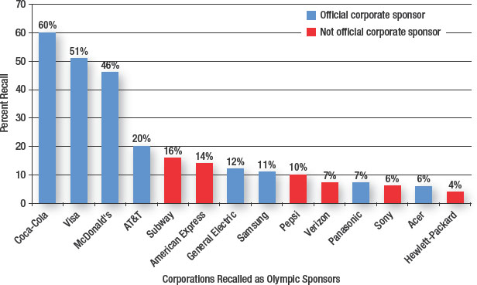
Figure 14.9 Recall of Official and Nonofficial Olympic Sponsors
Source: Adapted from Aaron Baar, “Olympics Sponsors Benefit, As Do Competitors,” Marketing Daily, http://www.mediapost.com/publications/article/122665/olympics-sponsors-benefit-as-do-competitors.html?edition=, February 17, 2010.
Notes:
This slide shows the potential impact of ambush marketing. The cost to be an official sponsor of the Winter Olympics was $40 million. A survey was conducted where people were asked to identify the official sponsors of the Olympics. The blue bars are the official sponsors, the red bars are companies that were not sponsors. The top three identified, Coca-Cola, VISA, and McDonald’s, were all official sponsors. But Subway, which was not an official sponsor, was identified by 16% of the sample as a sponsor. Other companies that were incorrectly identified as sponsors include American Express, Pepsi, Verizon, Sony, and HP.

Slide 38
Ethics and Advertising Ambush Marketing (2 of 2)
Direct ambush marketing
Firm intentionally capitalizes on event
Indirect ambush marketing
Firm suggests it is associated with event
Allusion ambushing
Distractive ambushing
Saturation ambushing
Incidental ambush marketing
No intention, indirect effect
Notes:
Direct ambush marketing occurs when firms intentionally design ads or marketing campaigns to capitalize on a major sporting event to appear to be official sponsors when they are not. Indirect ambush marketing occurs when a firm suggests or hints it is associated with a sporting event when it is not. Allusion ambushing creates an impression that the company is a sponsor, when it is not. Distractive ambushing is when a company designs a promotion or event near the official sporting event to garner attention of fans attending the event. Saturation ambushing occurs when a firm increases its advertising and marketing exposure during a major event by purchasing spot time or using other means of acquiring additional advertising time or space. Incidental ambush marketing occurs when a brand is associated with an official event without any intentional or indirect effort on their part. It just happened.

Slide 39
Ethics and Advertising Stealth Marketing
Entices consumers to look at a product
Does not identify being a sponsor
Shrewd marketing or Unethical deception
Notes:
A recent and controversial marketing approach is stealth marketing, which is an attempt to get consumers to look at a product through a personal contact without them every realizing it was a sales pitch. The person making the sales or product pitch never identifies himself/herself as a sponsor of the brand or the motivation for demonstrating or discussing the product. Some argue this is just a shrewd marketing approach that is designed to get around clutter and is perfectly ethical. Others argue it is unethical and deceptive, since the sponsor or brand ambassador never identifies his/her personal ties with the company.

Slide 40
Responding to Ethical Challenges
Hedonism
Maximizes pleasure, minimizes pain
Homeostasis
Natural craving for balance
Law
Dictates right and wrong
Religion
Provides a philosophy for living
Golden rule
Common sense
Logic and reasoning
Gut instinct
Notes:
Hedonism is the philosophy of life that maximizes pleasure and minimizes pain. Homeostasis is the natural craving for a balance in life. Laws are passed to provide guidelines on what society says is right and wrong behaviors. Religion also offers guidance in terms of ethical behaviors. Religion offers a philosophy of living. Many religions teach the concept of the golden rule – treat others as you would want to be treated. Then there is common sense, which relies on logic and reasoning. Some call this a person’s gut instinct about what is right and wrong. The difficulty is that there are many situations that are gray, not clearly right or wrong.

Slide 41
Ethics Programs
Ethics training programs
Codes of ethics
Professional organizations
Workplace codes
Ethics consulting systems
Ethical hotlines
Whistle-blower
Notes:
In response to what has occurred with unethical conduct within businesses, companies have developed ethics training programs, codes of ethics, and ethics consulting systems. Codes of ethics have been developed by most professional organizations. For marketing it is the American Marketing Association. Most companies have developed codes of ethics to govern workplace activities. Ethical hotlines have been developed where people can report unethical conduct. Laws have also been passed to protect the whistle-blower from retaliation.

Slide 42
International Implications
Legal systems vary
Common law
United States and western countries
Civil law
European countries
Theocratic law
Based on religious teachings
Ethics and moral
Notes:
Ethics in the United States is not the same as it is in other countries. What is considered ethical varies widely around the world. Legal systems vary because of cultures in each region. The U.S. system of law is based on the principle of common law. European laws are based on the concepts of civil law. Many of the countries in the Middle East have laws based on religion, theocratic laws.

Slide 43
Blog Exercises
Reebok
Federal Trade Commission
Better Business Bureau
Notes:
The blog exercises for Chapter 14 include Reebok, the Federal Trade Commission, and the Better Business Bureau.

Slide 44
Copyright

