Slide 1
Clinical skills for pharmacist
326 PHCL

Slide 2
Communication Skills
326 PHCL
Nora A. Alkhudair

Slide 3
Communication Skills
Can it Be Learned?
Notes:
ability to communicate clearly and effectively with patients, family members, physicians, nurses, pharmacists, and other health care

Slide 4
Incentives to start learning
poor communication skills
Excellent pharmacy databases
excellent communication skills
average pharmacy databases

Slide 5
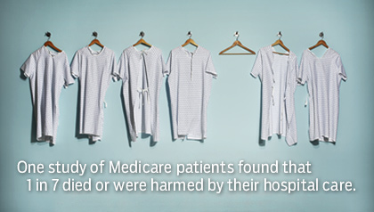
Incentives to start learning
Notes:
inaccurate patient medication history
inappropriate therapeutic decisions patient confusion, disinterest, and noncompliance.
patient’s frustration with the health care system.

Slide 6
Incentives to start learning
Important information is not exchanged in an appropriate and timely manner.

Slide 7
Effective communication skills
Building a trusting relationship
Ensure an effective exchange of information
Appreciate patient needs
Understand and accept pharmacist recommendations.

Slide 8
How we communicate?
Communication activities:
Verbally (through words)
Non-verbally
visually (through pictures or printed materials)
kinesthetically (through body language)
Written

Slide 9
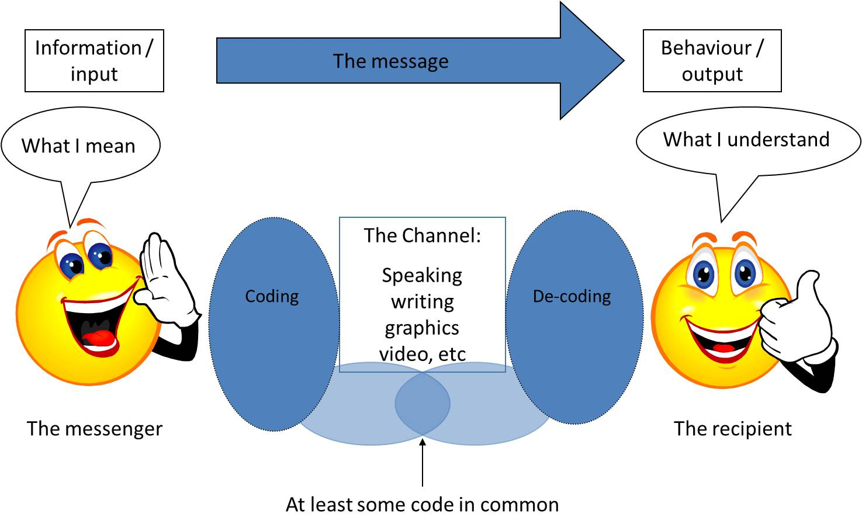
Communication
The structure of communication can be described as a system made up of several elements.
Feedback
Notes:
The intended message is put into words by the sender, who transmits it (through speech or writing) to the receiver, who must then decode the message to understand the intended message.

Slide 10
Empathy
Empathy is a type of understanding
listening to the total communication—words, feelings, and gestures—and letting the patient know that you are really hearing what he or she is saying.
Notes:
It is not an emotional state of feeling sympathetic or sorry for someone. Nor is it the same as the virtue of compassion.

Slide 11
Communication With Colleagues
learning and using interpersonal communication skills within the workplace.
Begins with respect for other coworkers and a willingness to be team player.
Regular meetings should be scheduled to bring up problems or issues in the workplace in a non-confrontational or non-blaming way.

Slide 12
Communicating Information to Physicians
Keep patient focused
Provide the physician with any meaningful background information
Clearly and concisely outline the problem the patient is experiencing with the drug therapy
Propose a solution (pharmacist’s intervention)
If face to face, request physician feedback for the solution

Slide 13
Assertive Versus Unassertive and Aggressive Behavior
Passive | Aggressive | Assertive
Is afraid to speak up | Interrupts and 'talks over' others | Speaks openly
Speaks softly | Speaks loudly | Uses a conversational tone
Avoids looking at people | Glares and stares at others | Makes good eye contact
Shows little or no expression | Intimidates others with expressions | Shows expressions that match the message
Isolates self from groups | Controls groups | Participates in groups
You're okay, I'm not | I'm okay, you're not | I'm okay, you're okay

Slide 14
Thank you!

