Slide 1

Corpus-Based ELT
CEL Symposium
Creating Learning Designers
Dania A. Salamah
King Saud University
15 April 2018

Slide 2
Contents
A corpus is...
Main Features
Types of Corpora
Annotation
Examples
Corpora & Language Teaching
Vocabulary & Corpora
Grammar/Writing & Corpora
Tutorials

Slide 3
A corpus is...
“a large and principled collection of natural texts” (Biber, Conrad, & Reppen, 1998, p. 12).
“a collection of machine-readable authentic texts (including transcripts of spoken data) which is sampled to be representative of a particular language or language variety” (McEnery, Xiao, & Tono, 2006, p. 5).

Slide 4
Main Features
Machine readable
Authentic
Representative

Slide 5
Types of Corpora
General vs specific
Written vs spoken
Synchronic vs diachronic
Learner vs monitor

Slide 6
Annotation
In order to benefit from a corpus, it needs to be “annotated” or “tagged”.
Annotation refers to the encoding of linguistic information, such as:
  Phonetic/phonemic annotation → syllable boundaries
  Morphological annotation → prefixes, suffixes, stems
  Grammatical tagging → Part-of-speech (POS)
  Syntactic parsing → syntactic structure (i.e., phrases, clauses)
  Error tagging → errors made by language learners

Slide 7
Examples
Corpora:
Corpus of Contemporary American English (COCA): https://corpus.byu.edu/coca/
British National Corpus (BNC): https://corpus.byu.edu/bnc/
Other tools:
Sketch Engine: https://www.sketchengine.eu/

Slide 8
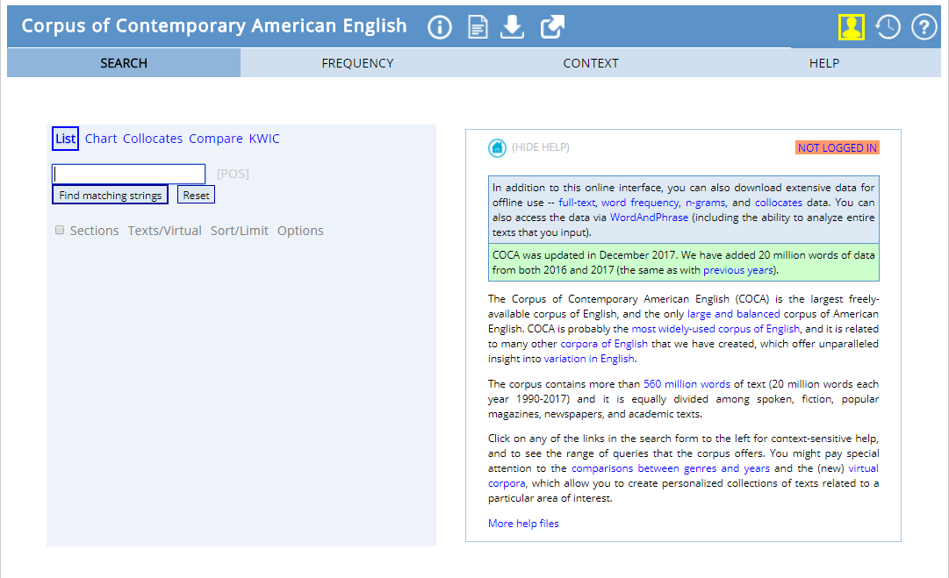
COCA
Corpus of Contemporary American English

Slide 9
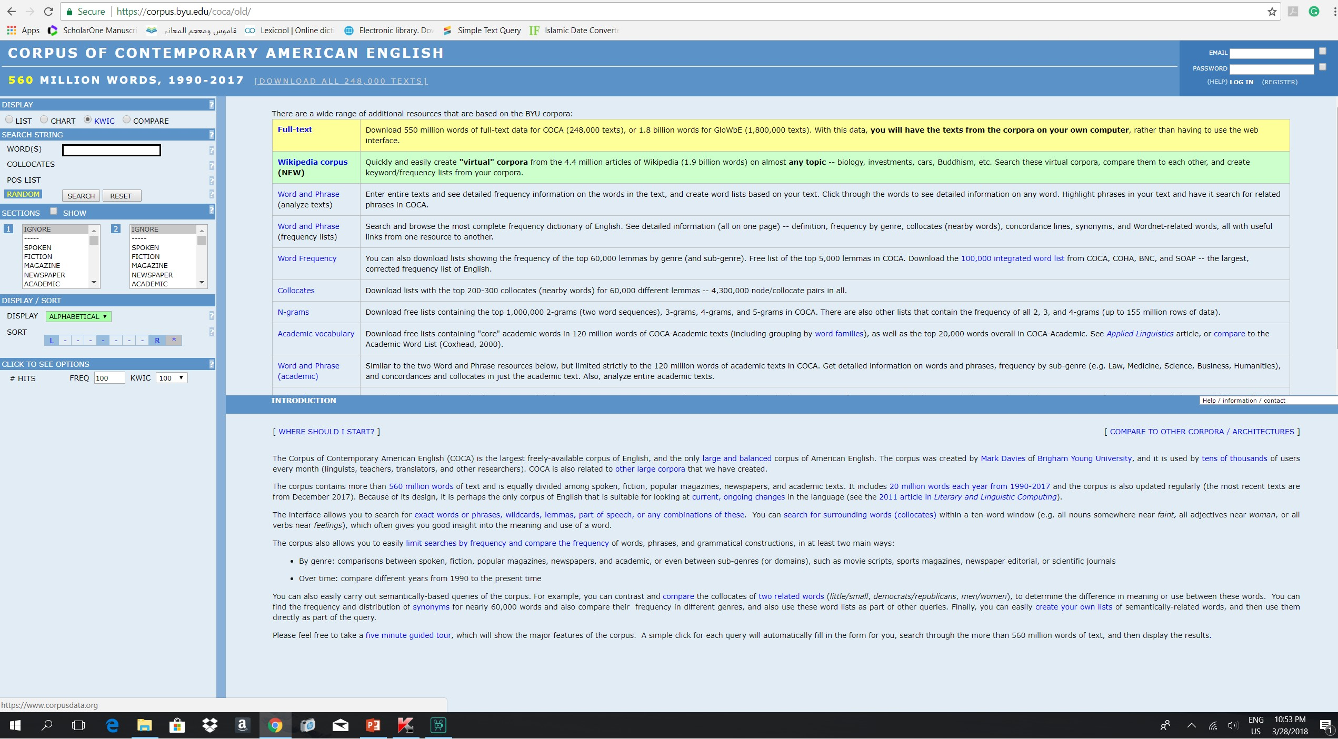

Slide 10
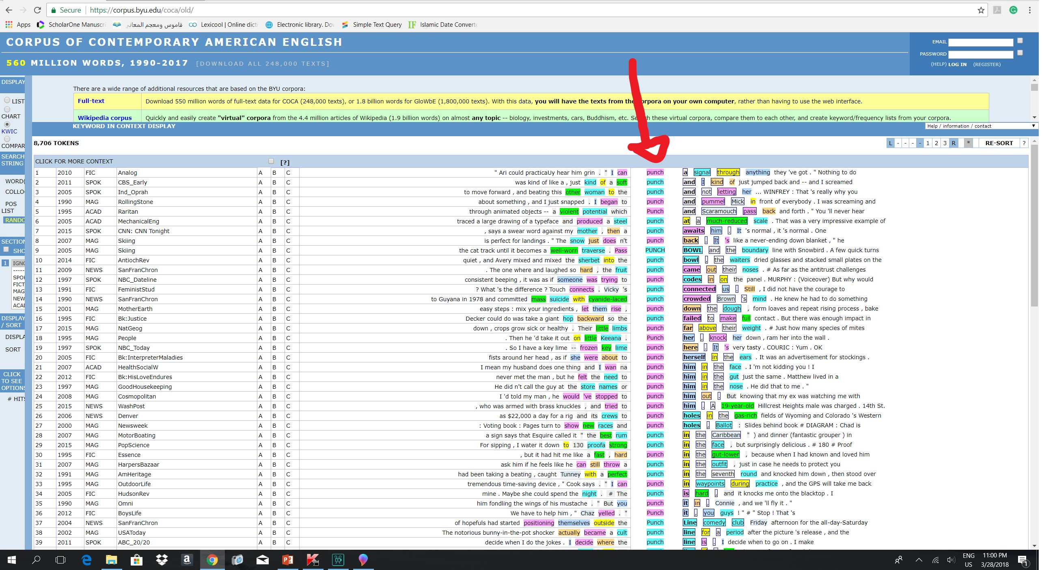

Slide 11
Corpora &
Language Teaching
Corpora have influenced syllabus design, materials development, and language testing.
Some advantages of corpus-based language teaching:
  Authentic examples of language use
  Communicative language use
  Frequency data

Slide 12
Vocabulary & Corpora
Some aspects that can be studied using corpora:
The meanings associated with certain words
The frequency of a word related to other words
The collocates of a word
The distribution of near synonyms

Slide 13
Incorporating corpora into vocabulary teaching:
Using concordance sheets
Identifying the meanings of new words using corpora
Identifying the collocates of words using corpora
Creating fill-in-the-blank activities and/or tests

Slide 14
Grammar/Writing
& Corpora
Some aspects that can be studied using corpora:
The use and function of morphological features
The use and function of different parts of speech
The function of syntactic/grammatical constructions

Slide 15
Incorporating corpora into grammar/writing teaching:
Checking for suitable structures
Pre-writing activities by viewing sample texts
Enhancing structural awareness

Slide 16
Tutorials
Introduction to COCA: https://www.youtube.com/watch?v=sCLgRTlxG0Y
Using POS tags in COCA: https://www.youtube.com/watch?v=KP-7thiUnLM
Collocations in COCA: https://www.youtube.com/watch?v=t_SxpfiPo_o
Sketch Engine: https://www.youtube.com/watch?v=Z3zBLrlBWG8

Slide 17
Bibliography
Biber, D., Conrad, S., & Reppen, R. (1998). Corpus linguistics: Investigating language structure and use. Cambridge: Cambridge University Press.
Chen, Y. H. (2004). The use of corpora in the vocabulary classroom. The Internet TESL Journal, 10(9). Retrieved from http://iteslj.org/Techniques/Chen-Corpora.html
Hunston, S. (2002). Corpora in applied linguistics. Cambridge: Cambridge University Press.
Hunston, S. (2006). Corpus linguistics. In K. Brown (Ed.), Encyclopedia of Language and Linguistics (2nd ed.) (pp. 234-248). Amsterdam: Elsevier.
McCarthy, M. (2006). Explorations in corpus linguistics. Cambridge: Cambridge University Press.
McEnery, T., Xiao, R., & Tono, Y. (2006). Corpus-based language studies. UK: Routledge.

Slide 18
Thank you!
Feel free to contact me:
dsalamah@ksu.edu.sa
Or visit my website:
http://fac.ksu.edu.sa/dsalamah

