Slide 1
Syllabus
Course Name: General Physics (Mechanics)
Text Books:

Slide 2
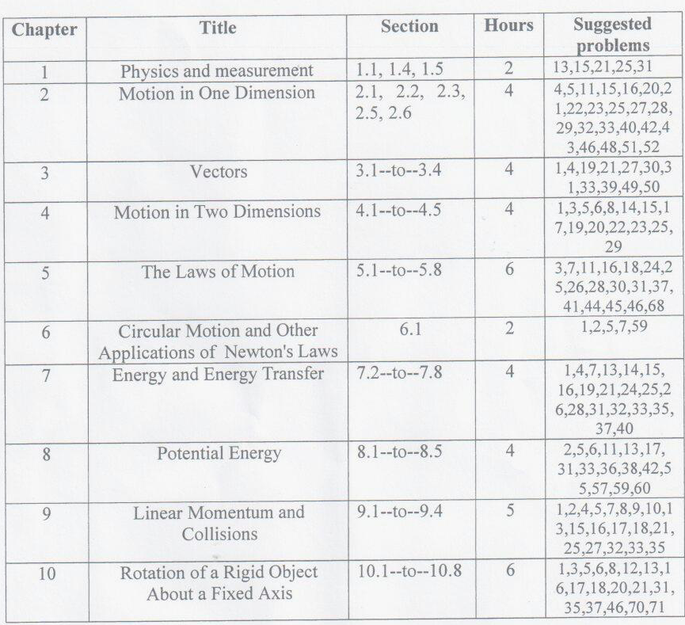
Syllabus

Slide 3
Information
Teaher’s name: Mohd. Shahabuddin
Office : Building # 4 Room # 1A52
E-mail: mshahab1969@gmail.com
Office Time: I will let you know after one week.

Slide 4
Marks distribution
Mid term Exam First- 15
Mid Term exam 2nd – 15
Practical Work- 30
Final Exam - 40
Total 100

