Slide 1
Introduction to C Programming
Created by :Dr. Nouf Aljaffan
Edited by : Nouf almunyif

Slide 2
Objectives
Write simple C programs.
Use simple input and output statements.
Use the fundamental data types.
Learn computer memory concepts.
Use arithmetic operators.
Learn the precedence of arithmetic operators.
Write simple decision making statements.
Begin focusing on secure C programming practices

Slide 3
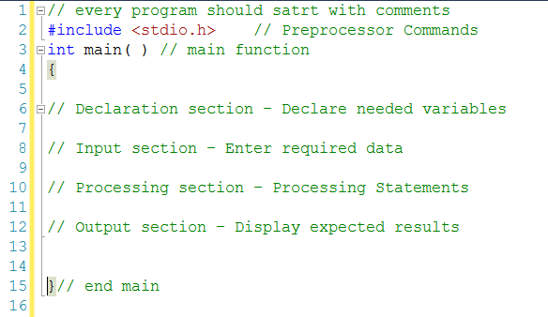
Structure of a .c file
Add Comments
Line comment: // my comment
multi-line comments : /* my comments */
Insert pre-processor definitions
#include < [file name & extension] >
Add function prototypes and variable declarations
Define main function
int main( void ) { [function body] }
Define other functions

Slide 4
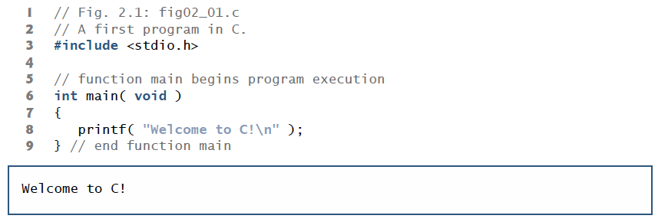
Comments begin with //. Comments document programs and improve program readability

Slide 5
Header contains information used by the compiler when compiling calls to standard input/output library functions such as printf.

Slide 7
The function main is a part of every C program.
The parentheses after main indicate that main is
a program building block called a function C programs contain one or more functions, one of which must be main.
Every program in C begins executing at the function main.

Slide 8
Functions can return information. The keyword int to the left of main indicates that main “returns” an integer (whole-number) value.

Slide 9
Functions can receive information when they’re called upon to execute. The void in parentheses
after main indicates that main does not receive any information.

Slide 10
A left brace, {, begins the body of every function
A corresponding right brace, }, ends each function .
This pair of braces and the portion of the program between the braces is
called a block.

Slide 11
The printf function instructs the computer to display information on the screen.
• A string is sometimes called a character string, a message or a literal

Slide 12
Every statement must end with a semicolon

Slide 15
Structure of a .c file
the backslash (\) is called an escape character
When encountering a backslash
in a string, the compiler looks ahead at the next character and combines it with the backslash
to form an escape sequence
The escape sequence \n means newline

Slide 16
Structure of a .c file

Slide 17
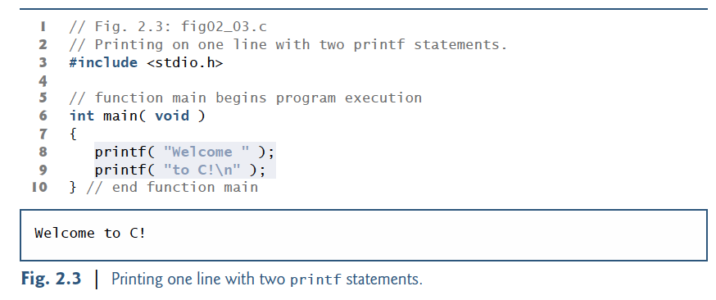
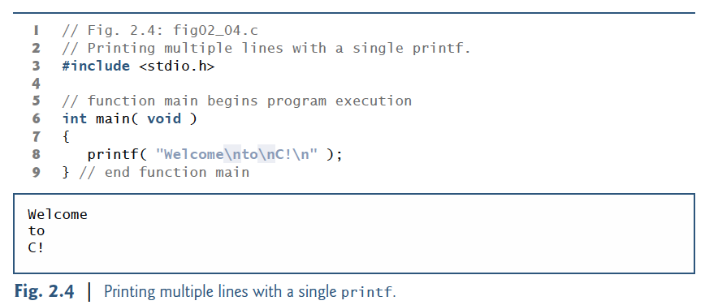
Multiple printf

Slide 18
Avoid Single-Argument printf
If you need to display a string that terminates with a newline, use the puts function,
If you need to display a string without a terminating newline character, use printf with two arguments—a "%s" format control string and the string to display.

Slide 19
Variables and DataTypes

Slide 20
Variables/Identifiers
Names that represent values in the program
Similar to algebraic variables
All variables have a type which must be declared
E.g. int x; float y;
Type determines :
how arithmetic is preformed,
how much memory space is required.

Slide 21
Data types and sizes
C has a small family of datatypes.
Numeric (int, float, double)
Character (char)
User defined (struct,union)

Slide 22
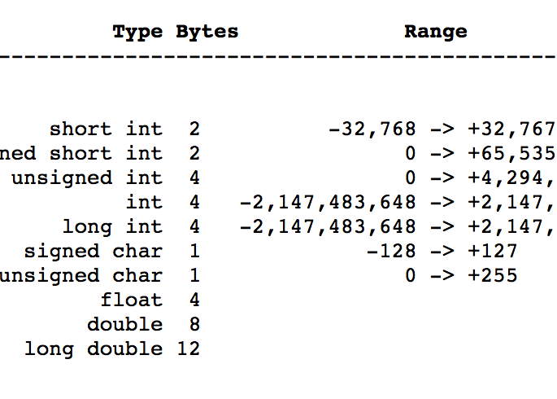
Basic Data Types
The individual sizes are machine/compiler dependent.
However, the following is guaranteed:
sizeof(char)<sizeof(short)<=sizeof(int)<=sizeof(long)
sizeof(char)<sizeof(short)<=sizeof(float)<=sizeof(double)

Slide 23
Variables and Variable Definitions
Naming rules:
Variable names can contain letters,digits and _
Variable names should start with letters.
Keywords (e.g., for,while etc.) cannot be used as variable names
Variable names are case sensitive. int x; int X declares two different variables.

Slide 24
Pop quiz (correct/incorrect):
int money$owed;
int total_count
int score2
int 2ndscore
int long

Slide 25
Variable declaration
The general format for a declaration is
Type variable name [=value] ;
char x; /∗ uninitialized ∗/
char x=’A’; /∗ intialized to ’A’∗/
char x=’A’,y=’B’; /∗multiple variables initialized ∗/
char x=y=’Z’; /∗multiple initializations ∗/

Slide 26
Input / Output
More format specifiers
printf (); //used to print to console(screen)
example: printf(“%c”, ’a’);
scanf (); //used to take an input from console(user).
example: scanf(“%d”, &a);
%c The character format specifier.
%d The integer format specifier.
%i The integer format specifier (same as %d).
%f The floating-point format specifier.
%o The unsigned octal format specifier.
%s The string format specifier.
%u The unsigned integer format specifier.
%x The unsigned hexadecimal format specifier.
%% Outputs a percent sign.

Slide 27
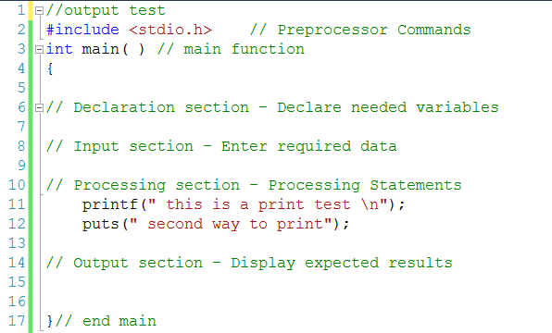
Output: If you need to display a string on the screen

Slide 28
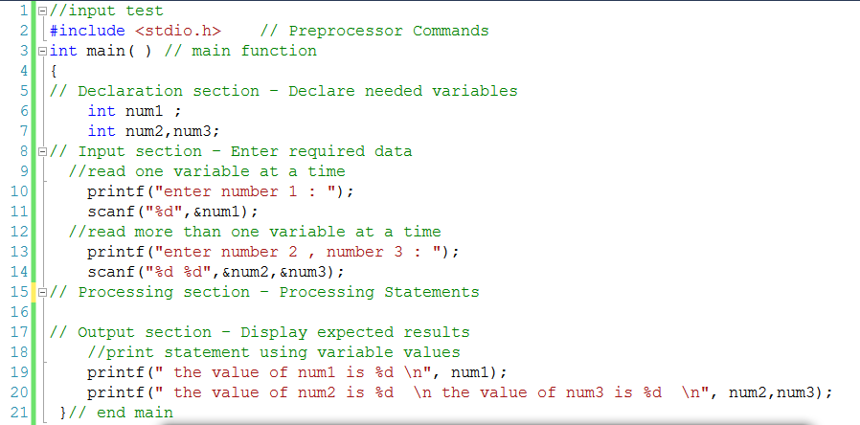
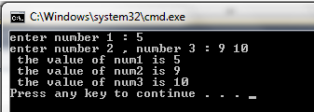
Input: if you want to read values from the user

Slide 29
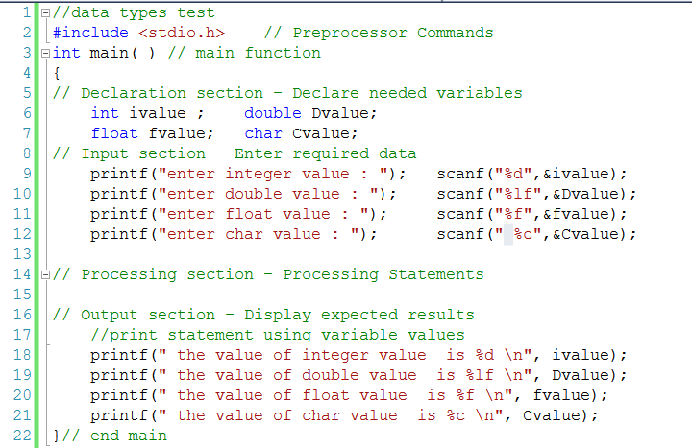
Declaring different types

Slide 30
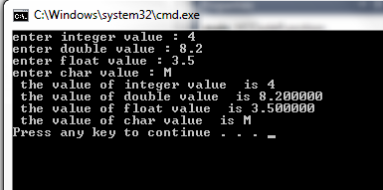
output

Slide 31
Any Question!

