Slide 1
Iteration & Looping
Edited by : Nouf Almunyif

Slide 2
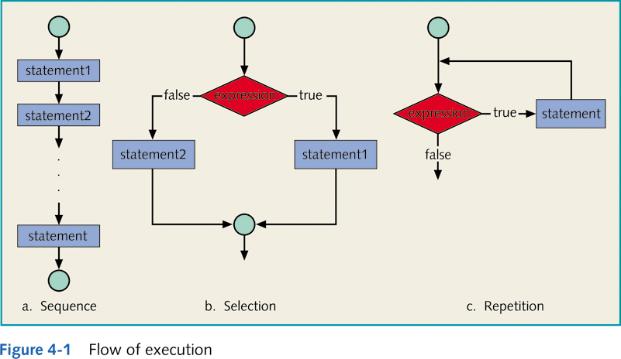
Flow of execution

Slide 3
Means of iteration:
Loop
Group of instructions that a computer executes repeatedly while some condition remains true

Slide 4
iteration: 1- Counter-Controlled Iteration
Counter-Controlled Iteration : when the number of repetitions is fixed ( known ) .
It requires
  control variable (or loop counter).
  The initial value of the control variable.
  Updating the counter ( increment or decrement) by which the control variable is modified each time through the loop.
  The condition that tests for the final value of the control variable (i.e., whether looping should continue).

Slide 5
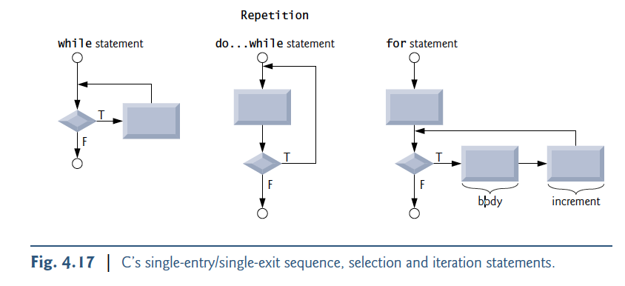
Iteration & Looping
First, the initialization expression is executed.
Then, the loop repetition condition is tested.
If the condition is true, the statement enclosed in { } are executed.
After that the update expression is evaluated.
Then the loop repetition condition is retested.
The statement is repeated as long as the condition is true.
For loop can be used to count up or down by any interval.
If there’s more than one statement in the body of the for, braces are required to enclose the body of the loop.
General Form of for statement
for (initialize; loop repetition condition ; update)
{ //Steps to perform each iteration }

Slide 6
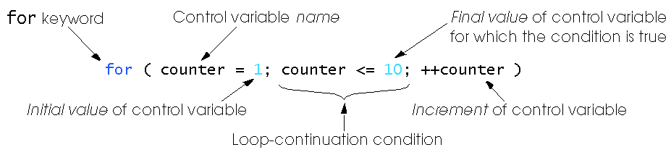

The for Statement

Slide 7
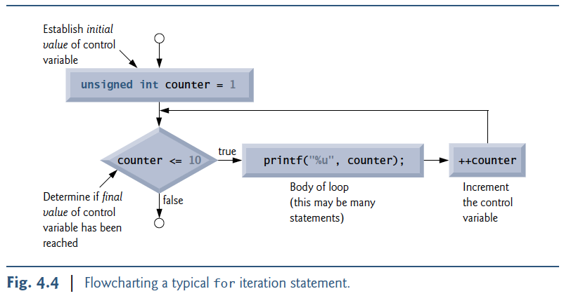
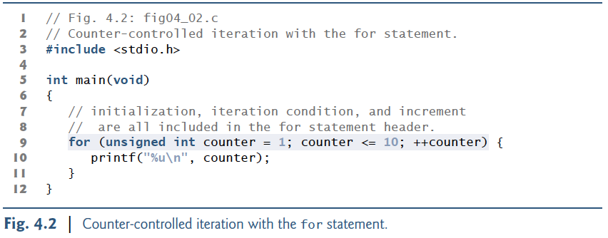
for Statement : print numbers from 1 to 10

Slide 8
Exercises :
Print numbers from 10 to 100 ;
Print the sum of numbers from 1 to 6
Print the sum and product of even numbers from 1 to 10

Slide 9
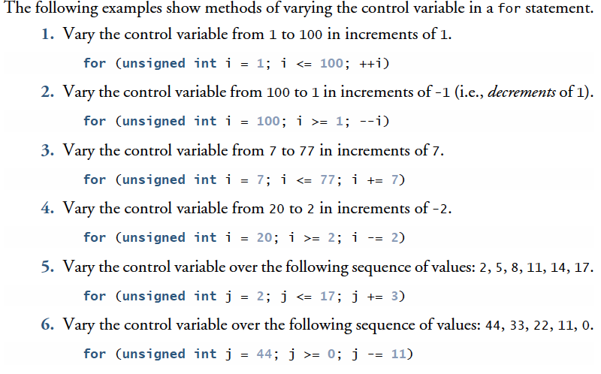
for Iteration Statement

Slide 10
While Iteration Statements
Initialization
While( condition){
statements
update
}

Slide 11
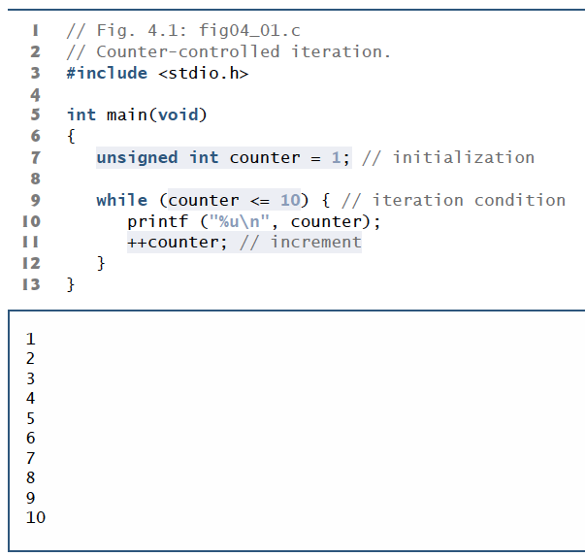
While Statements : print numbers from 1 to 10

Slide 12
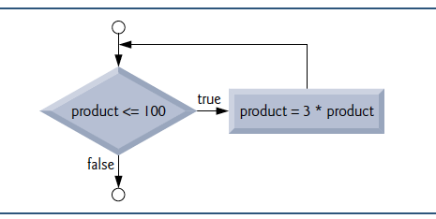
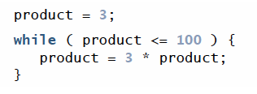
While Statements

Slide 13

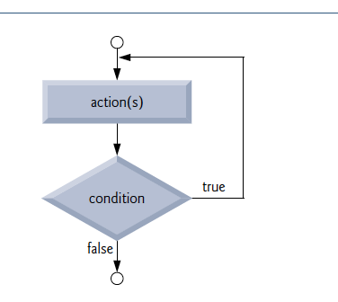
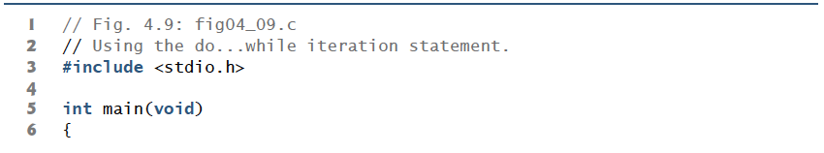
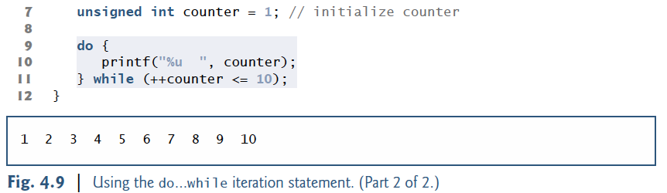
do…while Iteration Statement
There are some situations, generally involving interactive input,
when we know that a loop must execute at least one time.

Slide 14
iteration: 2- Sentinel-controlled iteration
the number of repetitions is not fixed. In many cases, the number of repetitions depends on user input
the user uses a special value called a sentinel value to indicate “end of data entry.”
The sentinel value must be chosen so that it’s not confused with an acceptable input value.
General form:
  Input the first data item into variable;
  while (variable != sentinel)
  {
  .
  .
  .
  input a data item into variable;
  .
  .
  .
  }

Slide 15
Sentinel-Controlled while Loop
Program to compute the product of entered numbers 0 to stop

Slide 16
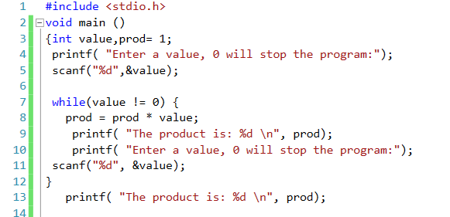
Sentinel-Controlled while Loop example1

Slide 17
Sentinel-Controlled while Loop
Compute the sum of a list of exam scores

Slide 18
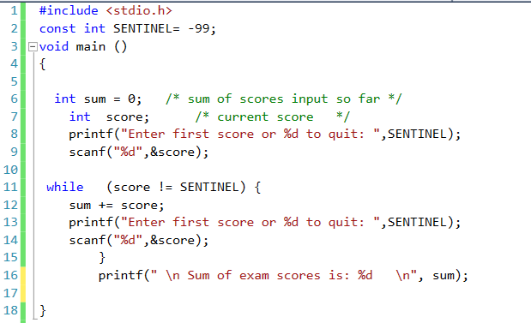
Sentinel-Controlled while Loop

Slide 19
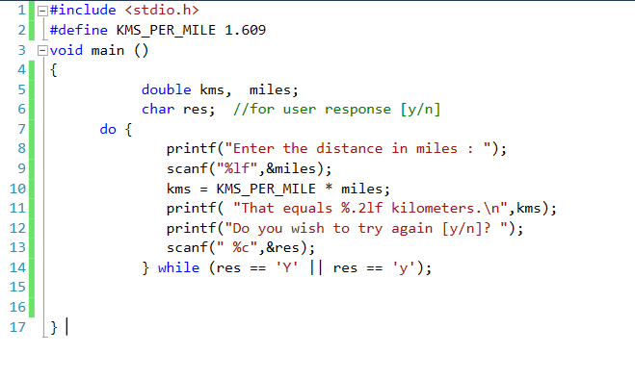
do while Example1 : converts miles to kilometers – repeatedly hint : kilometers = 1.609 * miles;

Slide 20
break and continue Statements
break and continue are used to alter the flow of control.

Slide 21
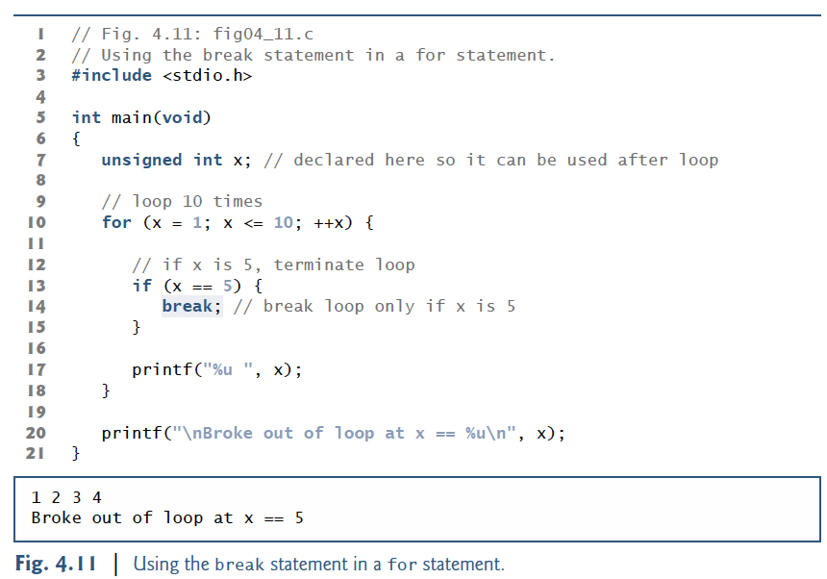
break Statement
break can be used in a while, for, do…while or switch statement
causes an immediate exit from that statement.
  Program execution continues with the next statement after that while, for, do…while or switch.

Slide 22
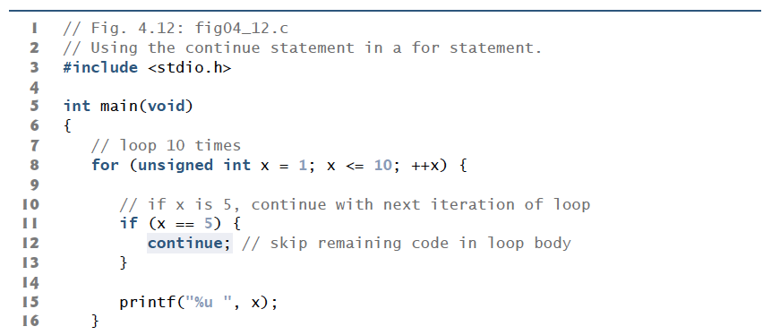
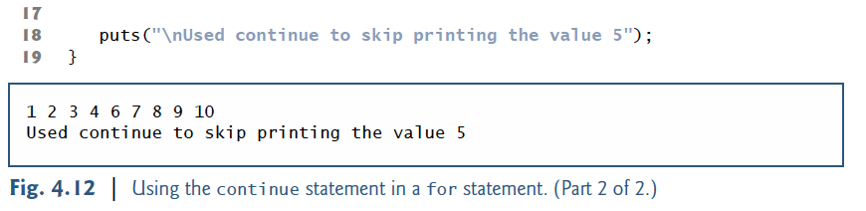
continue Statement
continue can be used in a while, for or do…while
Cause skipping the remaining statements in that control statement’s body
and performs the next iteration of the loop.

Slide 23
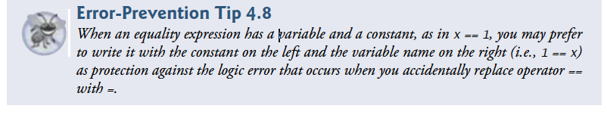
Confusing Equality (==) and Assignment (=)
Operators

Slide 24
Exercises
Sum the odd integers between 1 and 99 using a for statement.
Print the integers from 1 to 20 using a while loop and the counter variable x. Print only five integers per line.
[Hint: Use the calculation x % 5. When the value of this is 0, print a newline character, otherwise print a tab character.]

Slide 25
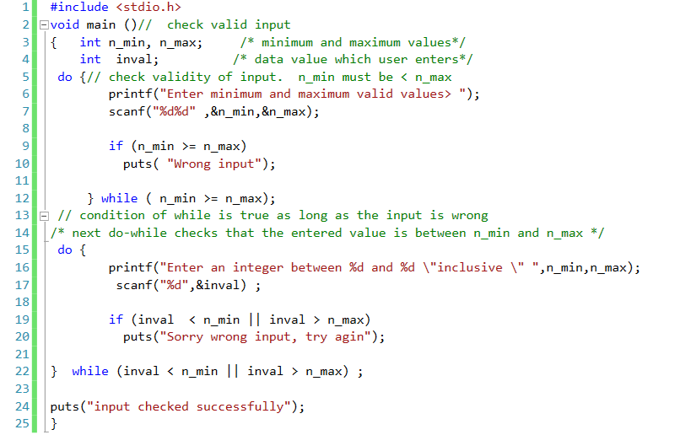
do while Example2 :check input

Slide 26
Nested Loops
Nested loops consist of an outer loop with one or more inner loops.
Each time the outer loop is repeated, the inner loops are reentered
  Their loop control expressions are reevaluated
  All required iterations are performed again.

Slide 27
Example: Sum of Scores of 3 sections calculate the total scores in each section for 3 sections.
Each section's * scores are terminated by the sentinel -99. */

Slide 28
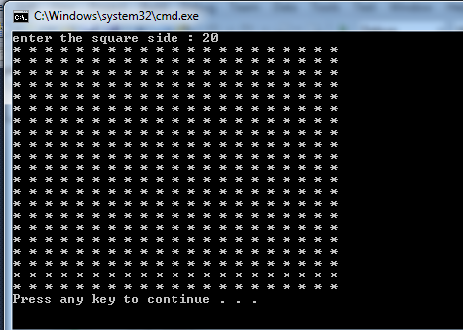
Draw a square :the side is input from the user

Slide 29
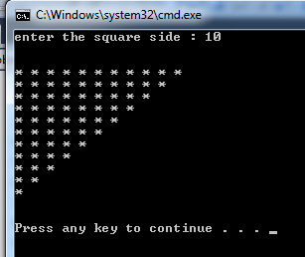
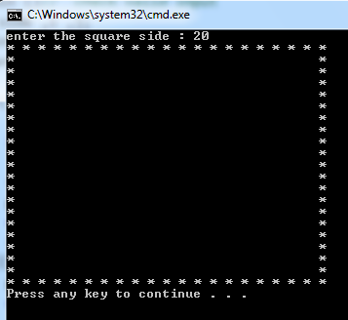
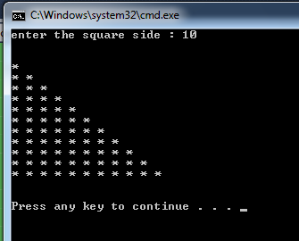
Try this

